Slide 1
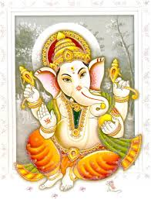
Good morning

Slide 2
Machine Learning
Write about three things you have learnt in your life so far,.
Name three machines you are using at this stage.
Have you seen the movies Terminator, Bicentennial man?. If yes, comment.

Slide 3
Good morning

Slide 4
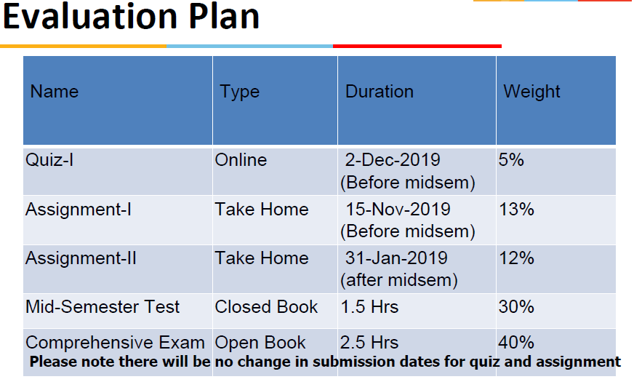
Machine Learning
ML

Slide 5
Good morning

Slide 6
Learning
Learning is defined as “any relatively permanent change in behaviour that occurs as a result of practice and experience”. This definition has three important elements.
Change in behaviour
Change through practice or experience
Change should last relatively permanent(longer)

Slide 7
Learning
Any learning hence involves activities.
Inductive Learning
Deductive Learning
Learning by analogy….
Inductive Learning is when a System tries to induce a general rule from a set of observed instance.
The hypothesis produced is sometimes called the concept description—essentially a program that can be used to classify subsequent instances.

Slide 8
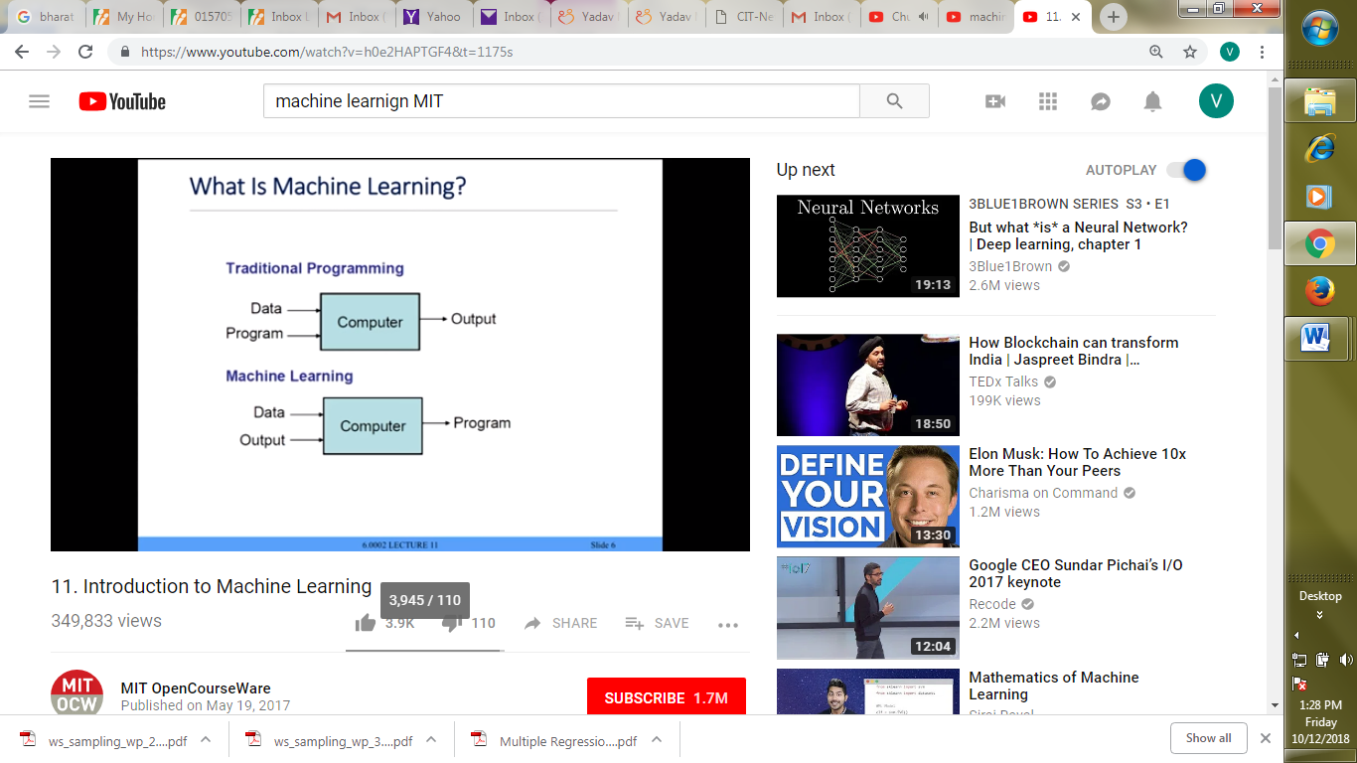
Machine learning
Machine Learning is a modeling technique that involves data.
A computer program is said to learn from experienceEwith respect to some class of tasksTand performance measureP, if its performance at tasks in T, as measured by P, improves with experience E. (Tom Mitchell, 1998)

Slide 9
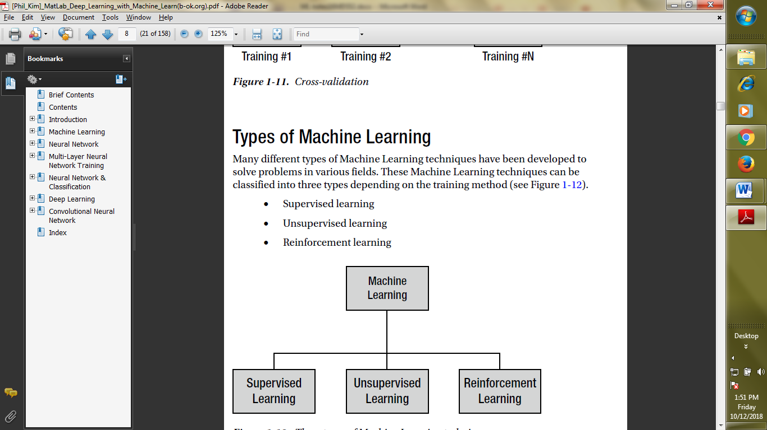
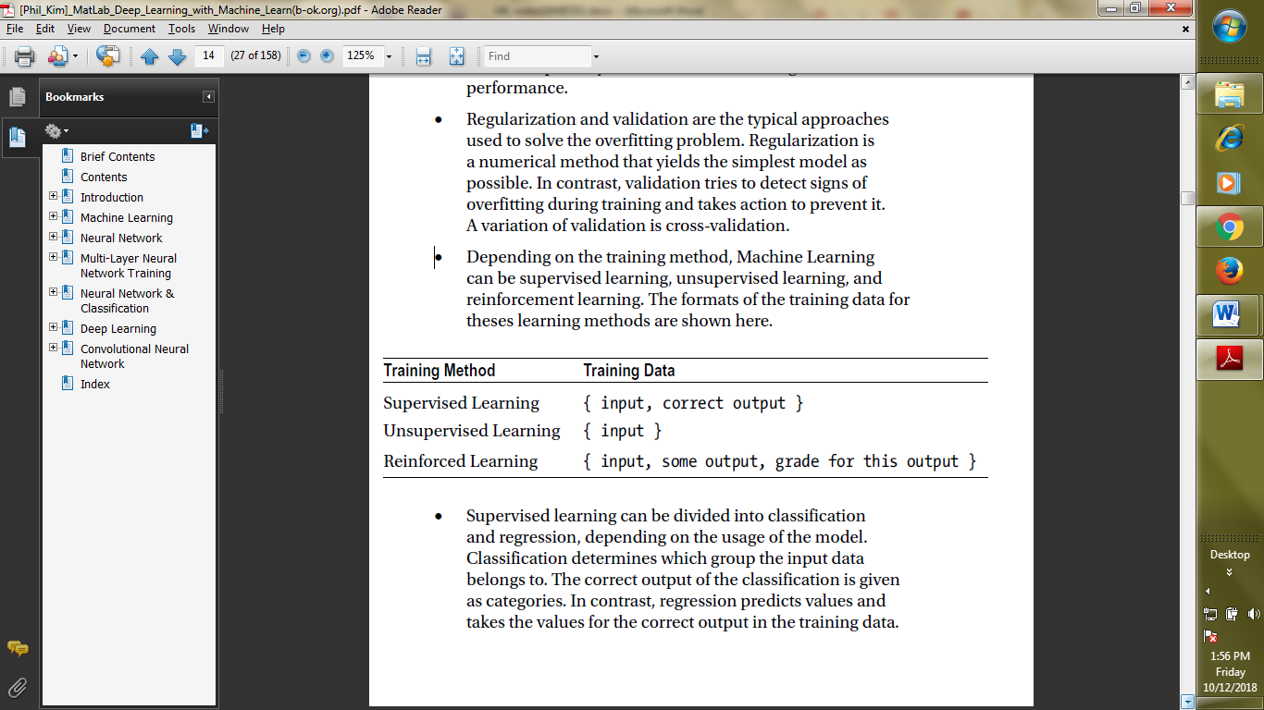
Machine Learning
Types of learning

Slide 10
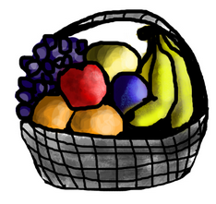
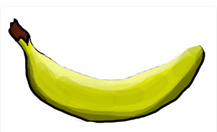
Supervised
S
If shape of object is rounded and depression at top having color Red then it will be labelled as –Apple.
If shape of object is long curving cylinder having color Green-Yellow then it will be labelled as –Banana.
Now , if we give

Slide 11
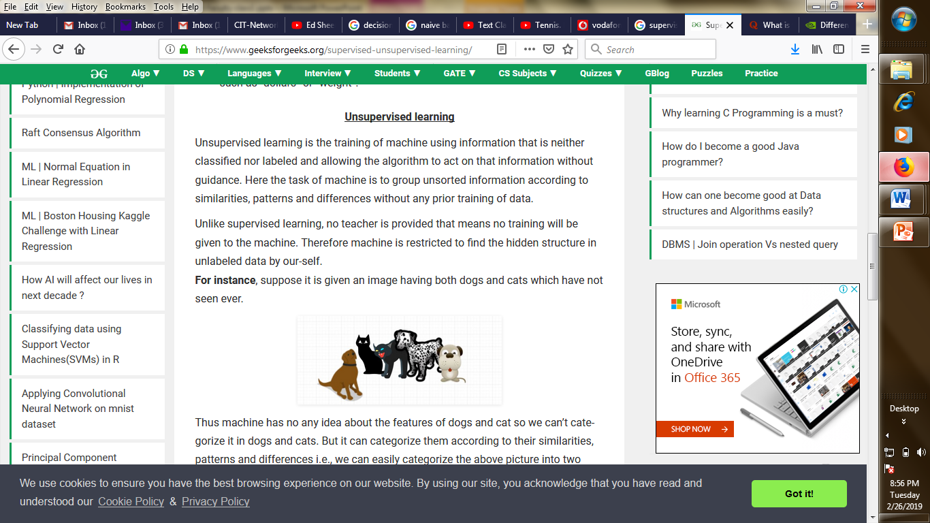
Unsupervised
Suppose, we have a picture
And ,no classification as earlier.
Then, the machine will form clusters based on similarities and uses the clusters for classification of a new animal.

Slide 12
Machine Learning
Is an interdisciplinary field, comprising of concepts and results from
Probability and Statistics,
Artificial Intelligence
Information theory
Philosophy
Psychology
Neurobiology…
to name a few.

Slide 13
Machine Learning
Albert Einstein says-” Keep things simple but not simpler”
Occam’s razor(Philosophy) suggests-”Simplest hypothesis is the best”.
Psychology and neurobiology-” over a very broad range of learning problems, people's response time improves with practice according to a power law”
Statistics-” Characterization of errors that occur when estimating the accuracy of a hypothesis based on a limited sample of data.”

Slide 14
Good morning

Slide 15
Designing a Learning system
Choosing the training experience
Choosing the Target function
Algorithm for learning from examples

Slide 16
Version Space
Approach to concept learning.
Learning is to produce a description that is consistent with all positive examples but no negative examples.
G-Boundary, S-Boundary

Slide 17
Version Space
Step1: Initialize G and S.
Step2: For a new instance
If it is positive, remove from G any description that do not cover it and generalize the S as little as possible to include it.
If it is negative, remove from S any description that cover it and specialize G as little as possible so that they will not cover it.
Step 3: Repeat step 2 till G=S.

Slide 18
Version Space-Example
Task: Teach a child to identify black cards in a poker game.
Negative instance: (3, diamond)
Positive instances: (7,spade), (4,club)
Step1: G={ (x,y)}; S=nil
Step2: N1->G={(even,y),(x, heart),(x,black)}, S=nil
P1->G={(x,black)}; S={(7,spade)}
P2-> G={(x,black)}; S={(x,black)}

Slide 19
Good morning

Slide 20
Designing a Learning system- Training Experience
One key attribute is whether the training experience provides direct or indirect feedback regarding the choices made by the performance system.
A second important attribute of the training experience is the degree to which the learner controls the sequence of training examples[supervise/unsupervised].
A third important attribute of the training experience is how well it represents the distribution of examples over which the final system performance P must be measured[train/test].

Slide 21
Designing a Learning system- Target function
Move to numerical domain (or) assign values, V: S-> R.
More expressive the function, the closer it is to the truth but will need more training examples[regression equation].

Slide 22
Machine Learning-Issues
What algorithms are available for learning a concept? How well do they perform?
How much training data is sufficient to learn a concept with high confidence?
When is it useful to use prior knowledge?
Are some training examples more useful than others?
What are the best tasks for a system to learn?
What is the best way for a system to represent its knowledge?

Slide 23
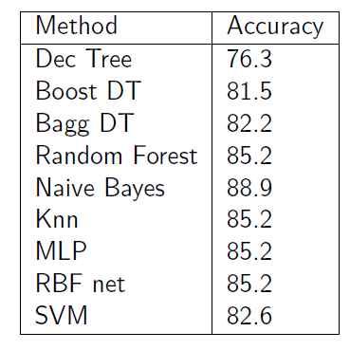
Machine Learning-Issues
What algorithms are available for learning a concept? How well do they perform?
Identification of Heart Disease

Slide 24
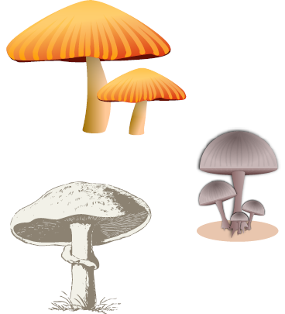
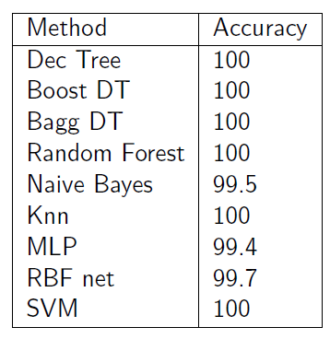
Machine Learning-Issues
What algorithms are available for learning a concept? How well do they perform?
Identification of Mushroom

Slide 25
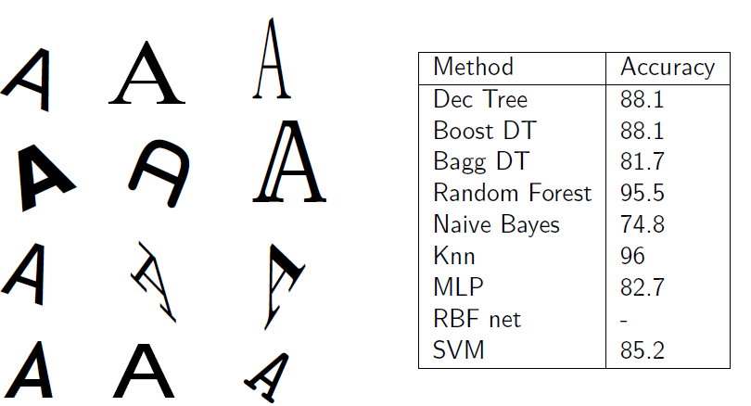
Machine Learning-Issues
What algorithms are available for learning a concept? How well do they perform?
Optical character recognition

Slide 26
Machine Learning-Issues
What algorithms are available for learning a concept? How well do they perform?
Optical character recognition

Slide 27
Good morning

Slide 28
Mathematical Topics
Probability

