Slide 1
Introduction to Statistical Methods
Revision and Distributions
16-Nov-2019

Slide 2
Agenda
Statistics – Population – Sample – Representation of large data by a smaller set – Extension to population thro the probability theory vehicle.
Data representation, Frequency –count representation and Histograms, Area under the curve and counts, Limiting behaviour with smaller intervals, density curve.
Probability definitions, set theory, uncertain events, basic axioms, random events, random variables and probability distributions.
Discrete and continuous probability distributions, Binomial, Poisson and Normal distributions and their properties
Expected value and variance, properties
Relevance of normal distribution, properties, how it could be applied to draw certain conclusions.
2

Slide 3
Statistical methods – basic approach
Univariate analysis
Bivariate and multi variate.
Univariate – Central tendency and variation (mean, variance)
Graphical – Histogram, Box plots .
Bivariate (Covariance, correlation matrices etc.,)
Selection of samples
Analysis of the sample data.
Fit a probability distribution.
Make suitable assumption on the population (variance of the population known)
Determine the required performance
Test for the performance with the sample data
How far the conclusions valid in the population

Slide 4
Descriptive statistics - Histogram
Discrete and continuous variables:
Discrete – If either possible values are from a finite set or infinite but can be ordered.
Continuous if possible values can take any value in the entire line of real numbers.
Frequency – Number of times a value occurs
Relative frequency – Frequency / Total observations
In the continuous case, we have to split the values into intervals and plot the frequency in each interval in the Y axis.
If the width keeps shrinking, the histogram tends to be a continuous curve which is called density curve which’d later turn out to be a probability density curve.

Slide 5
Histograms Cont….
These are one of the most useful graphical technique in EDA.
These are bar plots of counts vs subgroups of an exposure variable
Each bar represents the frequency of the cases for the range of values.
This’d given an indication of the probability distribution.
Home work:
Exercise 1.9 in the reference book
Install R.
Use Hist and density command
See the results.

Slide 6
Mean
Also referred as the “arithmetic average”
The most commonly used measure of the center of data
Numbers that describe what is average or typical of the distribution
Computation of Sample Mean:
= Σ Y/ N = (Y1 + Y2 + Y3 + … Yn) / N where
“Y bar” equals the sum of all the scores, Y, divided by the number of scores, N.
Computation of the Mean for grouped Data
Where f Y = a score multiplied by its frequency

Slide 7
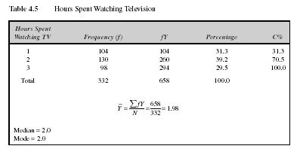
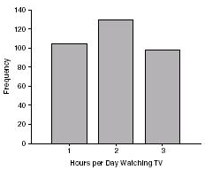
Mean: Grouped Scores
Data of Children watching TV in Bengaluru

Slide 8
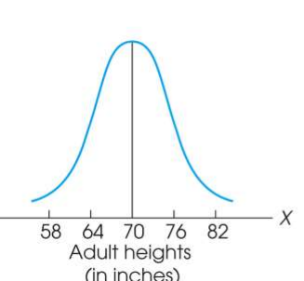
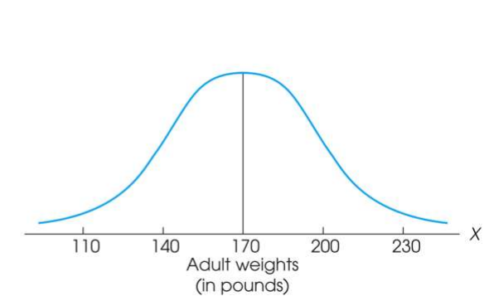
Measure of Variability
Variability can be defined several ways:
A quantitative distance measure based on the differences between scores
Describes distance of the spread of scores or distance of a score from the mean
Purposes of Measure of Variability:
Describe the distribution
Measure how well an individual score represents the distribution

Slide 9
The Standard Deviation
Most common and most important measure of variability is the standard deviation
A measure of the standard, or average, distance from the mean
Describes whether the scores are clustered closely around the mean or are widely scattered
Calculation differs for population and samples
Variance is a necessary companion concept to standard deviation but not the same concept

Slide 10
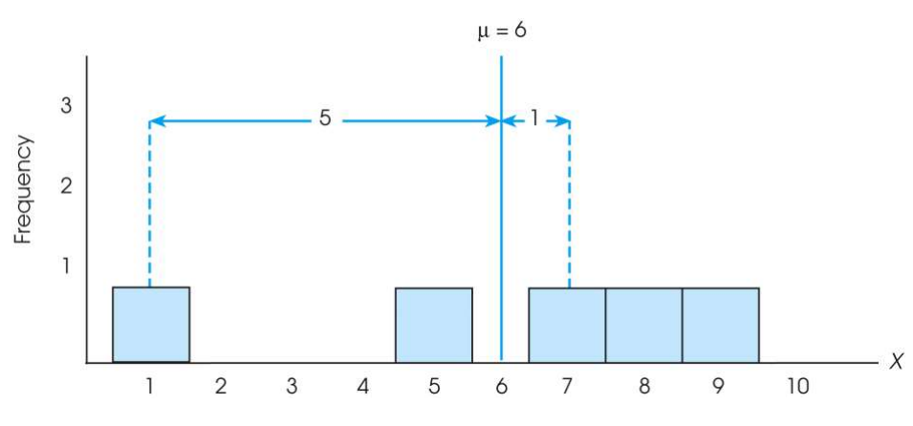

The Standard Deviation
Exercise : Find out the deviations of all the data points with the mean….and then find the ‘mean deviation’.

Slide 11

The Standard Deviation
Mean deviations will always be ‘zero’ !
(because Mean is a balance point)
Then, how do you find ‘Standard Deviation’ ?
Need a new strategy

Slide 12

The Standard Deviation
New Strategy :
First square each deviation score
Then sum the Squared Deviations (SS)
Average the squared deviations
Mean Squared Deviation is known as “Variance”
Variability is now measured in squared units

Slide 13
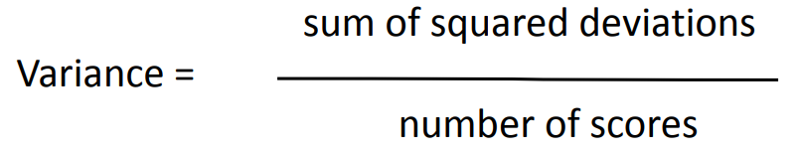
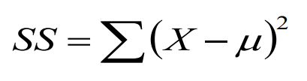
The Variance
Variance equals mean (average) squared deviation (distance) of the scores from the mean
where

Slide 14
The Population Variance
Population variance equals mean (average) squared deviation (distance) of the scores from the population mean
Variance is the average of squared deviations, so we identify population variance with a lowercase Greek letter sigma squared: σ ²
Standard deviation is the square root of the variance, so we identify it with a lowercase Greek letter sigma: σ

Slide 15
Standard Deviation and Variance for a Sample
Goal of inferential statistics:
Draw general conclusions about population
Based on limited information from a sample
Samples differ from the population
Samples have less variability
Computing the Variance and Standard Deviation in the same way as for a population would give a biased estimate of the population values

Slide 16
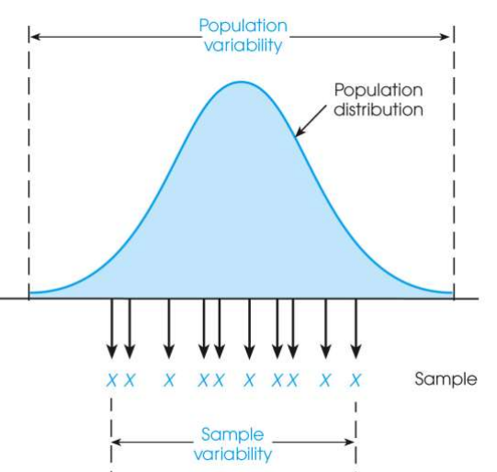
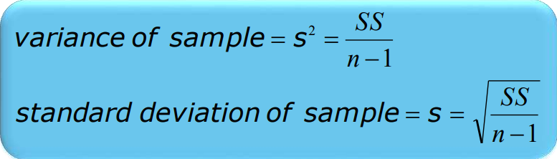
Sample Standard Deviation and Variance
Sum of Squares (SS) is computed as before
Formula for Variance has n-1 rather than N in the denominator
Notation uses s instead of σ
Population of Adult Heights

Slide 17
Degrees of Freedom
Population variance
Mean is known
Deviations are computed from a known mean
Sample variance as estimate of population
Population mean is unknown
Using sample mean restricts variability
Degrees of freedom
Number of scores in sample that are independent and free to vary
Degrees of freedom (df) = n – 1

Slide 18
Proof for using n-1 as divisor for variance
S² represents the sample variability.
But the population variability should be certainly more.
When the population is finite, the formula is
SS / N and not SS/(n-1)
where
When the Mu is not known, we are using Xbar.
All X(i) is will be closer to Xbar than Mu.
To compensate for that we replace N by N-1. which essentially represents the degrees of freedom since the knowledge of average fixes one variable out of N variables.

Slide 19
Probability
Probability refers to the study of randomness and uncertainty.
The language of probability is used in informal manner in normal circumstances.
The methodology of probability will enable us to express in precise language such informal statements.

Slide 20
Random Experiment
Term "random experiment" is used to describe any action whose outcome is not known in advance. Here are some examples of experiments dealing with statistical data:
Tossing a coin
Counting how many times a certain word or a combination of words appears in the text of the “King Lear” or in a text of Confucius
counting occurrences of a certain combination of amino acids in a protein database.
pulling a card from the deck

Slide 21
Sample spaces, sample sets and events
The sample space of a random experiment is a set S that includes all possible outcomes of the experiment.
For example, if the experiment is to throw a die and record the outcome, the sample space is S = { 1,2,3,4,5,6}
Qn-
What is the sample space if the experiment is ‘throwing a die twice’? (it will be pairs , better to represent in alphabets, A to F and then write as AA,AB, AC….EE – How many events?

Slide 22



Discrete sample spaces.
Continuous sample spaces
S=(1,3) => Set of all points between 1 and 3 in the real line R except 1 and 3.

Slide 23
Event
An event is a set of outcomes of the experiment. This includes the null (empty) set of outcomes and the set of all outcomes. Each time the experiment is run, a given event A either occurs, if the outcome of the experiment is an element of A, or does not occur, if the outcome of the experiment is not an element of A.

Slide 24
Events - Examples
2 Dices are thrown once. Let the faces of each dice be {A,B,C,D,E,F}.
Here the sample space is the set of all the outcomes.
i.e., { AA, AB,AC,AD,AE,AF, BA,BB,…………FF}
Total number of outcomes is 36.
Some events :
Event with same faces in both dices
{AA,BB,CC,DD,EE,FF}
Event in which the face of Dice1 is A
….many more.

Slide 25

Null set
Objective interpretation of probability is based on the frequency.
When we consider ‘tossing the coin’ , we could infer that as the number of trials is increased, the ratio between Head and tail moves towards .5.
This relative frequency interpretation of probability is said to be objective because it rests on a property of the experiment rather than on any particular individual concerned with the experiment.
In many cases, the experiments are unrepeatable. In such cases, ‘degree of faith’ is to be taken as probability which belongs to the class ‘subjective interpretation.

Slide 26
Complement of an Event
The complement of event A is defined to be the event consisting of all sample points that are not in A.
The complement of A is denoted by A^{c}.
The Venn diagram below illustrates the concept of a complement.
Sample Space S
Event A
A^{c}

Slide 27
Union of Two Events
The union of events A and B is the event containing all sample points that are in A or B or both.
The union is denoted by A  B
The union of A and B is illustrated below.
Sample Space S
Event A
Event B

Slide 28
Intersection of Two Events
The intersection of events A and B is the set of all sample points that are in both A and B.
The intersection of A and B is the area of overlap in the illustration below.
Sample Space S
Intersection
Event A
Event B

Slide 29
Mutually Exclusive Events
Two events are said to be mutually exclusive if the events have no sample points in common. That is, two events are mutually exclusive if, when one event occurs, the other cannot occur.
Sample
Space S
Event A
Event B

Slide 30
Independent & Dependent
Events are either
independent (the occurrence of one event has no effect on the probability of occurrence of the other) or
dependent (the occurrence of one event gives information about the occurrence of the other)

Slide 31















Slide 32
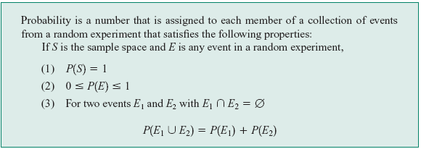
Axioms of Probability

Slide 33
Probability - events
Events based definition
Given an experiment and a sample space , the objective of probability is to assign to each event A, a number P(A), called the probability of the event A, which will give a precise measure of the chance that A will occur.
To ensure that the probability assignments will be consistent with our intuitive notions of probability, all assignments should satisfy the axioms (basic properties) of probability.

Slide 34
Probability - defns
Objective interpretation of probability is based on the frequency.
When we consider ‘tossing the coin’ , we could infer that as the number of trials is increased, the ratio between Head and tail moves towards .5.
This relative frequency interpretation of probability is said to be objective because it rests on a property of the experiment rather than on any particular individual concerned with the experiment.
In many cases, the experiments are unrepeatable. In such cases, ‘degree of faith’ is to be taken as probability which belongs to the class ‘subjective interpretation.

Slide 35





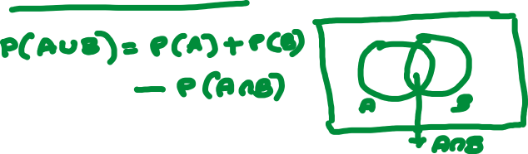



Slide 36
Probability as a Numerical Measure of the Likelihood of Occurrence
Increasing Likelihood of Occurrence
0
.5
1
Probability:
The occurrence of the event is
just as likely as it is unlikely.

Slide 37



1
The sales manager of an e commerce company says that 80% of those who visit their website for the first time do not buy any mobile. If a new customer visits the website, what is the probability that the customer would buy mobile

Slide 38


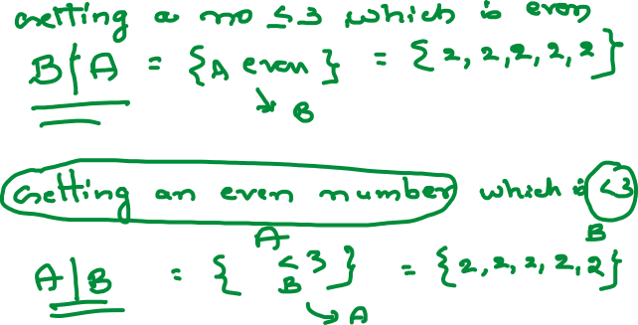



Slide 39
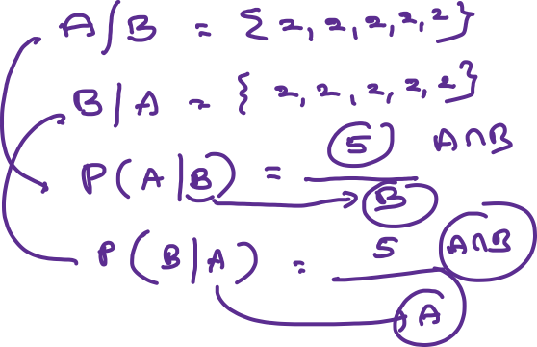

Slide 40




Conditional Probability
The probability of event B given that event A has occurred P(B|A) or, the probability of event A given that event B has occurred P(A|B)

Slide 41












Conditional Probability
The probability of event B given that event A has occurred P(B|A) or, the probability of event A given that event B has occurred P(A|B)

Slide 42










6
Three persons A,B and C are competing for the post of CEO of a company. The chances of they becoming CEO are 0.2,0.3 and 0.4 respectively.
The chances of they taking employees beneficial decisions are 0.50,0.45 and 0.6 respectively
What are the chances of having employees beneficial decisions after having new CEO

Slide 43













Slide 44

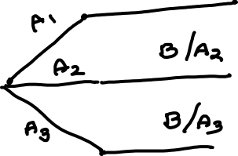



Slide 45
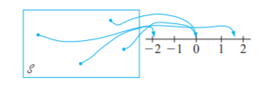
Random Variables
A random variable is a variable hat assumes numerical values associated with the random outcome of an experiment, where one (and only one) numerical value is assigned to each sample point.
Random variables are customarily denoted by uppercase letters, such as X and Y, near the end of our alphabet. In contrast to our previous use of a lowercase letter, such as x, to denote a variable, we will now use lowercase letters to represent some particular value of the corresponding random variable. The notation means that x is the value associated with the outcome s by the rv X.

Slide 46
Random Variables
A random variable is a numerical description of the outcome of an experiment.
A random variable can be classified as being either discrete or continuous depending on the numerical values it assumes.
A discrete random variable may assume either a finite number of values or an infinite sequence of values.
A continuous random variable may assume any numerical value in an interval or collection of intervals.

Slide 47
Types of random Variables
A discrete random variable can assume a countable number of values.
Number of steps to the top of the Eiffel Tower*
A continuous random variable can assume any value along a given interval of a number line.
The time a tourist stays at the top
once s/he gets there
*Believe it or not, the answer ranges from 1,652 to 1,789. See Great Buildings

Slide 48


Two Types of Random Variables
Discrete random variables
Number of sales
Number of calls
Shares of stock
People in line
Mistakes per page
Continuous random variables
Length
Depth
Volume
Time
Weight

Slide 49
Probability Distributions for Discrete Random Variables
The probability distribution of a discrete random variable is a graph, table or formula that specifies the probability associated with each possible outcome the random variable can assume.
p(x) ≥ 0 for all values of x
Σp(x) = 1

Slide 50
4.2: Probability Distributions for Discrete Random Variables
x | P(x)
1 | .30
2 | .21
3 | .15
4 | .11
5 | .07
6 | .05
7 | .04
8 | .02
9 | .02
10 | .01
Say a random variable x follows this pattern: p(x) = (.3)(.7)^{x-1}
for x > 0.
This table gives the probabilities (rounded to two digits) for x between 1 and 10.

Slide 51
Expected Values of Discrete Random Variables
The mean, or expected value, of a discrete random variable is

Slide 52
Expected Values of Discrete Random Variables
The variance of a discrete random variable x is
The standard deviation of a discrete random variable x is

Slide 53
Example: JSL Appliances
Discrete random variable with a finite number of values
Let x = number of TV sets sold at the store in one day
where x can take on 5 values (0, 1, 2, 3, 4)
Discrete random variable with an infinite sequence of values
Let x = number of customers arriving in one day
where x can take on the values 0, 1, 2, . . .
We can count the customers arriving, but there is no finite upper limit on the number that might arrive.

Slide 54
Discrete Probability Distributions
The probability distribution for a random variable describes how probabilities are distributed over the values of the random variable.
The probability distribution is defined by a probability function, denoted by f(x), which provides the probability for each value of the random variable.
The required conditions for a discrete probability function are:
f(x) > 0
Σf(x) = 1
We can describe a discrete probability distribution with a table, graph, or equation.

Slide 55
Example : JSL Appliances
Using past data on TV sales (below left), a tabular representation of the probability distribution for TV sales (below right) was developed.

Slide 56
Example: JSL Appliances
Graphical Representation of the Probability Distribution
.50
.40
Probability
.30
.20
.10
0 1 2 3 4
Values of Random Variable x (TV sales)

Slide 57
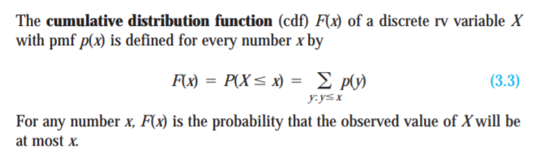
Cumulative distribution function

Slide 58
Discrete Uniform Probability Distribution
The discrete uniform probability distribution is the simplest example of a discrete probability distribution given by a formula.
The discrete uniform probability function is
f(x) = 1/n
where:
n = the number of values the random
variable may assume
Note that the values of the random variable are equally likely.

Slide 59
Expected Value and Variance
The expected value, or mean, of a random variable is a measure of its central location.
Expected value of a discrete random variable:
E(x) = μ = Σxf(x)
The variance summarizes the variability in the values of a random variable.
Variance of a discrete random variable:
Var(x) = σ ² = Σ(x - μ)²f(x)
The standard deviation, σ, is defined as the positive square root of the variance.

Slide 60
Example: JSL Appliances
Expected Value of a Discrete Random Variable
The expected number of TV sets sold in a day is 1.2

Slide 61
Example: JSL Appliances
Variance and Standard Deviation
of a Discrete Random Variable
x x - μ (x - μ)² f(x) (x - μ)²f(x)
0 -1.2 1.44 .40 .576
1 -0.2 0.04 .25 .010
2 0.8 0.64 .20 .128
3 1.8 3.24 .05 .162
4 2.8 7.84 .10 .784
1.660 = σ ²
The variance of daily sales is 1.66 TV sets squared.
The standard deviation of sales is 1.2884 TV sets.

Slide 62
Binary random variables
Many processes have outcomes binary in nature (True or False, Success or failure etc., )
Here, the events are { Success, failure}
The random variables in these cases are {0,1}
X(Success) = 1
X(Failure) = 0
Any random variable whose only possible values are 0 and 1 is called a Bernoulli random variable.
For x=0, probability is p and x=1, probability is 1
Bernoulli’s formula is (p^x)(1-p)^(1-x)
For x=0, probability is 1-p and for x=1, probability is p.

Slide 63
Parameters for probability distribution
Suppose p(x) depends on a quantity that can be assigned any one of a number of possible values, with each different value determining a different probability distribution.
Such a quantity is called a parameter of the distribution.
The collection of all probability distributions for different values of the parameter is called a family of probability distributions

Slide 64
Binomial Probability Distribution
Properties of a Binomial Experiment
The experiment consists of a sequence of n identical trials.
Two outcomes, success and failure, are possible on each trial.
The probability of a success, denoted by p, does not change from trial to trial.
The trials are independent.

Slide 65
Example: Evans Electronics
Binomial Probability Distribution
Evans is concerned about a low retention rate for employees. On the basis of past experience, management has seen a turnover of 10% of the hourly employees annually. Thus, for any hourly employees chosen at random, management estimates a probability of 0.1 that the person will not be with the company next year.
Choosing 3 hourly employees a random, what is the probability that 1 of them will leave the company this year?
Let: p = .10, n = 3, x = 1

Slide 66
Binomial Probability Distribution
Binomial Probability Function
where:
f(x) = the probability of x successes in n trials
n = the number of trials
p = the probability of success on any one trial

Slide 67
Example: Evans Electronics
Using the Binomial Probability Function
= (3)(0.1)(0.81)
= .243

Slide 68
Example: Evans Electronics
Using the Tables of Binomial Probabilities

Slide 69
Example: Evans Electronics
First
Worker
Second
Worker
Third
Worker
Value
of x
Probab.
L (.1)
3
.0010
Leaves (.1)
S (.9)
2
.0090
Leaves (.1)
L (.1)
2
.0090
Stays (.9)
S (.9)
1
.0810
L (.1)
2
.0090
Leaves (.1)
S (.9)
1
.0810
Stays (.9)
L (.1)
1
.0810
Stays (.9)
S (.9)
0
.7290

Slide 70
Binomial Probability Distribution
Expected Value
E(x) = μ = np
Variance
Var(x) = σ ² = np(1 - p)
Standard Deviation

Slide 71
Example: Evans Electronics
Binomial Probability Distribution
Expected Value
E(x) = μ = 3(.1) = .3 employees out of 3
Variance
Var(x) = σ ² = 3(.1)(.9) = .27
Standard Deviation

Slide 72
Poisson Probability Distribution
Properties of a Poisson Experiment
The probability of an occurrence is the same for any two intervals of equal length.
The occurrence or nonoccurrence in any interval is independent of the occurrence or nonoccurrence in any other interval.

Slide 73
Poisson Probability Distribution
Poisson Probability Function
where:
f(x) = probability of x occurrences in an interval
μ = mean number of occurrences in an interval
e = 2.71828

Slide 74
Example: Mercy Hospital
Using the Poisson Probability Function
Patients arrive at the emergency room of Mercy Hospital at the average rate of 6 per hour on weekend evenings. What is the probability of 4 arrivals in 30 minutes on a weekend evening?
μ = 6/hour = 3/half-hour, x = 4

Slide 75
Example: Mercy Hospital
Using the Tables of Poisson Probabilities

Slide 76
Continuous Probability Distributions
Uniform Probability Distribution
Normal Probability Distribution
Exponential Probability Distribution
f(x)
x
μ

Slide 77
Continuous Probability Distributions
A continuous random variable can assume any value in an interval on the real line or in a collection of intervals.
It is not possible to talk about the probability of the random variable assuming a particular value.
Instead, we talk about the probability of the random variable assuming a value within a given interval.
The probability of the random variable assuming a value within some given interval from x₁ to x₂ is defined to be the area under the graph of the probability density function between x₁ and x₂.

Slide 78
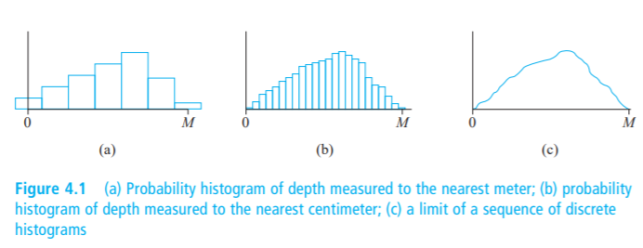
Discrete to Continuous (Histogram to Probability density)
Suppose the variable X of interest is the depth of a lake at a randomly chosen point on the surface.
Let the maximum depth (in meters), so that any number in the interval [0, M] is a possible value of X.
If we “discretize” X by measuring depth to the nearest meter, then possible values are nonnegative integers less than or equal to M.
The resulting discrete distribution of depth can be pictured using a probability histogram.
If we draw the histogram so that the area of the rectangle above any possible integer k is the proportion of the lake whose depth is (to the nearest meter) k, then the total area of all rectangles is 1. A possible histogram appears in Figure 4.1(a)

Slide 79
Discrete to continuous
If depth is measured much more accurately and the same measurement axis as in Figure 4.1(a) is used, each rectangle in the resulting probability histogram is much narrower, though the total area of all rectangles is still 1.
A possible histogram is pictured in Figure 4.1(b); it has a much smoother appearance than the histogram in Figure 4.1(a).
If we continue in this way to measure depth more and more finely, the resulting sequence of histograms approaches a smooth curve, such as is pictured in Figure 4.1(c).
Because for each histogram the total area of all rectangles equals 1, the total area under the smooth curve is also 1.
The probability that the depth at a randomly chosen point is between a and b is just the area under the smooth curve between a and b.
It is exactly a smooth curve of the type pictured in Figure 4.1(c) that specifies a continuous probability distribution.

Slide 80
Normal Probability Distribution
Normal Probability Density Function
where:
μ = mean
σ = standard deviation
π = 3.14159
e = 2.71828

Slide 81
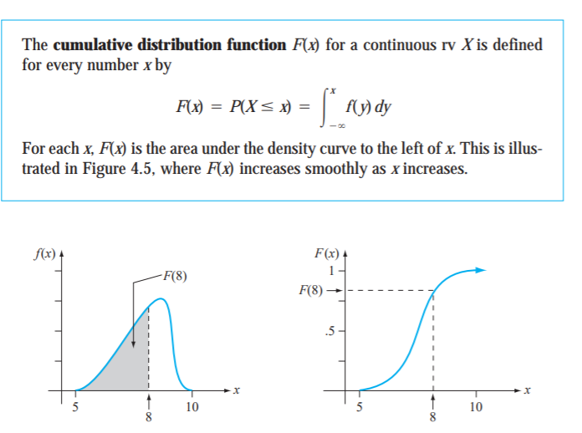
Cumulative distribution function

Slide 82
Normal distribution
The motivation:
When analyzing the fast changing random events like Brownian motion, the Normal distributioin can be naturally arrived at.
A particle keeps changing its direction. Start with a particle moving right and left with probability p and 1-p.
Then, for moving ‘r’ right steps, the probability is given by the binomial distribution function Bi(r,n) =
(n!/r!(n-r)!)(p^r)(1-p)^(n-r).
Making n → inf and p such that np is finite (around 15), the use of Sterling’s theorem followed by soe algebraic manipulations give rise to the above formula.

Slide 83
Normal Probability Distribution
Graph of the Normal Probability Density Function
f(x)
x
μ

Slide 84
Normal Probability Distribution
Characteristics of the Normal Probability Distribution
The shape of the normal curve is often illustrated as a bell-shaped curve.
Two parameters, μ (mean) and σ (standard deviation), determine the location and shape of the distribution.
The highest point on the normal curve is at the mean, which is also the median and mode.
The mean can be any numerical value: negative, zero, or positive.
… continued

Slide 85
Normal Probability Distribution
Characteristics of the Normal Probability Distribution
The normal curve is symmetric.
The standard deviation determines the width of the curve: larger values result in wider, flatter curves.
The total area under the curve is 1 (.5 to the left of the mean and .5 to the right).
Probabilities for the normal random variable are given by areas under the curve.

Slide 86
Normal Probability Distribution
% of Values in Some Commonly Used Intervals
68.26% of values of a normal random variable are within +/- 1 standard deviation of its mean.
95.44% of values of a normal random variable are within +/- 2 standard deviations of its mean.
99.72% of values of a normal random variable are within +/- 3 standard deviations of its mean.

Slide 87
Normal Probability Distribution
Normal Probability Density Function
where:
μ = mean
σ = standard deviation
π = 3.14159
e = 2.71828

Slide 88
Standard Normal Probability Distribution
A random variable that has a normal distribution with a mean of zero and a standard deviation of one is said to have a standard normal probability distribution.
The letter z is commonly used to designate this normal random variable.
Converting to the Standard Normal Distribution
We can think of z as a measure of the number of standard deviations x is from μ.

Slide 89
Example: Pep Zone
Standard Normal Probability Distribution
Pep Zone sells auto parts and supplies including a
popular multi-grade motor oil. When the stock of this
oil drops to 20 gallons, a replenishment order is placed.
The store manager is concerned that sales are being
lost due to stockouts while waiting for an order. It has
been determined that lead-time demand is normally
distributed with a mean of 15 gallons and a standard
deviation of 6 gallons.
The manager would like to know the probability of a
stockout, P(x > 20).

Slide 90
Example: Pep Zone
Standard Normal Probability Distribution
The Standard Normal table shows an area of .2967 for the region between the z = 0 and z = .83 lines below. The shaded tail area is .5 - .2967 = .2033. The probability of a stock-out is .2033.
z = (x - μ)/σ
= (20 - 15)/6
= .83
Area = .2967
Area = .5 - .2967
= .2033
Area = .5
z
0
.83

Slide 91
Example: Pep Zone
Using the Standard Normal Probability Table

Slide 92
Example: Pep Zone
Standard Normal Probability Distribution
If the manager of Pep Zone wants the probability of a stockout to be no more than .05, what should the reorder point be?
Let z_{.05} represent the z value cutting the .05 tail area.
Area = .05
Area = .5
Area = .45
0
z_{.05}

Slide 93
Example: Pep Zone
Using the Standard Normal Probability Table
We now look-up the .4500 area in the Standard Normal Probability table to find the corresponding z_{.05} value.
z_{.05} = 1.645 is a reasonable estimate.

Slide 94
Example: Pep Zone
Standard Normal Probability Distribution
The corresponding value of x is given by
x = μ + z_{.05}σ
= 15 + 1.645(6)
= 24.87
A reorder point of 24.87 gallons will place the probability of a stockout during leadtime at .05. Perhaps Pep Zone should set the reorder point at 25 gallons to keep the probability under .05.

Slide 95
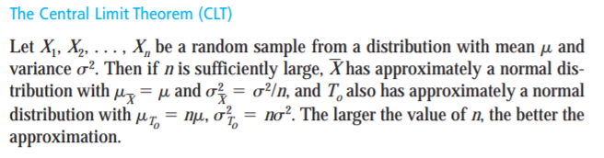
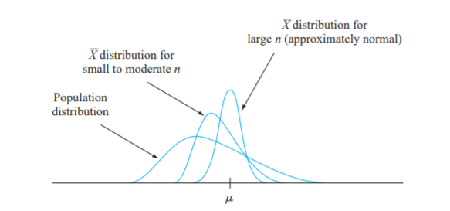
Central Limit theorem

Slide 96
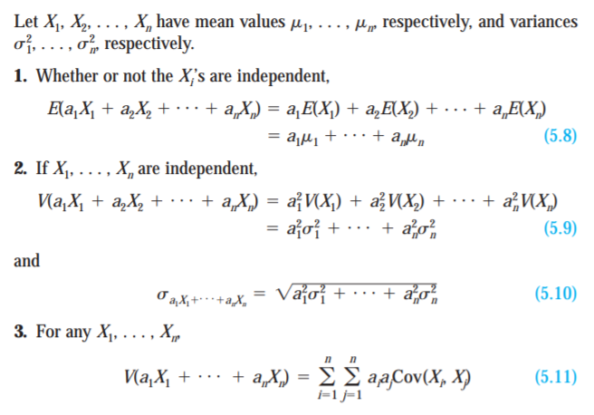
A few more properties

Slide 97
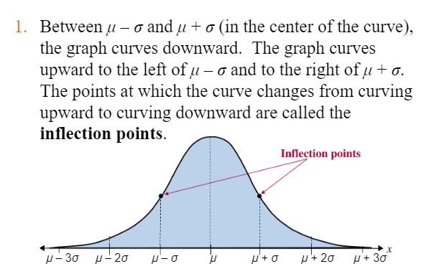
Normal distribution - properties
The mean, median, and mode are equal.
The normal curve is bell-shaped and is symmetric about the mean.
The total area under the normal curve is equal to 1.
The normal curve approaches, but never touches, the x-axis as it extends farther and farther away from the mean.

Slide 98
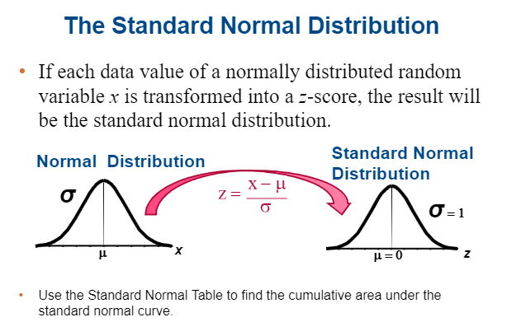
Normal distribution

Slide 99
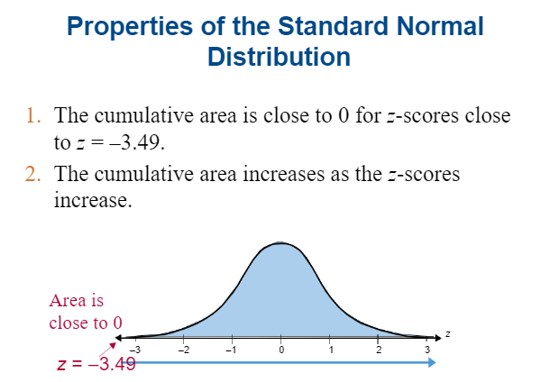

Slide 100
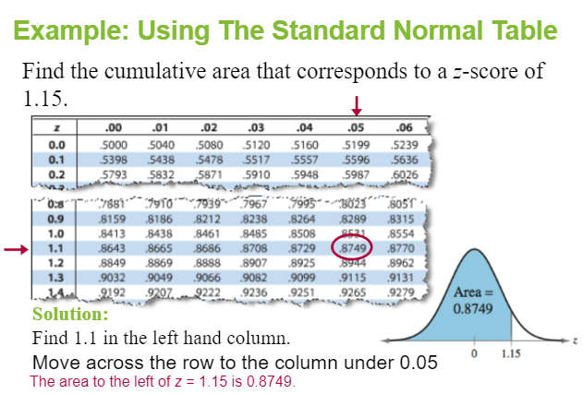
Normal distribution –Normal table

Slide 101
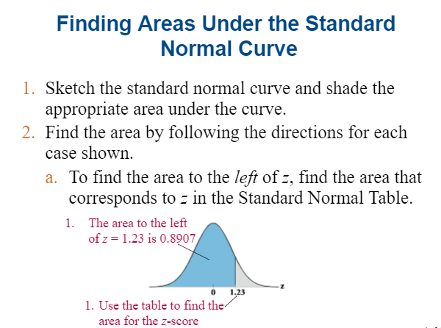

Slide 102
https://studiousguy.com/real-life-examples-normal-distribution/

Slide 103

Binomial to Normal
Apply the following expression for the factorial in the Binomial expansion( n! (n-r)! / r!) ( p^r) ((1-p)^(n-r)) followed by logarithms, ignoring higher order terms lead to the Normal distribution.
Stirling’s theorem

