Slide 1
Drowsiness detection
Under the guidance of
Dr. r. Sudha
Associate professor & Head
Department of computer applications [bca & mca]
Sathiya lingesh v
19bca043
Iii-bca

Slide 2
introduction
The project “Drowsiness Detection” is done to develop a system to prevent accidents from happening because of driver fatigue and sleepiness.
This project will detect person’s eyes whether it is closed or not using Euclidean algorithm. If, closed for few seconds then alarm starts to beep.
Then, this system will alert the driver when drowsiness is detected.
In 2015 survey, worldwide 1.25 million accidents were happening, which means every 25 seconds an accident is happening. In which, 20-25 percent of accidents are happening due to drowsiness.
Most of drowsiness accidents are happening due to restless driving, heavy work a day before due to which less sleep, late night drives between 2 am – 6 am.

Slide 3
Hardware specifications
Processor: Intel Core i5 9th Gen
Ram: 8 GB
Solid State Drive: 512 GB
Web-camera
software specifications
Operating System: Windows 10 Home (64 bit)
Libraries :
Numpy
Scipy
Dlib
Imutils
opencv
playsound

Slide 4
Existing system
The existing system of drowsiness detection has very slow rate of detection of blinking eyes, poor face recognition algorithm, takes more time to make alarm sound.
Sometimes, it may even fail to detect the person in lowlight and continuously beeping the alarm.
DRAWBACKS OF EXISTING SYSTEM:
Old sensors which were very slow and has short life span.
The algorithms used were too slow and has very high time complexity.
Poor camera quality due to which errors occur.
Sometimes, due to poor face recognition the alarm sound automatically beeps.
In, most of the country’s driver drowsiness detection were not implemented. Due, to which development in this sector is very slow.
Sometimes, due to error alarm starts beeping and we cannot even switch off or restart device.

Slide 5
Proposed system
To overcome these difficulties, we have developed a new algorithm which is more accurate and faster. This system works more faster and alerts the person on correct time.
ADVANTAGES OF PROPOSED SYSTEM:
Nowadays, the algorithm was very fast and more accurate.
New sensors were cheap and have high reliability.
The infrared cameras were developed to detect more accurately even in low light conditions.
In this algorithm, errors were reduced due to which accuracy is increased.
The processing speed of algorithm is increased so that the distance between the eyelids were calculated more faster and hence it also increases the accuracy.
Now, Alarm sounds starts to beep faster and accurately. Thus, the latency issue has been reduced.

Slide 6
modules
Face and Eye Detection
Webcam Video Capturing
Drowsiness Detection ( with Alert message and Beep sound)

Slide 7
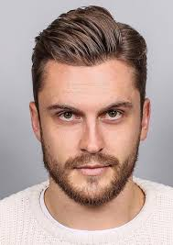
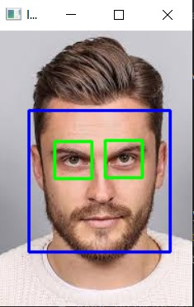
Module 1 Face and eye detection
In this module, we will run an image into python file and the output shows detected face image.
Test Image
Detected Face Image

Slide 8
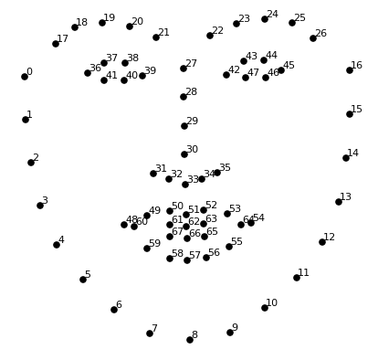
Facial coordinates

Slide 9
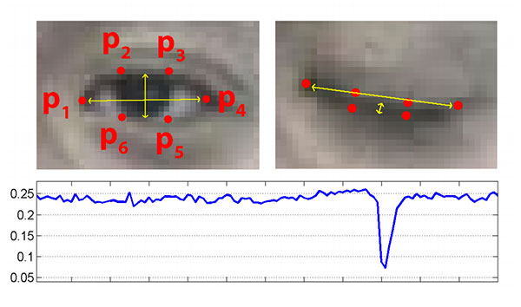

Euclidean algorithm

Slide 10
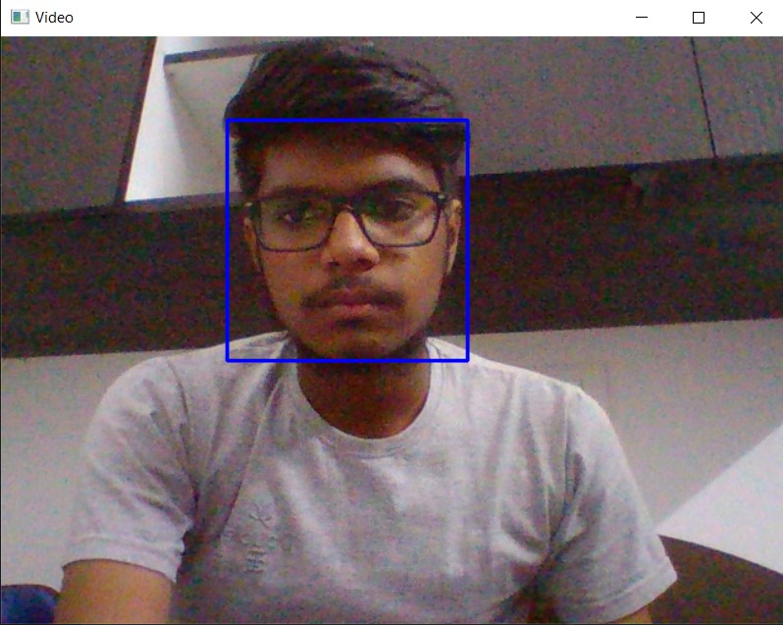
Module 2 Webcam Video Capturing
In this module, we will run an python file which starts webcam and live face image is detected.

Slide 11
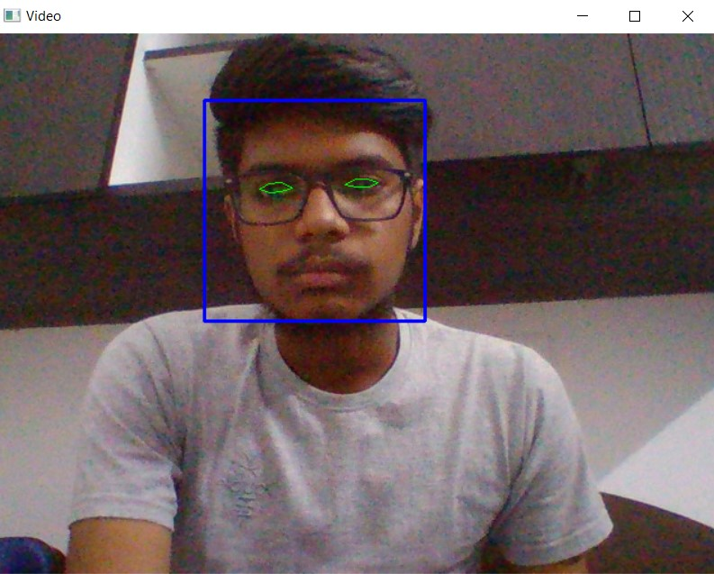
Module 3 Drowsiness Detection
In this module, we will detect whether the person is drowsy or not.

Slide 12
Data flow diagram
Capture Video from web-camera
Detect the Face
No of faces
>0
No
Yes
Detect the Eye
Extract Eye Region
No
Drowsy Driver?
Yes
Calculation of Judging Drowsiness
Alarm signal

Slide 13
Er diagram
Stop Ringing
Start Ringing
Alarm
Non-drowsy
Detection system
drowsy
Opening & closing eyes
Webcam
Image Processing
Analysis
Detection
Contains
Eye Detection
Face Detection
Drowsiness Detector

Slide 14
Input design
Here is the input deign of the program where face is detected to check whether person is drowsy or not.

Slide 15
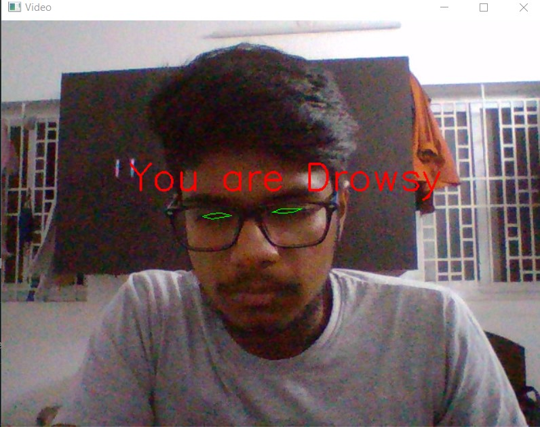
Output design
Here is the output deign of the program which displays the person is drowsy and alarm beeps.

Slide 16
conclusion
The Drowsiness Detection System developed based on eye closure of the driver can differentiate normal eye blink and drowsiness and detect the drowsiness while driving.
The proposed system can prevent accidents due to sleepiness while driving. This system works well even in case of drivers wearing spectacles and even under low light conditions if the camera delivers better output.
Information about the head and eyes position is obtained through various image processing algorithms.
During the monitoring, the system is able to decide if the eyes are opened or closed.
When the eyes have been closed for too long, a warning signal is issued. processing judges the driver’s alertness level on the basis of continuous eye closures.
It will reduce the accidents if it is placed in every vehicles’s dashboard.

Slide 17
Scope for future development
In the real time driver fatigue detection system, it is required to slow down a vehicle automatically when fatigue level crosses a certain limit. Instead of threshold drowsiness level it is suggested to design a continuous scale driver fatigue detection system. It monitors the level of drowsiness continuously and when this level exceeds a certain value a signal is generated which controls the hydraulic braking system of the vehicle.
The model can be improved incrementally by using other parameters like blink rate, yawning, state of the car, etc. If all these parameters are used it can improve the accuracy by a lot.
This type of detector can be used wherever we need. For example, In mines many accidents are happening due to drowsiness which cause may losses to the company and loss of life.
Same model and techniques can be used for various other uses like Netflix and other streaming services can detect when the user is asleep and stop the video accordingly.
It can also be used in any type of application that prevents user from sleeping.

Slide 18
BIBLIOGRAPHY
• COMPUTATIONALLY EFFICIENT FACE DETECTION; B. SCHLKOPF-A. BLAKE, S. ROMDHANI, AND P. TORR.
• INTRODUCTION TO PROGRAMMING USING PYTHON; Y. DANIEL ILANG.
• USE OF THE HOUGH TRANSFORMATION TO DETECT LINES AND CURVES IN PICTURE; R. DUDA AND P. E. HART.
• OPEN/CLOSED EYE ANALYSIS FOR DROWSINESS DETECTION; P.R. TABRIZI AND R. A. ZOROOFI.
WEBSITES REFERRED:
• https://www.scribd.com/book/15491045/Learning-OpenCV-Computer-Vision-with-the-OpenCV-Library
• https://www.scribd.com/document/46566105/opencv
• www.tutorialspoint.com
• https://www.pyimagesearch.com/2017/04/03/facial-landmarks-dlib-opencv-python

Slide 19
Thank you!

