Slide 1
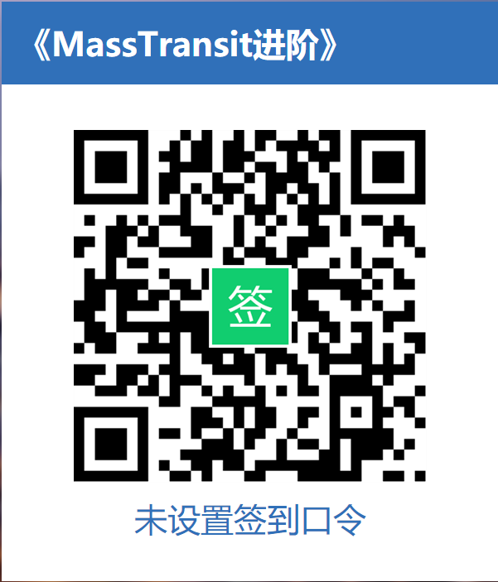

Slide 2

MassTransit进阶
薛明峰
中瑞金服研发中心
2019.06

Slide 3
主要内容
Service Bus 介绍
MassTransit
快速开始
认识 MassTransit
使用 MassTransit
DEMO
部署
高级进阶
最佳实践
总结

Slide 4
Service Bus 介绍

Slide 5
Service Bus 即为服务总线
Service Bus 提供“中继”和“中转”消息传递功能。在中继消息传递模式下，中继服务支持直接单向消息传递、请求/响应消息传递和对等消息传递。中转消息传递提供了持久异步消息传递组件（如队列、主题和订阅），具有支持发布-订阅和临时分离的功能：发送者和接收者不必同时处于联机状态；该消息传递基础结构能够可靠地存储消息，直到接收方准备好接收消息。

Slide 6
Service Bus 应用场景
分布式应用程序
并发量大的应用程序
需要高可用的应用程序

Slide 7
应用 Service Bus 需要接受
延时
最终一致性
分布式事务

Slide 8


.NET 下主流的 Service Bus 组件
MassTransit

Slide 9
MassTransit

Slide 10
MassTransit 是一款使用 .NET 构建的开源、免费、轻量的分布式应用程序消息通信组件。
MassTransit 提供了大量消息通信协议和对开发者友好的基于消息会话模式的异步消息连接服务；基于消息的通信是一个以可靠的、可衡量的方式集成的面向服务的技术架构。

Slide 11
功能清单
多种 Transport
Transport 可扩展
并发处理
连接管理
异常处理
重试机制
消息序列化
版本管理
集成 SignalR
路由
集成响应试编程 Rx
单元测试
工作流 Sagas
计划消息
监控
分布式事务

Slide 12


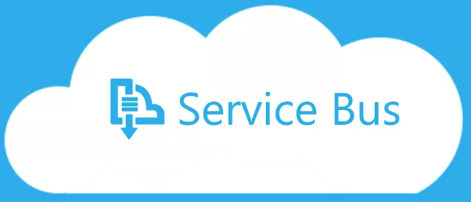

已集成的Transport
InMemory
RabbitMQ
Azure Service Bus
ActiveMQ
AmazonMQ
Amazon SQS

Slide 13
快速开始

Slide 14
mkdir GettingStarted
dotnet new console -o GettingStarted

Slide 15
cd GettingStarted
dotnet add package MassTransit.RabbitMQ

Slide 16
public class YourMessage
{
public string Text { get; set; }
}

Slide 17
public class Program{
public static void Main(){
var bus = Bus.Factory.CreateUsingRabbitMq(sbc =>
{
var host = sbc.Host(new Uri("rabbitmq://localhost"), h =>
{
h.Username("guest"); h.Password("guest");
});
sbc.ReceiveEndpoint(host, "test_queue", ep =>
{
ep.Handler<YourMessage>(context =>
Console.Out.WriteLineAsync($"Received: {context.Message.Text}"));
});
});
bus.Start(); // This is important!
bus.Publish(new YourMessage{Text = "Hi"});
Console.WriteLine("Press any key to exit"); Console.ReadKey();
bus.Stop();
}
}

Slide 18
认识 MassTransit

Slide 19
基本概念
Message Contracts
Serialization
Producers
Consumers
Sagas
Transports and endpoints

Slide 20
MassTransit在传输过程中
Concurrency
Connection management
Exception, retries, and poison messages
Serialization
Message header and correlation
Consumer lifecycle management

Slide 21
MassTransit在传输过程中
Routing
Rx integration
Unit testing made easy
Sagas
Scheduling
Monitoring performance counters

Slide 22
使用 MassTransit

Slide 23
安装 MassTransit

Slide 24
准备环境
.NET 4.5.2+
.NET Core 2+
.NET Standard 2.0

Slide 25
Transports
In Memory
RabbitMQ
Azure Service Bus
ActiveMQ

Slide 26
如何安装
安装 MassTransit
nuget Install-Package MassTransit
安装 RabbitMQ
nuget Install-Package MassTransit.RabbitMQ
安装 Azure Service Bus
nuget Install-Package MassTransit.AzureServiceBus

Slide 27
配置 MassTransit

Slide 28
MassTransit in a console application

Slide 29
定义 Message Contracts
public interface ValueEntered
{
string Value { get; }
}

Slide 30
定义应用程序入口
public class Program {
public static void Main() {
var busControl = ConfigureBus();
// Important! The bus must be started before using it!
busControl.Start();
do
{
Console.WriteLine("Enter message (or quit to exit)");
Console.Write("> ");
string value = Console.ReadLine();
if("quit".Equals(value, StringComparison.OrdinalIgnoreCase))
break;
busControl.Publish<ValueEntered>(new { Value = value });
}
while (true);
busControl.Stop();
}

Slide 31
配置 MassTransit
static IBusControl ConfigureBus()
{
return Bus.Factory.CreateUsingRabbitMq(cfg =>
{
cfg.Host(new Uri("rabbitmq://localhost"), h =>
{
h.Username("guest");
h.Password("guest");
});
});
}

Slide 32
MassTransit and ASP.NET Core

Slide 33
public class Startup{
public void ConfigureServices(IServiceCollection services) {
// Add framework services
services.AddHealthChecks();
services.AddMvc();
// Register your consumers if the need dependencies
services.AddScoped<SomeDependency>()
// Register MassTransit
services.AddMassTransit(x =>{
x.AddConsumer<OrderConsumer>();
x.AddBus(provider => Bus.Factory.CreateUsingRabbitMq(cfg =>{
var host = cfg.Host(new Uri("localhost"), hostConfigurator =>{
hostConfigurator.Username("guest");
hostConfigurator.Password("guest");
});
cfg.ReceiveEndpoint(host, "submit-order", ep =>
{
ep.PrefetchCount = 16;
ep.UseMessageRetry(r => r.Interval(2, 100));
ep.ConfigureConsumer<OrderConsumer>(provider);
});
}));
});
}
// everything else
}

Slide 34
MassTransit in a Windows service

Slide 35

http://topshelf-project.com/

Slide 36
定义应用程序入口
public class Program
{
public static int Main()
{
return (int)HostFactory.Run(cfg =>
cfg.Service(x => new EventConsumerService());
}
}

Slide 37
定义 EventConsumerService
class EventConsumerService : ServiceControl
{
IBusControl _bus;
public bool Start(HostControl hostControl)
{
_bus = ConfigureBus();
_bus.Start();
return true;
}
public bool Stop(HostControl hostControl)
{
_bus?.Stop(TimeSpan.FromSeconds(30));
return true;
}

Slide 38
定义 EventConsumerService
IBusControl ConfigureBus()
{
return Bus.Factory.CreateUsingRabbitMq(cfg =>
{
var host = cfg.Host(new Uri("rabbitmq://localhost"), h =>
{
h.Username("guest");
h.Password("guest");
});
cfg.ReceiveEndpoint(host, "event_queue", e =>
{
e.Handler<ValueEntered>(context =>
Console.Out.WriteLineAsync(
$"Value was entered: {context.Message.Value}"));
})
});
}

Slide 39
Transports

Slide 40
RabbitMQ configuration options
Bus.Factory.CreateUsingRabbitMq(cfg =>
{
cfg.Host(
new Uri("rabbitmq://a-machine-name/a-virtual-host"), host =>
{
host.Username("username");
host.Password("password");
});
});

Slide 41
Azure Service Bus configuration options
Bus.Factory.CreateUsingAzureServiceBus(x =>
{
var host = x.Host(serviceUri, h =>
{
h.SharedAccessSignature(s =>
{
s.KeyName = "keyName";
s.SharedAccessKey = "key";
s.TokenTimeToLive = TimeSpan.FromDays(1);
s.TokenScope = TokenScope.Namespace;
});
});
});

Slide 42
Amazon SQS
Bus.Factory.CreateUsingAmazonSqs(x =>
{
var host = x.Host(serviceUri, h =>
{
h.AccessKey(AccessKey);
h.SecretKey(SecretKey);
});
});

Slide 43
ActiveMQ / AmazonMQ
Bus.Factory.CreateUsingActiveMq(cfg =>
{
var host = cfg.Host("{your-id}.mq.us-east-2.amazonaws.com", 61617, h =>
{
h.Username(TestUsername);
h.Password(TestPassword);
h.UseSsl();
});
});

Slide 44
In-Memory transport
var busControl = Bus.Factory.CreateUsingInMemory(cfg =>
{
cfg.ReceiveEndpoint("queue_name", ep =>
{
//configure the endpoint
})
});
`loopback://localhost/queue_name`

Slide 45
创建契约（Message Contracts）

Slide 46
消息的类型
Commands
Events

Slide 47
Commands
Commands should be expressed in a verb-noun sequence, following the tell style.
UpdateCustomerAddress
UpgradeCustomerAccount
SubmitOrder

Slide 48
Events
Events should be expressed in a noun-verb (past tense) sequence, indicating that something happened.
CustomerAddressUpdated
CustomerAccountUpgraded
OrderSubmitted

Slide 49
强烈建议
定义消息契约时，使用 Interface 代替 Class， 保证消息中不参杂行为逻辑。

Slide 50
public interface UpdateCustomerAddress
{
Guid CommandId { get; }
DateTime Timestamp { get; }
string CustomerId { get; }
string HouseNumber { get; }
string Street { get; }
string City { get; }
string State { get; }
string PostalCode { get; }
}
bus.Send<UpdateCustomerAddress>(new {
CommandId: commandId,
Timestamp: DateTime.Now.Utc,
...
});

Slide 51
Message correlation（链路跟踪）
https://masstransit-project.com/MassTransit/usage/correlation.html

Slide 52
创建消费者（Consumer)

Slide 53
创建消费者（Consumer）
public class UpdateCustomerConsumer :
IConsumer<UpdateCustomerAddress>
{
public async Task Consume(ConsumeContext<UpdateCustomerAddress> context)
{
await Console.Out.WriteLineAsync( $"Updating customer: {context.Message.CustomerId}");
// update the customer address
}
}

Slide 54
链接到消费者（Consumer）
var busControl = Bus.Factory.CreateUsingRabbitMq(cfg =>
{
var host = cfg.Host(new Uri("rabbitmq://localhost/"));
cfg.ReceiveEndpoint(host, "customer_update_queue", e =>
{
e.Consumer<UpdateCustomerConsumer>();
});
});

Slide 55
生产消息（Message）

Slide 56
public async Task SendOrder(ISendEndpointProvider sendEndpointProvider)
{
var endpoint =
await sendEndpointProvider.GetSendEndpoint(_serviceAddress);
await endpoint.Send(new SubmitOrder(...));
}

Slide 57
Sending via interfaces
public interface SubmitOrder
{
string OrderId { get; }
DateTime OrderDate { get; }
decimal OrderAmount { get; }
}
public async Task SendOrder(ISendEndpoint endpoint)
{
await endpoint.Send<SubmitOrder>(new
{
OrderId = "27",
OrderDate = DateTime.UtcNow,
OrderAmount = 123.45m
});
}

Slide 58
Setting message headers
public interface SubmitOrder
{
string OrderId { get; }
DateTime OrderDate { get; }
decimal OrderAmount { get; }
}
public async Task SendOrder(ISendEndpoint endpoint)
{
await endpoint.Send<SubmitOrder>(new
{
OrderId = "27",
OrderDate = DateTime.UtcNow,
OrderAmount = 123.45m
}, context =>
context.FaultAddress = new Uri("rabbitmq://localhost/order_faults"));
}

Slide 59
Publishing events
public interface OrderSubmitted
{
string OrderId { get; }
DateTime OrderDate { get; }
}
public async Task NotifyOrderSubmitted(IPublishEndpoint publishEndpoint)
{
await publishEndpoint.Publish<OrderSubmitted>(new
{
OrderId = "27",
OrderDate = DateTime.UtcNow,
});
}

Slide 60
Publishing events
public class SubmitOrderConsumer : IConsumer<SubmitOrder>
{
private readonly IOrderSubmitter _orderSubmitter;
public SubmitOrderConsumer(IOrderSubmitter submitter)
=> _orderSubmitter = submitter;
public async Task Consume(IConsumeContext<SubmitOrder> context)
{
await _orderSubmitter.Process(context.Message);
await context.Publish<OrderSubmitted>(new
{
OrderId = context.Message.OrderId,
OrderDate = DateTime.UtcNow
})
}
}

Slide 61
异常处理

Slide 62
异常情况
数据库死锁
服务器忙
或者其它短时间即可恢复的状况

Slide 63
Retrying messages
public class SubmitOrderConsumer :
IConsumer<SubmitOrder>
{
ISessionFactory _sessionFactory;
public async Task Consume(ConsumeContext<SubmitOrder> context)
{
using(var session = _sessionFactory.OpenSession())
using(var transaction = session.BeginTransaction())
{
var customer = session.Get<Customer>(context.Message.CustomerId);
// continue with order processing
transaction.Commit();
}
}
}

Slide 64
Retrying messages
var sessionFactory = CreateSessionFactory();
var busControl = Bus.Factory.CreateUsingRabbitMq(cfg =>
{
var host = cfg.Host(new Uri("rabbitmq://localhost/"), h =>
{
h.Username("guest");
h.Password("guest");
});
cfg.ReceiveEndpoint(host, "submit-order", e =>
{
e.UseMessageRetry(r => r.Immediate(5));
e.Consumer(() => new SubmitOrderConsumer(sessionFactory));
});
});

Slide 65
异常情况
数据库宕机
远程服务不可用
或者其它长时间方可恢复的状况

Slide 66
Redelivering messages
var sessionFactory = CreateSessionFactory();
var busControl = Bus.Factory.CreateUsingRabbitMq(cfg =>{
var host = cfg.Host(new Uri("rabbitmq://localhost/"), h =>
{
h.Username("guest"); h.Password("guest");
});
cfg.UseMessageScheduler(new Uri("rabbitmq://localhost/quartz"));
cfg.ReceiveEndpoint(host, "submit-order", e =>{
e.UseScheduledRedelivery(r => r.Intervals(TimeSpan.FromMinutes(5), TimeSpan.FromMinutes(15), TimeSpan.FromMinutes(30)));
e.UseMessageRetry(r => r.Immediate(5));
e.Consumer(() => new SubmitOrderConsumer(sessionFactory));
});
});

Slide 67
Handling faults
public interface Fault<T>
where T : class
{
Guid FaultId { get; }
Guid? FaultedMessageId { get; }
DateTime Timestamp { get; }
ExceptionInfo[] Exceptions { get; }
HostInfo Host { get; }
T Message { get; }
}

Slide 68
Consuming faults
public class DashboardFaultConsumer :
IConsumer<Fault<SubmitOrder>>
{
public async Task Consume(ConsumeContext<Fault<SubmitOrder>> context)
{
// update the dashboard
}
}

Slide 69
大数据负荷（Large payloads）

Slide 70
InMemoryMessageDataRepository
FileSystemMessageDataRepository
MongoDbMessageDataRepository
EncryptedMessageDataRepository

Slide 71
配置大数据存储
public class YourMessage
{
public string YourName { get; set; }
public MessageData<byte[]> TheLargeMessage { get; set; }
}
...
serviceCollection.AddSingleton(new InMemoryMessageDataRepository());
...
cfg.ReceiveEndpoint(host, "submit-order", e =>
{
e.UseMessageData<YourMessage>(provider.GetService<IMessageDataRepository>());
e.ConfigureConsumer<YourMessageConsumer>(provider);
});

Slide 72
消费大数据
public async Task Consume(ConsumeContext<YourMessage> context)
{
var theLargeMessage = await context.Message.TheLargeMessage.Value;
// Continue consumption
}

Slide 73
生产大数据
var message = new YourMessage
{
YourName = "Test",
// repository is of the type IMessageDataRepository
TheLargeMessage = repository.PutBytes(yourByteArray)
};

Slide 74
计划消息

Slide 75
MassTransit集成
Scheduling API
In-memory scheduling
Azure Service Bus
RabbitMQ Delayed Exchange
Redelivering messages

Slide 76
配置 Quartz 地址
var busControl = Bus.Factory.CreateUsingRabbitMq(cfg =>
{
var host = cfg.Host(new Uri("rabbitmq://localhost/"), h =>
{
h.Username("guest");
h.Password("guest");
});
cfg.UseMessageScheduler(new Uri("rabbitmq://localhost/quartz"));
});

Slide 77
在 Consumer 中计划消息
public interface ScheduleNotification
{
DateTime DeliveryTime { get; }
string EmailAddress { get; }
string Body { get; }
}
public interface SendNotification
{
string EmailAddress { get; }
string Body { get; }
}

Slide 78
在 Consumer 中计划消息
public class ScheduleNotificationConsumer : IConsumer<ScheduleNotification>
{
Uri _notificationService;
public async Task Consume(ConsumeContext<ScheduleNotification> context)
{
await context.ScheduleSend<SendNotification>(_notificationService,
context.Message.DeliveryTime,
new
{
EmailAddress = context.Message.EmailAddress,
Body = context.Message.Body
});
}
}

Slide 79
在 Bus 中计划消息
var schedulerEndpoint = await bus.GetSendEndpoint(_schedulerAddress);
await schedulerEndpoint.ScheduleSend<SendNotification>(_notificationService,
context.Message.DeliveryTime,
new
{
EmailAddress = context.Message.EmailAddress,
Body = context.Message.Body
});

Slide 80
循环消息
public class PollExternalSystemSchedule : DefaultRecurringSchedule
{
public PollExternalSystemSchedule()
{
CronExpression = "0 0/1 * 1/1 * ? *"; // this means every minute
}
}
public class PollExternalSystem {}

Slide 81
循环消息
var schedulerEndpoint = await bus.GetSendEndpoint(_schedulerAddress);
var scheduledRecurringMessage =
await schedulerEndpoint.ScheduleRecurringSend(
InputQueueAddress,
new PollExternalSystemSchedule(),
new PollExternalSystem());

Slide 82
循环消息
await bus.CancelScheduledRecurringMessage(scheduledRecurringMessage);

Slide 83
观察消息

Slide 84
Observing received messages
public class ReceiveObserver : IReceiveObserver {
public Task PreReceive(ReceiveContext context)
{
// called immediately after the message was delivery by the transport
}
public Task PostReceive(ReceiveContext context)
{
// called after the message has been received and processed
}
public Task PostConsume<T>(ConsumeContext<T> context, TimeSpan duration, string consumerType)
where T : class
{
// called when the message was consumed, once for each consumer
}
……

Slide 85
Observing received messages
……
public Task ConsumeFault<T>(ConsumeContext<T> context, TimeSpan elapsed, string consumerType, Exception exception) where T : class
{
// called when the message is consumed but the consumer throws an exception
}
public Task ReceiveFault(ReceiveContext context, Exception exception)
{
// called when an exception occurs early in the message processing, such as deserialization, etc.
}
}

Slide 86
连接观察者
var busControl = Bus.Factory.CreateUsingRabbitMq(cfg =>
{
var host = cfg.Host(new Uri("rabbitmq://localhost/"), h =>
{
h.Username("guest");
h.Password("guest");
});
cfg.ReceiveEndpoint(host, "customer_update_queue", e =>
{
e.Consumer<UpdateCustomerConsumer>();
});
});
var observer = new ReceiveObserver();
var handle = busControl.ConnectReceiveObserver(observer);

Slide 87
Observing consumed messages
public class ConsumeObserver : IConsumeObserver
{
Task IConsumeObserver.PreConsume<T>(ConsumeContext<T> context)
{
// called before the consumer's Consume method is called
}
Task IConsumeObserver.PostConsume<T>(ConsumeContext<T> context)
{
// called after the consumer's Consume method is called
// if an exception was thrown, the ConsumeFault method is called instead
}
Task IConsumeObserver.ConsumeFault<T>(ConsumeContext<T> context, Exception exception)
{
// called if the consumer's Consume method throws an exception
}
}

Slide 88
Observing specific consumed messages
public class ConsumeObserver<T> : IConsumeMessageObserver<T> where T : class
{
Task IConsumeMessageObserver<T>.PreConsume(ConsumeContext<T> context)
{
// called before the consumer's Consume method is called
}
Task IConsumeMessageObserver<T>.PostConsume(ConsumeContext<T> context)
{
// called after the consumer's Consume method was called
// again, exceptions call the Fault method.
}
Task IConsumeMessageObserver<T>.ConsumeFault(ConsumeContext<T> context, Exception exception)
{
// called when a consumer throws an exception consuming the message
}
}

Slide 89
Observing sent messages
public class SendObserver : ISendObserver
{
public Task PreSend<T>(SendContext<T> context)
where T : class
{
// called just before a message is sent, all the headers should be setup and everything
}
public Task PostSend<T>(SendContext<T> context)
where T : class
{
// called just after a message it sent to the transport and acknowledged (RabbitMQ)
}
public Task SendFault<T>(SendContext<T> context, Exception exception)
where T : class
{
// called if an exception occurred sending the message
}
}

Slide 90
Observing published messages
public class PublishObserver : IPublishObserver
{
public Task PrePublish<T>(PublishContext<T> context)
where T : class
{
// called right before the message is published (sent to exchange or topic)
}
public Task PostPublish<T>(PublishContext<T> context)
where T : class
{
// called after the message is published (and acked by the broker if RabbitMQ)
}
public Task PublishFault<T>(PublishContext<T> context, Exception exception)
where T : class
{
// called if there was an exception publishing the message
}
}

Slide 91
观察生命周期

Slide 92
Observing lifecycle events
public class BusObserver : IBusObserver {
public Task PostCreate(IBus bus)
{
// called after the bus has been created, but before it has been started.
}
public Task CreateFaulted(Exception exception)
{
// called if the bus creation fails for some reason
}
public Task PreStart(IBus bus)
{
// called just before the bus is started
}
public Task PostStart(IBus bus, Task busReady)
{
// called once the bus has been started successfully. The task can be used to wait for
// all of the receive endpoints to be ready.
}
public Task StartFaulted(IBus bus, Exception exception)
{
// called if the bus fails to start for some reason (dead battery, no fuel, etc.)
}
public Task PreStop(IBus bus)
{
// called just before the bus is stopped
}
public Task PostStop(IBus bus)
{
// called after the bus has been stopped
}
public Task StopFaulted(IBus bus, Exception exception)
{
// called if the bus fails to stop (no brakes)
}
}

Slide 93
Observing lifecycle events
……
public Task StartFaulted(IBus bus, Exception exception)
{
// called if the bus fails to start for some reason (dead battery, no fuel, etc.)
}
public Task PreStop(IBus bus)
{
// called just before the bus is stopped
}
public Task PostStop(IBus bus)
{
// called after the bus has been stopped
}
public Task StopFaulted(IBus bus, Exception exception)
{
// called if the bus fails to stop (no brakes)
}
}

Slide 94
连接观察者
var busObserver = new BusObserver();
var busControl = Bus.Factory.CreateUsingRabbitMq(cfg =>
{
var host = cfg.Host(new Uri("rabbitmq://localhost/"), h =>
{
h.Username("guest");
h.Password("guest");
});
cfg.ReceiveEndpoint(host, "customer_update_queue", e =>
{
e.Consumer<UpdateCustomerConsumer>();
});
cfg.BusObserver(busObserver);
});

Slide 95
日志

Slide 96
MassTransit集成
Log4Net
NLog
Serilog
Microsoft Extensions Logger

Slide 97
NLog
using MassTransit.NLogIntegration;
//configure NLog
var busControl = Bus.Factory.CreateUsingRabbitMq(cfg =>
{
/* usual stuff */
cfg.UseNLog();
});

Slide 98
Microsoft Extensions Logger
// MassTransit.Extensions.Logging package.
services.AddSingleton(sp => Bus.Factory.CreateUsingRabbitMq(cfg =>
{
/* usual stuff */
// to use custom logger, use this:
cfg.UseExtensionsLogging(new LoggerFactory());
// To use configured logger, use this:
cfg.UseExtensionsLogging(sp.GetRequiredService<ILoggerFactory>());
}));

Slide 99
监控

Slide 100
MassTransit集成
Application Insights
Diagnostic Source

Slide 101
DEMO

Slide 102
MassTransit-Samples
https://github.com/ZhongruiGroup/MassTransit-Samples

Slide 103
Send

Slide 104
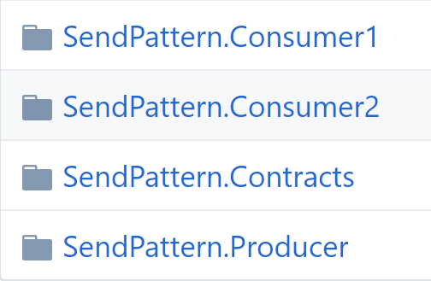

Slide 105
Consumer 1.A
Consumer 1.B
Producer
Consumer 2

Slide 106
Publish & Subscribe

Slide 107
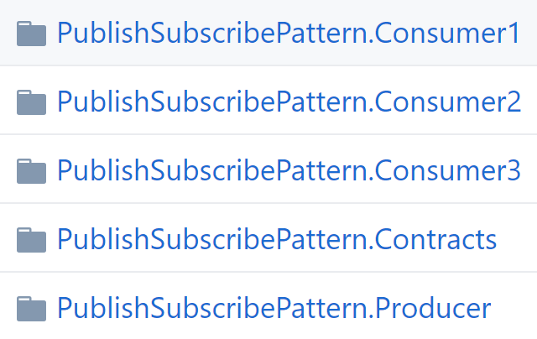

Slide 108
Consumer 1.A
Consumer 1.B
Consumer 2.A
Consumer 2.B
Producer
Consumer 3

Slide 109
Request & Response

Slide 110
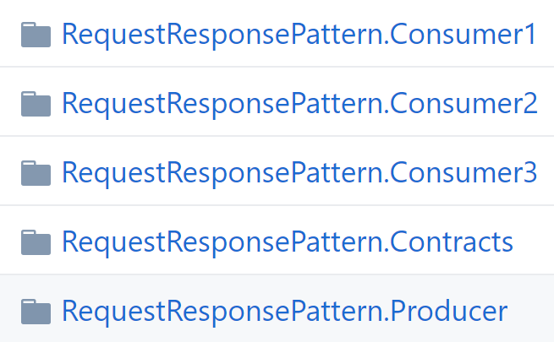

Slide 111
Consumer 1.A
Consumer 1.B
Consumer 2.A
Consumer 2.B
Producer
Consumer 3

Slide 112
Handle Exceptions

Slide 113
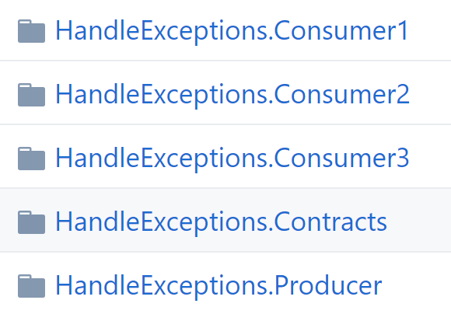

Slide 114
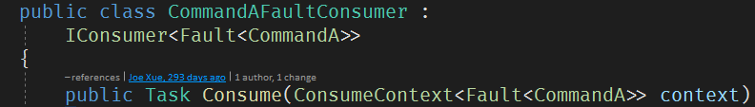


Slide 115
Schedule Messages

Slide 116
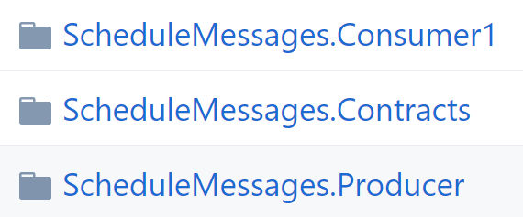

Slide 117
Consumer 1
Producer

Slide 118
部署

Slide 119
宿主
In a console application
In ASP.NET Core
In a Windows service
In a web application

Slide 120
http://topshelf-project.com/

Slide 121
宿主环境
Windows
Linux
Docker
K8s

Slide 122
高级进阶

Slide 123
工作流 Sagas
分布式事务 Courier
中间件 middleware
审计 Audit
Turnout
事务 Transaction
SignalR

Slide 124
最佳实践

Slide 125
Message Contracts
定义成 Interfaces
Command：verb-noun
Event：noun-verb (past tense)

Slide 126
一个业务流程，消息不易过多

Slide 127
一个消息体积，以小为好

Slide 128
减少数据库的访问，把需要的数据放在消息中

Slide 129
借助大数据负载方案传递大数据

Slide 130
设计时，提前考虑MQ组件处理消息的能力， 避免消息堆积。

Slide 131
RabbitMQ 拆分虚拟目录
为消息定义自己的队列
负载消费者（Consumer）

Slide 132
设计业务系统时
划分业务边界
梳理业务流程图
定义事件风暴（Commands/Events）
定义虚拟目录/队列
拆分消费者/微服务

Slide 133
总结

Slide 134

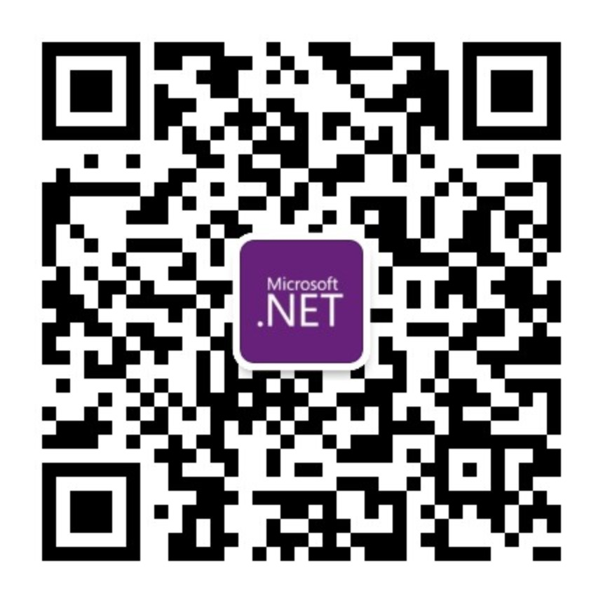
THANKS

