Slide 1
Name : Santhosh S
NM id : au730321104046
Reg.No : 730321104046
Year : III
Degree : B.E / CSE
College Name : Builders Engineering College
3/21/2024 Annual Review

Slide 2
IMAGE COLORIZATION USING OPENCV
3/21/2024 Annual Review

Slide 3


AGENDA
Introduction to Image Colorization
Overview of Deep Learning Techniques
Dataset Preparation and Preprocessing
Training Deep Learning Models
Evaluation Metrics and Challenges
Applications and Future Directions
3/21/2024 Annual Review

Slide 4

PROBLEM STATEMENT
Image colorization using Deep Learning aims to address the challenge of adding realistic and accurate colors to black and white images. Traditional methods often lack the ability to produce natural-looking colorizations, especially in complex images. Deep Learning techniques, particularly Convolutional Neural Networks (CNNs), have shown promise in generating high-quality colorizations by learning complex patterns and relationships in images. However, challenges such as preserving image details, handling different image types, and computational complexity remain. This presentation will explore how Deep Learning can be effectively used to tackle these challenges and improve the quality of colorization results.
3/21/2024 Annual Review

Slide 5

PROJECT OVERVIEW
Project Title: Image Colorization using Deep Learning.
Objective: Develop a model to automatically add color to black and white images.
Approach: Utilize Convolutional Neural Networks (CNNs) for learning color mapping from grayscale to RGB images.
Dataset: Use a large dataset of grayscale images paired with their corresponding colored versions for training.
Implementation: Train the model using TensorFlow/Keras, optimizing for colorization accuracy and speed.
Outcome: Produce a Deep Learning model capable of accurately colorizing grayscale images, with potential applications in photography, film, and art restoration.
3/21/2024 Annual Review

Slide 6

WHO ARE THE END USERS?
Photographers and Artists: To enhance and add realism to black and white images.
Historians and Archivists: For restoring and preserving historical images and documents.
Medical Professionals: To enhance medical imaging for analysis and diagnosis.
Entertainment Industry: For colorizing old films, videos, and animations.
Graphic Designers: To create visually appealing designs and illustrations.
3/21/2024 Annual Review

Slide 7

YOUR SOLUTION AND ITS VALUE PROPOSITION
"Our solution utilizes Deep Learning algorithms, specifically Convolutional Neural Networks (CNNs), to automatically add color to black and white images. By leveraging large datasets and advanced neural network architectures, our model can accurately and efficiently colorize images, providing a fast and reliable tool for enhancing visual content. This technology offers a valuable solution for various industries, including photography, historical preservation, medical imaging, and entertainment, enabling users to effortlessly transform grayscale images into vibrant, colored representations."
3/21/2024 Annual Review

Slide 8

THE WOW IN YOUR SOLUTION
Automatically and accurately add realistic colors to black and white images.
Preserve fine details and textures, ensuring high-quality colorization results.
Provide a fast and efficient way to colorize images, saving time and effort.
Enable creative exploration by allowing users to experiment with different color palettes.
Revitalize old and historical images, bringing them to life with vibrant colors and renewed visual appeal.
3/21/2024 Annual Review

Slide 9
MODELLING
Data Collection
Preprocessing
Model Selection
Model Architecture
Loss Function
Training
Evaluation
Fine-tuning
Inference
Deployment
3/21/2024 Annual Review

Slide 10
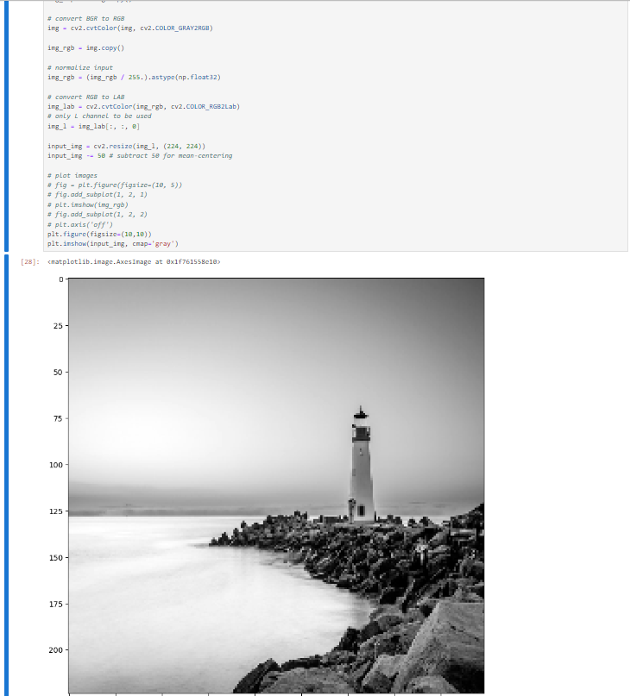
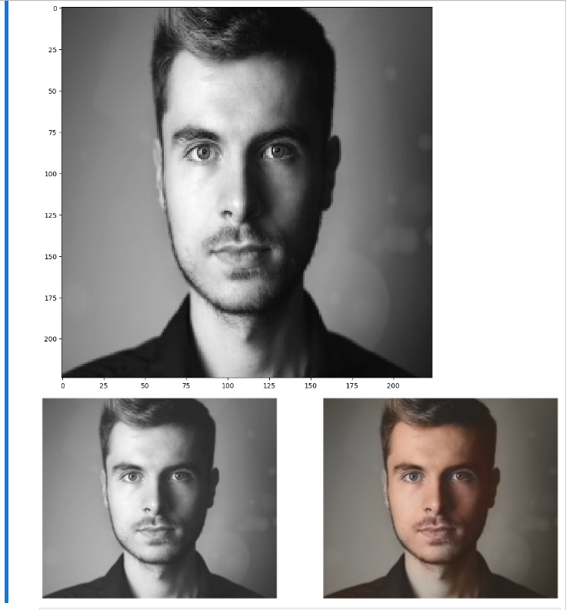
RESULTS
Demo Link
3/21/2024 Annual Review

