Slide 1
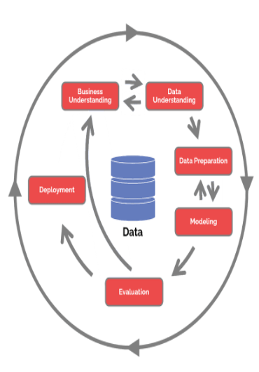
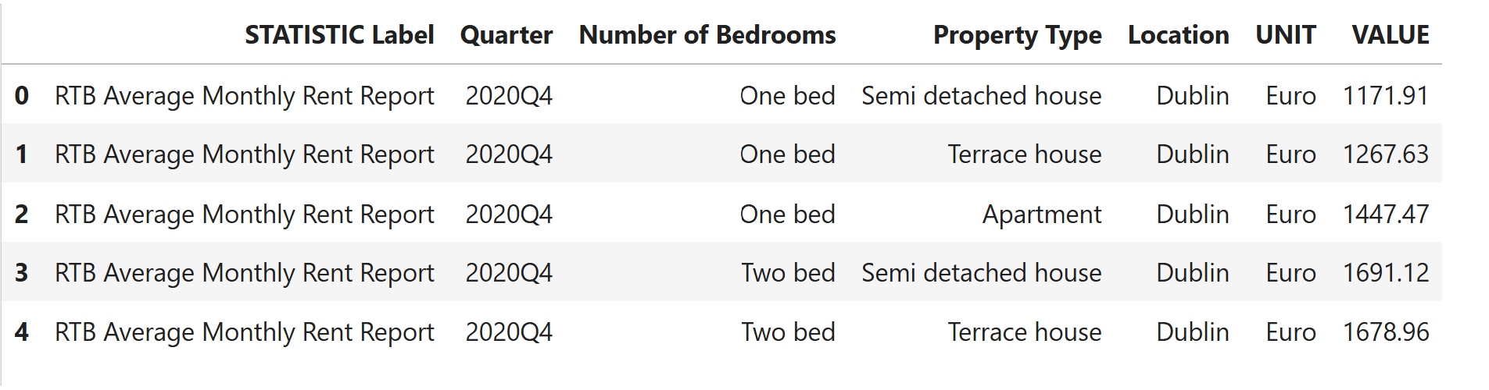
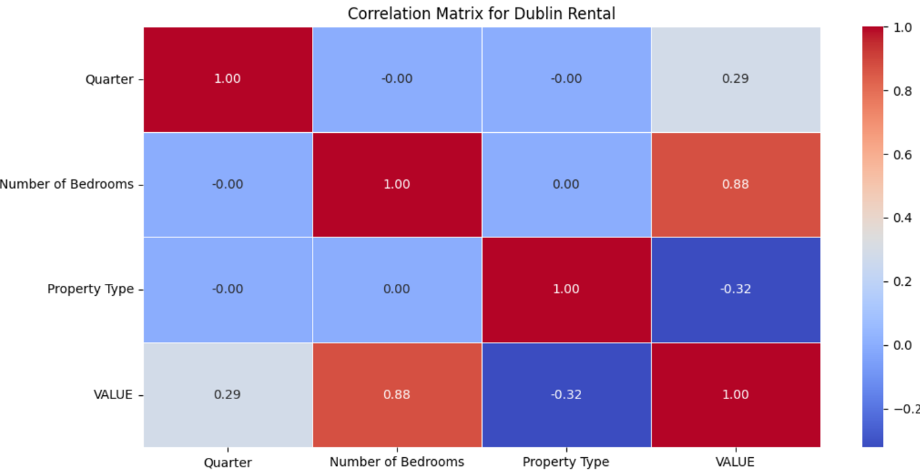
Rent Predictor: A Machine Learning Approach to Forecast Dublin Home Rent
Santhosh Shanmugasundaram, CCT College Dublin, May 2025
Introduction
Project Scope
Dataset
Self Efficacy
Rental homes are an integral part of the housing ecosystem, providing an alternative to homeownership. A properly functioning housing market is an essential ingredient of a properly functioning economy and society. (IPOA and IPAV)
From an economic, social and political perspective, housing is currently the greatest challenge faced by Irish policymakers. The housing challenge is manifested in a lack of supply of owner-occupier and rental properties; prohibitively high house prices and rents; and a serious problem of homelessness. (IPOA and IPAV)
The scope of this project is to understand the Project Management strategy using the average price to rent a home at Dublin County during every quarter for three different types of homes namely apartment, terrace house and semi-detached house. The target of this study is to help the renters to decide on the future rent prices in Dublin so that expenses are planned.
Downloadable from https://data.cso.ie/table/RIQ02
Below are the columns in the datasheet
1.STATISTIC Label – Description of the dataset
2.Quarter – Time period indicating the data time
3.Number of Bedrooms – Indicate the number of bedrooms in the house. It has 3 values namely – One bed, two bed and three bed.
4.Property type – 3 possible values namely, semi-detached house, Terrace house and Apartment
5.Location – In this dataset, this will contain only ‘Dublin’
6.Unit – Indicates the currency and this will contain only ‘Euro’
7.Value – Numerical value indicating the rent amount.
Problem Defintion
The inability to provide an adequate supply of suitable and affordable housing supply for those who want to rent has very negative economic and social consequences. These consequences include:
• High and rising rents take spending power out of the economy and render it very difficult for aspiring house buyers to build up a sufficient deposit.
• High and rising house rents put upward pressure on wages, and this undermines national competitiveness.
• The availability of an abundant supply of high-quality housing to rent or purchase at affordable prices is a necessary condition for labour mobility within a country and between countries. For Ireland, inward migration is an essential part of the economic model, and housing can act as a major impediment to such labour flows.
(IPOA and IPAV)
I have used the AI technology along with the Machine Learning model Random Forest Regression, Linear Regression and ARIMA to analyse the data between Q4 2020 and Q1 2024. Post the analysis, home rental price in Dublin County for the next 7 quarter has been predicted.
Methodology
CONCLUSIONS
This is a process model that serves as the base for a data science process and includes Business understanding, Data understanding, Data preparation, Modelling, Evaluation and Deployment.
A detailed analysis of the data has been done to find the feature important columns as shown.
Project Ethics
The rules of projects ethics were followed to avoid any mishandling of data, keeping the data private, confidential, safety, accountability and not biased towards any race or religion or category.
The data is downloaded from the Ireland Central Statistics Office website and used to predict the average home rent price in the Dublin County.
REFERENCES

