Slide 1
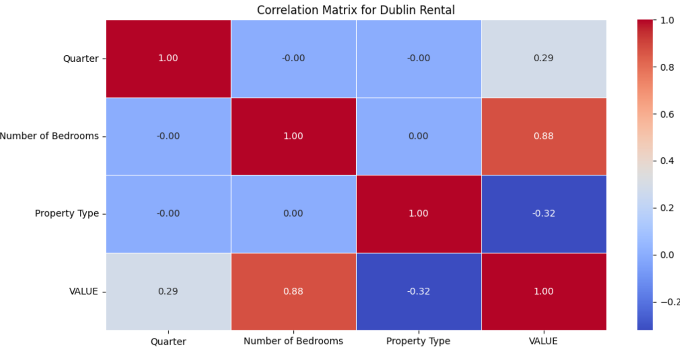
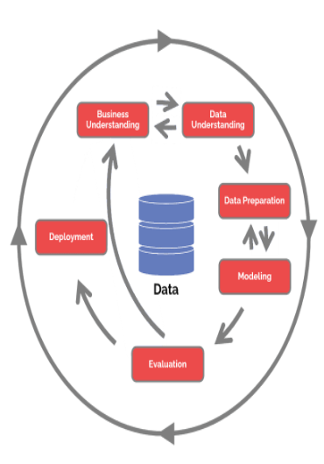
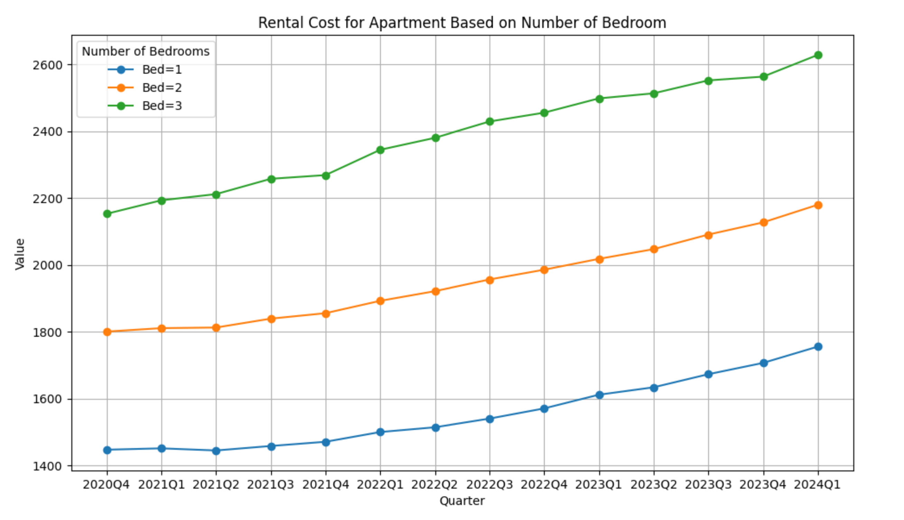
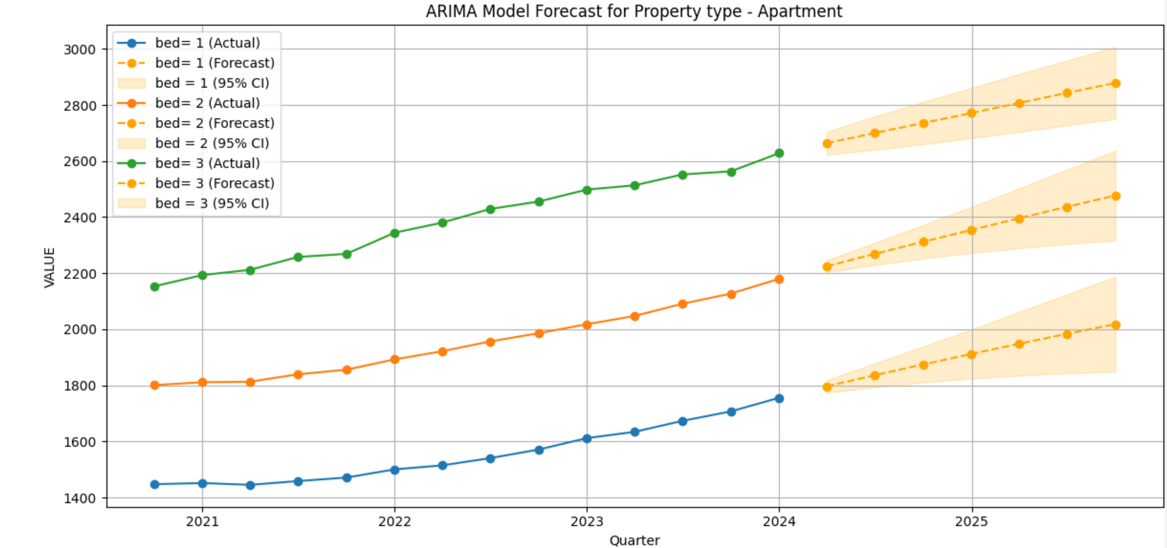
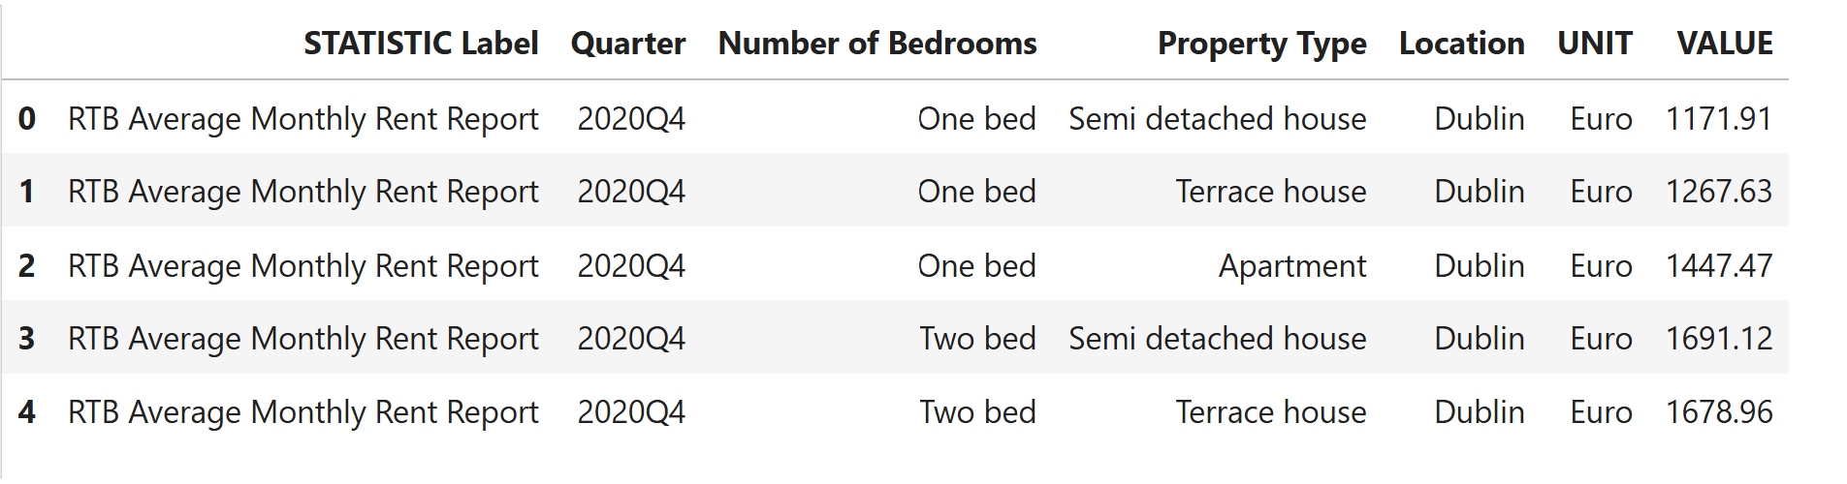
Rent Predictor: A Machine Learning Approach to Forecast Dublin Home Rent
Santhosh Shanmugasundaram, CCT College Dublin, May 2025
Introduction
Project Scope
Initial Analysis
ARIMA Model
Rental homes are an integral part of the housing ecosystem, providing an alternative to homeownership. A properly functioning housing market is an essential ingredient of a properly functioning economy and society. (IPOA and IPAV)
From an economic, social and political perspective, housing is currently the greatest challenge faced by Irish policymakers. The housing challenge is manifested in a lack of supply of owner-occupier and rental properties; prohibitively high house prices and rents; and a serious problem of homelessness. (IPOA and IPAV)
The scope of this project is to understand the Project Management strategy using the average price to rent a home at Dublin County during every quarter for three different types of homes namely apartment, terrace house and semi-detached house. The target of this study is to help the renters to decide on the future rent prices in Dublin so that expenses are planned.
Performing an exploratory data analysis on the data, we are able to find the features that drive the rental price.
Using 80-20 training and testing data split. Since the scenario is time specific, we use only continuous data.
Forecasted data is validated against below metrics and follow results obtained –
MAE: 328.96
MSE: 151810.41
RMSE: 389.63
MAPE: 16.52%
ARIMA model can also be implemented with hyperparameters technique by setting values to parameter ‘p’, ‘d’ and ‘q’.
Problem Defintion
The inability to provide an adequate supply of suitable and affordable housing supply for those who want to rent has very negative economic and social consequences. These consequences include:
• High and rising rents take spending power out of the economy and render it very difficult for aspiring house buyers to build up a sufficient deposit.
• High and rising house rents put upward pressure on wages, and this undermines national competitiveness.
• The availability of an abundant supply of high-quality housing to rent or purchase at affordable prices is a necessary condition for labour mobility within a country and between countries. For Ireland, inward migration is an essential part of the economic model, and housing can act as a major impediment to such labour flows.
(IPOA and IPAV)
I have used the AI technology along with the Machine Learning model Random Forest Regression, Linear Regression and ARIMA to analyse the data between Q4 2020 and Q1 2024. Post the analysis, home rental price in Dublin County for the next 7 quarter has been predicted.
CONCLUSIONS
Methodology
According to various facts and references discussed above shows there is significant increase in the home rental fares in Dublin during the upcoming quarter.
Study clearly that the property type ‘Apartment’ has the biggest upward trend in price compared to the other property type. Therefore, we see the strong demand for rental homes will continue in 2025 as well.
Using multiple data split percentage for training and testing (80-20, 75-25, 70-30) along with machine learning techniques like cross validation and grid search CV, Random Forest Regression and Linear Regression models were created.
Dataset
Downloadable from https://data.cso.ie/table/RIQ02
HyperParameters
1.Quarter – Time period indicating the data time
2.Number of Bedrooms –One, two and three bed.
3.Property type –Semi-detached, Terrace & Apartment
4.Value – Numerical value indicating the rent amount.
Best HyperParameters for Random Forest Regression: {'max_depth': 10, 'max_features': 10, 'min_samples_split': 10, 'n_estimators': 100}
Best HyperParameters for Linear Regression: Best Ridge parameters : {'alpha’: 1 , 'max_iter': 1000, 'solver’: auto', 'tol': 0.0001} Best Lasso parameters : {'alpha’: 1, 'max_iter': 1000, 'tol': 0.0001} Model Accuracy : 0.95
REFERENCES
Project Ethics
(IPOA and IPAV) - POA, and IPAV. THE IRISH PRIVATE RENTAL MARKET. IPAV.ie, June 2022. Available at: https://www.ipav.ie/sites/default/files/ipav_ipoa_jim_power_updated_report_june_2022.pdf
(Hotz) - Hotz, Nick. “What Is CRISP DM?” Data Science Project Management, 2024, Available at: www.datascience-pm.com/crisp-dm-2/.
(Data Science PM) - Data Science PM. “What Is CRISP DM?” Data Science Project Management, 9 Dec. 2024, Available at: https://www.datascience-pm.com/crisp-dm-2/
(Simplilearn) - Simplilearn. “The Ultimate Guide to Cross Validation in Machine Learning for 2021.” Simplilearn.com, 18 Mar. 2024, www.simplilearn.com/tutorials/machine-learning-tutorial/cross-validation. Available at: https://www.simplilearn.com/tutorials/machine-learning-tutorial/cross-validation
(Rowe) - Rowe, Walker. “Mean Squared Error, R2, and Variance in Regression Analysis.” BMC Blogs, 2018, www.bmc.com/blogs/mean-squared-error-r2-and-variance-in-regression-analysis/. Available at: https://www.bmc.com/blogs/mean-squared-error-r2-and-variance-in-regression-analysis/
(Shah) - Shah, Rahul. “GridSearchCV |Tune Hyperparameters with GridSearchCV.” Analytics Vidhya, 23 June 2021, www.analyticsvidhya.com/blog/2021/06/tune-hyperparameters-with-gridsearchcv/. Available at: https://www.analyticsvidhya.com/blog/2021/06/tune-hyperparameters-with-gridsearchcv/
(IBM) - IBM, IBM. “IBM Cognos Analytics 12.0.x.” Ibm.com, 18 Jan. 2024, www.ibm.com/docs/en/cognos-analytics/12.0.0?topic=forecasting-statistical-details. Available at: https://www.ibm.com/docs/en/cognos-analytics/12.0.0?topic=forecasting-statistical-details
The rules of projects ethics were followed to avoid any mishandling of data, keeping the data private, confidential, safety, accountability and not biased towards any race or religion or category.
The data is downloaded from the Ireland Central Statistics Office website and used to predict the average home rent price in the Dublin County.

