Slide 1

Continuous Vs Discrete Data
Introduction to AI/ML

Slide 2
Continuous
Discrete

Slide 3
Continuous
Discrete

Slide 4
Continuous
Discrete

Slide 5
Discrete
Definition: Data that can only take specific, fixed values (whole numbers, no fractions or decimals).
Key Feature: You can count discrete data.
Examples:
The number of students in a class (e.g., 25 students).
The number of cars in a parking lot (e.g., 50 cars).
The number of apples in a basket (e.g., 10 apples).

Slide 6
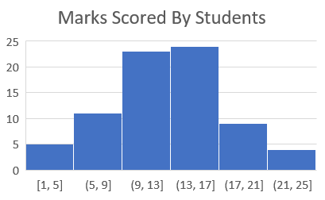
Continuous
Definition: Data that can take any value within a range (including fractions or decimals).
Key Feature: You measure continuous data.
Examples:
Your height (e.g., 170.5 cm).
The temperature outside (e.g., 27.3°C).
The time it takes to run a race (e.g., 12.45 seconds).

Slide 7
When to Use Each
Use discrete data for counts or categories (e.g., number of items, people, etc.).
Use continuous data for measurements that can have decimals (e.g., time, weight, distance).

