Slide 1

Marketplace Review Authenticity Filter: Human vs AI vs Human-Assisted (with Review Analytics)
Presented By: Santhosh Kumar Shatharaju

Slide 2

Goal
Core Question: Can we automatically identify whether a piece of text is AI-generated or human-written
“In a world flooded with synthetic voices, can we still trust what we read?”

Slide 3



Why It Matters?
LLM Proliferation
The rapid advancement and accessibility of LLMs have led to a surge in synthetic text generation, including fake reviews.
Ethical Integrity
Protecting the integrity of our platform and maintaining user trust requires robust methods to combat fraudulent or misleading content.
Explainable Detection
There is a critical need for transparent and explainable detection systems that can clearly justify the classification of a review as synthetic or authentic.
Studies show AI-powered review analysis can increase customer satisfaction by 25% and customer complaints by 30%.
Around 85% of customers trust online reviews

Slide 4
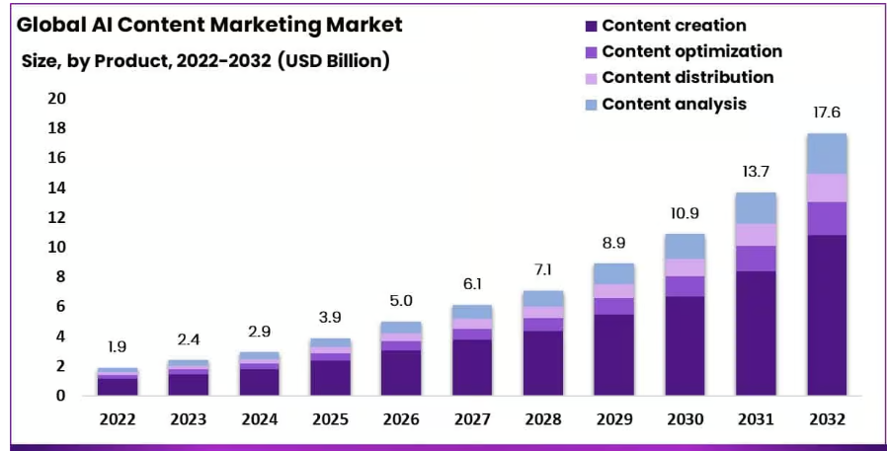
Statistics
According to the Article [Source]:
The content marketing industry will grow to $17.6 billion by 2032.
Content creation will dominate it by more than 55%

Slide 5
Pipeline flowchart
Data Setup Collect diverse review samples
Preprocessing Clean, tokenize, normalize
Baseline Models Traditional classifiers (e.g., SVM, RF)
Deep Learning LSTM, Transformers
Hybrid Models & Sentiment Combine linguistic + emotional cues
Explainability
SHAP, LIME for transparency
Final Evaluation Accuracy, precision, recall
Feature Engineering Stylometry, metadata, semantic features
5

Slide 6
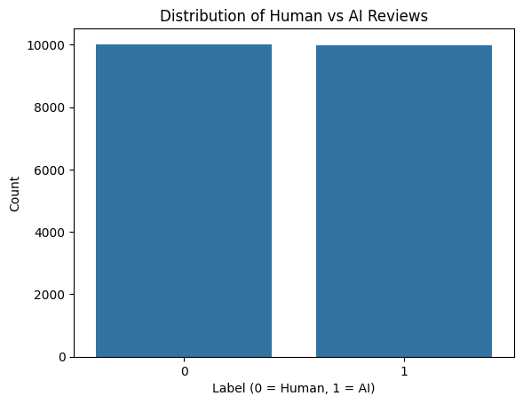
Data Collection & Setup
Diverse Data Sources
Yelp and Amazon reviews for consumer opinions
HC3 and Kaggle datasets for benchmark comparisons
Google Maps reviews via SerpAPI for real-world sentiments.
Balanced Dataset Curation
Careful balance of AI-generated and human-written reviews
Standardized structure with clear labeling system
Consistent formatting for reliable downstream modeling

Slide 7
Data Cleaning & Preprocessing
Remove Noise & Distractions
Clean punctuation, HTML tags, and special characters that don't contribute to semantic meaning or model performance
Label Unification & Structure
Ensure consistent labeling and formatting across all reviews for reliable training and evaluation processes.
Text Normalization & Lemmatization
Reduce words to base forms, remove stopwords, and standardize text format for consistent analysis
7

Slide 8

Feature Engineering
Have you ever wondered How Large Language models like ChatGPT, Bert… Generate the text?

Slide 9
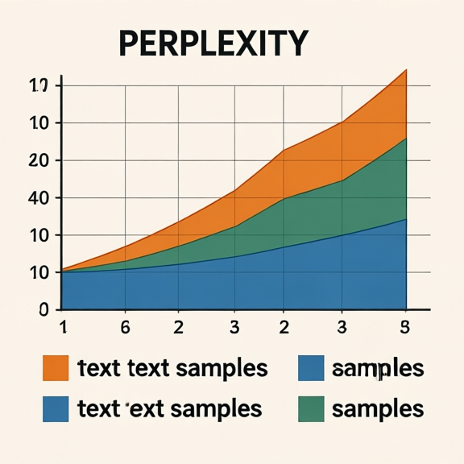
Features For models:
a) Linguistic Features:
Perplexity and entropy to measure linguistic unpredictability
Burstiness to detect unnatural repetition
Readability scores and POS tag ratios to assess fluency and structure
Stopword frequency and rare word repetition to flag anomalies
Repetition of Rare Words
b) Vectorization and Embeddings:
TF-IDF vectorization
Word Embedding Using Bert
9

Slide 10
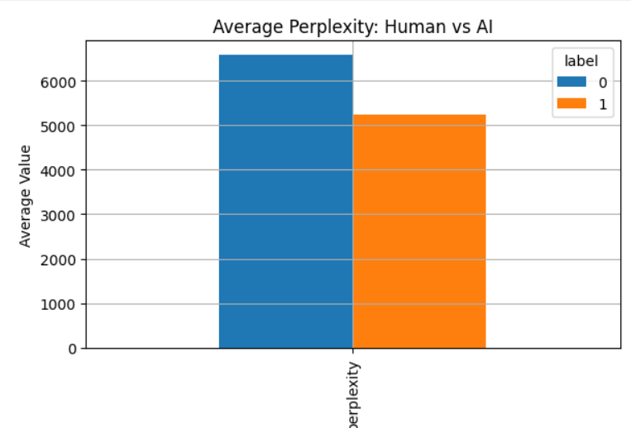
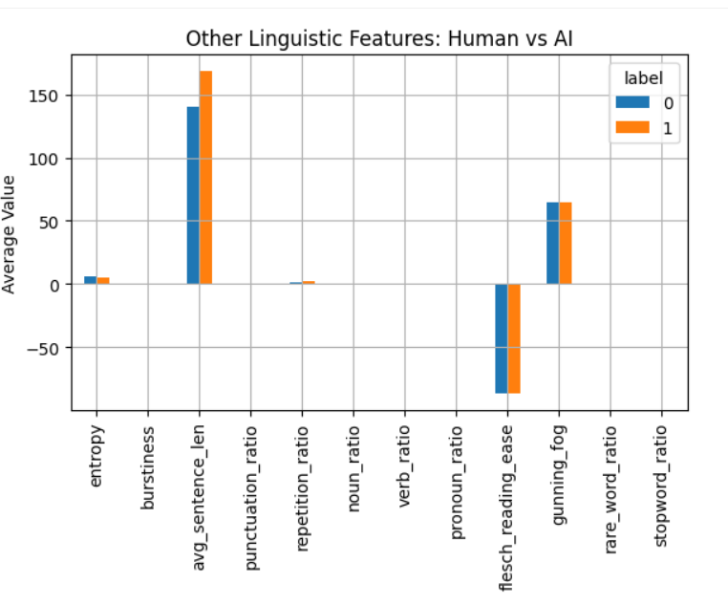
AI Text VS Human Text:

Slide 11
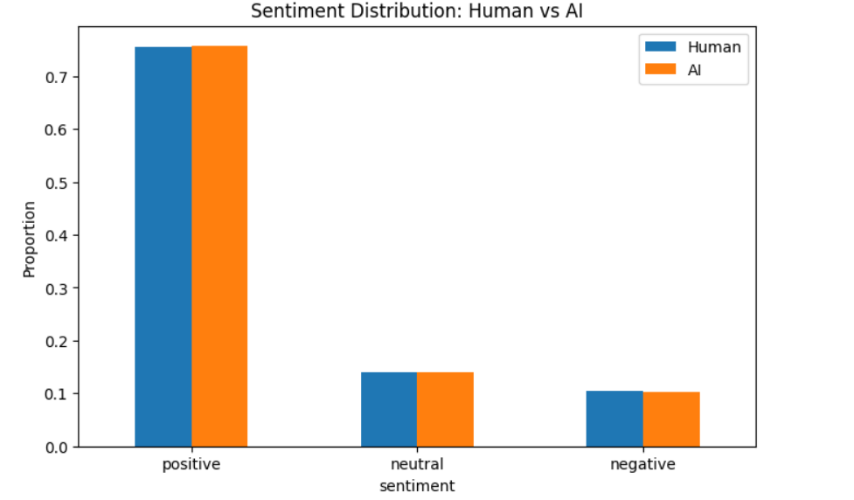
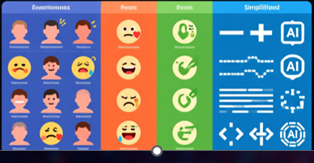
Sentiment Analysis:
Used Vader for sentiment Analysis.

Slide 12

Analysis Plan
Types of Data For Analysis:
Only Text (TF-IDF Vectors)
Embeddings
Hybrid ( Linguistic + Embeddings)
Models Used:
Logistic Regression
Support Vector Machine
Random Forest
XGBoost
Bert transformer
Category | Model | Description
🟦 TF-IDF (Classical ML) | Logistic Regression, Linear SVC, Random Forest, XGBoost | Lightweight text-based classifiers trained on TF-IDF vectors
🟩 Embedding-based | Logistic Regression, XGBoost | Models trained on DistilBERT / RoBERTa embeddings
🟧 Hybrid Models | Logistic Regression, XGBoost | Combined linguistic + embedding features for richer representation
🟥 Stacked Ensemble (Meta Model) | Logistic Regression meta-layer | Stacks predictions from best-performing models to capture complementary strengths

Slide 13
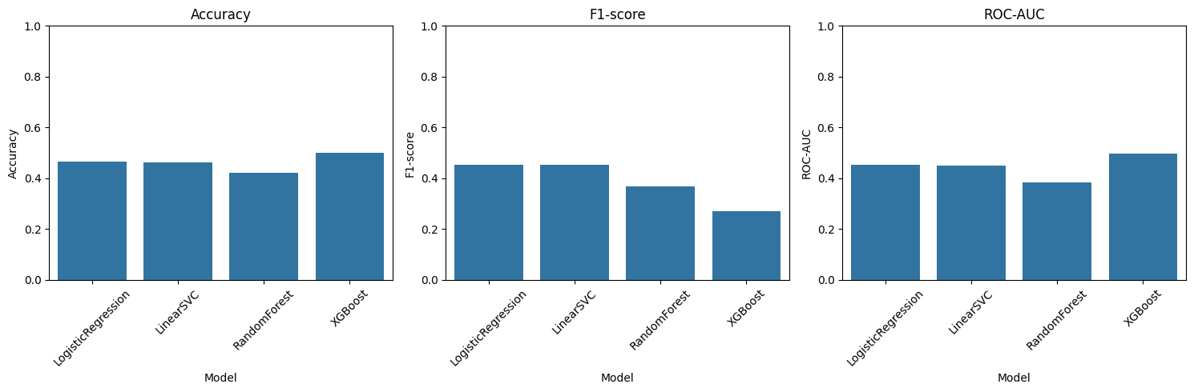
TF-IDF (Classical ML):
Using only TF-IDF vectorization with these four baseline models resulted in relatively poor performance, with all evaluation metrics are around 0.5, indicating that the models failed to capture meaningful patterns from the data

Slide 14
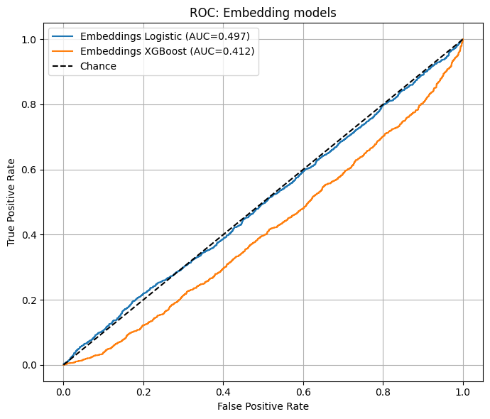
Embedding-without Linguistic
Using only embeddings generated by DistilBERT without incorporating any linguistic features also failed to improve the performance. As shown by the ROC curve, the models achieved around 50% accuracy, indicating no significant learning.

Slide 15
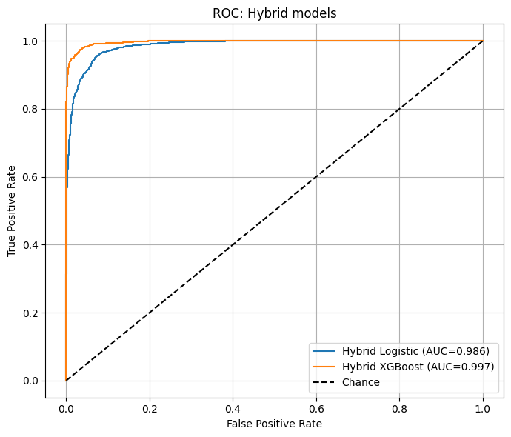
Embedding + Linguistic
Hybrid approach (linguistic features + embeddings) improved performance notably with both Logistic Regression and XGBoost.

Slide 16
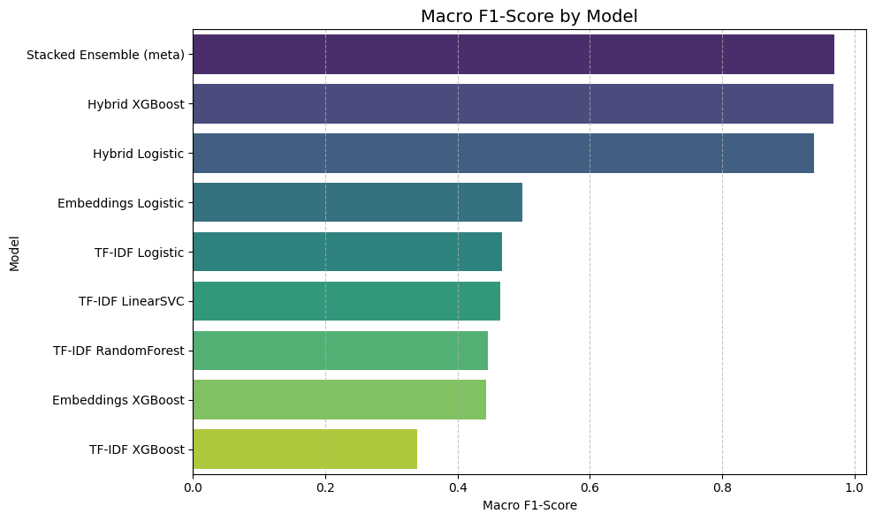
Final Evaluation & Results For our Models:
The hybrid model that integrates both linguistic and embedding-based features demonstrated significantly superior performance compared to all other models and methods.

Slide 17
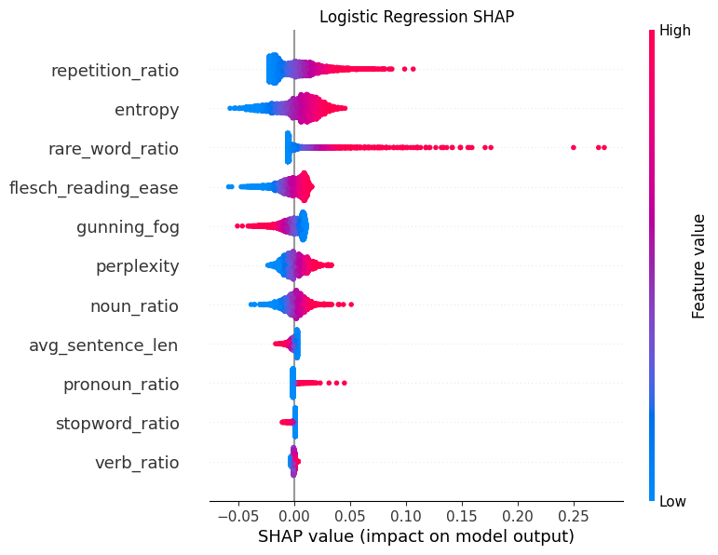
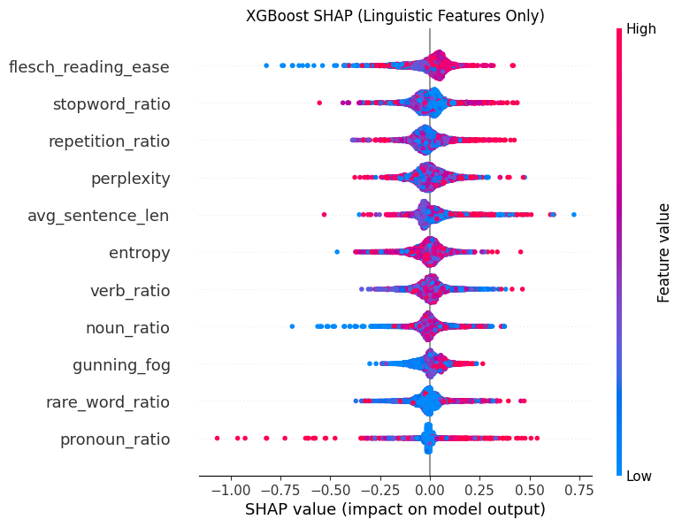
Explainability & Visualization
17

Slide 18
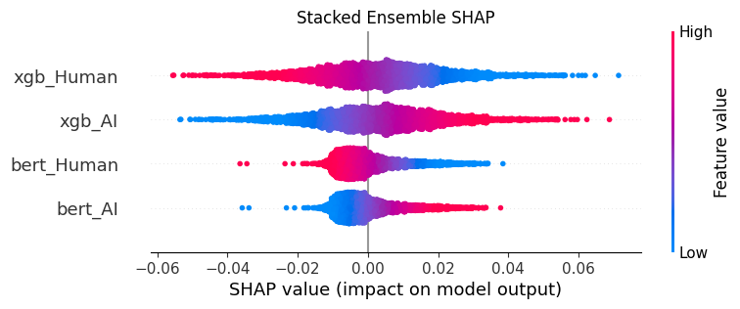
Explainability & Visualization
18

Slide 19
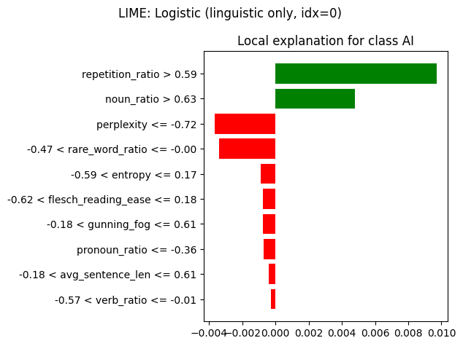
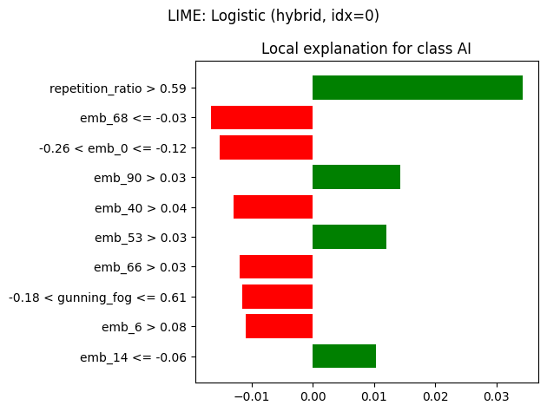
Explainability & Visualization
19

Slide 20
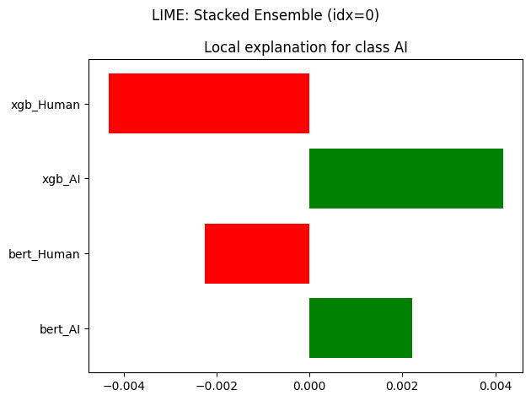
Explainability & Visualization
20

Slide 21
Future Work
Build and validate an AI-review detector to automatically remove the AI written reviews on products.
Use topic modelling for product reviews with negative sentiment to detect
defects on products.
It can also be extended to every text analytics to avoid AI generated reviews to
Ensure transparency.

Slide 22
References
1. Zellers et al., 2019 – Defending Against Neural Fake News
* Introduced Grover, a model for detecting AI-generated news.
* [https://arxiv.org/abs/1905.12616](https://arxiv.org/abs/1905.12616)
2. Solaiman et al., 2019 – Release Strategies and the Social Impacts of Language Models
* Discussed ethical and technical aspects of detecting AI-generated text.
* [https://arxiv.org/abs/1908.09203](https://arxiv.org/abs/1908.09203)
3. Jawahar et al., 2020 – Automatic Detection of AI-Generated Text
* Techniques for statistical & embedding-based detection.
* [https://arxiv.org/abs/2009.11474](https://arxiv.org/abs/2009.11474)
4. Gehrmann et al., 2019 – GLTR: Statistical Detection and Visualization of Generated Text
* Introduced GLTR tool for explainable AI text detection.(https://arxiv.org/abs/1906.04043)
22

Slide 23

Any Questions?

Slide 24


