Slide 1
DS MINI PROJECT
TOP 250 Movies

Slide 2
Introduction
Algorithm
Dataset Ana
Goals and Strategy FlowChart and HeatMap Query Session
Agenda

Slide 3

Introduction to the Mini Project

Slide 4
Algorithm
Here we have collected info about the top Hollywood movies
We import the necessary libraries
We clean the dataset and scale their features according to our needs
The cleansed dataset is used to visualize

Slide 5
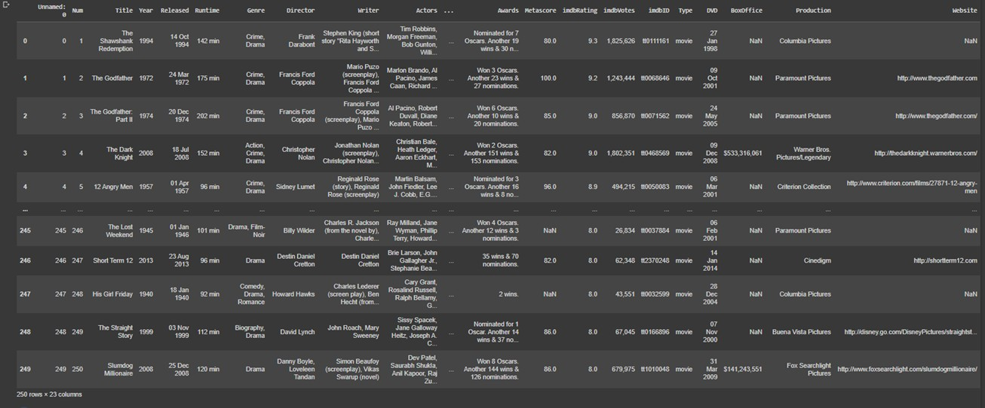
Top 250 Movies
Sample datas from dataset

Slide 6
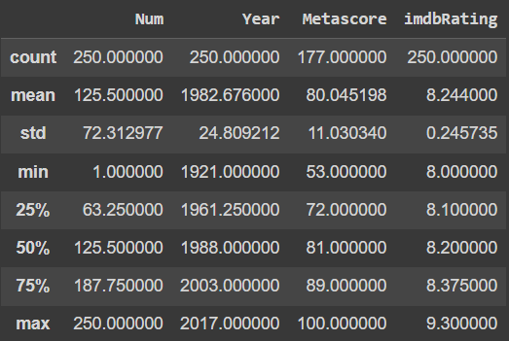
Describe

Slide 7
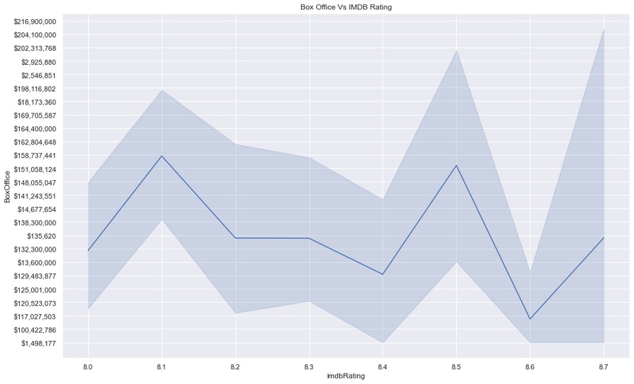
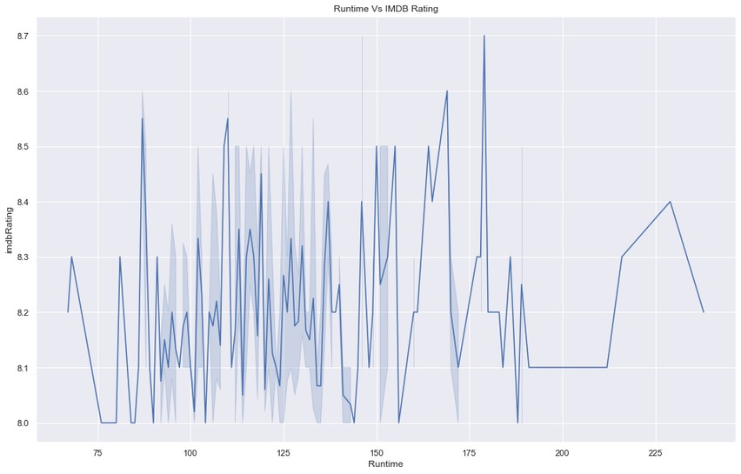
Goals and Strategy

Slide 8
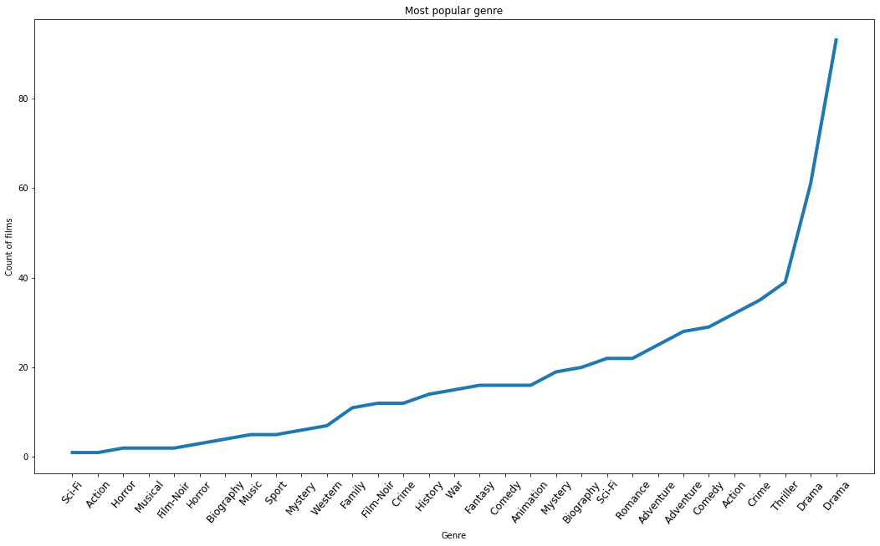
Goals and Strategy

Slide 9
FlowChart
Visualizing Outliers
Removing Outliers
Removing Outlier
Cleansing
Dataset
Pie Chart
Seaborn
Using Seaborn and Matplot
Line Chart
Matplot

Slide 10
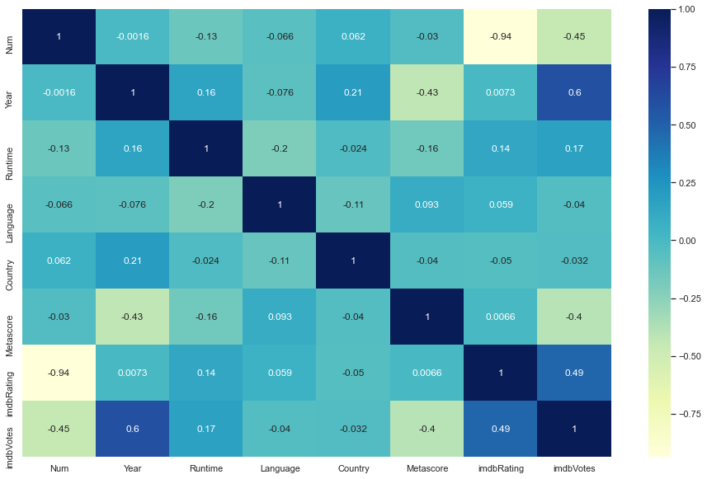
HeatMap

Slide 11










Resource Page
https://colab.research.google.com/drive/18R u5rOFHNLiFGlQkkI4AhIzmYlRhIcl4? usp=sharing

Slide 12

Peers
VENKATESH E | 212221230119
RAJESH KANNAN M | 212221230081
KRISHNA PRAKAASH D M | 212221230052
AKASH KUMAR B | 212221040011

Slide 13
Query Session

Slide 14
THANK YOU

