Slide 1
🏛️ ENTERPRISE E-GOVERNANCE PLATFORM
Digital Subsidy & Grant
Administration Platform (DSGA)
🔒 Secure • 👁️ Transparent • 📄 Paperless • 👥 Citizen-Centric
Presented by: Team 2 Members
Infosys Springboard Internship 7.0 Batch-2
Notes:
SLIDE 1 (0:00 - 0:15 | 15s)
Talking Points:
• Good morning/afternoon everyone. We are Team 2 presenting our project: The Digital Subsidy & Grant Administration Platform (DSGA).
• Built under the Infosys Springboard Internship 7.0 Batch-2, DSGA is an enterprise-grade Direct Benefit Transfer e-governance system designed to make subsidy management secure, transparent, paperless, and citizen-centric.

Slide 2
CURRENT CHALLENGES • SLIDE 2 OF 9
Problem Statement
Critical bottlenecks and leakages in traditional paper-based subsidy administration
📄 Paper-Based Applications
🚨 IMPACT: PROCESSING DELAYS
Manual physical files
🔍 Lack of Transparency
🚨 IMPACT: SUBSIDY LEAKAGES
No centralized scheme visibility
⚠️ Physical Verification
🚨 IMPACT: FRAUD RISKS
Risk of duplicates & forged proofs
⏳ No Real-Time Tracking
🚨 IMPACT: CITIZEN UNCERTAINTY
Citizens lack status visibility
🏦 Delayed Disbursement
🚨 IMPACT: FUND DELIVERY DELAYS
Manual voucher release bottlenecks
⚖️ Poor Audit Trails
🚨 IMPACT: ACCOUNTABILITY GAPS
Paper logs hinder grievance redressal
Notes:
SLIDE 2 (0:15 - 0:50 | 35s)
Talking Points:
• Traditional subsidy administration faces 6 critical challenges:
1. Paper forms that create severe processing delays;
2. Lack of transparency that causes subsidy leakages;
3. Physical document checks prone to fraud and duplicates;
4. No real-time status updates for citizens;
5. Delayed manual disbursements rather than direct treasury transfers;
6. Incomplete audit logs hindering grievance redressal.
• DSGA was engineered specifically to eliminate these bottlenecks.

Slide 3
PROJECT OVERVIEW • SLIDE 3 OF 9
Our Solution — DSGA Platform
A modern enterprise-grade DBT e-governance architecture replacing paper silos
📝 Application | Online Subsidy Applications
Self-service portal & document upload
🏛️ DSGA PLATFORM
Enterprise DBT E-Governance
Automated Subsidies • Direct Transfers • Real-Time Tracking
⚡ Connectivity | Secure REST APIs
Schemes, applications & payment endpoints
👥 Governance | Multi-Role Approval
Separation: Verifier, Approver, Sanctioner
🔄 Continuity | Offline Sync
Remote field verification persistence
🔐 Protection | JWT + RBAC Security
Cryptographic token role authorization
CORE FOUNDATION: Java 17 • Spring Boot 3 • React 19 • MySQL / H2 Relational Database
Notes:
SLIDE 3 (0:50 - 1:25 | 35s)
Talking Points:
• DSGA provides a centralized hub-and-spoke solution uniting five core pillars:
1. Online Citizen Applications with automated validation;
2. Multi-Role Approvals establishing clear separation between verifiers, officers, and sanctioners;
3. Robust REST APIs powering every interaction;
4. Dual-Mode Offline Sync ensuring remote field verifiers can record data even without active internet;
5. Enterprise JWT + RBAC security protecting sensitive citizen data.
• All built on modern Java 17, Spring Boot 3, React 19, and MySQL.

Slide 4
SYSTEM ENGINEERING • SLIDE 4 OF 9
Technology Stack
Robust 4-layer enterprise architecture built with modern frameworks
LAYER 1: FRONTEND PRESENTATION TIER
React 19 + Vite 8 + Tailwind CSS + Recharts
Fast Single Page App (SPA), responsive dashboards, analytics charts
React 19 • Vite 8 • Tailwind CSS • Recharts
LAYER 2: BACKEND ENTERPRISE SERVICES
Java 17 + Spring Boot 3.2
Modular REST microservices, business logic, validation & transactions
Java 17 LTS • Spring Boot 3.2 • REST APIs
LAYER 3: SECURITY & ACCESS CONTROL
Spring Security + JWT (JSON Web Tokens)
Stateless authentication filter, Role-Based Access Control (RBAC), BCrypt
Spring Security 6 • JWT Auth • RBAC • BCrypt
LAYER 4: PERSISTENCE & API TESTING
Spring Data JPA + Hibernate + MySQL / H2 + REST APIs + Swagger / Postman
ORM entity mappings, dual-mode DB (MySQL prod / H2 test), API test suites
Spring Data JPA • MySQL / H2 • Swagger • Postman
Notes:
SLIDE 4 (1:25 - 1:55 | 30s)
Talking Points:
• Our engineering stack is strictly divided into 4 clean layers:
1. Frontend: React 19 and Vite 8 for instant load times, Tailwind CSS for design consistency, and Recharts for analytics;
2. Backend: Java 17 and Spring Boot 3.2 delivering high-performance REST microservices;
3. Security: Spring Security and stateless JWT token authentication with RBAC;
4. Data & API: Spring Data JPA with Hibernate, running seamlessly on MySQL production and H2 in-memory, fully verified via Swagger and Postman.

Slide 5
ARCHITECTURE FLOW • SLIDE 5 OF 9
System Architecture
End-to-end layered data pipeline connecting clients, business services, and database
1. CLIENT TIER
2. REST API GATEWAY
3. SERVICE LAYER
4. REPOSITORY LAYER
5. DATABASE TIER
React 19 Frontend
& Postman API Suite
─────────
Citizen Portal
Admin Dashboard
Spring Boot Controllers
& Security Filter
─────────
JWT Auth Filter
DTO Validation
Spring Business
Service Logic
─────────
Workflow Engine
Approval Rules
Spring Data JPA
& Hibernate ORM
─────────
CRUD Repositories
DB Transactions
MySQL Production
& H2 Test Database
─────────
Schemes, Ledger
Audit Trail Records
CORE SYSTEM PIPELINE EXECUTION FLOW
Client (React/Postman) ➔ REST API Controller ➔ Business Service ➔ JPA Repository ➔ MySQL / H2 DB
Notes:
SLIDE 5 (1:55 - 2:35 | 40s)
Talking Points:
• Here is our complete System Architecture. It follows the enterprise 5-tier pipeline:
1. Client Tier: React frontend and Postman API suite;
2. REST API Gateway: Receives requests, handles JWT authentication filters and parameter sanitation;
3. Service Layer: Implements core business logic, scheme rules, and role validation;
4. Repository Layer: Spring Data JPA manages ORM abstractions and transactional integrity;
5. Database Tier: Stores schemes, citizen dossiers, grant ledgers, and audit trails.
• This strict separation of concerns guarantees high maintainability and security.

Slide 6
SECURITY & VERIFICATION • SLIDE 6 OF 9
Security Architecture & API Testing
JWT authentication lifecycle paired with comprehensive Postman API test suites
🔐 JWT AUTHENTICATION FLOW
🧪 POSTMAN API VERIFICATION
1. Login Credentials: POST /api/auth/login
2. Spring Security: Validates user identity & credentials
3. Signed JWT Token: Generated with role claims
4. Bearer Token Returned: Client attaches token in headers
5. Secure Request Validation: AuthFilter inspects every request
6. Token Expiration: Stateless session protection
• Auth APIs: Login & role retrieval verified across roles
• Scheme APIs: GET /api/schemes, POST validation
• Application APIs: Submission, status queries & uploads
• Payment APIs: Sanction order generation & DBT trigger
• Authorization Header: Bearer token auto-injected
• Response Validation: HTTP 200 OK, 201 Created & 403 Forbidden
SECURITY CHAIN: User Login ➔ Signed JWT ➔ RBAC Authorization ➔ Secure Protected REST Endpoint
Notes:
SLIDE 6 (2:35 - 3:10 | 35s)
Talking Points:
• Security and quality assurance are central to DSGA:
• On the left, our stateless JWT Authentication Lifecycle: credentials authenticate via Spring Security, issuing an encrypted JWT with role claims passed in Bearer headers.
• On the right, rigorous Postman API Testing: we verified endpoints for Auth, Schemes, Applications, and Disbursements, validating 200 OK and 201 Created codes and RBAC restrictions.
• This ensures complete end-to-end security from login to payment execution.

Slide 7
CORE OPERATION • SLIDE 7 OF 9
System Workflow — 5-Stage Pipeline
End-to-end transparent lifecycle from citizen application to DBT fund credit
1
2
3
4
5
STAGE 1
Citizen Applies
👤 Citizen
─────────
• Online scheme selection
• Digital document upload
• Instant tracking ID
STAGE 2
Field Verification
📋 Verifier
─────────
• Offline field audit
• Identity verification
• Digital inspection report
STAGE 3
Officer Approval
👔 Approver
─────────
• Eligibility criteria check
• Scheme quota validation
• Departmental sign-off
STAGE 4
Grant Sanction
🏛️ Sanctioner
─────────
• Budget reservation
• Sanction order generated
• Digital voucher release
STAGE 5
PFMS / DBT Credit
💳 Bank / PFMS
─────────
• Direct treasury debit
• Automated UTR generated
• Live SMS & tracking update
PROVEN DISBURSEMENT PIPELINE
Paperless ➔ Verified ➔ Approved ➔ Sanctioned ➔ Direct Bank Transfer (UTR Generated)
Notes:
SLIDE 7 (3:10 - 4:10 | 60s)
Talking Points:
• This is our primary operational workflow slide, demonstrating how an application travels in 5 clear stages:
1. Citizen Applies: The citizen registers, chooses a scheme, and uploads digital proofs, receiving an instant tracking ID.
2. Field Verification: Field officers inspect proofs online or offline, uploading a geo-tagged verification report.
3. Officer Approval: The approving authority reviews eligibility quotas and signs off.
4. Grant Sanction: The sanctioning officer reserves the required scheme budget and generates the sanction order.
5. PFMS / DBT Credit: The treasury transfers funds directly into the beneficiary's bank account with an automated UTR number.
• A completely paperless journey: Applied, Verified, Approved, Sanctioned, and Disbursed with real-time tracking!

Slide 8
VALUE PROPOSITION • SLIDE 8 OF 9
Key Advantages
Transformative benefits delivered by DSGA over legacy subsidy workflows
🔐 Secure
✨ JWT + RBAC
Encrypted stateless tokens & role permissions
📄 Paperless
✨ DIGITAL DOSSIER
100% digital passes, vouchers & records
⚡ Faster
✨ AUTOMATED WORKFLOW
70% faster turnaround via automated rules
👁️ Transparent
✨ REAL-TIME TRACKING
Live 5-stage tracking for citizens & admins
💰 Zero Leakage
✨ DIRECT BENEFIT TRANSFER
Direct treasury bank credit via PFMS
📋 Accountable
✨ AUDIT TRAIL
Immutable logs & citizen grievance redressal
Notes:
SLIDE 8 (4:10 - 4:45 | 35s)
Talking Points:
• DSGA delivers 6 core strategic advantages:
1. Security: Powered by JWT and granular RBAC;
2. Paperless: A completely digital dossier with zero paper loss;
3. Faster: Automated validation dramatically slashing cycle times;
4. Transparent: Real-time 5-stage tracking keeping citizens informed;
5. Leakage Prevention: Direct Benefit Transfer delivering funds straight to bank accounts;
6. Accountable: Complete immutable audit trails and built-in grievance redressal.

Slide 9
PROJECT SUMMARY • SLIDE 9 OF 9
Conclusion & Impact
Engineering a scalable digital backbone for equitable public subsidy distribution
DSGA = SECURE + TRANSPARENT + SCALABLE E-GOVERNANCE
Enterprise Full-Stack Engineering for Modern Digital India
💻 Full-Stack Engineering
Spring Boot 3 + React 19 architecture with clean modularity
🔒 Secure RBAC Authentication
Stateless JWT token security with zero privilege leakage
🗄️ REST API & Database
Robust JPA entity design with dual MySQL & H2 support
👥 Citizen-Centric Governance
100% paperless Direct Benefit Transfer with live audit trails
“From application to disbursement — one transparent digital workflow.”
Notes:
SLIDE 9 (4:45 - 5:00 | 15s)
Talking Points:
• To conclude: DSGA successfully demonstrates modern full-stack engineering, combining Spring Boot 3, React 19, JWT security, and PFMS integration into a unified public administration platform.
• 'From application to disbursement — one transparent digital workflow.'
• Thank you! We are now open for questions.

Slide 10
UI Screenshots
Application UI Screenshots
Live interface walkthrough across all 5 user roles

Slide 11
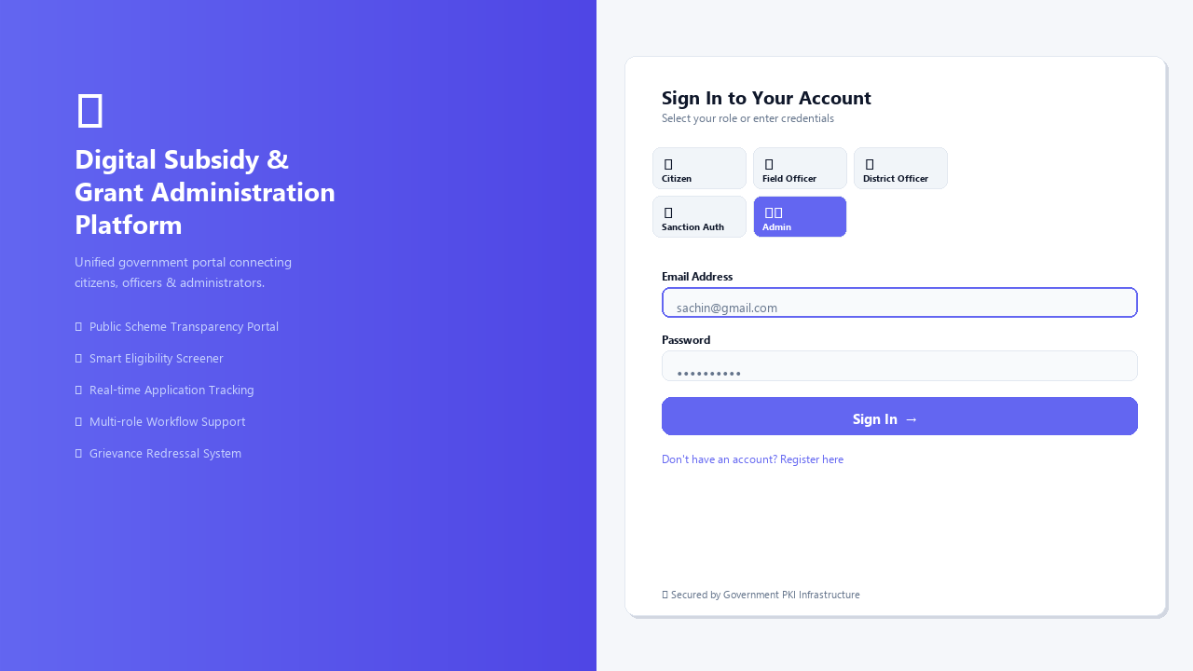
1
Login & Role Selection
DSGA Platform
Multi-role auth: Citizen | Field Officer | District Officer | Sanction Authority | Admin

Slide 12
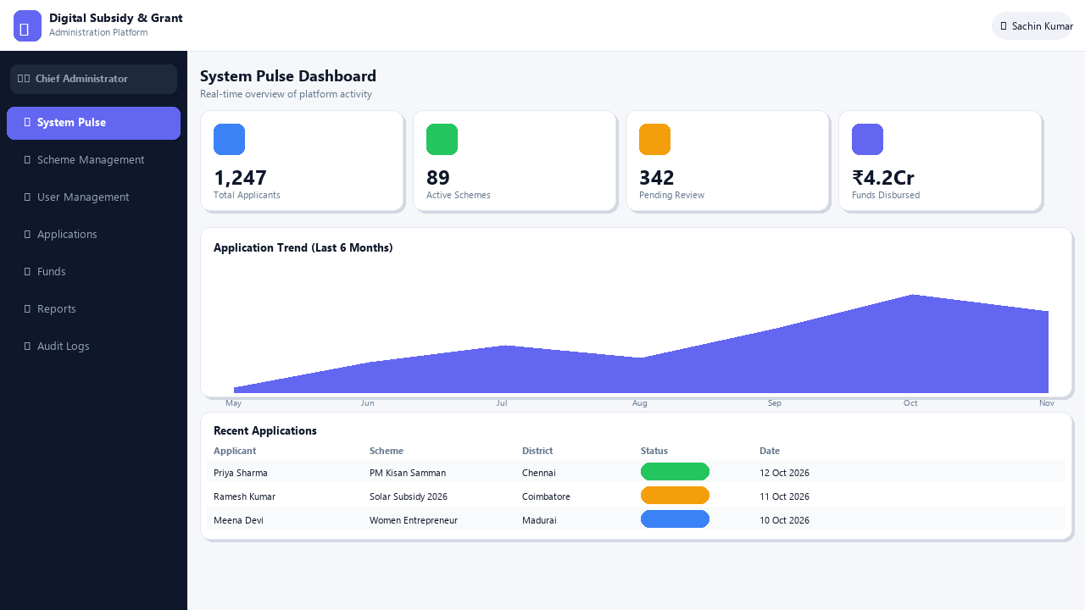
2
Admin System Pulse Dashboard
DSGA Platform
Real-time KPIs, 6-month application trend chart, and recent activity table

Slide 13
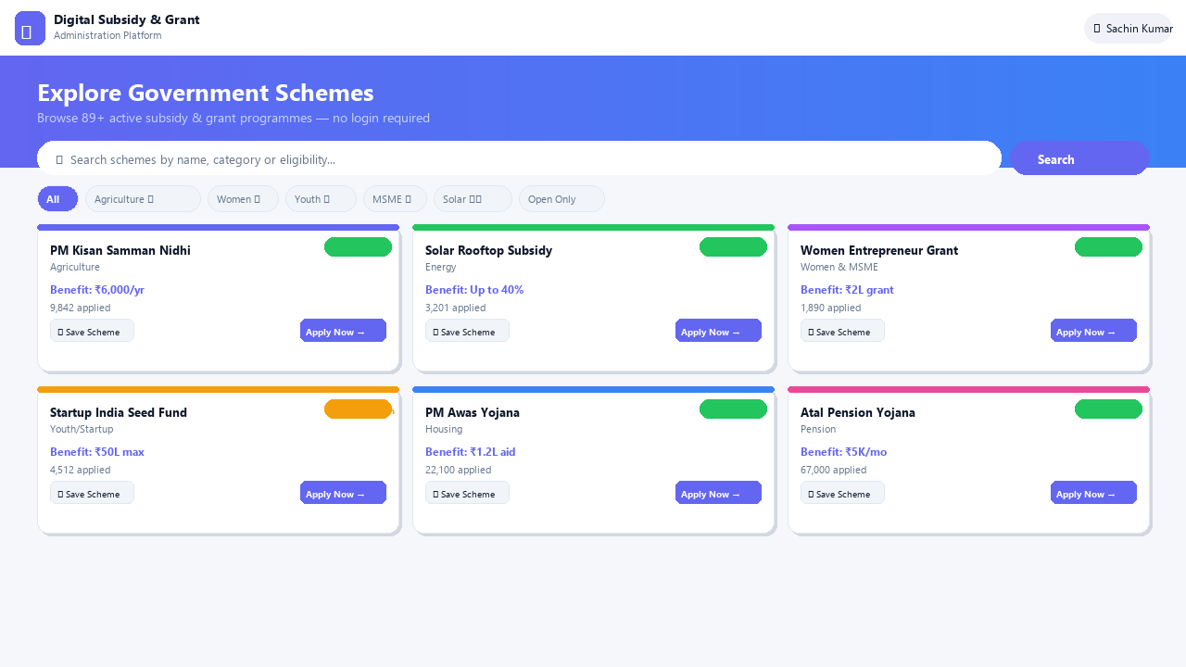
3
Public Scheme Transparency Portal
DSGA Platform
Unauthenticated scheme browsing with search, filters, eligibility badges & Save Scheme

Slide 14
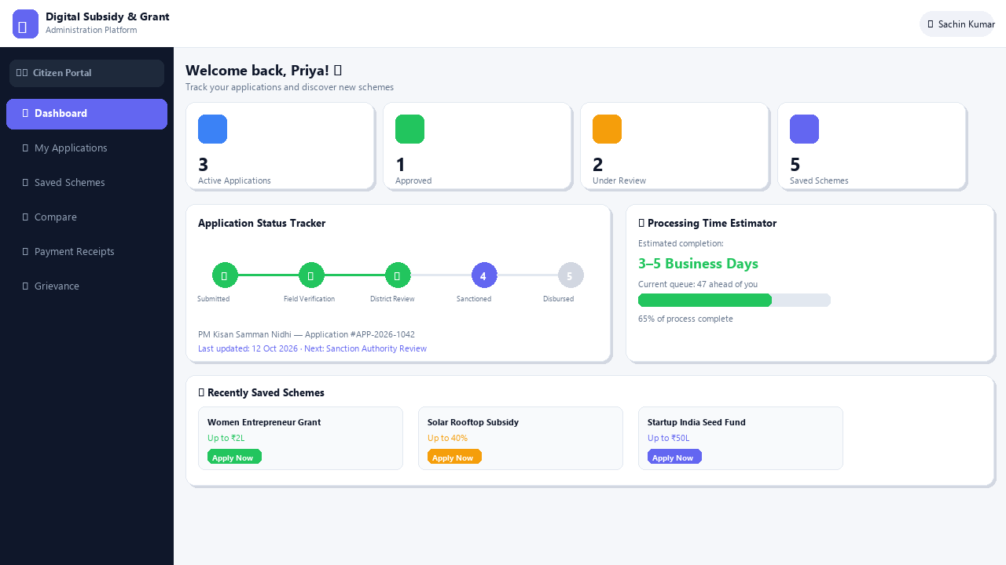
4
Citizen (Applicant) Dashboard
DSGA Platform
Application status stepper, processing time estimator, saved schemes wishlist

Slide 15
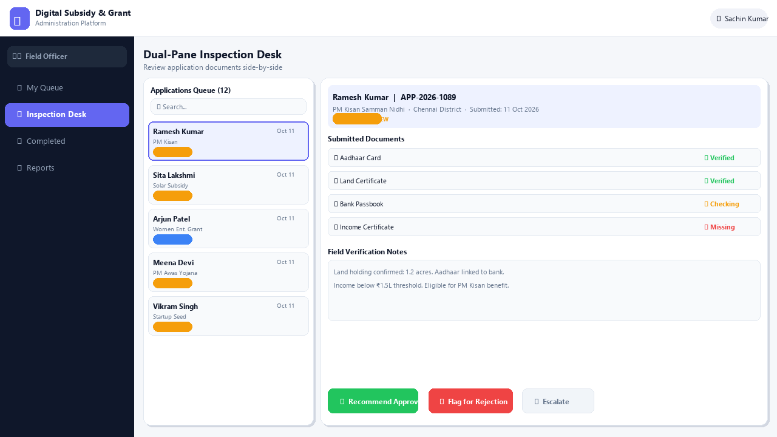
5
Field Officer – Dual-Pane Inspection Desk
DSGA Platform
Side-by-side document review, verification notes, approve / flag / escalate workflow

Slide 16
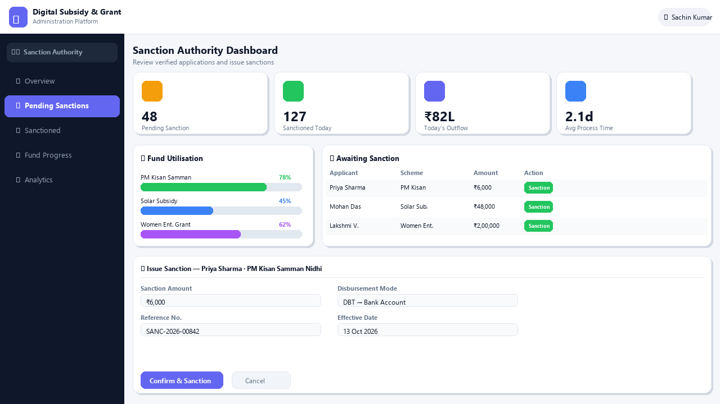
6
Sanction Authority Dashboard
DSGA Platform
Fund utilisation progress, pending sanctions queue, and one-click sanction modal

Slide 17
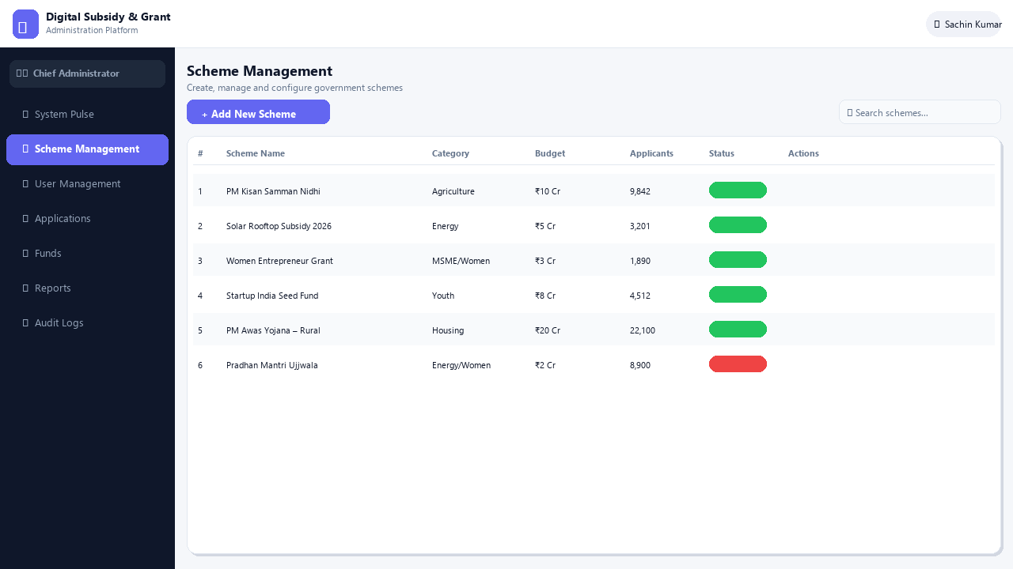
7
Scheme Management (Admin)
DSGA Platform
Create, edit, toggle status & delete government schemes with full audit trail

Slide 18
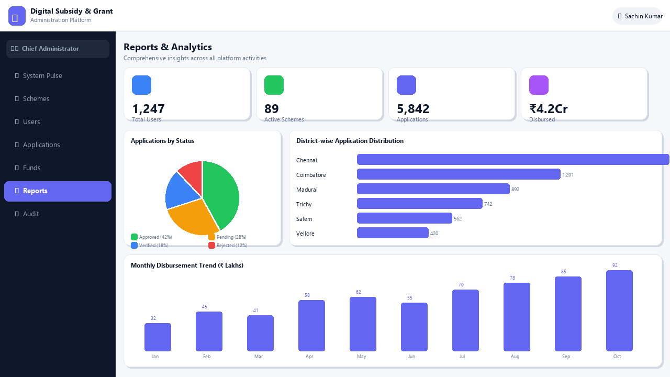
8
Reports & Analytics
DSGA Platform
District-wise distribution, monthly disbursement trend, status pie chart & KPI strip

