Slide 1
🏛
Digital Subsidy & Grant
Administration Platform
Project Review Presentation — Group 1
React 19 + Vite · Spring Boot 3.2.5 · MySQL · Tailwind CSS
👥 5 Roles
📋 89+ Schemes
📊 Real-time Tracking
⚡ Full-Stack
October 2026

Slide 2
Key Features & Modules
🔍
Public Scheme Transparency Portal
🏷️
Save Scheme (Wishlist)
🧠
Smart Eligibility Screener
Unauthenticated exploration of 89+ schemes
Real-time status badges • Multi-faceted filtering • Processing time estimates
Tag-based bookmarking with authenticated isolation
Scheme comparison • Smart recommendations
Unbiased eligibility evaluator before applying
Auto-matching of citizen profile to scheme criteria
📍
Real-time Application Tracking
🛡️
Dual-Pane Verification Desk
💬
Grievance Redressal
Step-by-step status updates with journey stepper
Notification drawer • ETA estimation
Side-by-side document review for field officers
Annotation tools • Flag & escalation workflow
Citizens can raise complaints at any stage
Escalation matrix • SLA tracking • Resolution proof

Slide 3
System Architecture & Technology Stack
Frontend Layer
React 19 + Vite + Tailwind CSS
Multi-role SPA • 5 role-specific dashboards • Context API state
API Gateway / Proxy
Vite Dev Proxy → /api routes
CORS-safe backend calls • Stateless JWT Auth
Backend Layer
Spring Boot 3.2.5 REST API (Port 8080)
Controllers • Services • Repositories • DTO mapping
Database Layer
MySQL + schema.sql
Users • Schemes • Applications • Audit Logs • Funds

Slide 4
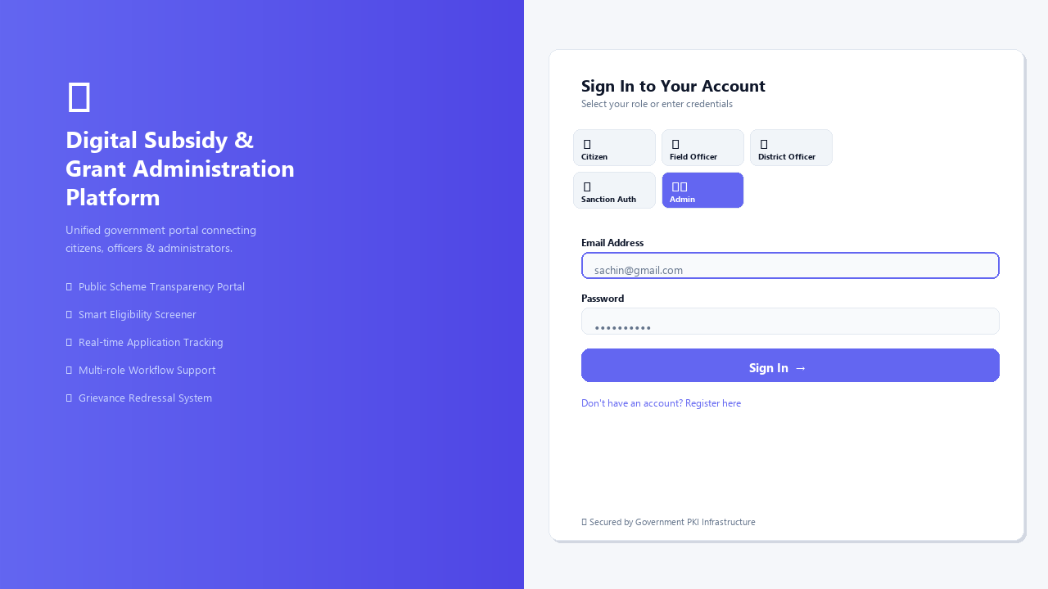
4
Login & Role Selection
Digital Subsidy & Grant Platform
Multi-role authentication: Citizen, Field Officer, District Officer, Sanction Authority, Administrator

Slide 5
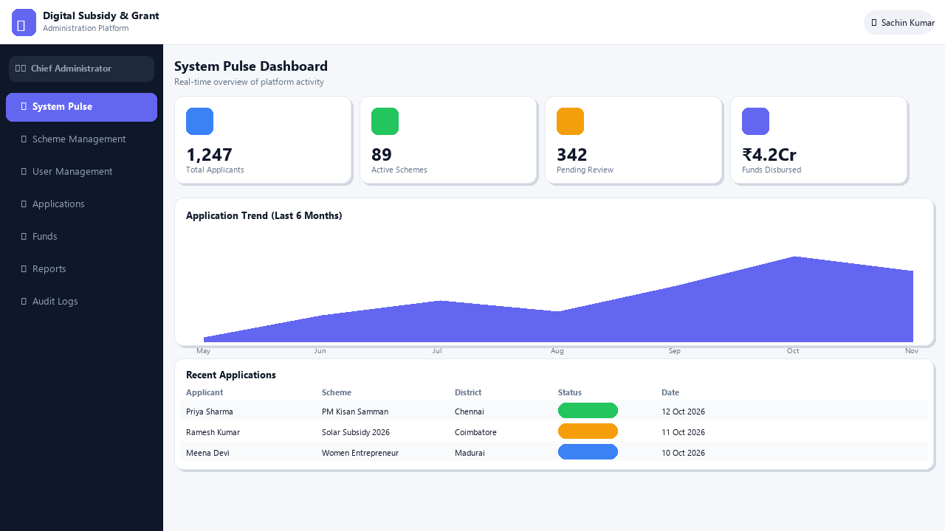
5
Admin System Pulse Dashboard
Digital Subsidy & Grant Platform
Real-time KPIs, application trend charts, and recent activity feed for Chief Administrator

Slide 6
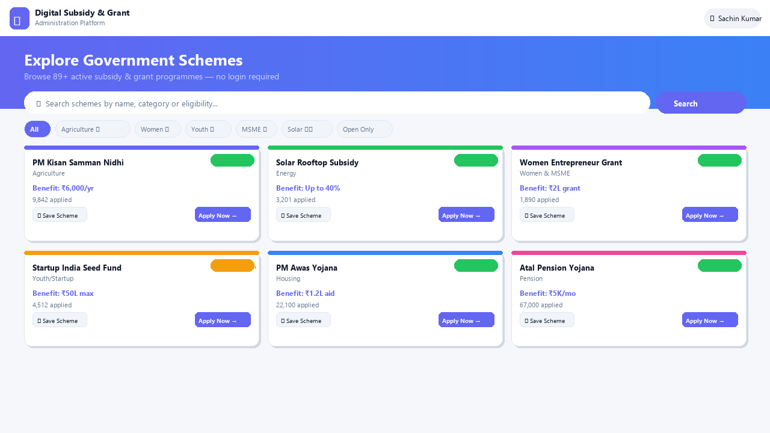
6
Public Scheme Transparency Portal
Digital Subsidy & Grant Platform
Unauthenticated scheme exploration with search, filtering, eligibility badges, and Save Scheme (Wishlist)

Slide 7
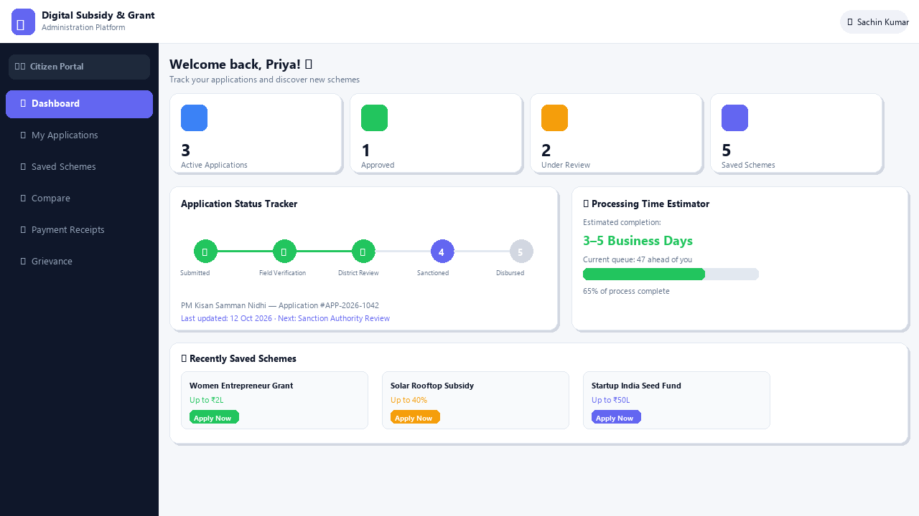
7
Citizen (Applicant) Dashboard
Digital Subsidy & Grant Platform
Application status tracker, processing time estimator, saved schemes and journey stepper

Slide 8
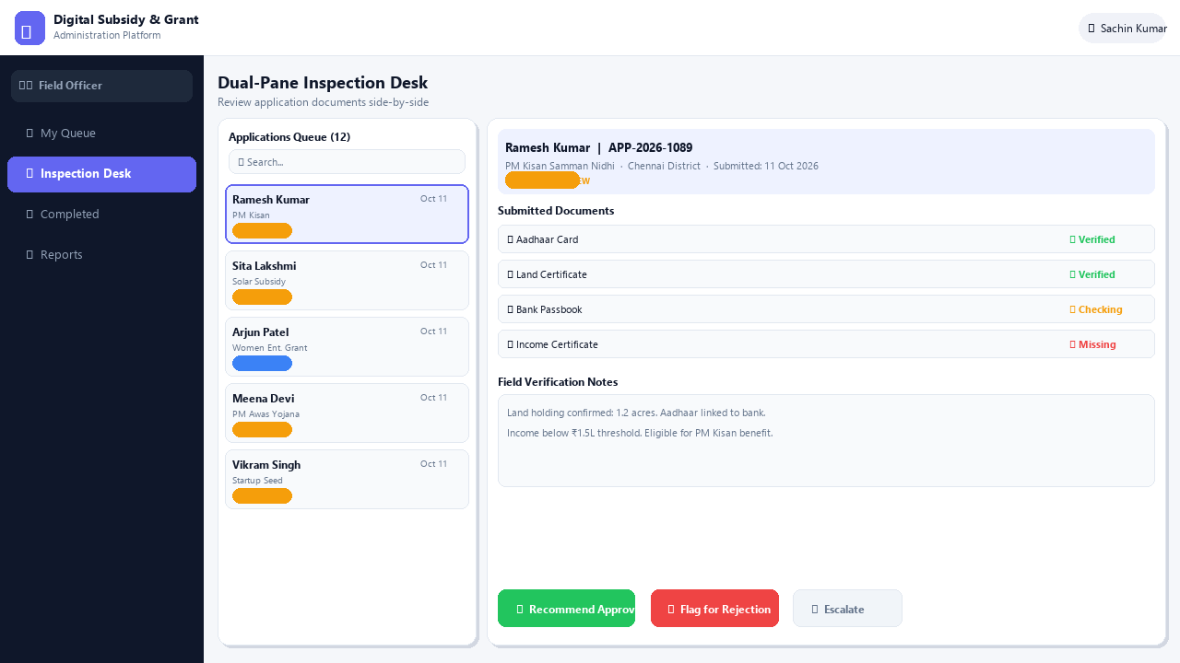
8
Field Officer – Dual-Pane Inspection Desk
Digital Subsidy & Grant Platform
Side-by-side document review, verification notes, approve / flag / escalate workflow

Slide 9
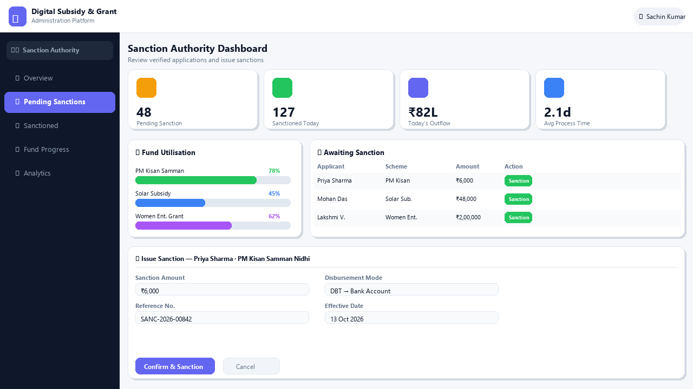
9
Sanction Authority Dashboard
Digital Subsidy & Grant Platform
Fund utilisation widget, pending sanctions queue, and one-click sanction modal

Slide 10
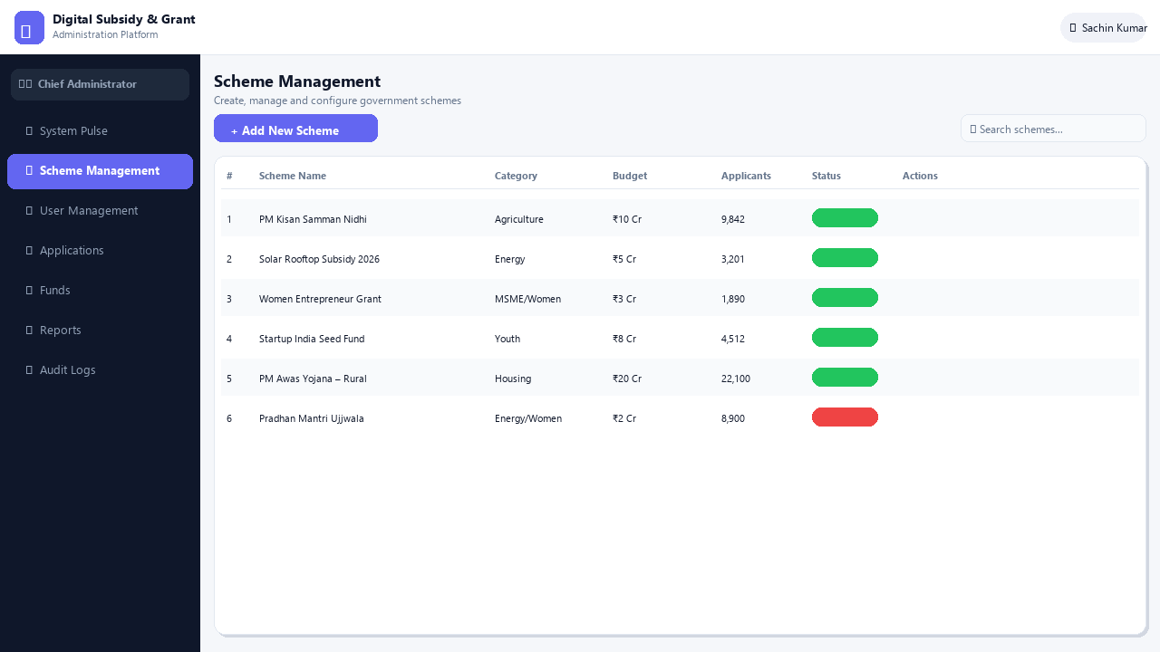
10
Scheme Management (Admin)
Digital Subsidy & Grant Platform
Create, edit, toggle status and delete government schemes with full audit trail

Slide 11
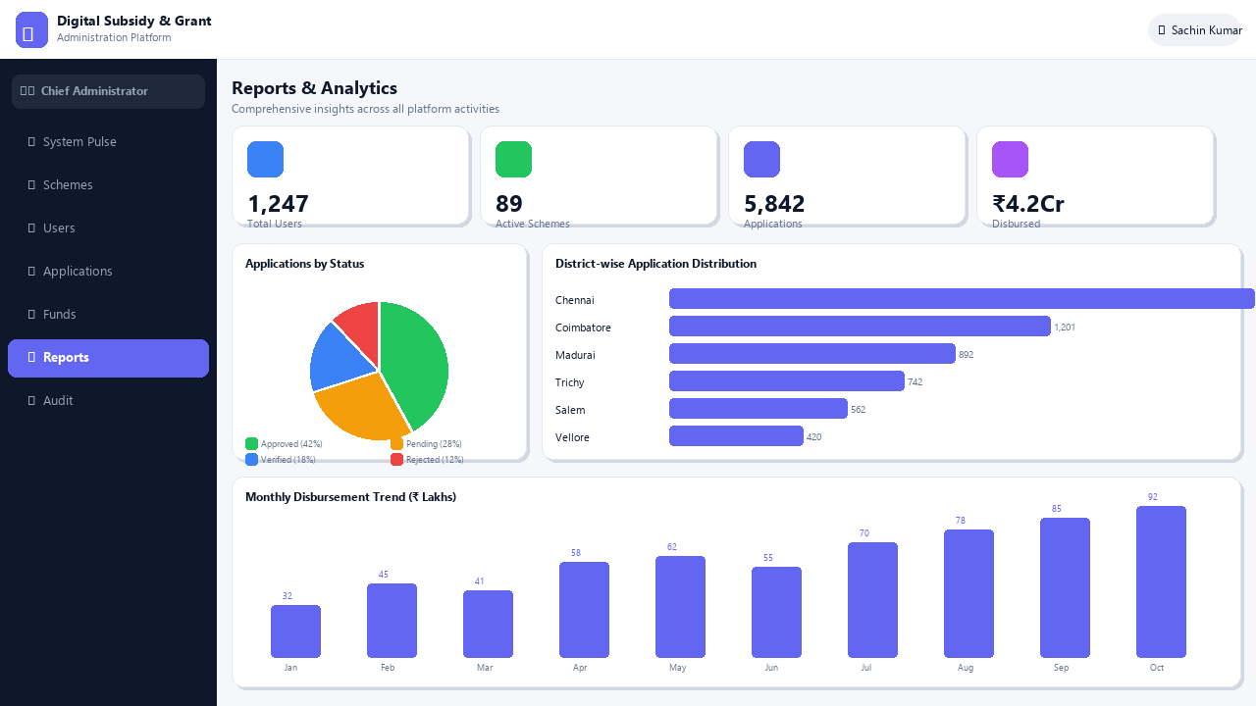
11
Reports & Analytics
Digital Subsidy & Grant Platform
District-wise distribution, monthly disbursement trend, status pie chart and KPI strip

