Slide 1
Santhoshwar R 715521104039
Final Project
3/4/2024 Annual Review

Slide 2
PROJECT TITLE
Apple Stock price prediction using Recurrent Neural Network (RNN)
3/4/2024 Annual Review

Slide 3


AGENDA
Problem Statement
Project Overview
End Users
Our Solution and Proposition
Modelling Approach
Results
Conclusion
3/21/2024 Annual Review
3/4/2024 Annual Review

Slide 4

PROBLEM STATEMENT
The objective of this project is to develop a Recurrent Neural Network (RNN) regressor for performing time series prediction. Specifically, the goal is to forecast the stock price of Apple Inc. seven days into the future. This project aims to replicate a figure shown in the provided notes, where the stock price of Apple was predicted using an RNN.
To achieve this, we will utilize the Long Short-Term Memory (LSTM) architecture, which is a type of RNN designed to address the vanishing gradient problem and capture long-term dependencies in sequential data.
By completing this exercise, participants will gain practical experience in constructing RNNs using Keras, which will be beneficial for tackling similar projects involving time series forecasting and sequential data analysis.
3/4/2024 Annual Review

Slide 5

PROJECT OVERVIEW
The project aims to create a user-centric stock price prediction application focused on forecasting Apple Inc.'s stock price seven days ahead. Leveraging advanced machine learning techniques like Long Short-Term Memory (LSTM) within the Keras framework, the application offers accurate predictions while ensuring simplicity and efficiency. Key components include data collection and preprocessing, where historical stock price data is cleaned, normalized, and split for model training. The LSTM-based RNN model is designed to capture temporal dependencies and prevent overfitting. Wireframes for the user interface are developed to facilitate intuitive interaction, covering data input, model training, prediction display, and user settings. Training involves optimizing model hyperparameters and evaluating performance on validation data. Iterative refinement incorporates feedback to improve both model accuracy and user experience. Documentation ensures transparency in the modeling process, while deployment readiness guarantees scalability and compatibility. Ultimately, the project aims to empower investors and analysts with a reliable tool for making informed decisions in the dynamic stock market environment.
3/4/2024 Annual Review

Slide 6

WHO ARE THE END USERS?
Individual investors
Financial analysts
Traders
Researchers
3/4/2024 Annual Review

Slide 7

YOUR SOLUTION AND ITS VALUE PROPOSITION
The proposed solution involves developing an LSTM-based RNN regressor for forecasting Apple Inc.'s stock price seven days ahead. Leveraging the Keras framework, it simplifies model construction and training. Data preprocessing involves encoding, scaling, and splitting historical stock data for optimal model training. The trained model is evaluated using unseen validation data to ensure accuracy. This streamlined approach empowers users with advanced time series prediction capabilities, effectively capturing temporal dependencies and patterns in sequential data, thereby aiding in informed decision-making within the stock market landscape.
The proposed solution involves leveraging LSTM-based RNN regressor for forecasting Apple Inc.'s stock price, aided by Keras for streamlined model development. Data preprocessing ensures optimal training, while training and evaluation ascertain accuracy. Key value propositions include accurate predictions, automation for efficiency, adaptability, scalability, and insightful understanding of market dynamics. Overall, it empowers users with advanced analytics, enabling informed decision-making within the dynamic stock market landscape.
3/4/2024 Annual Review

Slide 8

THE WOW IN YOUR SOLUTION
High accuracy
Real time prediction
seamless integration of cutting-edge technology and user-centric design, culminating in a powerful tool for stock market analysis and forecasting.
3/4/2024 Annual Review
‹#›

Slide 9
MODELLING
During the modeling phase, we collect and preprocess historical stock price data for Apple Inc., integrating wireframes for user interface design. They will design an LSTM-based RNN model using Keras, focusing on input, output, and dropout layers for regularization. Concurrently, wireframes will be crafted to depict user interface elements such as data input, training, prediction display, and settings. Following this, the model will be trained, optimizing hyperparameters and employing techniques like early stopping. Validation will assess prediction accuracy, employing metrics like Mean Squared Error (MSE). Teams will iteratively refine the model and wireframes based on evaluation results and user feedback. Documentation will capture the modeling process, while preparation for deployment ensures code modularity and compatibility. By integrating wireframes into the modeling phase, teams ensure alignment with user needs, fostering collaboration between developers, designers, and stakeholders to create a polished and user-friendly application for stock price prediction.
3/4/2024 Annual Review
‹#›

Slide 10
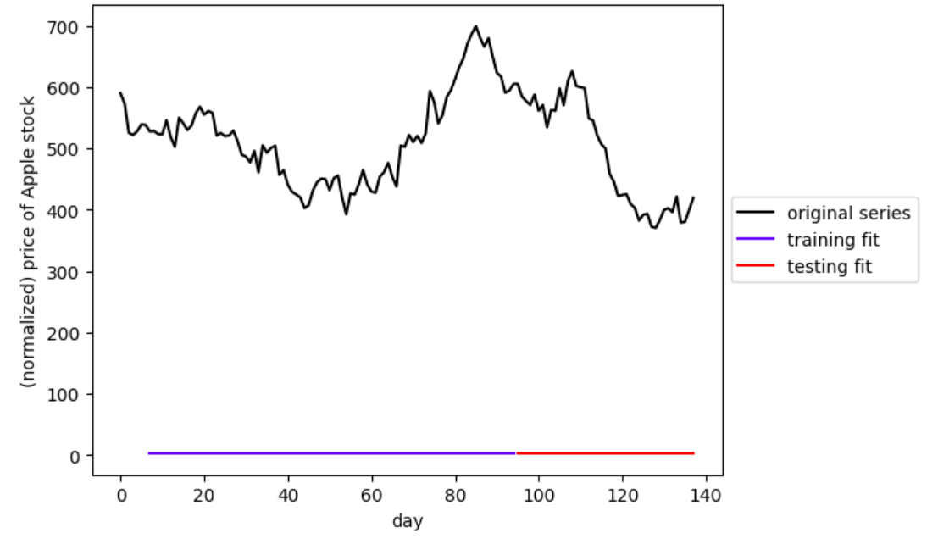
RESULTS
3/4/2024 Annual Review
‹#›

Slide 11
CONCLUSION
In our presentation, we'll be diving into how we can use a special type of technology called LSTM-based RNN regressors to predict what Apple Inc.'s stock price might be in the future. We're going to make things easier by using a tool called Keras to build and train our prediction model. To start off, we'll talk about how we get the data ready for our model. This involves getting the historical stock data, cleaning it up, and making sure it's in a format our model can understand. Then, we'll use the power of LSTM networks to look for patterns and trends in the data that could help us make better predictions. Throughout the presentation, we'll show you step-by-step how we build, train, and test our model. And finally, we'll talk about why this matters – how accurate predictions can help us make smarter decisions in the ever-changing world of the stock market.

Slide 12
REFERENCE
https://aws.amazon.com/what-is/recurrent-neural-network/#:~:text=A%20recurrent%20neural%20network%20(RNN,complex%20semantics%20and%20syntax%20rules.
https://www.geeksforgeeks.org/introduction-to-recurrent-neural-network/
https://encord.com/blog/time-series-predictions-with-recurrent-neural-networks/
https://machinelearningmastery.com/time-series-prediction-lstm-recurrent-neural-networks-python-keras/
https://www.tableau.com/learn/articles/time-series-analysis#:~:text=Time%20series%20analysis%20is%20a,data%20points%20intermittently%20or%20randomly.

