Slide 1

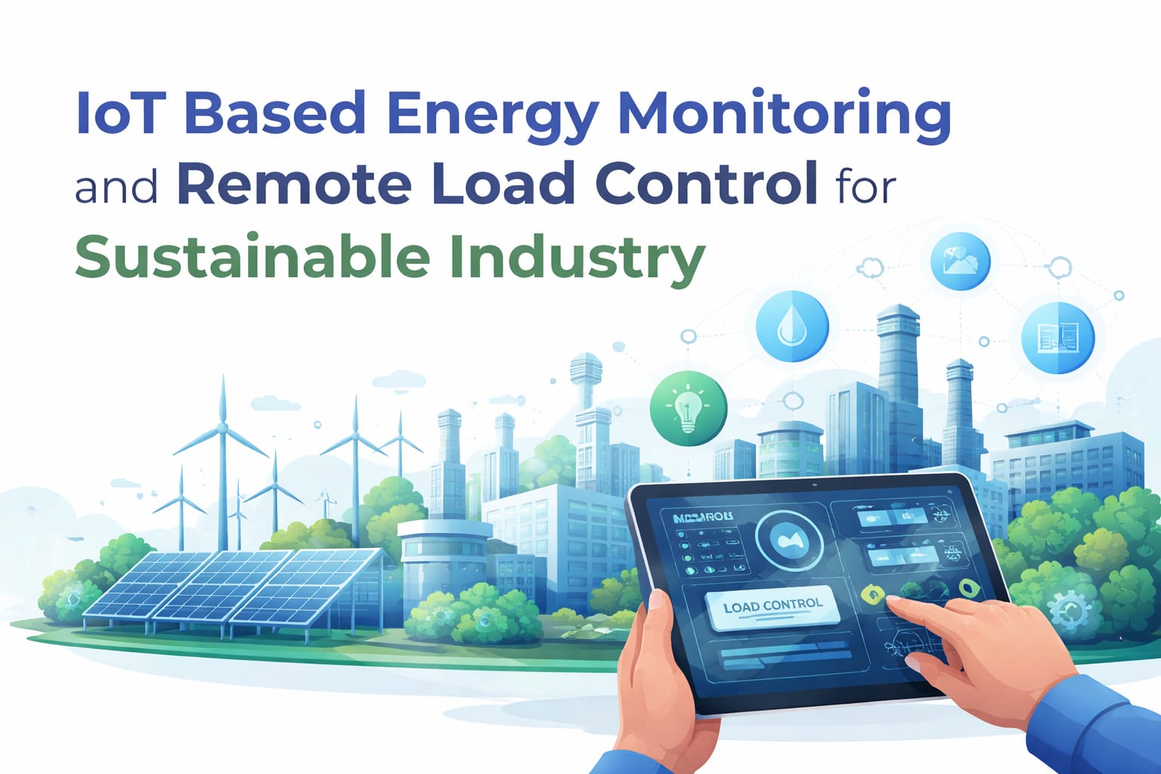
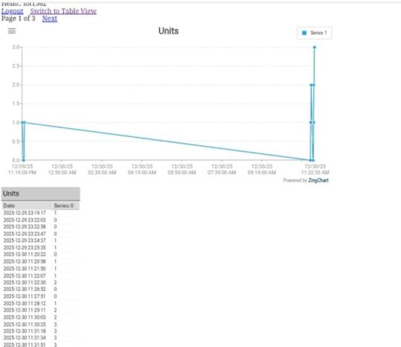
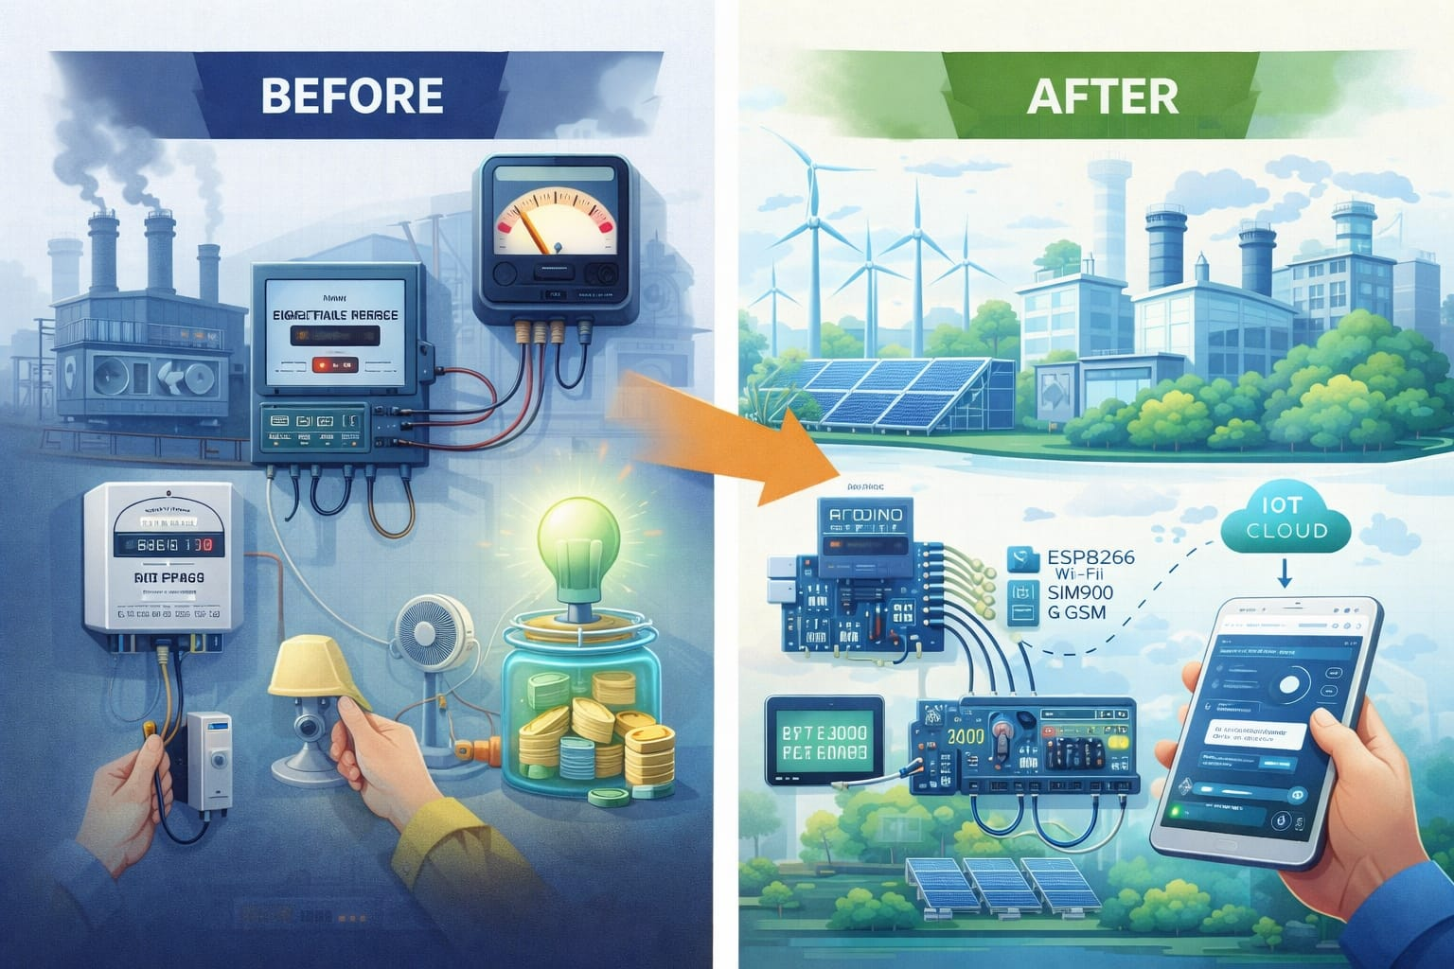
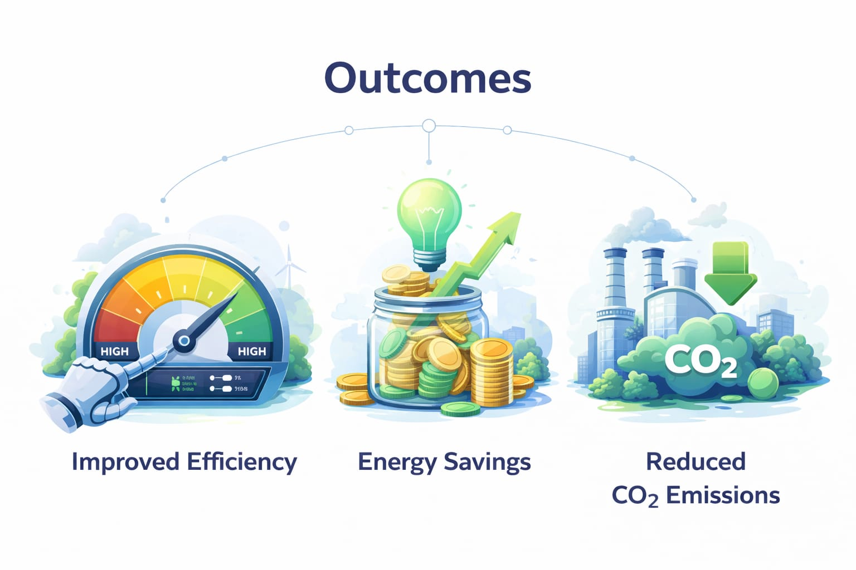
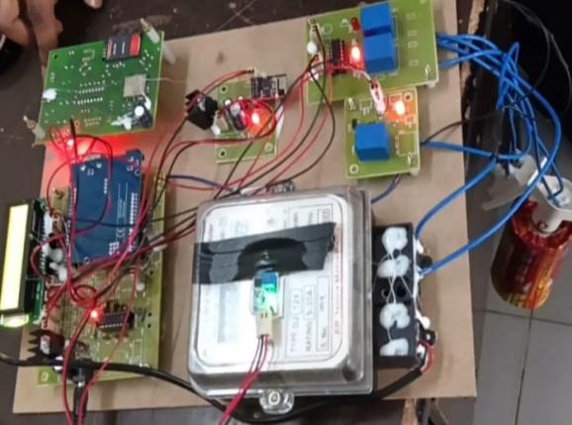
SMART CONNECT 2K26 - IoT
IoT Based Energy Monitoring and Remote Load Control For Sustainable Industry
Seelam Santhosh, Yarramsetty Anusha, Mailapalli Naveen, Peddiboyina Bhanu Sai Teja
SESHADRI RAO GUDLAVALLERU ENGINEERING COLLEGE, 521356
Introduction
Materials Requried :
Tables & Graphs
IoT Based Energy Monitoring and Remote Load Control For Sustainable Industry uses IoT technology to monitor electricity usage and control industrial loads remotely in real time. It helps reduce energy wastage, improves power efficiency, and supports smarter and more sustainable industrial energy management.
1 Hardware Components
Microcontroller – Arduino UNO (R3)
LCD Display – 16×2 LCD
Energy Meter – 240V AC Single Phase
IoT Module – ESP8266 Wi-Fi Module
GSM Module – SIM900
Relay Modules – AC Relay (for load control)
AC Loads – Light, Fan, 3-Pin Socket (240V)
Power Supply – 12V DC Supply
2. Software Components
Arduino IDE
IoT Cloud Server
Real-Time Monitoring Platform
Communication Protocols (Wi-Fi / GSM)
This graph and the Table shows the real-time energy units consumed using the proposed IoT-Based Energy Monitoring and Remote Load Control for Sustainable Industry. It helps monitor power usage over time and detect changes in electricity consumption. Overall, the system enables efficient and reliable energy management.
Objectives:
Procedure for implementation :
Reference:
Enhance Energy Monitoring – Use IoT sensors and smart meters to track real-time electricity consumption in industrial systems.
Enable Remote Load Control – Allow industries to switch and control electrical loads remotely using IoT and GSM communication.
Monitor Power Usage – Display real-time voltage, current, and energy data through LCD and cloud monitoring platforms.
Reduce Energy Wastage – Optimize power consumption by identifying unnecessary load usage and improving efficiency.
1. Problem Definition
Identify the industrial energy problem your IoT system will solve.
Example: Monitoring electricity consumption and remotely controlling loads to reduce energy wastage in industries.
2. Literature Review
Research existing energy monitoring and smart power management systems.
Identify limitations such as lack of remote control, poor real-time monitoring, or dependency on a single communication system.
3. System Design
a. Block Diagram
Draw a block diagram showing energy meter, Arduino microcontroller, IoT module (ESP8266), GSM module, relay control, cloud/server, and user monitoring interface.
b. Hardware & Software Components
List and describe each:
Energy Meter (for power measurement)
Microcontroller (Arduino UNO)
Communication Modules (Wi-Fi, GSM )
Programming Environment (Arduino IDE)
Cloud / Real-Time Server for monitoring
LCD Display for system status and readings
Kumar, R., Patel, S., & Verma, A. (2020). IoT-based energy monitoring system using Arduino and ESP8266. IEEE IoT Journal.
Zhang, H., Liu, Y., & Chen, Q. (2019). Smart energy management system using IoT for industrial applications. IEEE Access.
Sharma, P. R., & Gupta, V. (2021). Remote load control using IoT technology. International Journal of Smart Grid.
.
7
Acknowledgements:
I would like to express my sincere gratitude to my mentors, faculty members, and teammates for their constant guidance and support throughout the development of this project, “IoT Based Energy Monitoring and Remote Load Control For Sustainable Industry.” Their valuable insights and encouragement have been instrumental in shaping the ideas and execution of this work.
I also acknowledge the resources, research papers, and online platforms that provided the necessary technical knowledge on quantum computing, IoT, and smart traffic management. Finally, I am thankful to my family and friends for their motivation and continuous support during this project.
.
Outcomes:
Remote Load Control – Electrical devices can be controlled remotely through IoT and GSM communication.
Real-Time Energy Monitoring – Voltage, current, and power usage can be continuously monitored through cloud platforms.
Reduced Energy Wastage – Smart load management helps minimize power loss and improve system efficiency.
Reliable System Operation – IoT connectivity ensures continuous monitoring and quick response to abnormal conditions.
A
B
Before and After:
1
2
Conclusion:
The proposed IoT-based system successfully monitors industrial electricity consumption and controls electrical loads efficiently. Real-time data monitoring and remote operation improve energy management while reducing manual intervention. This project demonstrates how IoT technology can support smarter, more efficient, and sustainable industrial energy solutions.
Contact Information:
:
Authors : Dr.Anand Babu T, S.Santhosh, Y.Anusha, M.Naveen, P.Bhanu Sai Teja. Corresponding Author :
Address | Tel: +91- 8328208151 Email: Santhoshseelam36@gmail.com
4

