Slide 1
Cancer Detection and Evaluation using Artificial Intelligence
Team: Santhosh Kumar Padige
Under the guidance of Prof. Vahid Behzadan

Slide 2
Motivation
As of 2019, on average, 1 in 8 U.S women (approx. 12%) would develop invasive breast cancer at some point during her life.
5-year survival rate for breast cancer is 100% with early detection and 15% with late detection (UK Cancer research)
Artificial intelligence (AI) techniques play a key role in healthcare in recent years.
In the case of breast cancer, Artificial intelligence techniques can be used to distinguish between malignant and benign tumours for enabling early detection.
Most AI based applications focus on large data sets citing AI’s ability to handle big data.
However, from a user’s perspective most users have access to publicly available small data sets.
Thus, it is interesting to analyse if the traditional non complex basic AI algorithms can achieve high accuracy classifications using small datasets.

Slide 3

Research Questions
Objective of this paper is to apply AI algorithms to classify breast cancer outcomes using a small publicly available data set.
Research Question 1: Can basic Artificial intelligence based algorithms classify breast cancer outcomes with high accuracies for small datasets?
Research Question 2: Which factors are most important for classification of breast cancer outcomes?
In addition, this study develops a breast cancer prediction platform.

Slide 4
Literature Review
Table 1 summarises prior research on Artificial intelligence algorithms, sample strategies and classification accuracies.
Continued experimenting with different AI algorithms are also important as each has its own advantages and drawbacks.

Slide 5
References | Algorithms | Sampling Strategies 1 | Classification Accuracies (%)
Quinlan 1993 | C4.5 DT | 10–fold cross validation | 94.74
Setiono and Liu 1995 | Pruned ANN | 50–50 training-testing | 96.56
Bennett and Blue 1998 | SVM | 5–fold cross validation | 97.20
Setiono 2000 | Neuro-rule ANN | 10-fold cross validation | 97.97
Sarkar and Leong 2000 | k-NN | 50–50 training-testing | 98.25
 | Fuzzy k-NN | 50–50 training-testing | 98.83
Abbass 2002 | EANN | 80–20 training-testing | 98.10
Bagui et al. 2003 | k-RNN | 10-fold cross validation | 98.10
Kiyan and Yildirim 2004 | RBN | 50–50 training-testing | 96.16
 | GRNN | 50–50 training-testing | 98.80
 | PNN | 50–50 training-testing | 97.00
 | AIP | 50–50 training-testing | 95.74
Polat et al. 2005 | C4.5 + FS-AIRS | 10–fold cross validation | 98.51
Pach and Abonyi 2006 | F-DT | 10–fold cross validation | 95.27
Polat and Güneş 2007 | LS-SVM | 10–fold cross validation | 98.53
Akay 2009 | F-score-SVM | 10–fold cross validation | 99.51
Karabatak and Ince 2009 | AR-ANN | 3–fold cross validation | 97.40
Marcano-Cedeño et al. 2011 | AMAIP | 60–40 training-testing | 99.26
Chen et al. 2011 | RS-SVM | 80–20 training-testing | 96.87
Fan et al. 2011 | CBFDT | 75–25 training-testing | 98.90
Chen et al. 2012 | PSO-SVM | 10-fold cross validation | 99.31
Koyuncu and Ceylan 2013 | RF-ANN | 50–50 training-testing | 98.05
 | PSO-ANN | 50–50 training-testing | 97.36
Medjahed et al. 2013 | k-NN (Euclidean) | Holdout method | 98.70
Azar and El-Said 2014 | PSVM | 4–fold cross validation | 96.00
 | NSVM | 4–fold cross validation | 96.57
 | LPSVM | 4–fold cross validation | 97.14
 | LSVM | 4–fold cross validation | 95.43
 | SSVM | 4–fold cross validation | 96.57
Sumbaly et al. 2014 | J48 | 10–fold cross validation | 94.36
Seera and Lim 2014 | FMM-CART-RF | 50–50 training-testing | 97.29
Bhardwaj and Tiwari 2015 | GOANN | 10-fold cross validation | 99.26
Nahato et al. 2015 | RS-BPANN | 80–20 training-testing | 98.60
Abdel-Zaher and Eldeib 2016 | DBN-ANN | 54.9–45.1 training-testing | 99.68
Devi and Devi 2016 | FFC + OD + J48 | 10–fold cross validation 2 | 99.90
Kumar et al. 2017 | SVM-Naive Bayes-J48 | 10–fold cross validation | 97.13
Latchoumi and Parthiban 2017 | WPSO-SSVM | 5–fold cross validation | 98.42
Osman 2017 | Two-Step-SVM | 10–fold cross validaiton | 99.10

Slide 6
Research Design
AI algorithms implemented: Ridge, Adaboost, GradientBoost, RandomForest, PCA+Ridge and Neural Networks AI algorithms.
These models are incorporated in the breast cancer prediction platform.
Traditional benchmark AI technique: logistic regression model.
We the benchmark model performance against our AI algorithm performance.
In addition, we identify important features that contribute to breast cancer classification.

Slide 7
Breast Cancer Prediction Platform

Slide 8
Data
The dataset: Publicly available (created by Dr. William H. Wolberg, physician at the University Of Wisconsin Hospital at Madison, Wisconsin, USA (Wolberg and Mangasarian 1990).
Breast-cancer-Wisconsin has 699 instances (Benign: 458 Malignant: 241)
2 classes (65.5% malignant and 34.5% benign)
11 integer-valued attributes.

Slide 9
Number | Attribute | Domain
0 | ID number | id number
1 | radius (mean of distances from centre to points on the perimeter) | 1–10
2 | texture (standard deviation of grey-scale values) | 1–10
3 | perimeter | 1–10
4 | area | 1–10
5 | smoothness (local variation in radius lengths) | 1–10
6 | compactness (perimeter² / area — 1.0) | 1–10
7 | concavity (severity of concave portions of the contour) | 1–10
8 | concave points (number of concave portions of the contour) | 1–10
9 | symmetry | 1–10
10 | fractal dimension (“coastline approximation” — 1)

Slide 10
Empirical Results
Table 3. Model Type and Accuracy
Model Type | Accuracy (%)
Ridge | 94.7
Adaboost | 93.0
GradientBoost | 96.5
RandomForest | 98.2
PCA+Ridge | 94.7
Neural Network | 98.2
Interpretation: Random Forest and the Neural Network model reached a 98.2% accuracy rate, with least number of fault predictions for breast cancer classification

Slide 11
Feature Importance

Slide 12
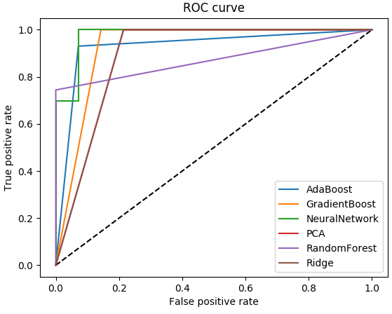
ROC Curve

Slide 14
Conclusion
This study identifies Random Forest and the Neural Network model to be most successful in breast cancer classification. (98.2% accuracy rate, and the least number of fault predictions)
concave_points_worst and perimeter_worst are the most important features for classifying breast cancer outcomes.
Our results show that AI algorithms can classify breast cancer outcomes with high accuracy and identify key characteristics even for small datasets.
Thus, higher accuracy can be achieved with standard work horse classification models versus more complicated models even for a smaller data set.
We highlight the significant potential in using AI techniques as a diagnostic tool for early detection of breast cancer in general.

