Slide 1
CGB1201 – JAVA PROGRAMMING
Department of Artificial Intelligence and Data Science
Academic Year: 2024 – 2025 (Odd Semester)
Register Number :2303811724321097
Name :SANTHOSH.S
Year :II
Semester :III
Section :B
Date :03-12-2024

Slide 2
Title of the Project
TEXT BASED ADVENTURE GAME

Slide 3
Problem Identification
1. Game State Management
2. Non-linear Story Progression
3. User Input Parsing
4. Game Logic Complexity
5. Story Writing and Dialogue
6.Handling Game Over and Restart Mechanisms
7.Output Formatting

Slide 4
Objective
1.Create an engaging storyline with multiple branching paths.
2.Implement an intuitive command-based input system.
3.Incorporate inventory and item management.
4.Provide player choices that affect the game’s outcome.
5.Design challenging puzzles or obstacles for the player.
6.Track player progress, inventory, and decisions.
7.Define clear game over and victory conditions.

Slide 5
Proposed Architecture
Game loop module
Startgame()
Scene module
explore cave()
enterForest()
Randomization module
exploreRandom()
Start Adventure
user input module
scanner class
utility module
pause ()
clear()

Slide 6
Java Programming - Concepts Used
1.Object-Oriented Programming (OOP): The code uses classes, objects, and methods to organize and structure the game logic.
2. Conditional Statements: The code uses if-else statements to handle different scenarios and make decisions based on user input.
3. Loops: The code uses loops (e.g., while loop) to repeat certain actions or scenarios.
4. Random Number Generation: The code uses the Random class to generate random numbers for certain game events.

Slide 7
List of Modules
1. Game Loop Module
2. Scene Module
3. Randomization Module
4. User Input Module
5. Game State Module
6. Utility Module

Slide 8
Module Description
1. Game Loop Module: startGame() method, which contains the main game loop.
2. Scene Module: exploreCave() and enterForest() methods, which represent different scenes in the game.
3. Randomization Module: exploreRandom() method, which generates random numbers for certain game events.
4. User Input Module: Scanner class, which handles user input.
5. Game State Module: Variables like health and score, which store the game state.
6. Utility Module: pause() and clear() methods, which provide utility functions for the game.

Slide 9
Source Code
import java.util.Scanner;
public class TextAdventureGame {
public static void main(String[] args) {
Scanner scanner = new Scanner(System.in);
System.out.println("Welcome To The Text Adventure Game!");
System.out.println();
System.out.println("You Find Yourself In A Mysterious Place:");
System.out.println("1. Explore The Dark Cave");
System.out.println("2. Walk Through The Enchanted Forest");
System.out.print("Enter Your Choice: ");
int choice1 = scanner.nextInt();
if (choice1 == 1) {
System.out.println();

Slide 10
Source Code
System.out.println("You Enter The Dark Cave And Discover A Treasure Chest!");
System.out.println("1. Open The Chest");
System.out.println("2. Leave The Cave");
System.out.print("Enter Your Choice: ");
int choice2 = scanner.nextInt();
if (choice2 == 1) {
System.out.println();
System.out.println("You Find Out Treasure!");
System.out.println("Your Score: 20");
System.out.println("You Are Now Good To Go Ahead");
} else {
System.out.println();

Slide 11
Source Code
System.out.println("You Leave The Cave Safely, But You Miss The Treasure!");
System.out.println("Your Score: 10");
System.out.println("Try Again To Find The Treasure.");
}
} else if (choice1 == 2) {
System.out.println();
System.out.println("You Walk Through The Enchanted Forest And Find A Hidden Path!");
System.out.println("You Gain Wisdom But No Treasure!");
System.out.println("Your Score: 15");
System.out.println("You Are Now Good To Go Ahead");

Slide 12
Source Code
}
else {
System.out.println();
System.out.println("Invalid Choice! Game Over.");
}
scanner.close();
}
}

Slide 13
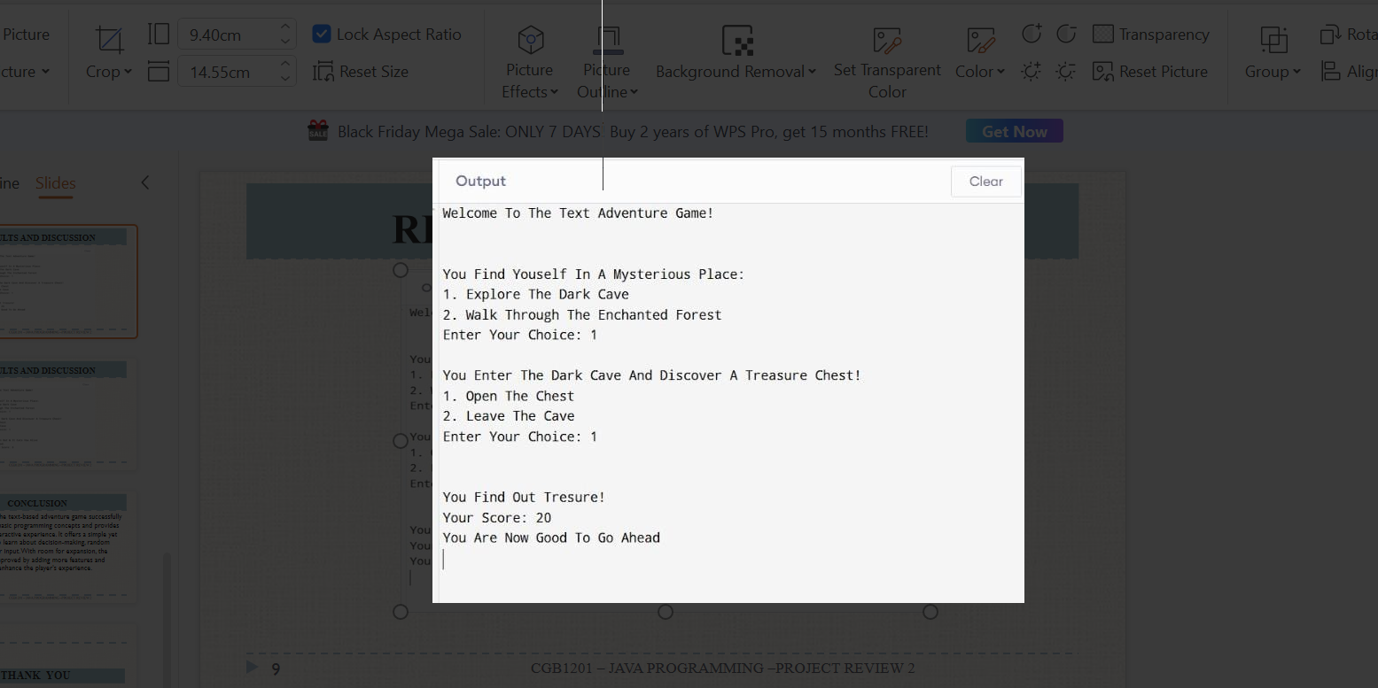
Results

Slide 14
Conclusion
In conclusion, the text-based adventure game successfully demonstrates basic programming concepts and provides an engaging interactive experience. It offers a simple yet effective way to learn about decision-making, random events, and user input. With room for expansion, the game can be improved by adding more features and complexity to enhance the player's experience.

Slide 15
Thank You
Any queries???

