Slide 1
DocShip
GitHub Repo: https://github.com/santhosh72744/DocShip
LinkedIn: https://www.linkedin.com/in/santhosh-kumar-232445250/

Slide 2

Welcome to DocShip
DocShip is a simple and reliable international document delivery platform.
It is specially made for people sending documents from USA to India.
We make the process easy and stress free.
Follow these easy steps to complete your shipment in just a few minutes.

Slide 3
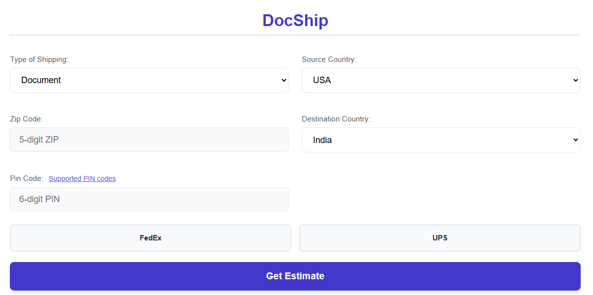
Shipping Estimate
The shipping type and route is already pre-selected.
So the user only enters their ZIP code and PIN code and selects a courier like FedEx or UPS.
ZIP must be exactly five digits and PIN must be exactly six digits and must exist in our database.
Users can also check supported PIN codes
DOCSHIP

Slide 4
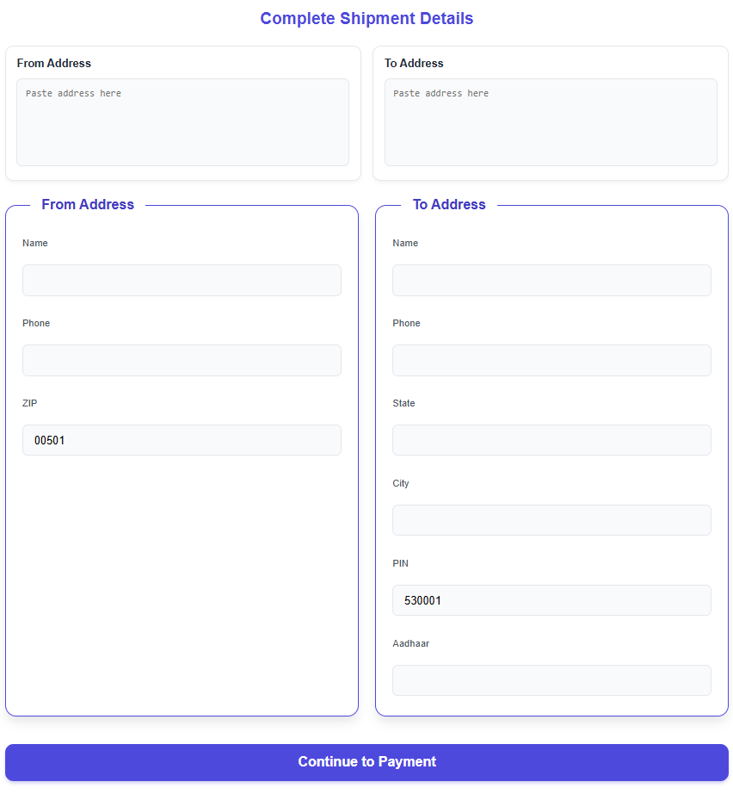
Shipment Details
You can simply paste your full address and let DocShip’s smart “Address Parser” fill in everything automatically.
It saves time and reduces errros.
You can also enter the details manually.
ZIP and PIN codes are automatically pre-filled.
Aadhar number must 12-digits.

Slide 5
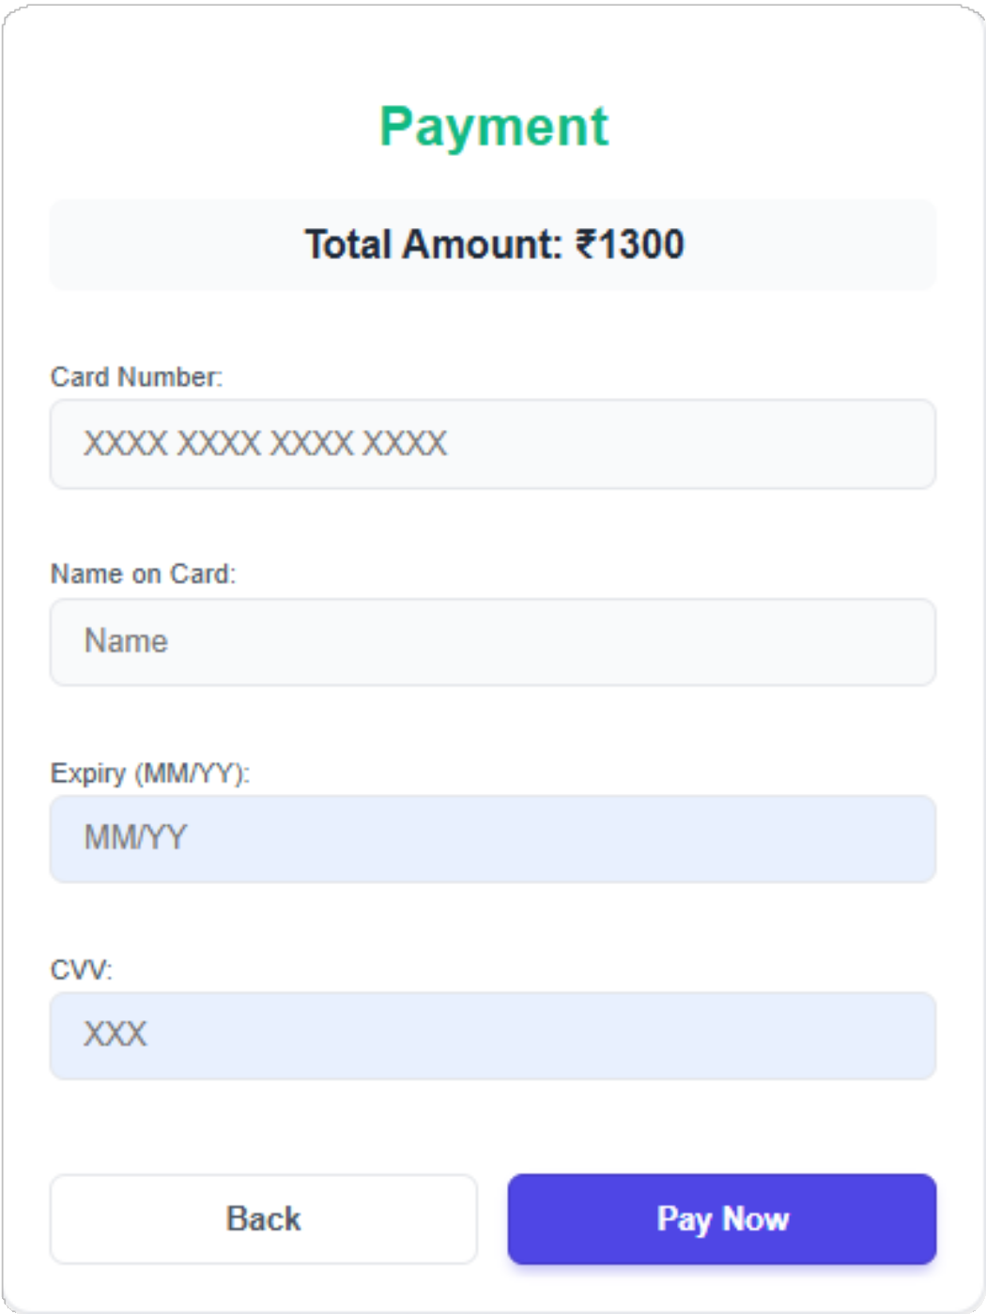

Make your payment
Enter your:
16-digit card number Cardholder name Expiry month and year
3 digit CVV
We validate card details and show a clear success message.
DOCSHIP

Slide 6
Shipping label
DocShip instantly generates a shipping label with:
Sender and receiver details
Courier information
Barcode
Tracking number
You can download this label.
Fastest and simplest way to send your documents internally.
DOCSHIP

Slide 7
Technical Architecture & Flow
DocShip uses a clean and lightweight architecture.
Each major step talks to a dedicated API:
Estimate API calculates price and duration.
Address parser API extracts structured fields.
Payment API validates and records card details.
Label generator API creates the final shipping label with tracking IDs.
It uses JSON as its database.
We store shipment data, address and payment data in JSON.
backend performs strict server-side validation.
This flow ensures the system is secure, consistent and user-friendly from start to end.
DOCSHIP

Slide 8
Roadmap & Future Vision
We will upgrade from JSON storage to a faster and secure database layer
We are adding new international routes,not just USA to India. We plan to introduce:
Real-time tracking
Whatsapp and email notifications
AI-powered address correction
Better payment protection
Our goal is to become a completely self-serve global platform. where customers can
estimate cost, schedule pickup, track documents, and manage everything in one place.
DocShip aims to make international document delivery simple, accurate and trustworthy for everyone.
DOCSHIP

Slide 9
Thank You
DOCSHIP
Email: santhosh.72744@gmail.com
Contact: 91+ 7386674979

