Slide 1
Automated Diabetic Retinopathy Detection System
Team Members:
1. NAVEEN KUMAR E (811721104072)
2. PRASANNA R (811721104080)
3. SANTHOSH S (811721104089)
Guided By:
Mrs.M.Mathumathi M.E.,(Ph.D).,

Slide 2
Content
1. Objective
2. Problem Statement
3. Existing System
4. Proposed System
5. Architecture
6.Modules in Project
7.Sample Output
8. Literature Survey
9.Future Enhancements
10.References

Slide 3
Objective
The objective of this project is to create an automated system for detecting Diabetic Retinopathy (DR) using machine learning techniques. By leveraging retinal images, the system aims to provide early and accurate diagnosis, reducing the reliance on manual examination and minimizing diagnostic errors with visualization to improve patient outcomes.

Slide 4
Problem Statement
Diabetic Retinopathy is a significant complication of diabetes, often leading to blindness if left untreated. Early detection is crucial but challenging due to the manual nature of current diagnosis methods, which are slow, prone to human error, and highly dependent on specialist availability. There is a need for an automated system with visualizations for scalable solution that can efficiently handle large datasets of retinal images and provide accurate diagnoses with minimal human intervention.

Slide 5
Existing System
Manual Screening: Current systems rely on ophthalmologists manually examining retinal images for signs of DR.
Basic Automated Tools: Some image processing tools exist but are limited in terms of precision and speed.
Disadvantages:
Time-consuming and labor-intensive.
Prone to human error and variability in diagnosis.
Limited scalability, especially in regions with fewer specialists.
Inability to handle large datasets efficiently.

Slide 6
Proposed System
The proposed system uses deep learning, particularly Convolutional Neural Networks (CNNs), to automatically analyze retinal images and detect Diabetic Retinopathy. The system will classify the severity of DR and provide real-time feedback.
Advantages:
Accuracy: CNNs can identify intricate features in retinal images, leading to more accurate diagnosis.
Speed: Automated analysis significantly reduces the time needed for diagnosis.
Scalability: Capable of handling large datasets efficiently, making it suitable for mass screening.
Consistency: Reduces variability in diagnosis and eliminates human error.

Slide 7
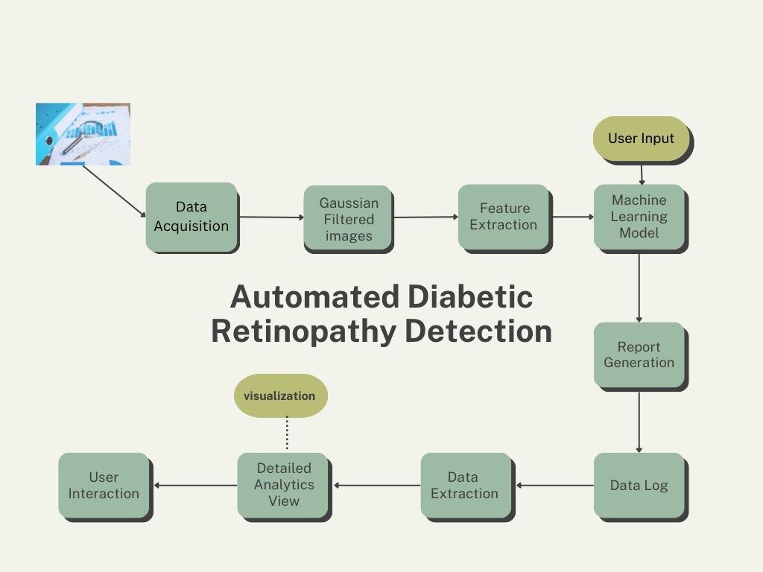
Architecture

Slide 8
Literature Survey
Title | Advantages | Disadvantages
“Deep Learning for Diabetic Retinopathy Detection through Retinal Fundus Images: A Survey “ (2022) Authors: A. A. Hassan, N. Al-Khafaji, S. Jassim | Comprehensive review, CNNs, improvements in diagnostic surgery | Does not address scalability changes and less implementations.
"Automated Diabetic Retinopathy Grading System Based on Deep Learning" (2021) Authors: M. A. Khan, N. Sharif, M. Y. Javed, S. Anwar | high accuracy in DR grading, Uses a large dataset, enhancing the model’s generalization | Requires high computational power, struggles with detecting rare DR features

Slide 9
Literature Survey
Title | Advantages | Disadvantages
"Efficient Transfer Learning Approach for Diabetic Retinopathy Classification Using Fundus Images" (2022) Authors: H. Gupta, P. K. Roy, S. Dey | Transfer learning – improves model performance , educed training time | may introduce bias, performance varies significantly depending on the dataset.
"Hybrid Deep Learning Framework for Automated Diabetic Retinopathy Detection" (2021) Authors: F. Yu, L. Zhou, H. Tang, X. Yang | Combines CNNs with traditional machine learning, strong performance | Increased model complexity, Higher training and inference times.

Slide 10
Literature Survey
Title | Advantages | Disadvantages
"Explainable AI for Diabetic Retinopathy Detection: A Step Towards Trustworthy AI in Healthcare“(2023) Authors: S. H. Lee, J. K. Kim, H. Park | Focuses on explainability , Improves trust among clinicians | Lower accuracy compared to purely deep learning-based models, Trade-off between transparency and performance
"DR Detection Using CNNs with Data Augmentation and Optimization Techniques“(2022) Authors: P. N. Sharma, R. Kumar, S. Verma. | Incorporates data augmentation techniques, Performs well on multiple public DR datasets | Still dependent on the quality of the augmented data, computational cost for training the model is high.

Slide 11
Modules
Data Acquisition and Preprocessing
Feature Extraction Module
Machine Learning Module
Report Generation Module
Data log Module
Data Analytics View Module
User Interface Module

Slide 12
Data Acquisition And Preprocessing Module
Data Acquisition and Preprocessing Module
Purpose: Acquire and prepare retinal images for analysis.
Key Processes:
Data collection from sources like Kaggle and EyePACS.
Preprocessing steps:
Noise reduction using Gaussian filtering.
Image resizing and normalization.
Contrast enhancement to highlight retinal abnormalities.
Outcome: High-quality images optimized for feature extraction.

Slide 13
Feature Extraction Module
Purpose: Identify critical features indicating diabetic retinopathy (DR).
Key Features Extracted:
Microaneurysms, hemorrhages, exudates, and vascular abnormalities.
Tools:
CNN-based feature extraction for accurate mapping of disease indicators.
Pre-trained models like ResNet.
Outcome: Feature maps highlighting DR-relevant regions for classification.

Slide 14
Machine Learning Module
Purpose: Classify images into DR severity levels.
Model Architecture:
ResNet-50 fine-tuned for retinal analysis.
Optimized using techniques like data augmentation and cross-entropy loss.
Severity Levels:
No_DR, Mild, Moderate, Severe, and Proliferative_DR.
Outcome: High accuracy in predicting DR severity for clinical decision-making.

Slide 15
Report Generation Module
Purpose: Generate user-friendly, detailed diagnostic reports.
Key Features:
Severity levels with confidence scores.
Grad-CAM heatmaps for affected areas.
Evidence-based treatment recommendations.
Outcome: Comprehensive reports for clinicians and patients in PDF format.

Slide 16
Data Log Module
Purpose: Securely store and organize diagnostic data for future use.
Implementation:
Hierarchical structure with metadata (timestamps, severity levels).
Encrypted storage for security.
Outcome: A reliable repository supporting follow-ups and research.

Slide 17
Data Analytics View Module
Purpose: Provide insights into system performance and disease trends.
Features:
Metrics like accuracy, precision, and recall.
Visualizations: heatmaps, pie charts, and graphs for trends and patterns.
Outcome: Enhanced understanding for healthcare administrators and researchers.

Slide 18
User Interface Module
Purpose: Ensure intuitive and accessible interaction with the system.
Features:
Image upload functionality.
Progress monitoring and error notifications.
Downloadable PDF reports.
Outcome: A minimalistic, user-friendly streamlit GUI with seamless navigation.

Slide 19
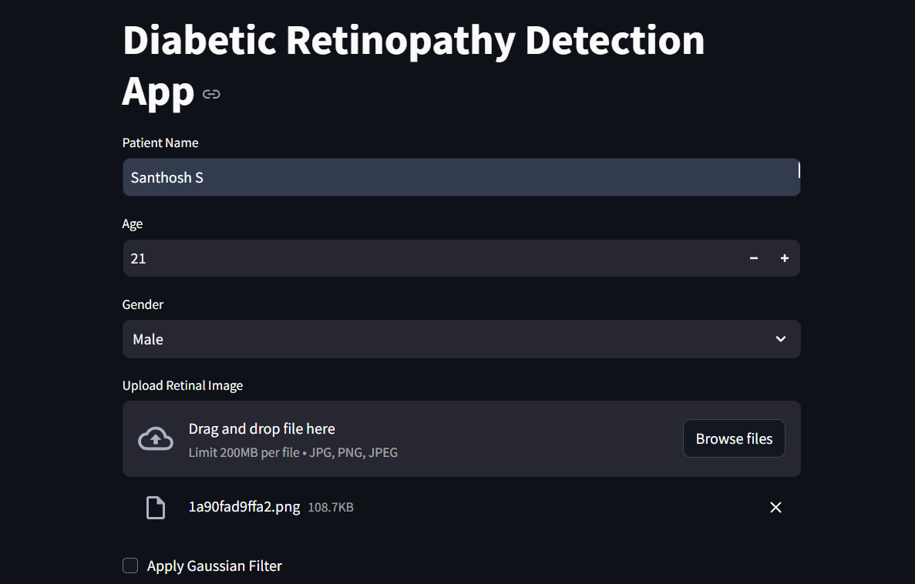
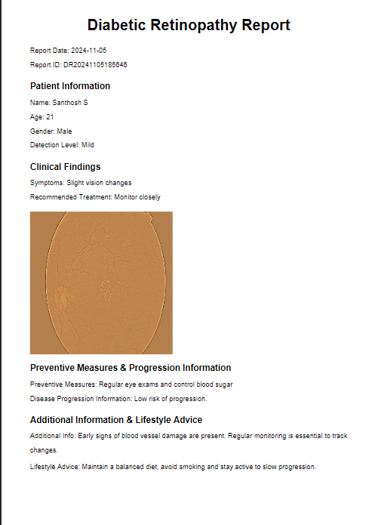
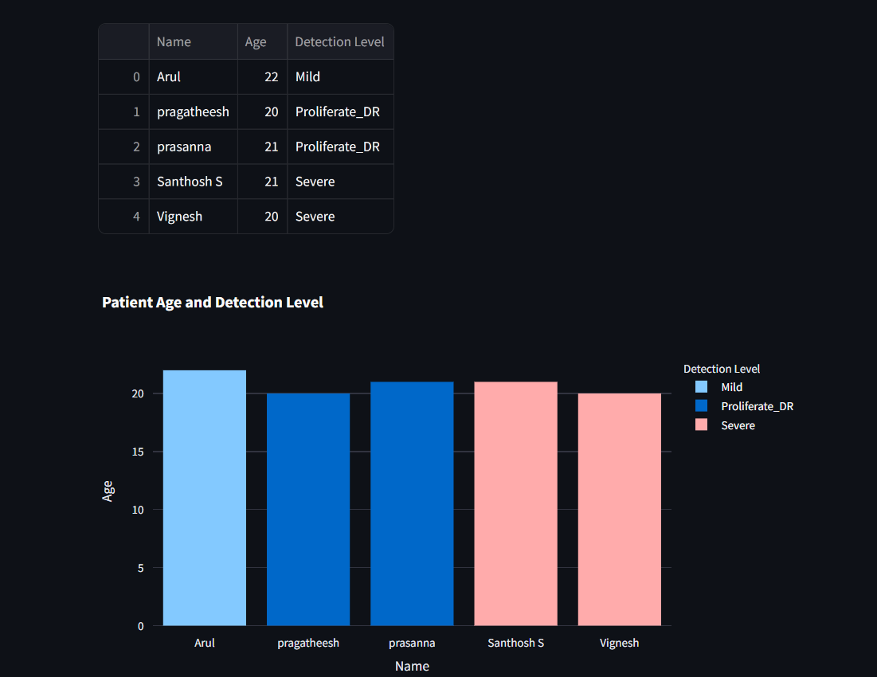
Sample Output

Slide 20
Future Enhancements
1. Integration with National Healthcare Systems
Objective: Expand the system's reach for large-scale public health management.
Features:
Integration with national healthcare databases to facilitate mass screenings.
Real-time reporting for clinicians and policymakers.
Use of anonymized data to aid medical research and improve AI models.
Impact:
Streamlined diagnosis processes in underserved regions.
Improved resource allocation and strategic healthcare planning.

Slide 21
Future Enhancements
Real-Time Video Retinal Screening
Objective: Enable dynamic analysis of retinal images for better accuracy.
Features:
Frame-by-frame analysis of live retinal video streams.
Immediate detection of DR indicators during clinical examinations.
Impact:
Reduced waiting times for diagnoses.
Enhanced disease progression monitoring with richer data capture.

Slide 22
References
[1] "Diabetic Retinopathy Detection Using Convolutional Neural Networks with Background Removal, and Data Augmentation" Leksakul, K., et al., 2024. https://www.mdpi.com/2076-3417/14/19/8823
[2] "A Survey of Machine Learning and Deep Learning Methods for Diabetic Retinopathy Detection" Sharma, A., et al., 2022. https://www.hindawi.com/journals/jhe
[3] "A Deep Learning Framework for the Detection and Classification of Diabetic Retinopathy in Fundus Images" Al-Bander, B., et al., 2021. https://www.scirp.org/journal/jbise
[4] "Retinal Image Analysis for Diabetic Retinopathy Detection Using Deep Convolutional Neural Networks" Xu, Y., et al., 2021.https://link.springer.com/journal/10278
[5] "Diabetic Retinopathy Detection Using Transfer Learning and Convolutional Neural Networks" Khan, M. A., et al., 2020. https://pubs.spie.org/journals/journal-of-medical-imaging

Slide 23
Thank You

