Slide 1
RigForge
Interactive Gaming PC Builder & Compatibility Estimation System
A responsive client-side web application for hardware assembly, constraint validation, and budget optimization
III Year B.E. CSE | Web Programming · Rajalakshmi Engineering College, Chennai
Santhosh G (240701473) & Rohith D (240701435) · Supervisor: Mrs. Deepa, AP/CSE · Oct 2026

Slide 2
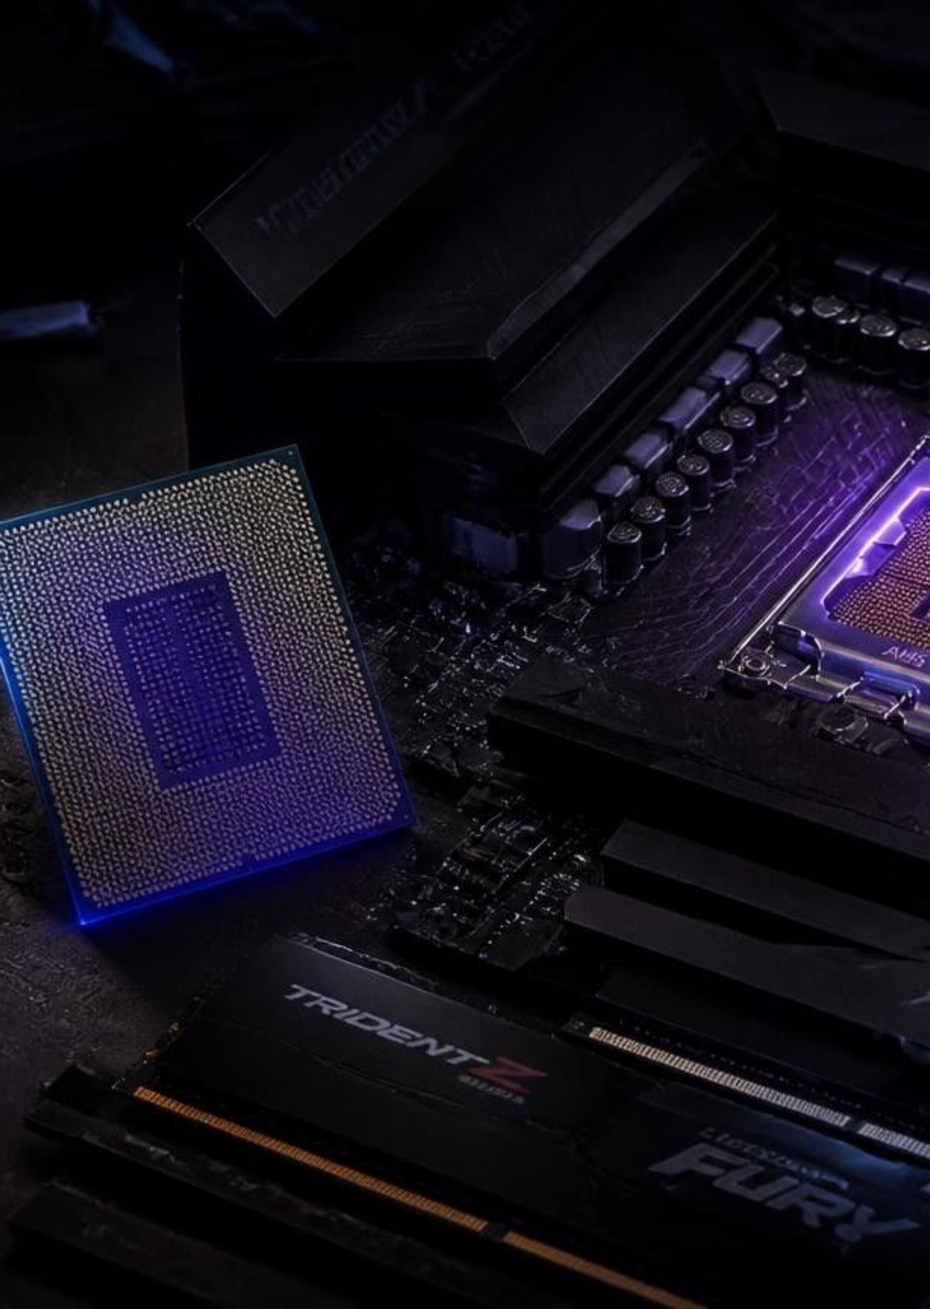
Custom PC building is full of costly friction
Socket mismatches
Forcing Intel LGA1700 into AMD AM4/AM5 bends pins and causes irreversible physical damage.
RAM & form factor conflicts
DDR4 and DDR5 differ in key notches, pinouts, and voltages (1.2V vs 1.1V); full ATX motherboards fail to fit Micro-ATX chassis.
Power deficits & regional gaps
Undersized PSUs trigger instant shutdown under gaming transients; existing global tools lack native ₹ currency, 18% GST calculation, and burden builders with ads and slow reloads.

Slide 3
Five objectives, one lightweight React stack
8 hardware categories: CPU, GPU, Motherboard, RAM, SSD, PSU, Case, Cooler
Sub-millisecond compatibility engine for sockets, RAM standards, and power draw
Live ₹ pricing with 18% GST, no page reloads
Visual budget planner with presets (₹50k, ₹75k, ₹1L, ₹1.5L) and custom input
Zero-server persistence: LocalStorage CRUD and printable quotations
Layer | Stack
React.js 18 | useState, useMemo, useContext
Bootstrap 5.3 | Bootstrap Icons
CSS3 | Custom dark cyberpunk (#0a0d14, neon cyan)
Vite 5.2 | Vite 5.2
HTML5 | localStorage

Slide 4




One context drives every view
BuilderContext.jsx acts as the single reactive source of truth across all five routed views
TIER 1 · UI LAYER
TIER 2 · STATE CORE
TIER 3 · LOGIC LAYER
Presentation
State Management
Business & Storage
Navigation Bar, Category Selector, Component Cards Grid, Sticky Sidebar, and Summary Invoice.
BuilderContext.jsx provides shared reactive state without prop-drilling or sync lag.
compatibilityChecker.js, priceCalculator.js, and storage.js utilities.
Selection
Parallel Engine
User toggles hardware in catalog
Totals (GST), Sockets & Power evaluate
Dispatch
Fast Render
Action updates central Context state
Virtual DOM reconciles in <16 ms

Slide 5

Four deterministic rules and a three-zone budget bar
Socket
Memory
Form factor
Power
socket(CPU) == socket(Motherboard)
ramType(RAM) ⊆ ramType(Motherboard)
motherboard form factor ∈ case supported form factors
System Draw = TDP(CPU) + TDP(GPU) + 100W; Recommended PSU = Draw × 1.30.
Critical alert if PSU wattage is below draw, advisory if under 30% headroom
Safe
Caution
Deficit
≤85%, green, “Within Budget”
85–100%, amber, “Near Limit”
>100%, red pulsing alert with exact over-budget amount

Slide 6
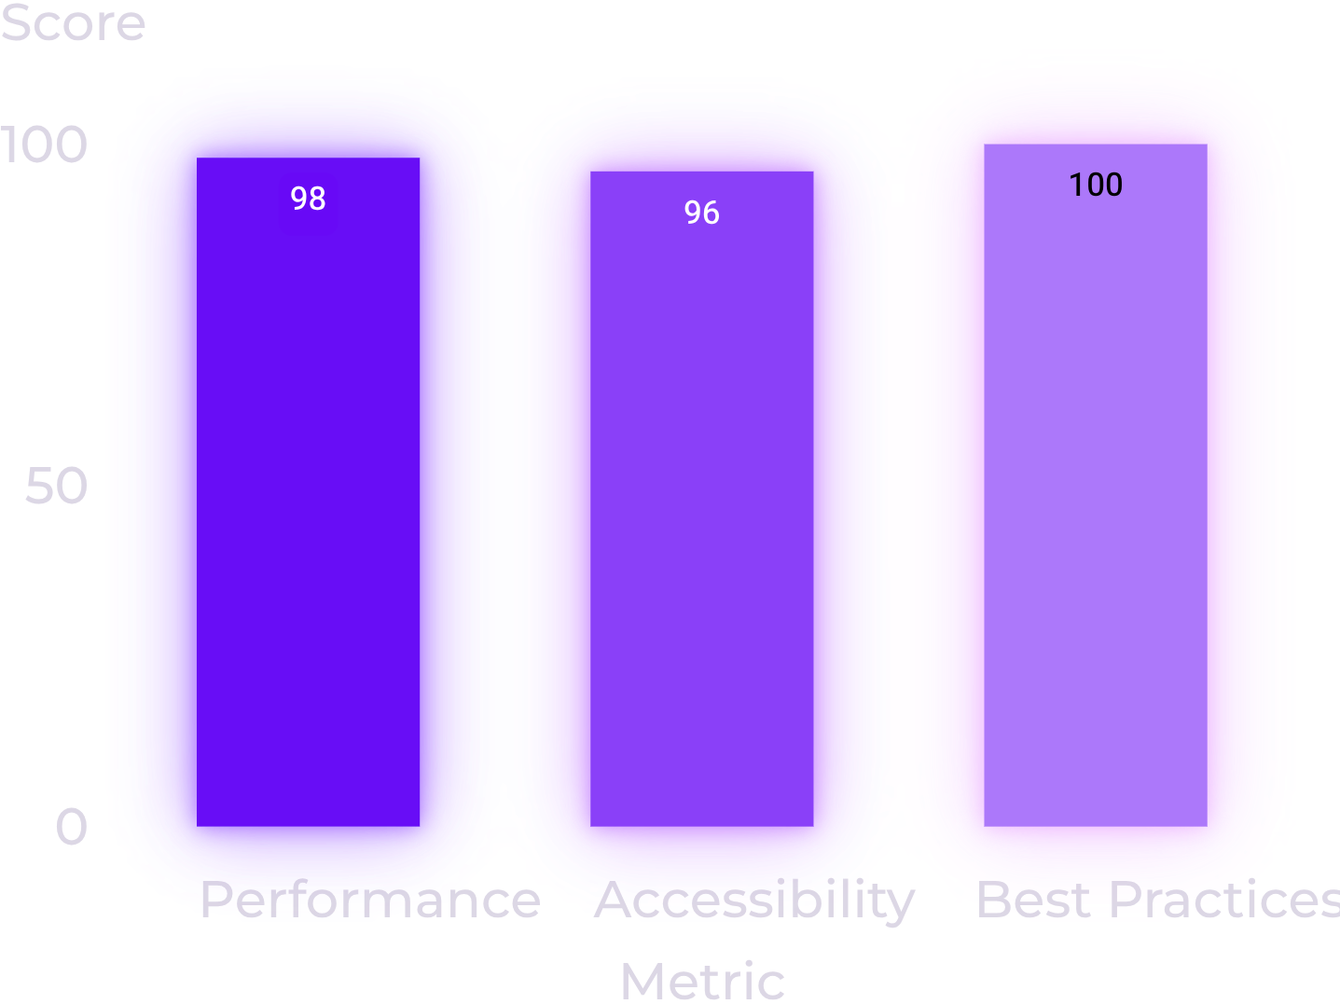
Delivered features and benchmarks back the design
Builder: 8 categories with search, brand filter, price sort.
4 presets: Budget Esports ₹51k; 1080p Ultra ₹81k; 1440p Powerhouse ₹1.35L; 4K Enthusiast ₹2.30L.
Compare builds side by side; print specification sheets via @media print; save rigs with LocalStorage CRUD.
Validation latency 0.52 ms (under 4% of a 60 FPS frame); bundle 72.4 KB gzipped, 0.6s load; 20/20 unit tests passed.
Lighthouse scores out of 100.

Slide 7
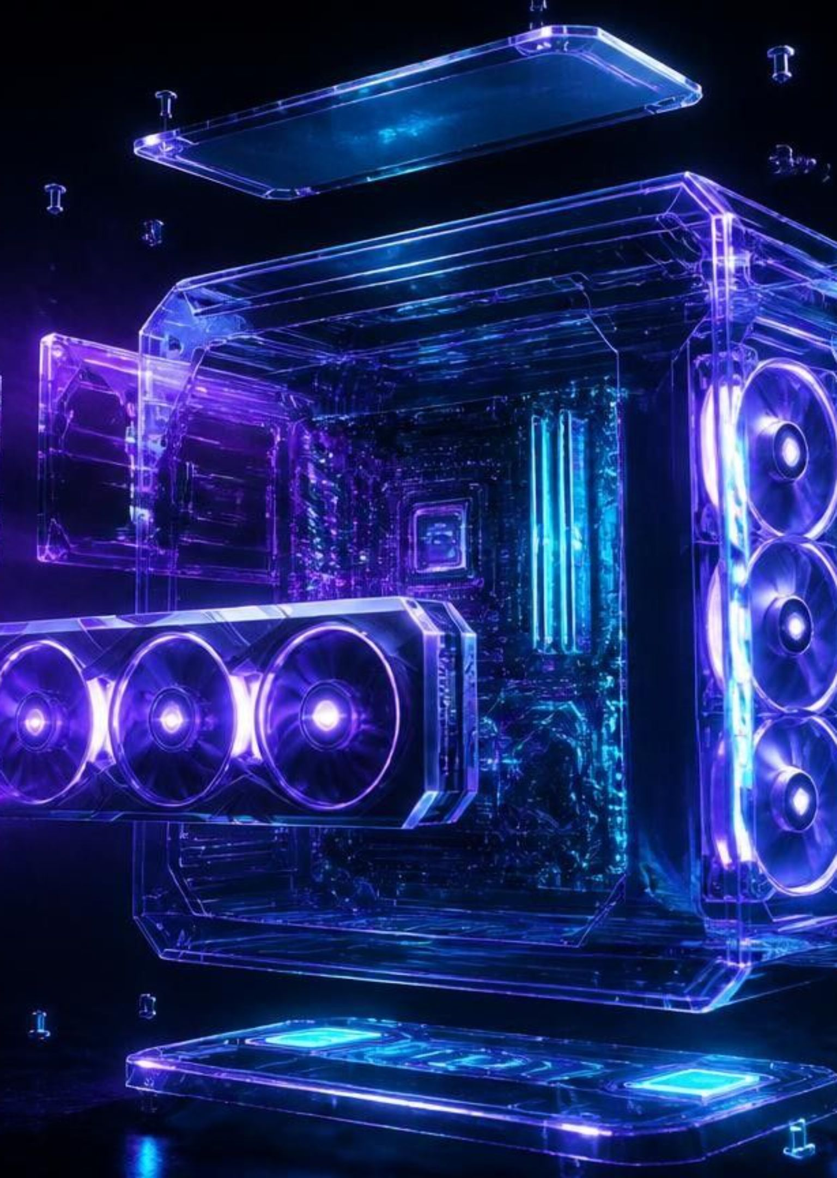
Client-side tools can make PC building error-free
Automated checks prevent physical and electrical configuration errors
Responsive cyber-gaming UI on React 18, Bootstrap 5, and Vite
Live ₹ pricing, 18% GST, and budget tracking
Fully client-side, with zero hosting or server cost
Future work
Live e-commerce scraping from MDComputers and PrimeABGB
AI-driven FPS predictor and CPU-GPU bottleneck estimates
Cloud community sharing with Supabase
3D component assembly in WebGL/Three.js
Thank you! Questions and discussion invited.

