Slide 1
Photo Album
by N, Santosha

Slide 2
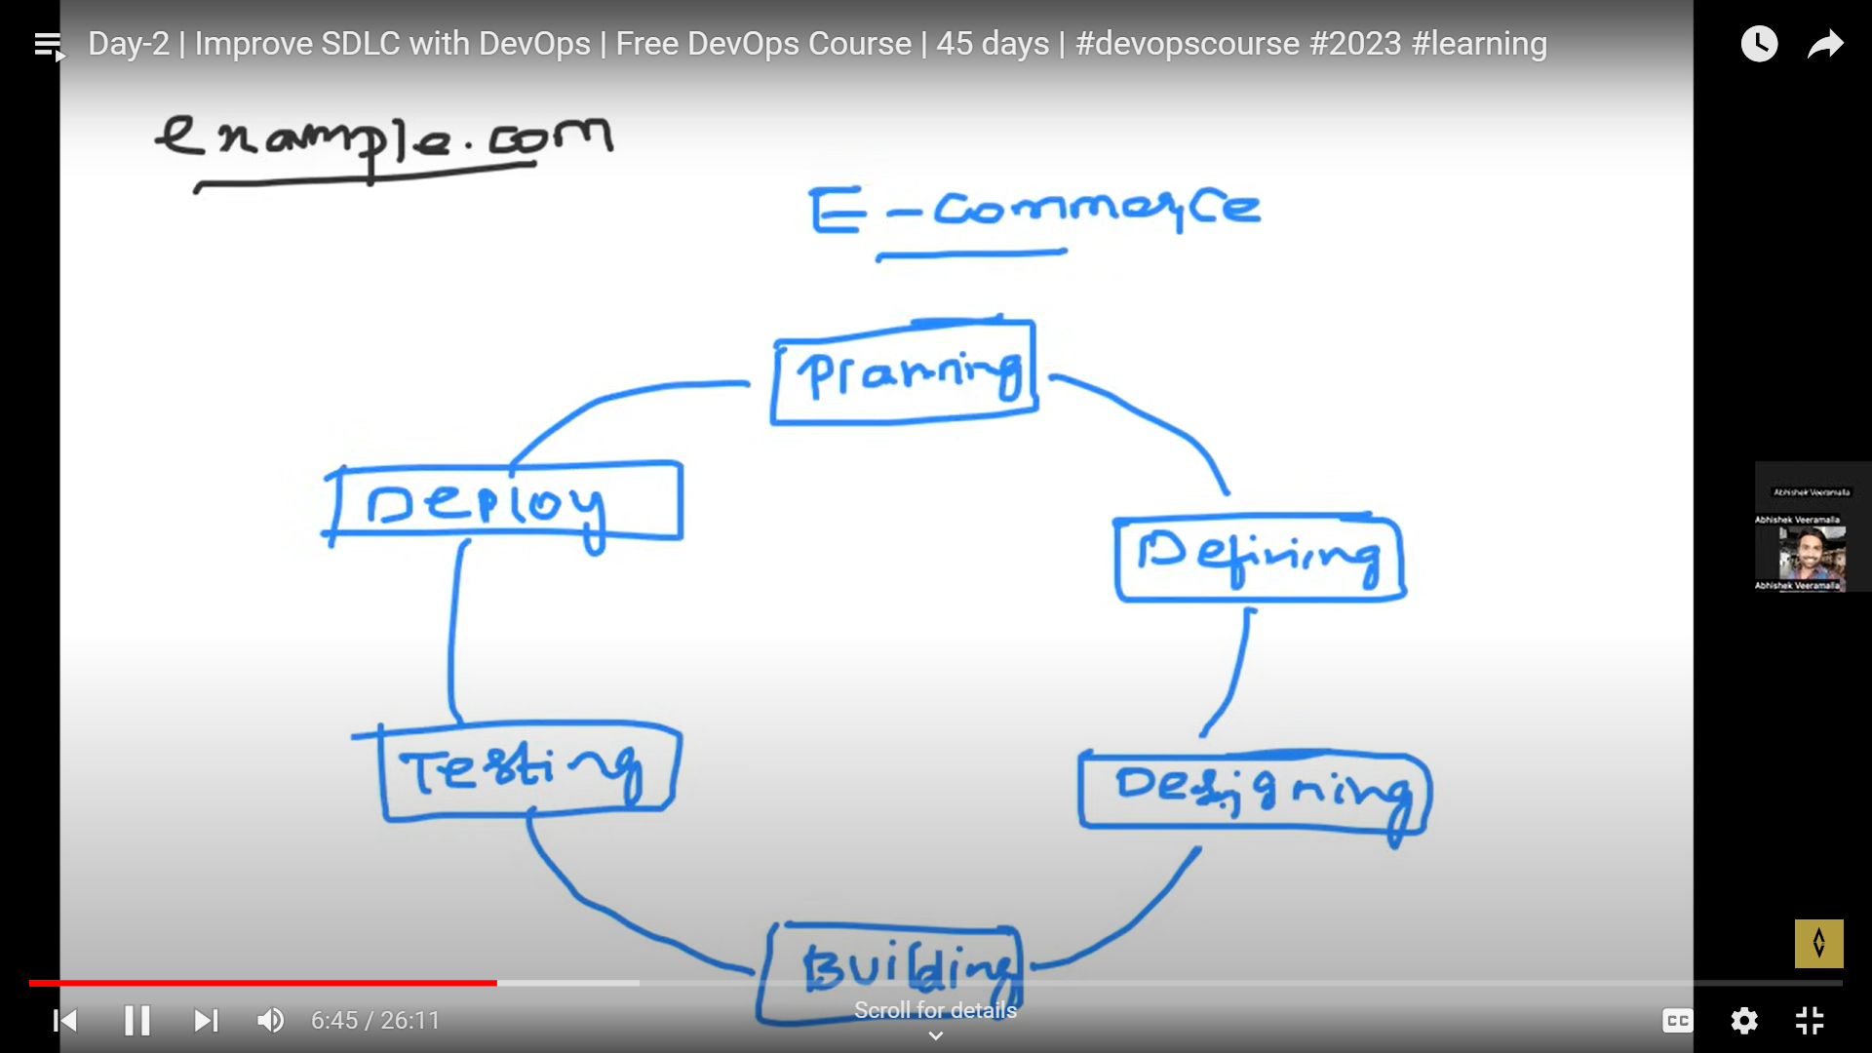

Slide 3
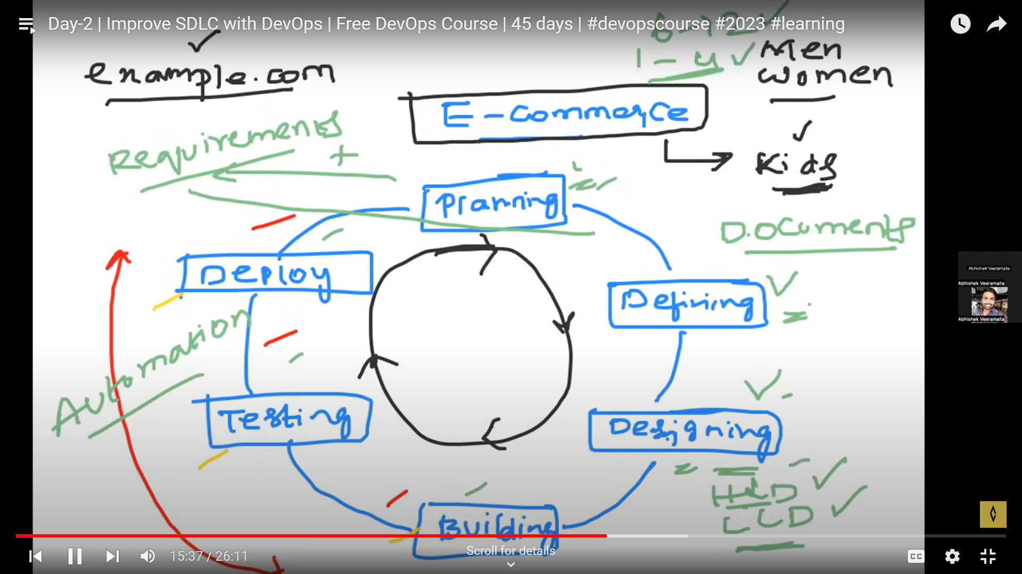

Slide 4
