Slide 1
Stroke Prediction
Real-Time Streaming ML Pipeline

Slide 2
Problem Statement
• Stroke is the 5th leading cause of death and disability globally
• Early prediction enables preventive intervention
• Requires real-time analysis of patient health metrics
• Need for scalable, distributed processing of large datasets

Slide 3
Solution Overview
• Real-time data ingestion via Apache Kafka
• Distributed processing using Spark Structured Streaming
• Machine Learning model for stroke risk prediction
• Persistent storage in Hadoop HDFS
• Scalable architecture for production deployment

Slide 4
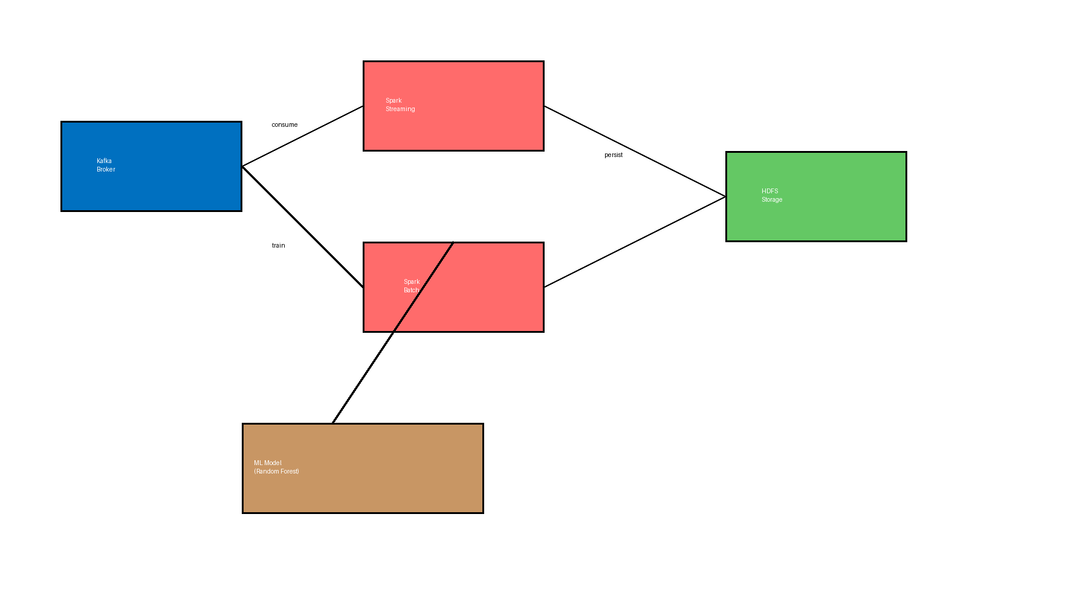
System Architecture

Slide 5
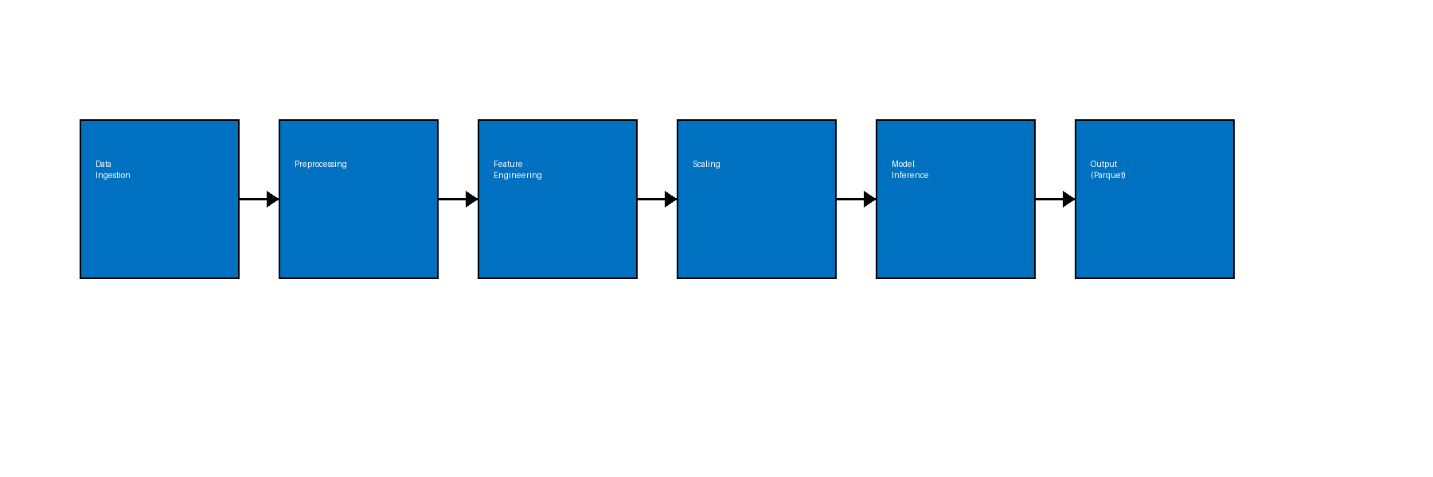
Data Processing Pipeline

Slide 6
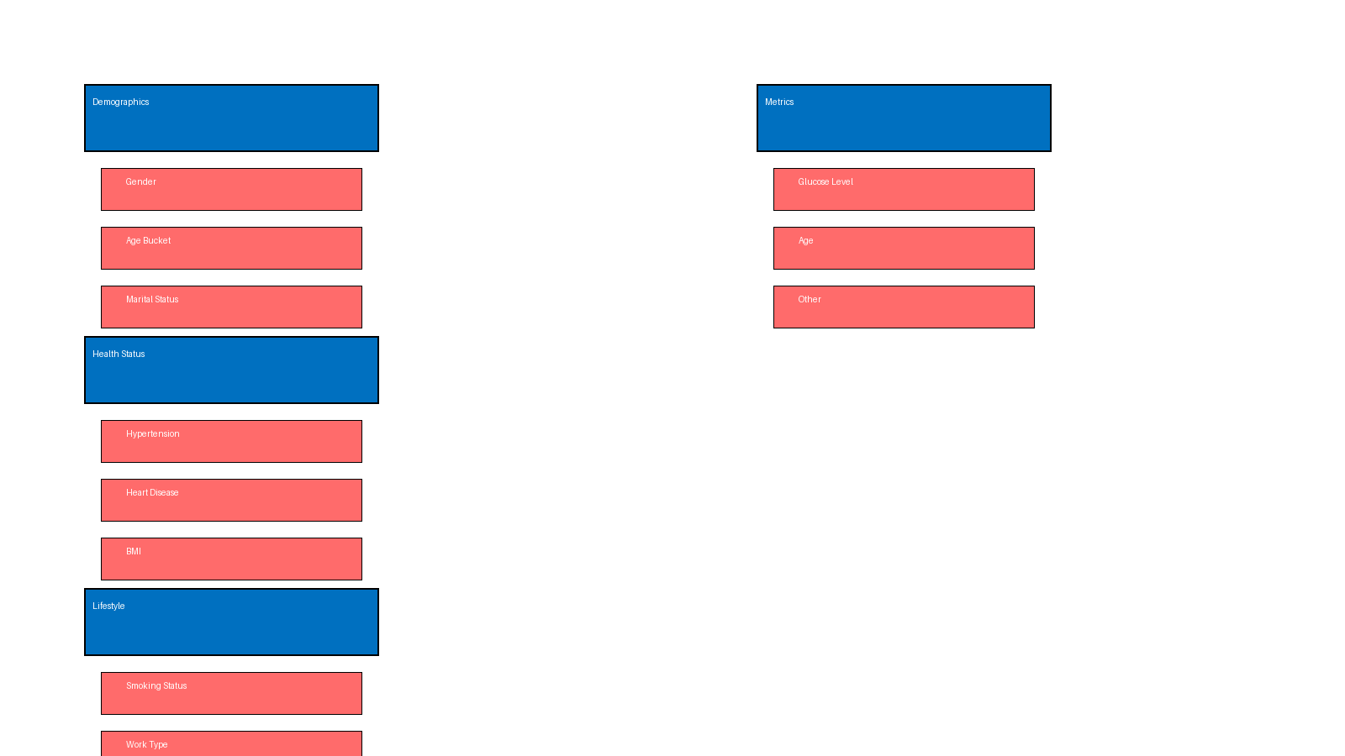
Prediction Features

Slide 7
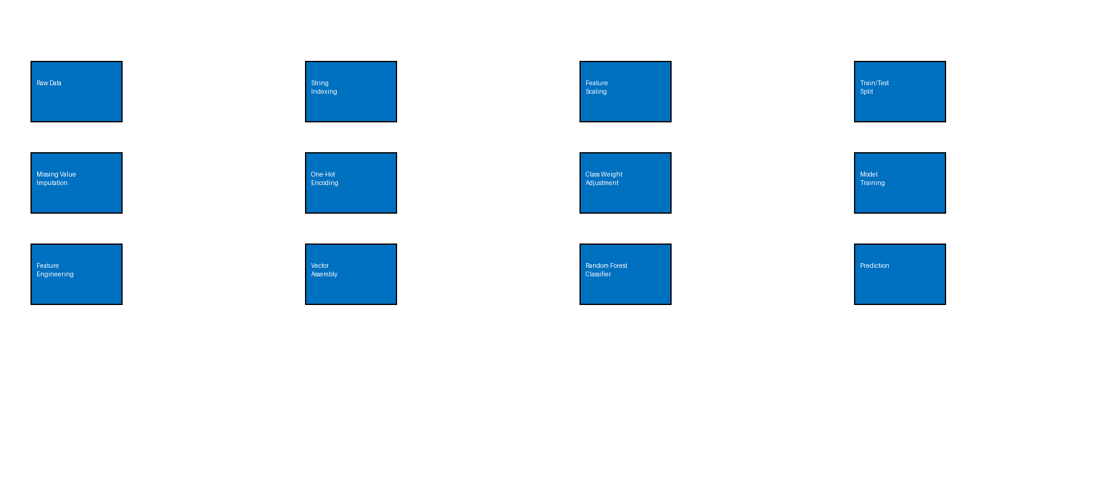
Machine Learning Pipeline

Slide 8
Technology Stack
• Apache Spark (PySpark): Distributed ML and data processing
• Apache Kafka: Real-time message streaming
• Hadoop HDFS: Distributed storage system
• Spark MLlib: Machine Learning Library
• Python 3.10+: Programming language

Slide 9
Data Schema (12 Features)
• Demographics: Gender, Age, Ever Married, Residence Type
• Health Indicators: Hypertension, Heart Disease
• Lifestyle: Smoking Status, Work Type
• Medical Metrics: Average Glucose Level, BMI
• Target Variable: Stroke (Binary: 0/1)

Slide 10
Feature Engineering
• Age Bucketing: Categorize into young, middle, senior
• String Indexing: Convert categorical variables to numeric
• One-Hot Encoding: Create binary features for categories
• Vector Assembly: Combine features into single vector
• Standardization: Scale features with mean and std dev

Slide 11
Random Forest Classifier
• Algorithm: Random Forest with 20 trees (default)
• Class Imbalance Handling: Weighted loss function
• Training Data: 80% / Test Data: 20% split
• Seed: 42 for reproducibility
• Output: Probability scores and binary predictions

Slide 12
Model Evaluation
• Confusion Matrix: True Positives, False Positives, etc.
• Precision: Accuracy of positive predictions
• Recall: Coverage of actual positive cases
• F1-Score: Harmonic mean of precision and recall
• ROC-AUC: Receiver Operating Characteristic curve

Slide 13
End-to-End Workflow
1. Data Upload: Load stroke data into HDFS
2. Model Training: Batch process with Spark MLlib
3. Model Persistence: Save models to HDFS
4. Streaming Ingestion: Consume data from Kafka
5. Real-time Inference: Apply trained model to stream
6. Result Storage: Save predictions as Parquet files

Slide 14
Implementation Details
• Kafka Topic: StrokePrediction (patient data)
• Checkpoint Path: /user/stroke/checkpoint
• Output Path: /user/stroke/stroke_predictions
• Model Artifacts: Saved for reproducible inference
• Streaming Mode: Append mode for continuous updates

Slide 15
Key Features
✓ Scalable: Distributed processing for large datasets
✓ Real-time: Stream processing with millisecond latency
✓ Reproducible: Fixed seeds and saved transformers
✓ Persistent: All data and models stored in HDFS
✓ Modular: Separate training and inference pipelines

Slide 16
Expected Outcomes
• Early stroke risk identification for at-risk patients
• Real-time predictions on incoming patient data
• Scalable to millions of patient records
• Foundation for clinical decision support systems
• Enables preventive healthcare interventions

Slide 17
Future Enhancements
• Model Versioning: Track and manage multiple models
• A/B Testing: Compare model performance in production
• Advanced Algorithms: Gradient Boosting, Neural Networks
• Real-time Dashboards: Live monitoring and alerts
• Integration: Connect to EHR and hospital systems

Slide 18
Challenges & Solutions
• Data Imbalance: Addressed via class weights
• Missing Values: Imputation with domain defaults
• Feature Scaling: Standardization for model convergence
• Latency: Spark Streaming for near real-time processing
• Reproducibility: Fixed seeds and saved transformers

Slide 19
Deployment Considerations
• Infrastructure: Hadoop cluster, Kafka brokers, Spark nodes
• Monitoring: Track model performance and data quality
• Security: Authentication, encryption, access control
• Scalability: Auto-scaling for variable data volumes
• Compliance: HIPAA and data privacy regulations

Slide 20
Conclusion
• Demonstrates real-time ML on distributed systems
• Production-ready streaming inference pipeline
• Practical application in healthcare domain
• Combines best practices from Big Data and ML engineering
• Foundation for advanced healthcare analytics

