Slide 1
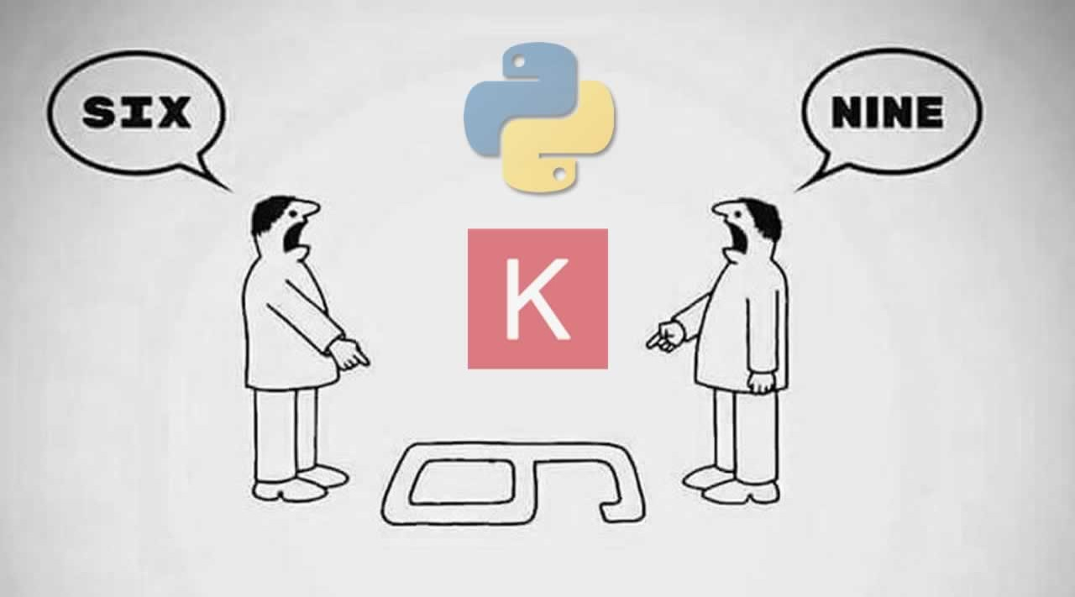
Digit Recognizer using ANN
Santhosh Kumar B V S R K

Slide 2
Problem Statement
The goal is to read the digit from image (image data is provided by pixel values from different columns in the dataset) and determine which digit it is.
The Dataset for this project (MNIST) is provided by KERAS as part of Image Classification using various techniques in Simple Neural Networks like Hidden Layers, Regularizers, Dropouts & Callbacks.

Slide 3
Steps to Perform
Load MNIST Data from Keras Datasets API of Tensor flow library.
Split Test data for allocating data for Validation.
Flatten Input image data represented in vector to a 1D array.
Run models with combinations of #of Hidden Layers, Drop Out, Regularizers & Callbacks (Early Stopping & Checkpoint).
Finalize a model which has better Accuracy & Loss.
Run Prediction on Test data using the chosen model.

Slide 4
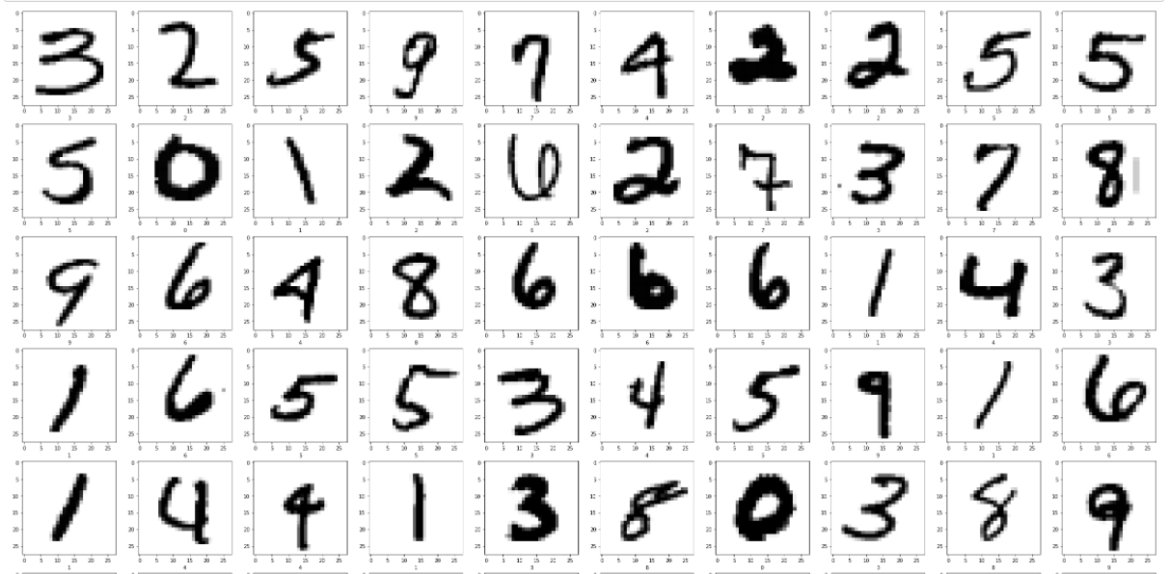
Keras MNIST Sample Data

Slide 5
How it Works ?
Image data represented in pixels is flattened to 1D array and passed as data to input layer. #of images = #no neurons in Input Layer.
Add multiple Hidden Layers with a specific #of neurons in each layer with an activation function.
After processing through multiple Hidden Layers along with few other parameters it’ll recognize the digit based on the learning from Neural Net.
You can also optimize the model by adding regularizer, dropouts & callbacks.

Slide 6
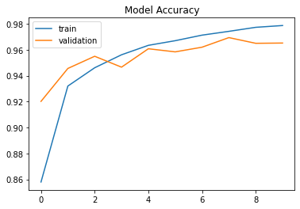
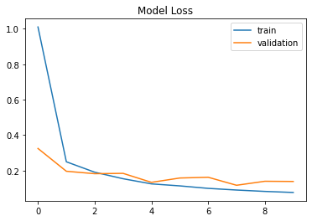
Model#1 ANN with 3 Hidden Layers

Slide 7
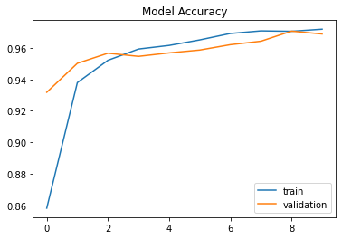
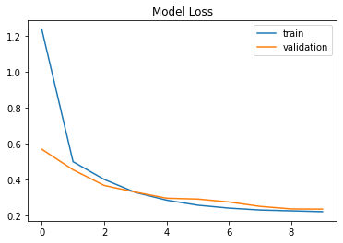
Model#2 ANN with HL & L1 Regularizer

Slide 8
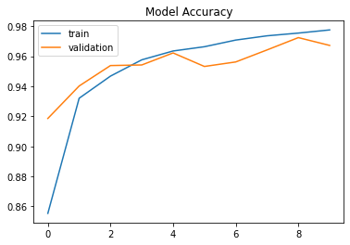
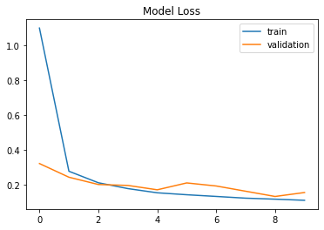
Model#3 ANN with HL & L2 Regularizer

Slide 9
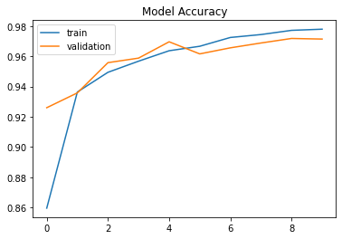
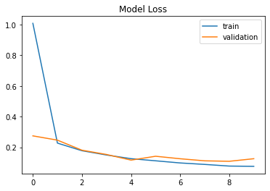
Model#4 ANN with HL & EarlyStopping Callback

Slide 10
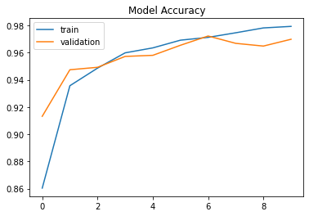
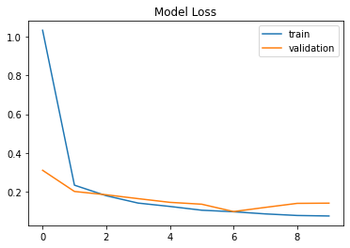
Model#5 ANN with HL & EarlyStopping, Checkpoint Callbacks

Slide 11
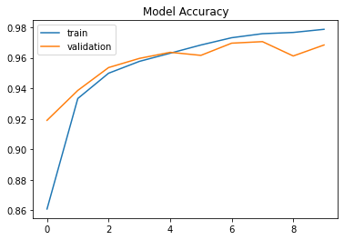
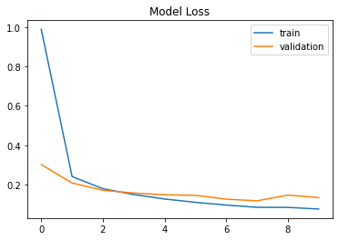
Model#6 ANN with HL, Dropouts & EarlyStopping, Checkpoint Callbacks

Slide 12
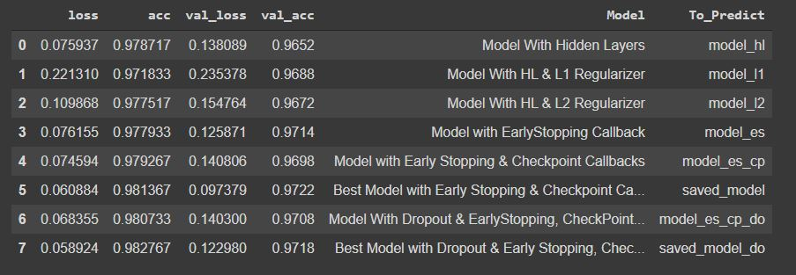
Accuracy & Loss across Models
Note: To_Predict shows the variable in which model is saved to use for prediction

Slide 13
CONCULSION
Considering the best model with 3 Hidden Layers & Callbacks [Early Stopping & Check Point] with Training & Validation accuracy at ~98% & ~97% & loss at ~6% & ~10% resulted in a Test data accuracy of 96.8% with loss of 12%.

Slide 14

THANK YOU

