Slide 1

Exploratory Data Analysis of Facebook Dataset
Santhosh Kumar BVSRK

Slide 2
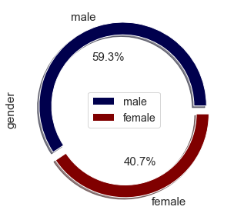
Which Gender users are more ?
Male users are more than Female

Slide 3
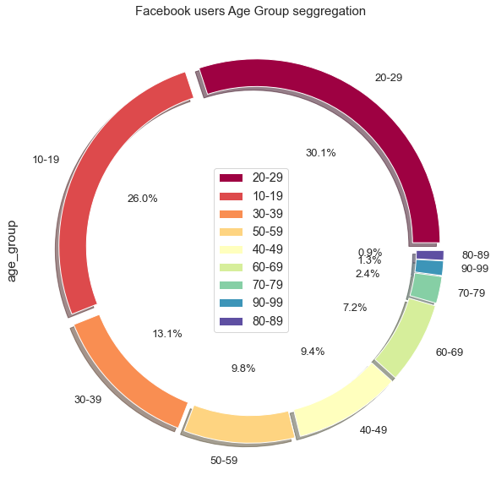
Which Age Group users are more ?
Majority of Users are in Age Group 20-29

Slide 4
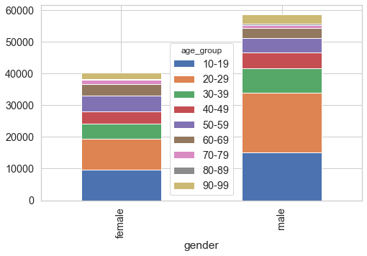
What is the age group of users who are more in number w.r.t gender ?
Female & Male in the Age Group of 20-29 are more in number

Slide 5
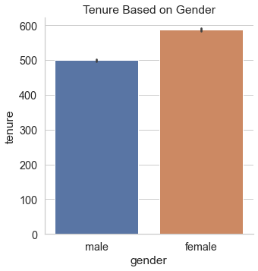
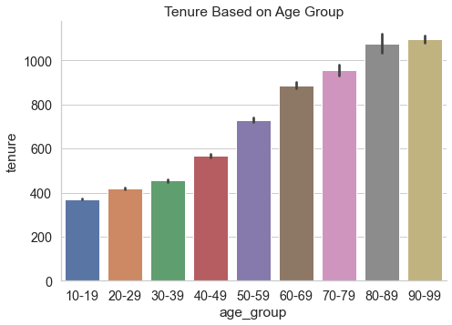
Which Gender & Age Group has highest Tenure ?
Tenure of Female is higher & Age group 90-99 has highest Tenure

Slide 6
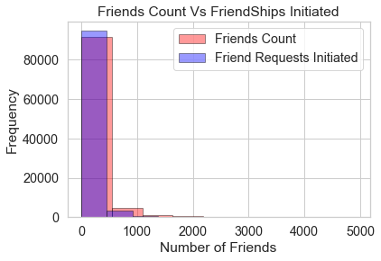
Which among Friends & Friendships Initiated have more count?
Friendships Initiated is more than Friends Count

Slide 7
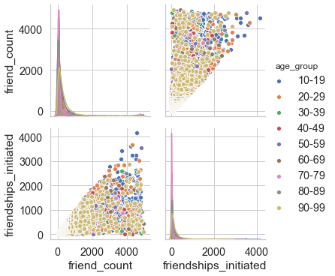
Users of which Age Group have more Friends Count & Friendships Initiated ?
Friends Count & Friendships Initiated are more in Age Group 10-19

Slide 8
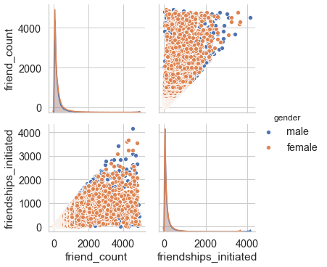
Users of which Gender have more Friends Count & Friendships Initiated ?
Friends Count & Friendships Initiated are more for Male

Slide 9
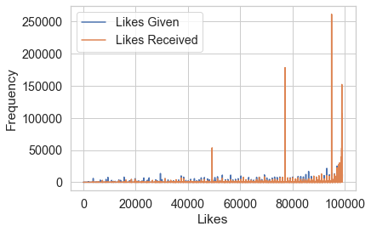
Whose count is more among Likes Received & Likes Given ?
Likes Received is more than Likes Given

Slide 10
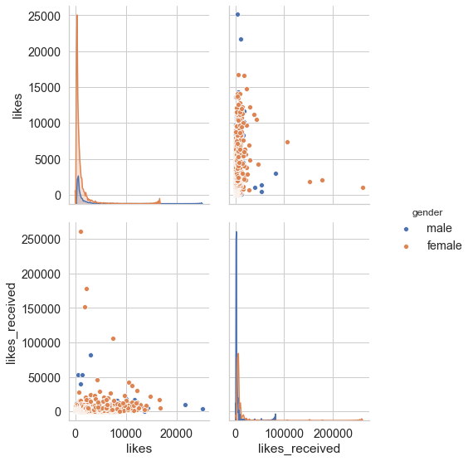
Which Gender has more Likes & Likes Received ?
Overall Likes are higher for Male & Female have higher Likes Received

Slide 11
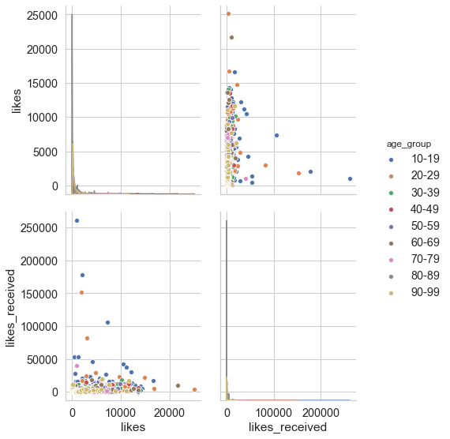
Which Age Group has more Likes & Likes Received ?
Users of Age Group 20-29 have more Likes & Users of Age Group 10-19 have more Likes Received

Slide 12
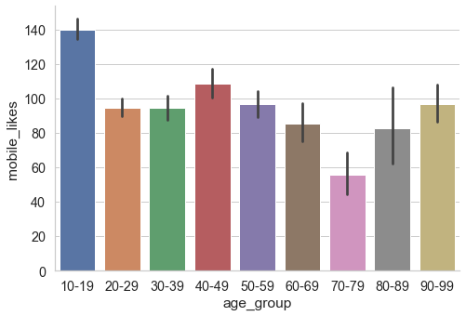
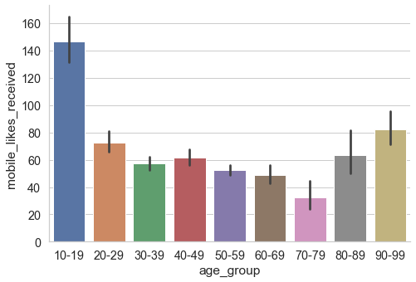
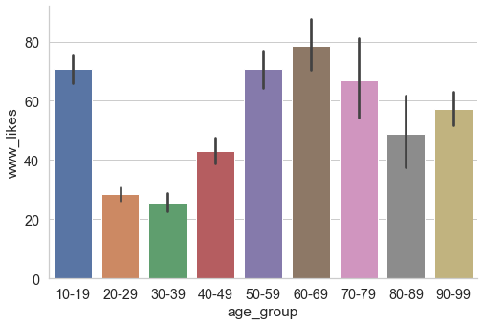
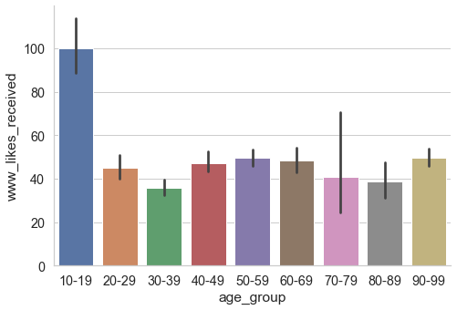
Which among Mobile & Web are more used ?
Mobile is more used than Web

Slide 13
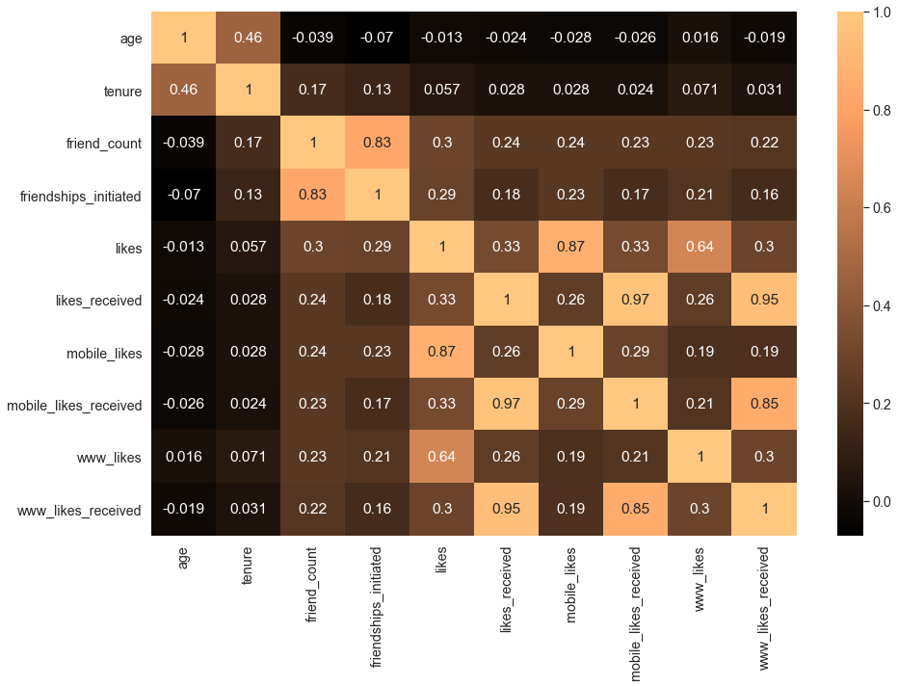
Which Variables are highly correlated ?
Likes Received is highly correlated with Mobile Likes Received & Web Likes Received

