Slide 1

Enhancing XYZ Bank's Term Deposit Marketing
Team: Data Geeks
Sai Mithilesh Reddy Bogireddy
Santhosh Chittiprolu
Sriharsha Penumudi
Amarnadh Oleti

Slide 2
Data-Driven Strategies for Client Engagement
The Challenge: XYZ Bank needs to refine its term deposit marketing, moving from traditional tactics to a more targeted, data-informed approach.
Our Approach: Utilizing machine learning on client data, we aim to uncover patterns indicating a higher likelihood of term deposit subscriptions.
Insights from Data: Our Exploratory Data Analysis (EDA) provides a deeper understanding of client behaviors and preferences, guiding our marketing strategy.
Actionable Outcomes: With predictive modeling, we identify key client segments for targeted marketing, aiming to boost campaign success and client relationships.

Slide 3
Data Overview
Dataset captures XYZ Bank's marketing campaign for term deposits via phone calls.
Objective: Predict whether a customer will subscribe to the deposit.
Timeframe: Spans May 2008 to November 2010.
Data includes client demographics: age, job, marital status, and education.
Contains details of the latest campaign contact: type, month, and duration.
Beyond client data, includes economic context indicators.
Indicators cover employment variation, consumer price index, confidence index, Euribor 3-month rate.
Offers insight into the economic backdrop during the marketing campaigns.

Slide 4
Exploratory Data Analysis (EDA)
Data Structure and Summary: Examined the dataset's structure, including feature types and missing values, and analyzed statistical summaries to understand distributions and variability.
Visual Exploration: Utilized histograms and bar charts to visualize distributions of numerical and categorical variables, revealing key trends and outliers.
Correlation and Target Analysis: Investigated correlations between variables and explored the relationship of each feature with the target variable 'y' to understand factors influencing term deposit subscriptions.
Data Preparation: Conducted data cleaning, feature engineering, and preprocessing, including handling missing values, encoding categorical variables, and applying class balancing techniques for the target variable.
Notes:
Displayed schema and the first few rows of the dataset.
Provided summary statistics for numerical columns.
Conducted univariate analysis for numerical columns ('age' and 'duration').
Analyzed categorical columns ('job' and 'marital') through groupBy operations.
Explored relationships between the target variable 'y' and other

Slide 5
Data Preprocessing
Null values Handling
One hot encoding is done for the categorical variables Job, Marital, Education, Default, Housing, Loan, Contact, Month, Day_of_week, Poutcome.
Feature Transformation
Imported necessary modules.
Defined columns for transformation.
Utilized VectorAssembler to merge features.
Produced assembled data.
VectorAssembler Implementation
Identified categorical columns for encoding.
Created input columns for VectorAssembler.
Merged categorical indices and numerical features.
Output includes selected columns and assembled data.

Slide 6
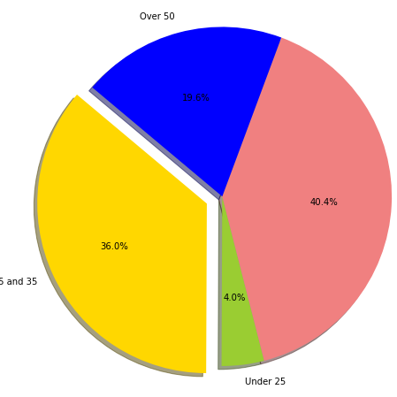
Age UDF distribution
Youth Segment (Under 25): 4.0% - Digital banking engagement and financial literacy programs could be pivotal.
Young Adults (25-35): 36.0% - Ideal candidates for home loans, personal financing, and beginning investment products.
Established Adults (36-49): 40.4% - The core demographic, likely interested in diversified investment options and education savings plans.
Senior Clients (Over 50): 19.6% - Potential focus on retirement planning, wealth management, and legacy planning services.

Slide 7
Correlation Analysis
Duration (0.405) shows a strong positive correlation with subscription (y).
Longer calls tend to significantly increase the chances of a subscription.
Emp_var_rate, euribor_3m, and nr_employed exhibit negative correlations with subscription (y).
Economic stability, indicated by lower rates and higher employment figures, positively influences subscription rates.
Previous contacts (0.230) show a moderate positive correlation with subscription (y).
Having had multiple contacts in the past enhances the probability of a subscription.

Slide 8
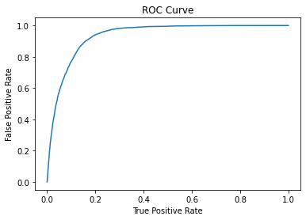
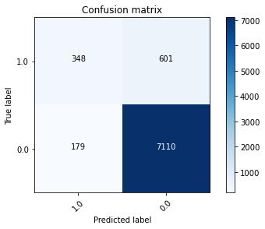
Logistic regression:
Employed Logistic Regression using PySpark's MLlib and scikit-learn for predictive modeling of term deposit subscriptions.
Achieved a 90.53% accuracy rate in forecasting term deposit subscriptions, evaluated using a confusion matrix.
Demonstrated robust predictive ability with a 93.36% Area Under the ROC Curve (AUC), highlighting model effectiveness in distinguishing between subscription outcomes.
Notes:
Model Building: Utilized Spark's Logistic Regression (MLlib) and scikit-learn for predictive analysis.
Data Preparation: Cleaned and partitioned data into training and test sets for model training and evaluation.
Performance Metrics: Achieved 90.53% accuracy in predicting outcomes, assessed via confusion matrix analysis.
Evaluation Insights: ROC curve analysis showcased a 93.36% area under the curve, indicating strong predictive performance.
Business Integration: Highlighted the significance of accurate predictions for strategic decision-making, emphasizing real-time implementation for operational efficiency and risk mitigation.

Slide 9
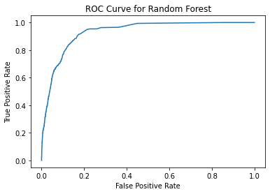
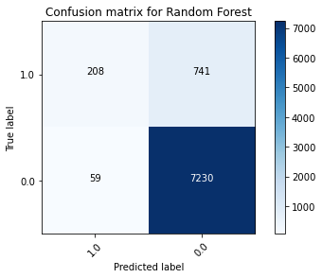
Random Forest Classifier:
Deployed the RandomForestClassifier from the PySpark library for ensemble learning and decision-making.
Achieved an Area Under the Curve (AUC) of 0.9301 for the Random Forest model, indicating its effectiveness in distinguishing subscription outcomes.
Compared to the Logistic Regression model, the Random Forest exhibited a slightly higher AUC of 0.9301 against 0.9336 from the Logistic Regression model.
Notes:
Model Implementation:
Utilized Random Forest Classifier using PySpark's MLlib for predictive analysis on term deposit subscriptions.
Deployed the RandomForestClassifier from the PySpark library for ensemble learning and decision-making.
Model Performance:
Achieved an Area Under the Curve (AUC) of 0.9301 for the Random Forest model, indicating its effectiveness in distinguishing subscription outcomes.
Compared to the Logistic Regression model, the Random Forest exhibited a slightly higher AUC of 0.9301 against 0.9336 from the Logistic Regression model.
Confusion Matrix:
Displayed a confusion matrix for the Random Forest model, showcasing its predictive accuracy.
Confusion matrix for Random Forest:
luaCopy code
[[ 208 741]
[ 59 7230]]
Highlighted the Random Forest model's ability to correctly predict positive and negative subscriptions.
ROC Curve Analysis:
Illustrated the ROC curve for the Random Forest model, indicating its true positive rate against the false positive rate.
AUC for the Random Forest model stood at 0.9301, reflecting its robust predictive performance.
Comparative Analysis:
When compared with the Logistic Regression model, the Random Forest showed slightly lower performance by 0.0035 in terms of AUC, suggesting a marginally less effective performance in discriminating between subscription outcomes.

Slide 10
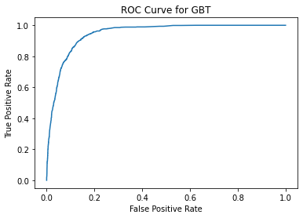
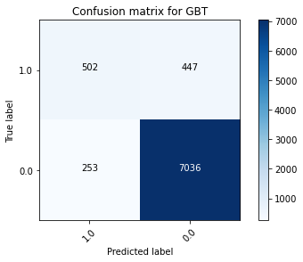
Gradient Boost classifier:
Utilized GBT Classifier with a maximum of 10 iterations for boosting decision-making.
Achieved an Area Under the Curve (AUC) of 0.9457 for the GBT model, signifying its strong capability in distinguishing subscription outcomes.
Compared to both the Logistic Regression and Random Forest models, GBT showed higher discriminatory power with the highest AUC of 0.9457.
The GBT model outperformed with a noticeably higher AUC, suggesting a superior ability to discriminate between subscription outcomes, especially in correctly predicting positive subscriptions.
Notes:
Model Implementation:
Employed the GBT Classifier from PySpark's MLlib for predictive analysis on term deposit subscriptions.
Utilized GBTClassifier with a maximum of 10 iterations for boosting decision-making.
Model Performance:
Achieved an Area Under the Curve (AUC) of 0.9457 for the GBT model, signifying its strong capability in distinguishing subscription outcomes.
Compared to both the Logistic Regression and Random Forest models, GBT showed higher discriminatory power with the highest AUC of 0.9457.
Confusion Matrix:
Displayed the confusion matrix for the GBT model, demonstrating its predictive accuracy.
Confusion matrix for GBT:
luaCopy code
[[ 502 447]
[ 253 7036]]
Highlighted the GBT model's ability to correctly predict positive and negative subscriptions, with improved precision in positive class prediction compared to other models.
ROC Curve Analysis:
Illustrated the ROC curve for the GBT model, demonstrating its true positive rate against the false positive rate.
The GBT model exhibited the highest AUC of 0.9457, showcasing its superior performance in separating subscription outcomes compared to Logistic Regression and Random Forest models.
Comparative Analysis:
Compared to both Logistic Regression and Random Forest models, the GBT model outperformed with a noticeably higher AUC, suggesting a superior ability to discriminate between subscription outcomes, especially in correctly predicting positive subscriptions.

Slide 11
Decision Tree:
Achieved an Area Under the Curve (AUC) of 0.6597 for the Decision Tree model.
When compared to the other models, the Decision Tree exhibited a lower AUC, indicating comparatively weaker performance in distinguishing subscription outcomes.
Notes:
Model Implementation:
Employed the Decision Tree Classifier from PySpark's MLlib for analyzing term deposit subscriptions.
Utilized DecisionTreeClassifier for making predictions based on features.
Model Performance:
Achieved an Area Under the Curve (AUC) of 0.6597 for the Decision Tree model.
When compared to the Logistic Regression model, the Decision Tree exhibited a lower AUC, indicating comparatively weaker performance in distinguishing subscription outcomes.
Confusion Matrix:
Demonstrated the confusion matrix for the Decision Tree model.
Confusion matrix for Decision Tree:
luaCopy code
[[ 502 447]
[ 253 7036]]
Showcased the model's ability to predict positive and negative subscriptions, indicating some misclassifications compared to the Logistic Regression model.
Comparative Analysis:
In comparison to the Logistic Regression model, the Decision Tree showed inferior performance in predicting term deposit subscriptions, as evidenced by its lower AUC.
The Decision Tree model might be less effective in distinguishing between subscription outcomes when compared to the Logistic Regression model.
Further Considerations:
Explore optimization techniques or feature engineering to enhance the Decision Tree's predictive power.
Consider ensemble methods or alternative algorithms that may potentially improve predictive accuracy compared to the Decision Tree model.

Slide 12
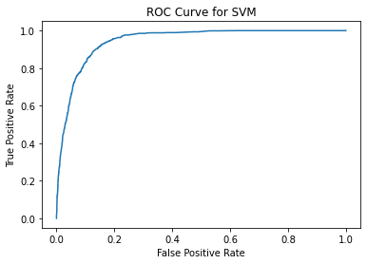
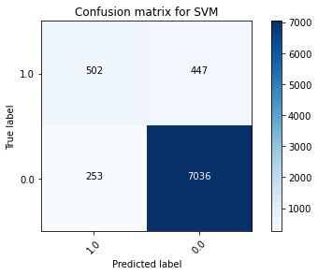
Support Vector Machines (SVM):
SVM displayed respectable predictive accuracy but slightly lower AUC compared to GBT.
Confusion matrix results were akin to GBT and Decision Trees, with relatively higher false positives.
K-mean clustering is also used to predict the term deposit subscription rate.
Notes:
Support Vector Machines (SVM):
AUC: 0.9155
Confusion Matrix:
luaCopy code
[[ 502 447]
[ 253 7036]]
SVM displayed respectable predictive accuracy but slightly lower AUC compared to GBT.
Confusion matrix results were akin to GBT and Decision Trees, with relatively higher false positives.
Comparison with Other Models:
SVM's AUC was slightly lower than that of GBT but notably higher than Logistic Regression, Random Forest, and Decision Trees.
Similar confusion matrix results were observed between SVM, GBT, and Decision Trees, hinting at comparable predictive patterns.
SVM offered a balance between accuracy and computational efficiency compared to complex ensemble models like GBT.
Key Insights:
SVM showcased decent predictive power but fell marginally short compared to GBT in terms of AUC.
The confusion matrix results for SVM were closer to GBT, indicating a comparative predictive pattern.
Consider using SVM for a good balance between predictive accuracy and computational cost, especially when simpler models are preferred over complex ensembles like GBT.

Slide 13
Best model
Gradient Boosted Trees excel with the highest AUC of 94.46%, indicating superior predictive accuracy in distinguishing between potential subscribers and non-subscribers.
Logistic Regression shows robust performance with an accuracy of 90.53% and an AUC of 93.36%, beneficial for its interpretability and balance in prediction.
Random Forest and Support Vector Machine present competitive performances with AUCs of 92.96% and 91.55%, respectively, offering reliable alternatives.
Decision Tree lags behind with a significantly lower AUC of 64.26%, suggesting it is less effective for this specific predictive task compared to other models.

Slide 14
Prescriptive Recommendations& Conclusions
Target Age Groups: Focus on older age groups, as they are more likely to subscribe. Tailoring products to suit their needs could be beneficial.
Focus on Specific Job Types: Prioritize marketing efforts towards retirees, students, and individuals in administrative or management roles.
Marital Status Consideration: Single individuals might be more receptive to term deposit offers, so consider campaigns targeting this demographic.
Seasonal Marketing Strategies: Adjust the timing of campaigns to target months with historically higher success rates, like March, December, October, and September.
Educational Level Targeting: Customize the marketing approach for individuals with university degrees and high school education, as they show a higher propensity to subscribe.

Slide 15

THANK YOU

