Slide 1
PROJECT PRESENTATION | DATA ANALYTICS & VISUALIZATION
AGRICULTURE
CROP ANALYTICS
RECORDS
500
CROPS
10
Data-driven insights for crop production, yield and farm performance
STATES
10
Dataset • Data Cleaning • Data Analysis • Visualization
YEARS
2023–26
Submitted by: K. SURYA • P. SHIVA SAI • G. SANTHOSH
SR University | Academic Year 2026–27
01

Slide 2
01 • DATASET
02
Dataset Overview
The uploaded agriculture dataset contains farm, crop, climate, input, yield and financial records.
RECORDS
ANALYTICAL FIELDS
CROP TYPES
STATES
YEAR COVERAGE
500
24
10
10
2023–2026
Farm-level records
25 original columns; blank index excluded
Rice, wheat, maize, onion, etc.
Geographic coverage
Four calendar years
KEY DATA FIELDS
DATASET SNAPSHOT
• State, District, Crop, Season and Year
• Area_Hectares, Soil_Type and weather measures
• Irrigation_Type and agricultural input quantities
• Yield_Tons, Yield_Per_Hectare and financial outcomes
• Disease_Risk
Total cultivated area: 2,052.04 hectares
Total crop production: 34,738.20 tons
Average yield: 17.93 tons/hectare
Geographic fields: State and District
AGRICULTURE CROP ANALYTICS • DATA ANALYTICS AND VISUALIZATION

Slide 3
02 • DATA PREPARATION
03
Data Cleaning & Preparation
Validation steps applied before calculating the descriptive statistics.
01
Structure check
02
Missing values
Confirmed 500 rows and 25 original columns.
One missing value in the index-like Unnamed: 0 field; zero in the 24 agricultural fields.
03
Duplicate check
04
Column handling
No fully duplicated rows found.
Excluded Unnamed: 0 because it is an index-like field, not an agricultural measure.
05
Data types
06
Range review
Checked numeric measures and categorical fields; no date parsing required.
Reviewed min/max values; retained extremes because no external validation limits were supplied.
CLEANING OUTCOME 500 / 500 records retained • 0 missing agricultural values • 0 duplicate rows
AGRICULTURE CROP ANALYTICS • DATA ANALYTICS AND VISUALIZATION

Slide 4
03 • DATA ANALYSIS
04
Exploratory Data Analysis
Descriptive findings from all 500 farm records.
CULTIVATED AREA
CROP PRODUCTION
AVERAGE YIELD
TOTAL REVENUE
TOTAL PROFIT
2,052.0 ha
34,738.2 t
17.93 t/ha
₹26.87 Cr
₹17.78 Cr
Total recorded area
Total yield
Across all records
Recorded revenue
Recorded profit
PRODUCTION HIGHLIGHTS
DISEASE RISK
• Sugarcane has the highest total production: 16,163.50 tons.
• Rabi is the highest-production season: 13,377.29 tons.
• 2024 has the highest yearly total: 10,335.87 tons.
• Average rainfall: 987.7 mm; average temperature: 26.7 °C.
Low
190
Medium
193
High
117
Medium risk is the most frequent category.
AGRICULTURE CROP ANALYTICS • DATA ANALYTICS AND VISUALIZATION

Slide 5
04 • AGRICULTURAL CHALLENGE
05
Problem Statement
Why farm-level data analysis can support better agricultural planning.
THE PROBLEM
CURRENT ANALYSIS CHALLENGES
Crop performance is influenced by crop choice, season, soil, rainfall, temperature, irrigation and input use. When these records are not analyzed together, it is difficult to compare productivity, understand differences between farms and identify where further investigation is needed.
• Farm, crop and location information can be spread across many records.
• Production totals alone do not show yield efficiency per hectare.
• Weather, soil and irrigation groups need to be compared carefully.
• Financial outcomes vary substantially across crop types.
• Disease-risk labels need monitoring and field validation.
AGRICULTURE CROP ANALYTICS • DATA ANALYTICS AND VISUALIZATION

Slide 6
05 • EVIDENCE FROM DATA
06
Problem Analysis — What the Dataset Shows
The supplied 500-row dataset provides measurable signals for further investigation.
TOP PRODUCTION CROP
TOP SEASON
TOP AVERAGE YIELD SOIL
HIGH DISEASE RISK
Sugarcane
Rabi
Loamy
117
16,163.5 tons
13,377.3 tons
22.40 tons/hectare
23.4% of records
WHAT THE RESULTS SUGGEST
IMPORTANT LIMITATION
• Compare total production and per-hectare yield separately.
• Review seasonal and year-wise differences before planning.
• Investigate soil and irrigation groups alongside crop mix.
• Track disease-risk categories with field-level verification.
This dataset is a set of 500 farm records. It does not establish why one crop or method performs better. The findings are descriptive, and correlations or group averages do not prove cause and effect.
AGRICULTURE CROP ANALYTICS • DATA ANALYTICS AND VISUALIZATION

Slide 7
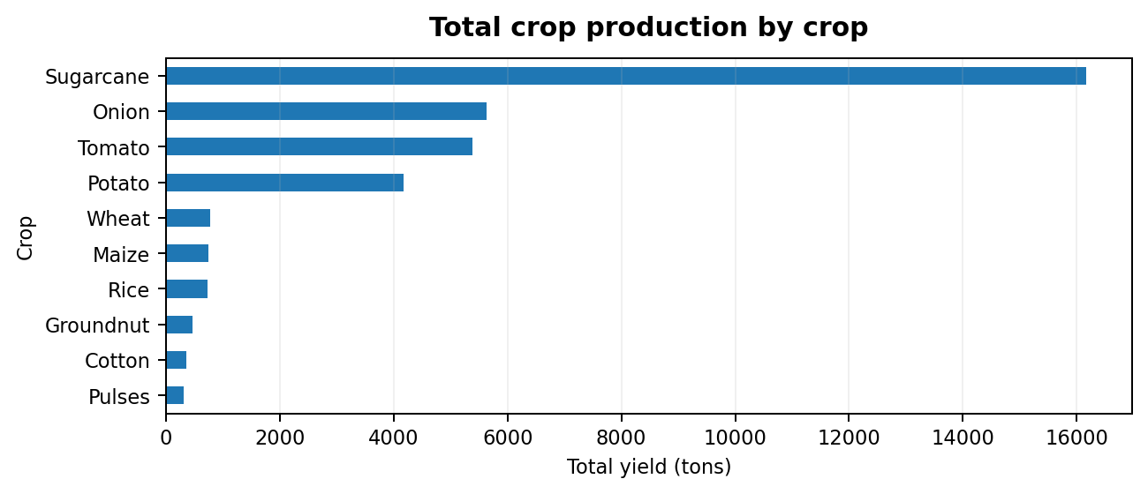
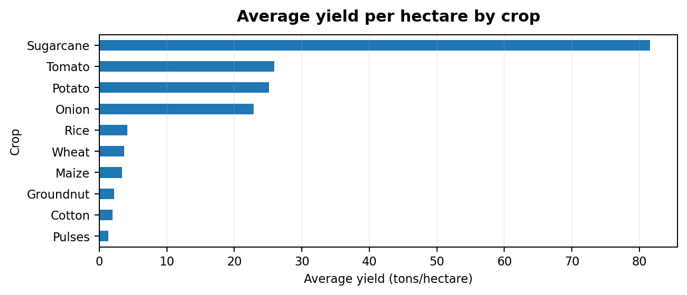
06 • VISUAL EVIDENCE
07
Crop Production & Yield Visualizations
Charts calculated directly from the uploaded agriculture dataset.
Figure 1. Sugarcane leads total output with 16,163.50 tons.
Figure 2. Per-hectare yield ranks crop efficiency differently from total production; highest average: Sugarcane (81.56 t/ha).
TOTAL OUTPUT
YIELD INTENSITY
AGRICULTURE CROP ANALYTICS • DATA ANALYTICS AND VISUALIZATION

Slide 8
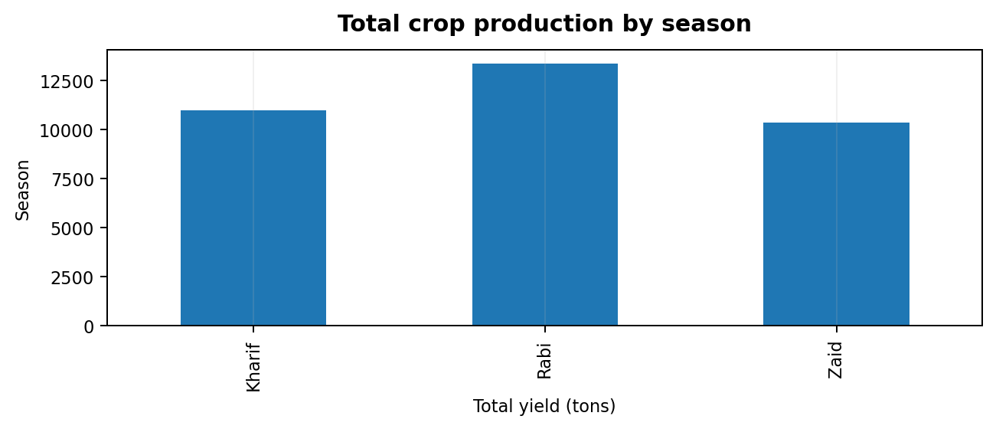
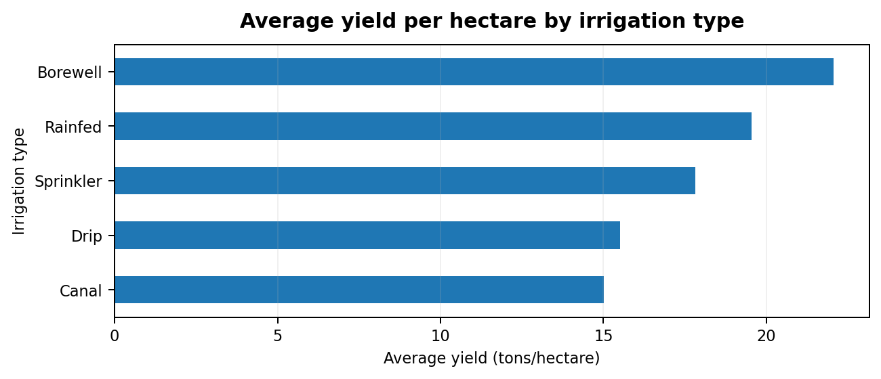
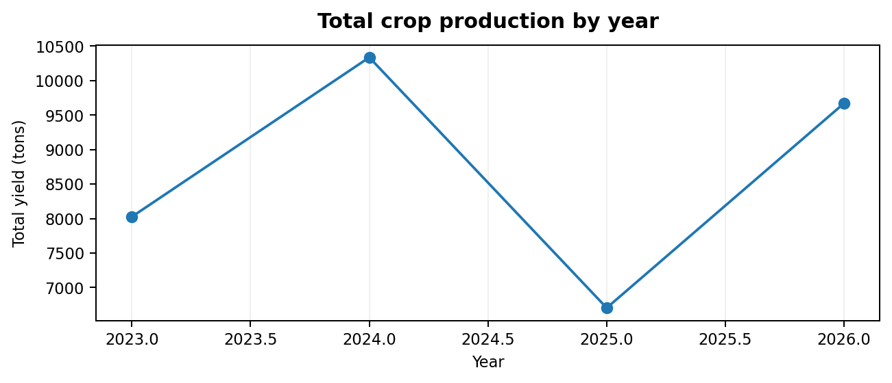
07 • COMPARATIVE ANALYSIS
08
Season, Irrigation & Year Patterns
Compare agricultural outcomes across key groups in the dataset.
Rabi has the highest seasonal production (13,377.3 tons).
Borewell shows the highest average yield (22.06 t/ha).
2024 has the highest annual total (10,335.9 tons).
AGRICULTURE CROP ANALYTICS • DATA ANALYTICS AND VISUALIZATION

Slide 9
08 • ACTION PLAN
09
Recommendations & Expected Benefits
Turn the dataset findings into practical next steps for agricultural analysis.
01 COMPARE
Review total crop output and yield per hectare separately when selecting crops or evaluating performance.
02 PLAN
Use season-wise and year-wise summaries to support crop planning and monitor changes over time.
03 INVESTIGATE
Compare soil, irrigation, rainfall and input use within similar crop groups before drawing conclusions.
04 MONITOR
Track disease-risk categories and verify high-risk records through field observations.
05 IMPROVE
Build a Power BI dashboard with filters for State, District, Crop, Season, Year, Soil and Irrigation.
EXPECTED BENEFITS: clearer comparisons • evidence-based planning • targeted monitoring • better reporting
AGRICULTURE CROP ANALYTICS • DATA ANALYTICS AND VISUALIZATION

Slide 10
09 • CONCLUSION
Agricultural decisions improve when farm data becomes insight.
Agriculture Crop Analytics examines 500 farm records across 10 crop types and 10 states. The dataset records 34,738.20 tons of total production and an average yield of 17.93 tons per hectare. Sugarcane leads total production, Rabi leads seasonal output, and 2024 has the highest annual total.
PRODUCTIVITY
PLANNING
MONITORING
Compare total production and yield per hectare
Use seasonal and yearly patterns
Track disease risk and farm conditions
Thank You
Submitted by: K. SURYA • P. SHIVA SAI • G. SANTHOSH
Data source: agriculture_crop_analytics_500_rows(3).csv | SR University • 2026–27

