Slide 1
E-COMMERCE SALES
ANALYTICS DASHBOARD
KLH DEEMED TO BE UNIVERSITY
B.Tech – Computer Science and Engineering (CSE) | Final Project Review | KLH Deemed to be University
TEAM MEMBERS
2420030013 – K. HARSHITH VARMA
2420030123 – G. SANTHOSH
2420030769 – K. SAI DANUSH
Guide: N. Sunanda
E-Commerce Sales Analytics Dashboard | B.Tech – Computer Science & Engineering (CSE)
E-Commerce Sales Analytics Dashboard | B.Tech – Computer Science & Engineering (CSE)
Notes:
Title slide. Replace all bracketed text. Use the full project title, list every team member with registration number, and name your guide. Insert the institution logo in the dashed box.

Slide 2
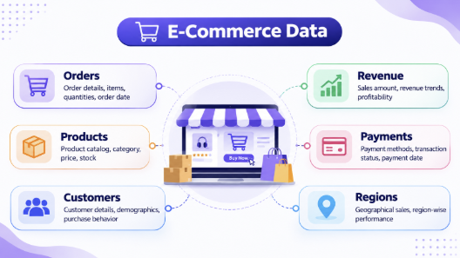



Introduction & Problem Statement
Background
E-commerce platforms generate large volumes of order, product, customer and payment data. Analysing this information helps businesses understand performance and customer purchasing patterns.
Problem Statement
Raw sales records are difficult to interpret quickly. The project brings key sales metrics and comparisons into one dashboard using data analysis and visualizations.
Motivation / Need
Business owners and sales teams can identify trends, popular products and category or regional differences. Without a consolidated view, useful patterns may remain hidden.
E-Commerce Sales Analytics Dashboard | B.Tech – Computer Science & Engineering (CSE)
E-Commerce Sales Analytics Dashboard | B.Tech – Computer Science & Engineering (CSE)
Notes:
State the domain, the exact problem and why it matters. Keep it to about 2 minutes. Add one real-world statistic if you can, with a citation.

Slide 3


Objectives & Scope
Objectives
1
Build an interactive dashboard to summarize e-commerce sales performance.
2
Clean missing, duplicate and incorrect records.
3
Perform EDA and calculate sales KPIs.
4
Visualize product, category, regional and time-based performance.
E-Commerce Sales Analytics Dashboard | B.Tech – Computer Science & Engineering (CSE)
E-Commerce Sales Analytics Dashboard | B.Tech – Computer Science & Engineering (CSE)
Notes:
Objectives should be measurable and start with action verbs. The scope slide tells the panel what you did and did not attempt.

Slide 4

Literature Survey
S.No | Author(s) & Year | Method / Technique | Key Findings | Limitation / Gap
1 | Ali, Aaron, Ahmed & Moses (2026) | EDA and Tableau visualization of Amazon India sales | Visualization reveals sales and location patterns | The proposed workflow combines cleaning, analysis and dashboard views.
2 | Aarthi et al. (2025) | Real-time e-commerce analytics dashboard | Combines revenue, conversion and customer metrics | This project focuses on clear KPI and segment comparisons.
3 | Patil et al. (2025) | Power BI dashboard and customer segmentation | Interactive BI supports strategic decisions | This project includes data preparation and EDA before visualization.
4 | Yadav, Lakshmi & Alekya (2024) | Retail analytics using Power BI | Charts make sales and customer patterns easier to interpret | The proposed dashboard emphasizes a unified sales view.
Research Gap
Existing approaches may separate data preparation, KPI calculations and visual comparisons. Our project connects these steps in one workflow so users can review sales, products, categories and regions together.
Literature entries are transcribed from the team's Review-1 slide; verify full bibliographic details before submission.
E-Commerce Sales Analytics Dashboard | B.Tech – Computer Science & Engineering (CSE)
E-Commerce Sales Analytics Dashboard | B.Tech – Computer Science & Engineering (CSE)
Notes:
Summarise four to six relevant papers or existing systems. End with the research gap, because that gap justifies your project.

Slide 5





Proposed System & Methodology
STEP 1
STEP 2
STEP 3
STEP 4
STEP 5
Define Problem
Collect Data
Design
Implement
Test & Evaluate
Identify the need, scope and success criteria.
E-commerce sales records; exact source, row count and file format to be confirmed from the final dataset.
Data cleaning, EDA, aggregation, ranking and visualization techniques.
Preprocessing, KPI analysis and dashboard visualization modules are assigned across the team.
Check data quality, manually verify KPI calculations and confirm chart values.
Key Novelty / Contribution
The contribution is a unified view of sales KPIs and comparisons across products, categories, payment methods, regions and time periods. It turns cleaned records into visual summaries that are easier to interpret.
E-Commerce Sales Analytics Dashboard | B.Tech – Computer Science & Engineering (CSE)
E-Commerce Sales Analytics Dashboard | B.Tech – Computer Science & Engineering (CSE)
Notes:
Walk through the five steps left to right. Rename the steps to match your project (for example, Requirement Analysis, Design, Coding, Testing, Deployment). End with your novelty.

Slide 6
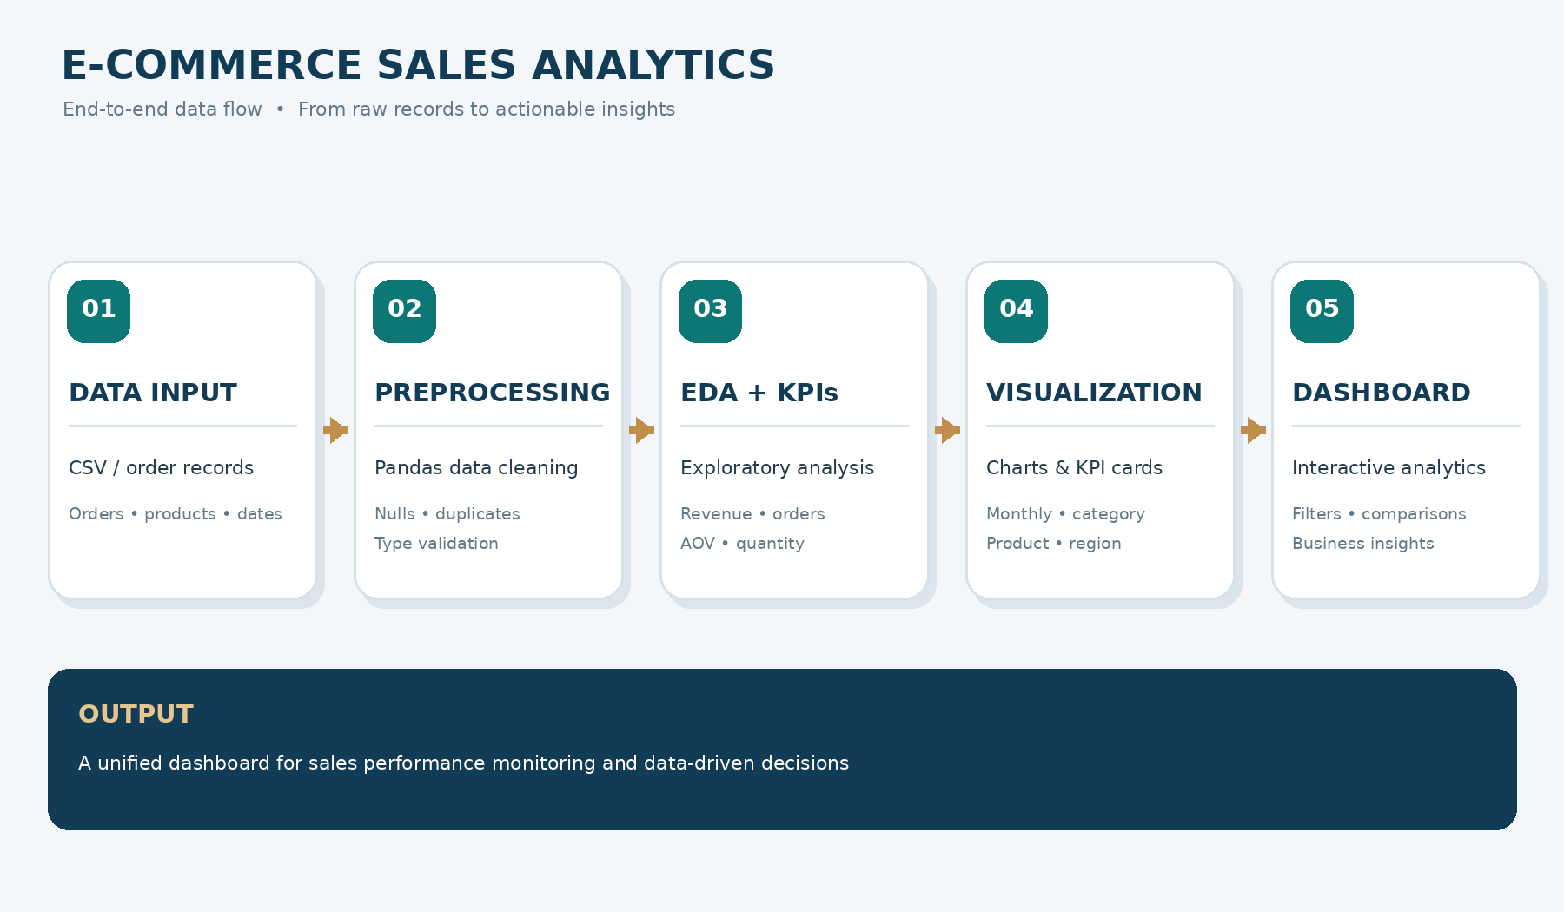
System Architecture
E-Commerce Sales Analytics Dashboard | B.Tech – Computer Science & Engineering (CSE)
E-Commerce Sales Analytics Dashboard | B.Tech – Computer Science & Engineering (CSE)
Notes:
Insert a clear block diagram: input, processing, storage, output. Number each block and explain them on the right. Redraw the figure yourself rather than copying it.

Slide 7


Hardware & Software Requirements
Hardware
Software & Tools
Libraries / Frameworks
• Standard laptop/desktop
• Sufficient storage for dataset and project files
• Network connection for data access
• Python 3.x
• VS Code / Jupyter Notebook
• Git for version control
• Pandas / NumPy for data handling
• Matplotlib / Seaborn for charts
• Streamlit for dashboard interface
Implementation focus: Python-based data analysis and an interactive dashboard prototype. Cloud deployment is a future enhancement.
E-Commerce Sales Analytics Dashboard | B.Tech – Computer Science & Engineering (CSE)
E-Commerce Sales Analytics Dashboard | B.Tech – Computer Science & Engineering (CSE)
Notes:
List only what you actually used, with versions. For a pure software project, shorten the hardware list and add cloud or deployment resources.

Slide 8
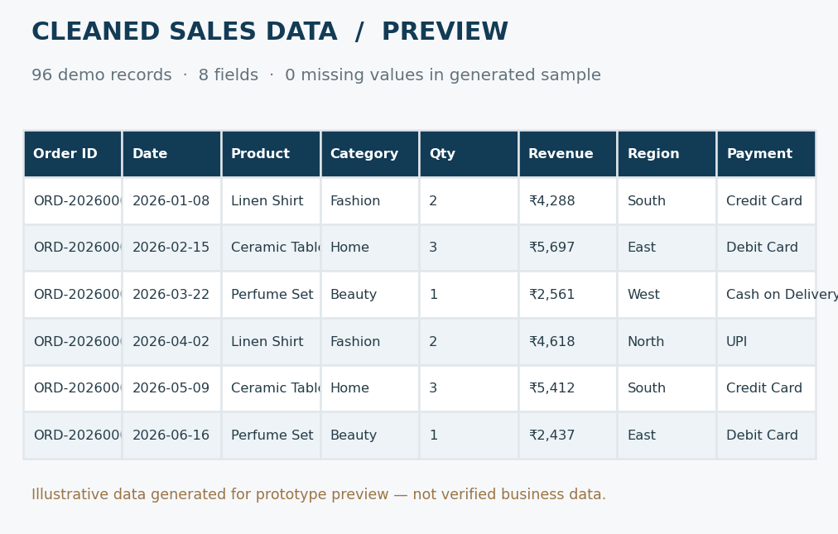
Dataset / Data Understanding
96
8
Records (rows)
Features (columns)
0
N/A
Missing values
Target classes
Source: Generated demonstration dataset bundled with the prototype.
Fields: order ID, date, product, category, quantity, revenue, region and payment.
Quality: 96 sample rows; 0 missing values in this generated sample.
Note: Replace demo data with the team's verified dataset for final reporting.
E-Commerce Sales Analytics Dashboard | B.Tech – Computer Science & Engineering (CSE)
E-Commerce Sales Analytics Dashboard | B.Tech – Computer Science & Engineering (CSE)
Notes:
Explain where the data came from and what it contains. Show a screenshot of the first rows or the info summary. For non-data projects, replace this slide with “Requirement Analysis” or “Input Specification”.

Slide 9
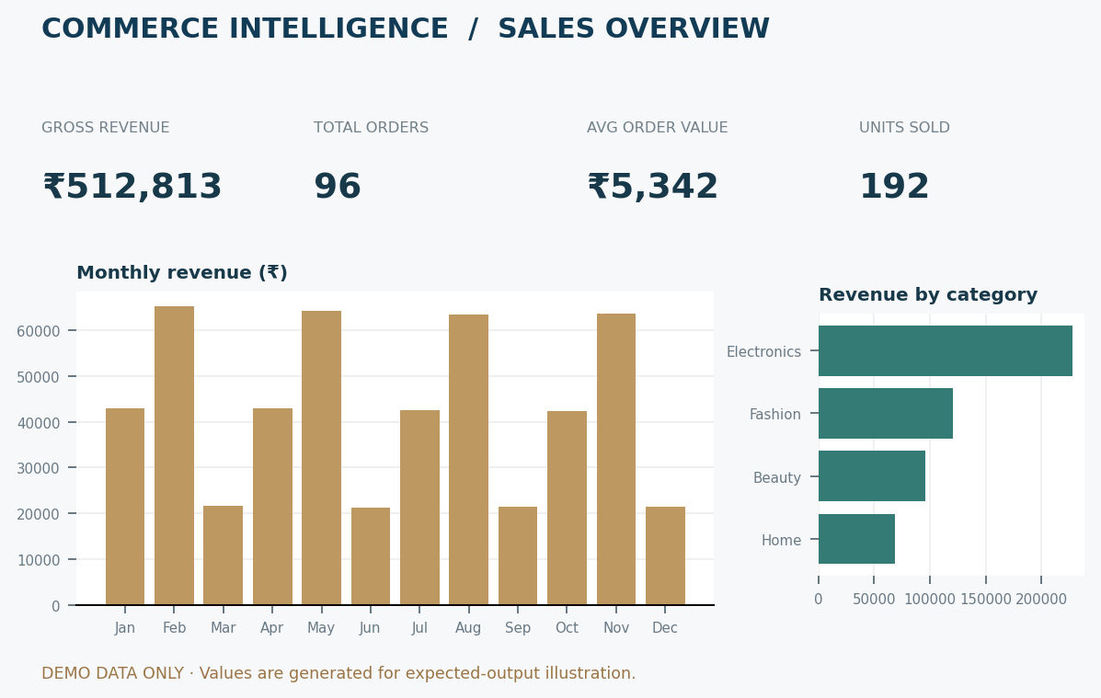
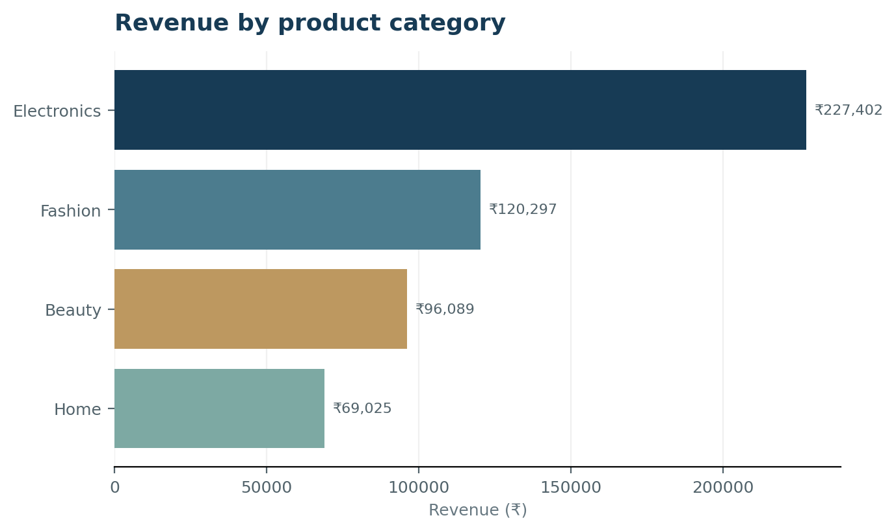
Data Preprocessing & Exploratory Analysis
Prototype charts use generated sample data for expected-output demonstration; validate again with the final dataset.
Cleaning
Transformation
Feature Selection
Check nulls and duplicates; correct invalid records and document cleaning rules.
Convert dates and numeric fields into suitable data types for reliable analysis.
Use available sales, product, customer, payment, date and region fields.
E-Commerce Sales Analytics Dashboard | B.Tech – Computer Science & Engineering (CSE)
E-Commerce Sales Analytics Dashboard | B.Tech – Computer Science & Engineering (CSE)
Notes:
Show two or three plots that tell a story: distributions, correlations, outliers. Explain what each plot told you and what you did about it.

Slide 10
Module-wise Description
1
Data Collection & Preprocessing
2
Data Analysis & Insights
Purpose: Collects and prepares reliable records.
Input → Output: Raw data → cleaned dataset.
Developed by: K. Harshith Varma
Purpose: Explores sales patterns and calculates business metrics.
Input → Output: Clean data → KPI tables and insights.
Developed by: G. Santhosh
3
Dashboard & Visualization
4
KPI & Validation
Purpose: Presents metrics through charts and dashboard views.
Input → Output: Analysis results → visual dashboard.
Developed by: K. Sai Danush
Purpose: Checks calculations and consistency of displayed results.
Input → Output: KPI/chart outputs → verified results.
Developed by: Team
E-Commerce Sales Analytics Dashboard | B.Tech – Computer Science & Engineering (CSE)
E-Commerce Sales Analytics Dashboard | B.Tech – Computer Science & Engineering (CSE)
Notes:
Divide the project into three to five modules. For each, state its purpose, inputs, outputs and who built it. Duplicate a card if you have more modules.

Slide 11

Algorithms & Technologies Used
Data Cleaning & EDA
Aggregation & KPI Calculation
Sorting, Ranking & Trend Analysis
Why chosen
To identify missing, duplicate and inconsistent records before analysis.
Key steps
Inspect schema, clean records and standardize dates and numeric fields.
Why chosen
To summarize business performance using clear, interpretable metrics.
Key formulas
Revenue = Σ order revenue
AOV = Revenue ÷ unique orders
Why chosen
To identify leading products and compare performance over time and across segments.
Key operations
Group by product/category/month; sort revenue in descending order.
Selection criteria: Use fields available in the dataset; prioritize order ID, date, revenue, quantity, product, category, region and payment.
E-Commerce Sales Analytics Dashboard | B.Tech – Computer Science & Engineering (CSE)
E-Commerce Sales Analytics Dashboard | B.Tech – Computer Science & Engineering (CSE)
Notes:
Name each model, algorithm or technology, say why you chose it, and list the key settings. Then explain how you picked the final one.

Slide 12
Implementation / Model Building
Feature Selection
Code snippet / pseudocode
Use valid order amount, order ID, quantity, product, category, date, payment and region fields where available.
PSEUDOCODE
sales = sum(valid_order_amounts)
orders = count_unique(order_id)
average_order_value = sales / orders
product_sales = group_by_product(sales)
top_products = sort_desc(product_sales)
render_kpis_and_charts()
Preprocessing Pipeline
Load data → inspect schema → handle missing/duplicate/invalid records → convert data types → prepare analysis fields.
Data Splitting
Not applicable: the described project uses descriptive analytics, not supervised model training.
Configuration
Use unique order IDs for order counts; group sales by product, category, region and date. Exact rules depend on dataset schema.
E-Commerce Sales Analytics Dashboard | B.Tech – Computer Science & Engineering (CSE)
E-Commerce Sales Analytics Dashboard | B.Tech – Computer Science & Engineering (CSE)
Notes:
Describe the build in the order you did it. Paste only the most important code or pseudocode, not entire files. For hardware projects, show the circuit or wiring summary instead.

Slide 13
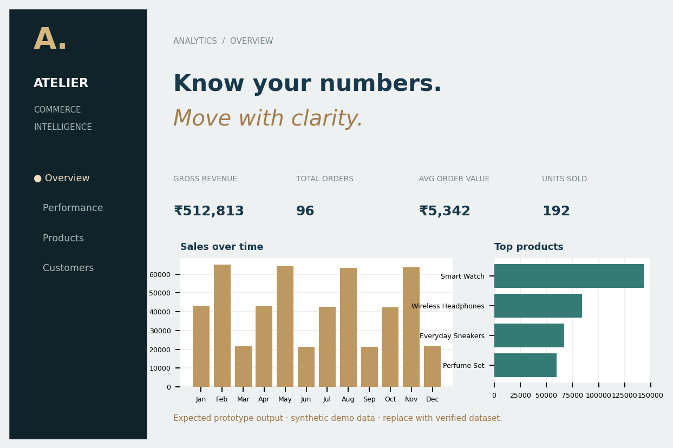
Working Prototype / Output Screens
EXPECTED OUTPUT 1 — CLEANED DATA
Preview of the generated sample dataset with 96 records and 8 fields.
EXPECTED OUTPUT 2 — SALES METRICS
Revenue, order count, average order value and category comparisons.
EXPECTED OUTPUT 3 — DASHBOARD
Premium dashboard preview with KPI cards, monthly sales and top products.
E-Commerce Sales Analytics Dashboard | B.Tech – Computer Science & Engineering (CSE)
E-Commerce Sales Analytics Dashboard | B.Tech – Computer Science & Engineering (CSE)
Notes:
Show real screenshots, photos of the hardware or a short demo video link. Caption each one with what the viewer should notice.

Slide 14
Sales Metrics & Performance Summary
DEMO DATASET — GENERATED SAMPLE
GROSS REVENUE
₹512,813
UNIQUE ORDERS
96
AVERAGE ORDER VALUE
₹5,342
UNITS SOLD
192
Expected prototype output generated from a synthetic 96-row sample dataset. These values demonstrate dashboard calculations and are not verified business results.
E-Commerce Sales Analytics Dashboard | B.Tech – Computer Science & Engineering (CSE)
E-Commerce Sales Analytics Dashboard | B.Tech – Computer Science & Engineering (CSE)
Notes:
Right-click the chart and choose Edit Data to enter your real numbers. Replace the metrics with the ones that fit your project (accuracy, latency, power, throughput, user rating). State clearly which option performed best.

Slide 15
Analysis & Key Findings
DEMO INSIGHTS
Top category: Electronics
Top product: Smart Watch
In this generated sample, Electronics records the highest category revenue. Fashion, Beauty and Home follow. The monthly chart shows the sample revenue pattern across the year.
These are expected-output examples only; final findings must be recalculated using the team's actual dataset.
E-Commerce Sales Analytics Dashboard | B.Tech – Computer Science & Engineering (CSE)
E-Commerce Sales Analytics Dashboard | B.Tech – Computer Science & Engineering (CSE)
Notes:
Explain what the numbers mean. Use a confusion matrix, ROC curve, feature-importance chart or output comparison. Be honest about weak results; panels value that.

Slide 16


Testing & Validation
Test ID | Test Description | Expected Result | Actual Result | Status
TC-01 | [What is tested] | [Expected output] | [Observed output] | [Pass / Fail]
TC-02 | [What is tested] | [Expected output] | [Observed output] | [Pass / Fail]
TC-03 | [What is tested] | [Expected output] | [Observed output] | [Pass / Fail]
TC-04 | [What is tested] | [Expected output] | [Observed output] | [Pass / Fail]
Functional Testing
Validation Method
Performance Testing
Check null/duplicate handling, data-type conversions, KPI functions and chart-data integration.
Use a hold-out dataset only if applicable; otherwise validate calculations against manually checked sample records.
Check that totals match source records, unique order counts are correct and charts update consistently with selected data.
E-Commerce Sales Analytics Dashboard | B.Tech – Computer Science & Engineering (CSE)
E-Commerce Sales Analytics Dashboard | B.Tech – Computer Science & Engineering (CSE)
Notes:
List representative test cases with expected and actual outcomes. Name the validation methods you used. Delete rows you do not need.

Slide 17


Challenges & Limitations
Challenges Faced
Limitations
• Missing or duplicate records → inspect and apply documented cleaning rules.
• Inconsistent data types → standardize dates and numeric fields.
• Comparing multiple dimensions → use grouped summaries and clear charts.
• Demo results are synthetic and must be replaced with verified project-dataset results.
E-Commerce Sales Analytics Dashboard | B.Tech – Computer Science & Engineering (CSE)
E-Commerce Sales Analytics Dashboard | B.Tech – Computer Science & Engineering (CSE)
Notes:
Be candid. Pair every challenge with how you solved it, and list limitations that the panel would otherwise spot themselves.

Slide 18

Conclusion
The project defines an end-to-end workflow for cleaning, analysing and visualizing e-commerce sales data. Final platform and dataset details must be confirmed.
1
Final Outcome
The prototype demonstrates revenue, order count, average order value and units sold using generated sample data. Final figures will be confirmed with the project dataset.
Interactive sales dashboard
with KPI cards, trends and category comparisons.
2
Expected outcome: a consolidated dashboard for product, category, regional and monthly sales analysis.
The planned dashboard consolidates key sales metrics and comparisons to make business performance easier to understand.
3
E-Commerce Sales Analytics Dashboard | B.Tech – Computer Science & Engineering (CSE)
E-Commerce Sales Analytics Dashboard | B.Tech – Computer Science & Engineering (CSE)
Notes:
Revisit each objective and say whether you met it. Quote your headline result with numbers. Do not introduce new material here.

Slide 19



Future Scope & Applications
Improve Performance
Optimize data loading and aggregation for larger sales datasets.
Applications
• E-commerce business performance monitoring
• Product and inventory planning
• Regional and category sales comparison
Users: business owners, sales teams and analysts.
Expand Data / Features
Add customer segmentation, repeat-purchase analysis and inventory indicators.
Deploy & Build an Interface
Publish the interactive dashboard for authorized business users.
Scale & Secure
Add scheduled data refresh, role-based access and secure storage.
E-Commerce Sales Analytics Dashboard | B.Tech – Computer Science & Engineering (CSE)
E-Commerce Sales Analytics Dashboard | B.Tech – Computer Science & Engineering (CSE)
Notes:
Give concrete next steps, ideally tied to the limitations. Then name two or three real-world uses.

Slide 20
Team Contribution
K. HARSHITH VARMA
2420030013
DATA COLLECTION & PREPROCESSING
Collect the dataset, inspect columns and data types, identify missing/duplicate records and prepare clean data.
G. SANTHOSH
2420030123
DATA ANALYSIS & INSIGHTS
Perform EDA, calculate sales KPIs, rank products and compare categories, regions and time periods.
K. SAI DANUSH
2420030769
DASHBOARD & VISUALIZATION
Create charts, KPI cards and dashboard views to present the analysis clearly.
Reg. No. | Name | Contribution / Modules Handled
[Reg. No.] | [Member 1] | [Modules, tasks and report sections]
[Reg. No.] | [Member 2] | [Modules, tasks and report sections]
[Reg. No.] | [Member 3] | [Modules, tasks and report sections]
[Reg. No.] | [Member 4] | [Modules, tasks and report sections]
Guide: N. Sunanda | Department of Computer Science and Engineering | KLH Deemed to be University
E-Commerce Sales Analytics Dashboard | B.Tech – Computer Science & Engineering (CSE)
E-Commerce Sales Analytics Dashboard | B.Tech – Computer Science & Engineering (CSE)
Notes:
Show that work was planned and shared. Every member should be able to explain their own module.

Slide 21

References
Ali, Aaron, Ahmed & Moses (2026), “Exploratory Data Analysis and Visualization of Amazon Sale Report Dataset using Tableau.” Full publication details to be verified.
Aarthi, Veera Varaha Kesavan, Sandeep & Lokeshwar (2025), “E-Commerce Sales Analysis Dashboard: Real-Time Analytics for Business Growth.” Details to be verified.
Patil, Kulkarni, Kaduskar, Shinde & Shahapurkar (2025), “Interactive E-Commerce Dashboard Using Power BI for Strategic Business Insights.” Details to be verified.
Yadav, Lakshmi & Alekya (2024), “Retail Insights: Unveiling E-Commerce Dynamics with Power BI.” Details to be verified.
Akter & Wamba (2016), “Big Data Analytics in E-commerce / Business Performance.” Verify the exact title and publication.
Project Links
GitHub: Not supplied
Dataset: Generated prototype sample
Demo video: Not supplied
E-Commerce Sales Analytics Dashboard | B.Tech – Computer Science & Engineering (CSE)
E-Commerce Sales Analytics Dashboard | B.Tech – Computer Science & Engineering (CSE)
Notes:
Use IEEE style, numbered in order of first citation in the deck. Include datasets, documentation and code repositories.

Slide 22
THANK YOU
Questions & Discussion
E-Commerce Sales Analytics Dashboard
B.Tech – Computer Science and Engineering (CSE)
Guide: N. Sunanda
E-Commerce Sales Analytics Dashboard | B.Tech – Computer Science & Engineering (CSE)
E-Commerce Sales Analytics Dashboard | B.Tech – Computer Science & Engineering (CSE)
Notes:
Leave this slide up during questions. Make sure every team member can answer questions about their own module.

