Slide 1
Sales Dashboard Overview
Created using Power BI | Dataset: Sales_Financial (Kaggle)

Slide 2
Objective & Tools
Objective:
To design an interactive sales dashboard that helps business stakeholders monitor key metrics such as revenue, profit, and sales performance across time, geography, and customer segments.
Tools Used:
- Power BI
- Dataset: Kaggle – Sales_Financial

Slide 3
Key KPIs & Dashboard Interactivity
Key KPIs:
- Total Revenue: 85M
- Total Profit: 32M
- Total Unit Price: 51M
Dashboard Interactivity:
- Slicers for Country and Year
- Cards for KPIs
- Time-series visualizations for revenue and profit
- Bar, pie, and line charts for deeper analysis

Slide 4
Insights & Analysis
- Highest revenue observed in December & June
- Accessories category is the top-performing product
- United States and United Kingdom are most profitable
- Adults (35–64 age group) make up the majority of customers
- Sales trends are visible with yearly and monthly comparisons

Slide 5
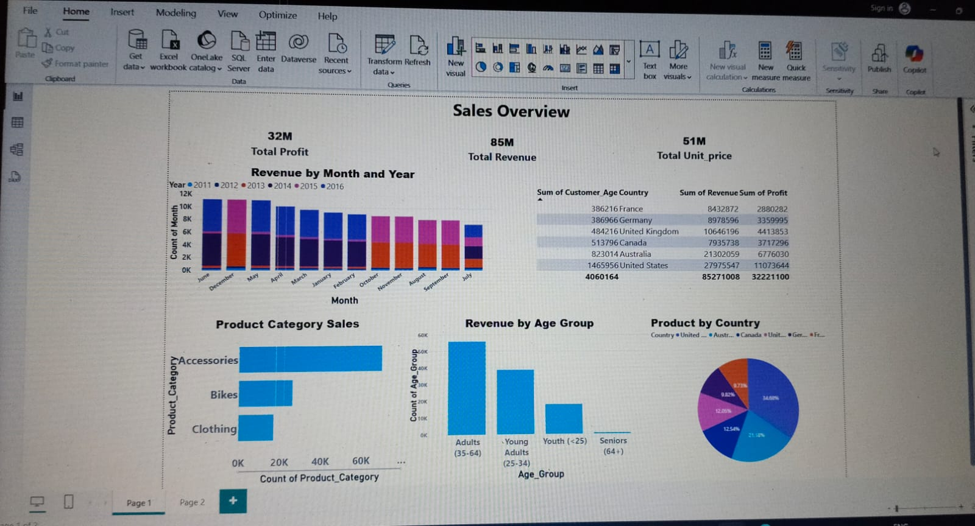
Dashboard Screenshot (Insert Below)

