Slide 1
ANALYZE IRIS DATA
- By Bugide Santhoshi

Slide 2
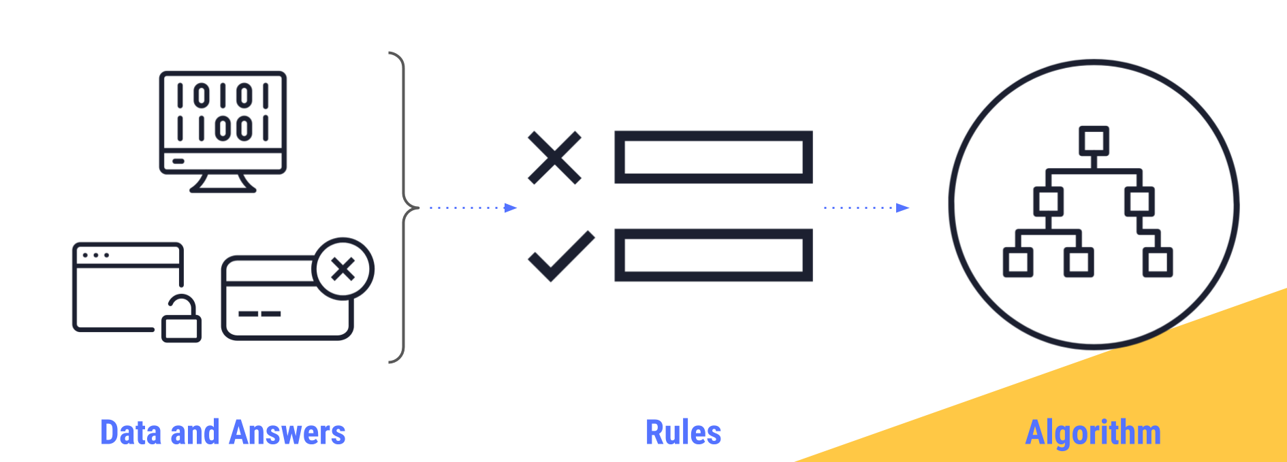
Introduction to Machine Learning
Before machine learning, traditional computer programming performed actions based on conditional statements such as “If”, “Then”, “Else” rules. As a result, to build a system that accepts or declines a credit card, for example, traditional programming would require long hours and thousands of lines of code. For this reason, having computers imitate human thinking and automatically improve their learning over time is an attractive option.
A machine learns when we provide data, such as past experiences and answers, as inputs. It can then look at patterns in the data in order to learn rules. These rules form the basis of algorithms.

Slide 3
Traditional programming
Computer
Data
Output
Program
Machine Learning
Computer
Data
Program
Output

Slide 4
Types of learning
Supervised learning : Training data included with desired outputs given
Unsupervised learning : Training data without desired outputs given
Reinforcement learning : Rewards from sequence of actions

Slide 5
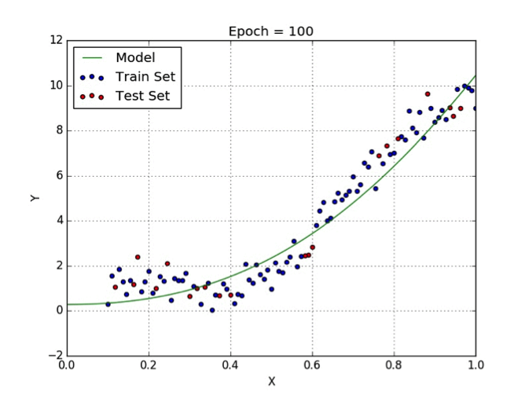
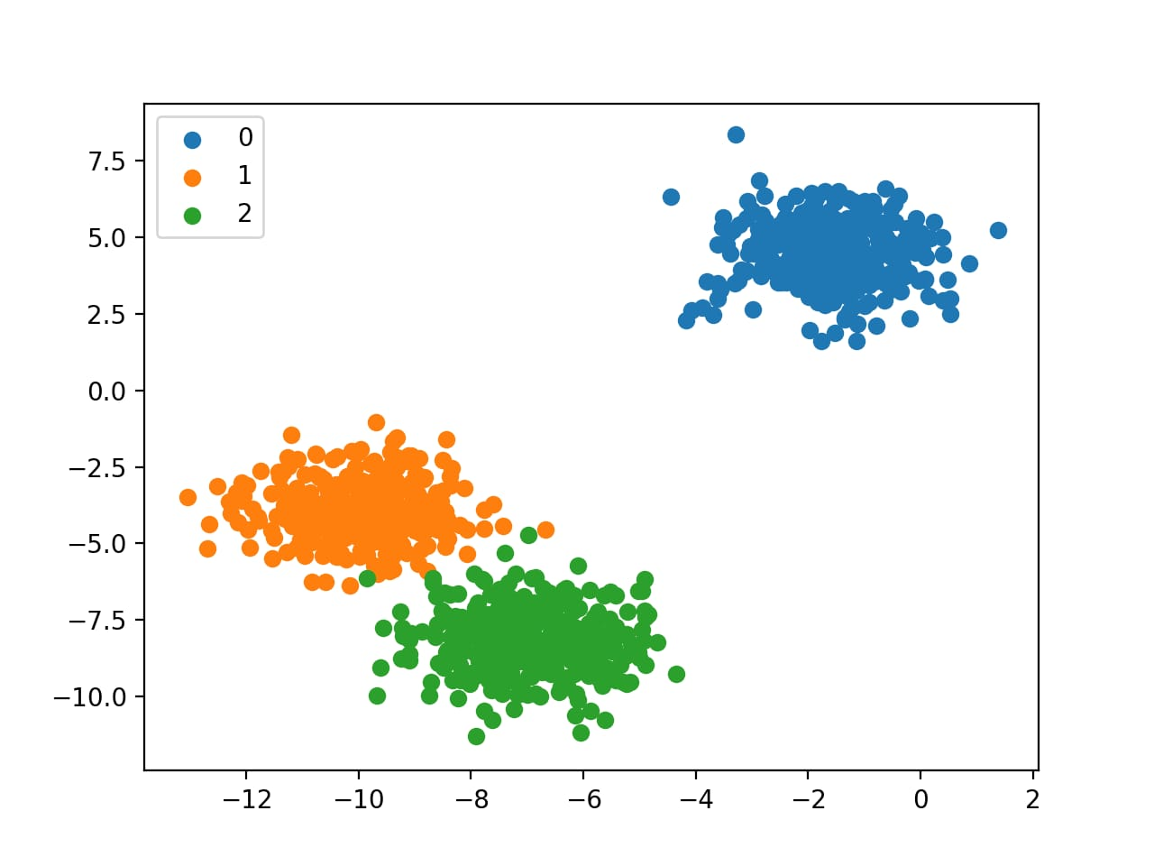
Supervised Learning: 1)Regression •Given (x1, y1), (x2, y2), ..., (xn, yn) •Learn a function f(x) to predict y given x–y axis real valued == regression
2)Classification •Given (x1, y1), (x2, y2), ..., (xn, yn) •Learn a function f(x) to predict y given x–y axis categorical == classification

Slide 6
Steps to build model
1 - Data Collection 2 - Data Preparation 3 - Choose a Model 4 - Train the Model 5 - Evaluate the Model 6 - Make Predictions

Slide 7





PYTHON Libraries used in ML
1)Numpy 2)Pandas 3)Scikit-learn 4)Matplotlib
5)TensorFlow 6)Keras 7)PyTorch 8)Scipy 9)Seaborn
Used in my project

Slide 8
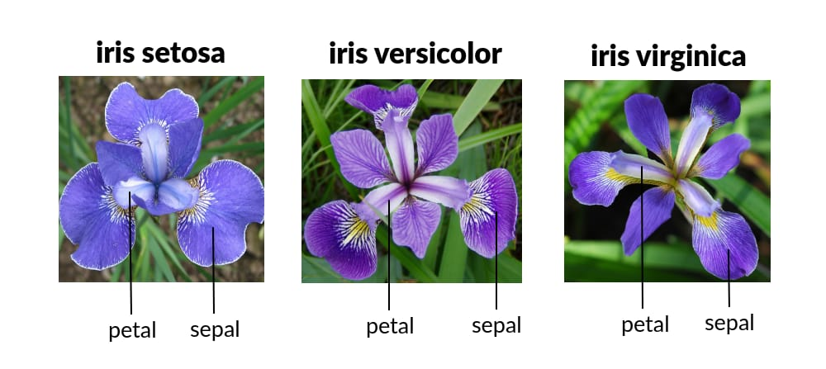
IRIS FLOWER DATA SET
Introduced by Ronald Fisher.
One of the clusters contains Iris-Setosa, while the other cluster contains both Iris virginica and Iris versicolor and is not separable without the species information Fisher used. It is multivariate(more than 2 dependent variable) data set Study of three related Iris flowers species. Data set contain 150 sample of each species(Iris-Setosa, Iris-Virginica, Iris-Versicolor)

Slide 9
Features Used : 1. Sepal length in cm 2. Sepal width in cm 3. Petal length in cm 4. Petal width in cm

Slide 10
Data Analysis : 1. Descriptive statistics- Mean, Min, Max etc . 2. Class Distribution (Species counts are balanced or imbalanced) – Balanced. 3. Univariate Plots:- Understand each attribute better.

Slide 11
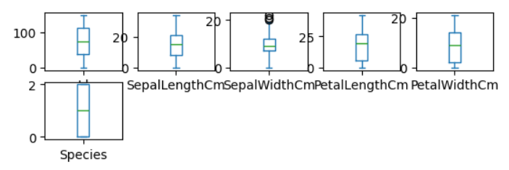
BOX and WHISKER plots(gives an idea about distribution of input attributes)

Slide 12
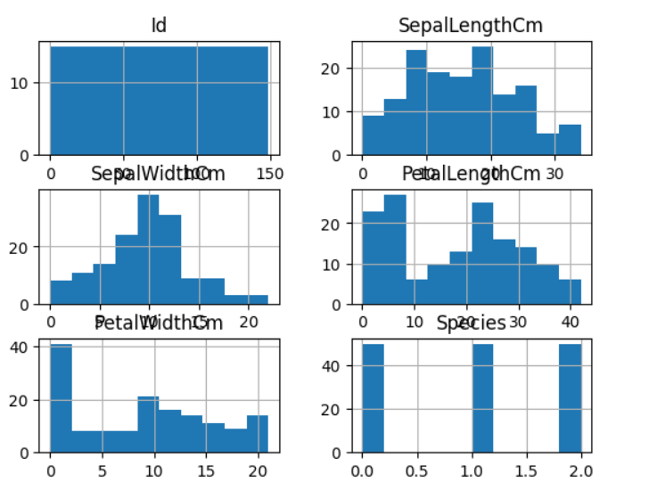
Plotting Histogram

Slide 13
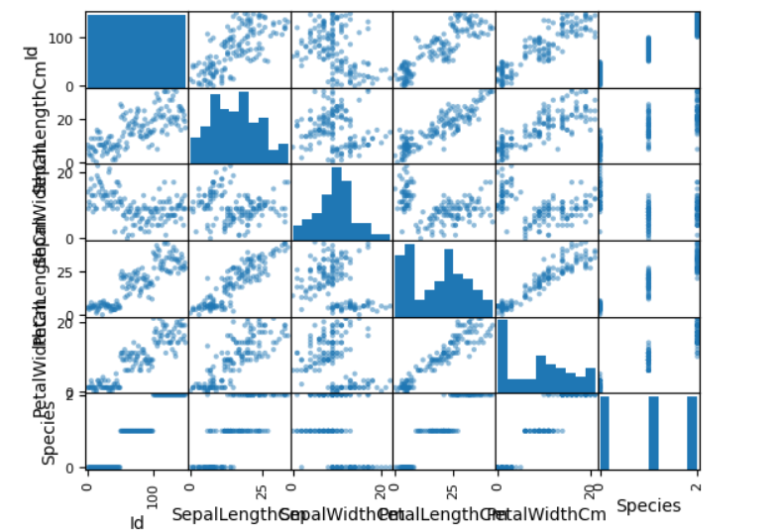
Plotting SCATTER GRAPH

Slide 14
Observation: 1. Using Sepal_Length & Sepal_Width features, we can only distinguish Setosa flower from others. 2. Separating Versicolor & Virginica is much harder as they have considerable overlap. 3. Hence, Sepal_Length & Sepal_Width features only work well for Setosa.

Slide 15
Steps to implement Machine Learning 1. Import Library 2. Analyse Data 3. Splitting the Data Set into train and test 4. Choosing right algorithm for training model 5. Test the algorithm with test data.

Slide 16
Algorithms Used: 1. Logistic Regression(LR) 2. Support Vector Machine(SVC) 3. Linear Discrimination Analysis(LDA) 4. Gaussian Naive Bayes(NB) 5. K-Nearest Neighbour(KNN) 6. Decision Tree Classsifier (DT)

Slide 17
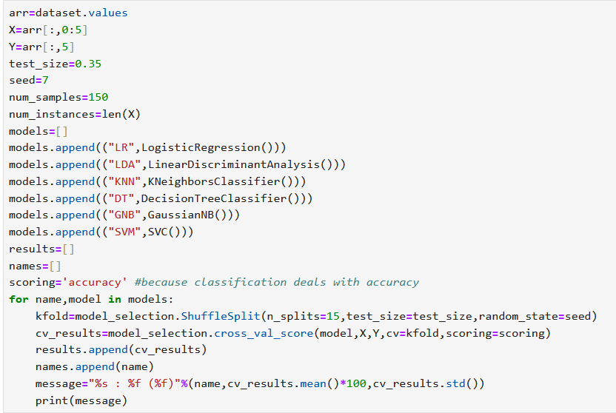
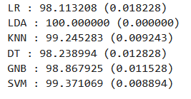

Evaluation of all models

Slide 18
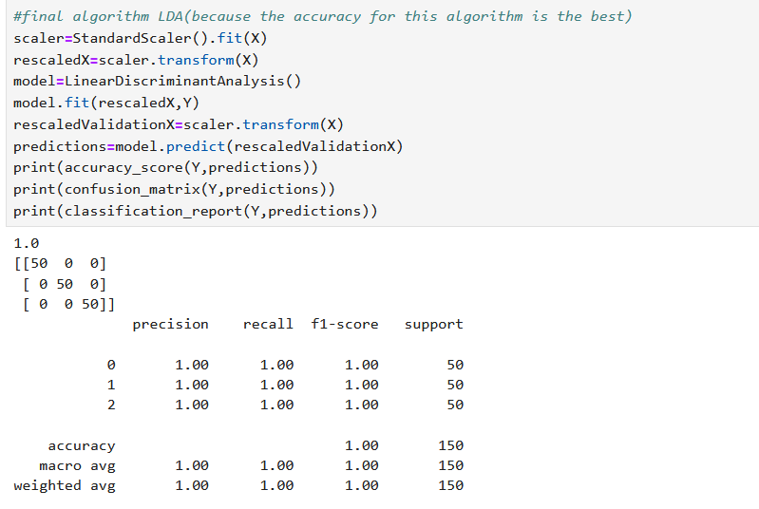

Slide 19
Thank you

