Slide 1
IoT Based Occupancy Monitoring Techniques for Energy Efficient Smart Buildings
RTRP Review – II Presentation
Guide :
M.Madhusudhan
Presented by:
Batch-7
K.Santhoshi
P.Kranthesh
M.Anas

Slide 2
INTRODUCTION
Energy consumption in modern buildings is increasing due to lighting, HVAC, and electronic devices.
Traditional building systems work on manual control or fixed schedules.
These systems waste energy when rooms are unoccupied.
IoT technology helps monitor occupancy in real time using smart sensors.
Sensor data helps automate lighting and ventilation systems.

Slide 3
PROJECT PURPOSE
The main aim of this project is to reduce energy wastage in buildings.
The system monitors real-time occupancy using IoT sensors.
Appliances such as lights and fans operate only when people are present.
The system also improves comfort and sustainability.
This project supports smart building automation.

Slide 4
EXISTING SYSTEM
Traditional energy management systems rely on manual switching or fixed schedules for lighting and HVAC. These systems do not consider real-time occupancy and often lead to energy wastage when rooms are empty. They also lack automation, scalability, and intelligent monitoring capabilities

Slide 5
DISADVANTAGES OF EXISTING SYSTEM
Manual control requires human intervention and monitoring.
Basic sensors may fail to detect stationary occupants.
No real-time data analysis or remote monitoring capability.
Lack of intelligent automation for energy optimization.

Slide 6
PROPOSED SYSTEM
The proposed system uses IoT technology for smart occupancy monitoring.
Sensors such as PIR and CO2 sensors detect human presence.
ESP32 microcontroller processes the sensor data.
Data is transmitted to cloud servers using MQTT protocol.
The system automatically controls lighting and ventilation.
This approach reduces energy consumption significantly.

Slide 7
ADVANTAGES OF PROPOSED SYSTEM
Reduces energy consumption by controlling appliances automatically.
Provides real-time occupancy monitoring.
Supports remote monitoring through IoT dashboards.
Improves building automation and operational efficiency.

Slide 8
HARDWARE REQUIREMENTS
ESP32 microcontroller for processing and communication.
PIR sensor to detect motion and human presence.
CO2 or gas sensors for monitoring air quality.
Relay module for controlling electrical appliances.
16x2 LCD display for showing system status.
DC fan and power supply used as prototype load.

Slide 9
SOFTWARE REQUIREMENTS
Operating system: Windows or Linux.
Programming language: Embedded C or Python.
Arduino IDE used for programming ESP32.
Cloud database such as Firebase or MySQL.
MQTT protocol for IoT communication.
Web dashboard for monitoring occupancy data.

Slide 10
NOVELTY OF THE PROJECT
• Integrates IoT sensors for accurate occupancy detection.
• Uses real-time data to control energy systems.
• Enables smart automation in buildings.
• Provides analytics for energy optimization.
• Reduces carbon footprint and operational costs.

Slide 11
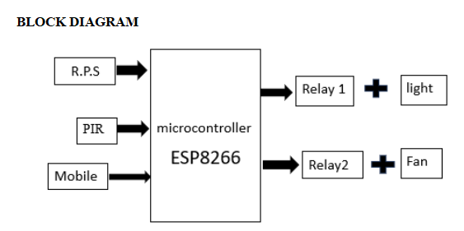
SYSTEM ARCHITECTURE
Sensors collect occupancy and environmental data.
Data is transmitted to ESP32 microcontroller.
Edge computing processes sensor data locally.
Processed data is sent to cloud server using WiFi.
Machine learning analyzes occupancy patterns.
Control signals are sent to appliances for automation.

Slide 12
MODULES OF THE SYSTEM
Hardware Setup Module integrates sensors and microcontroller.
Occupancy Detection Module identifies human presence.
Processing and Control Module controls appliances.
Display Module shows occupancy status on LCD.
IoT Monitoring Module sends data to the cloud.
Energy Efficiency Module ensures energy savings.

Slide 13
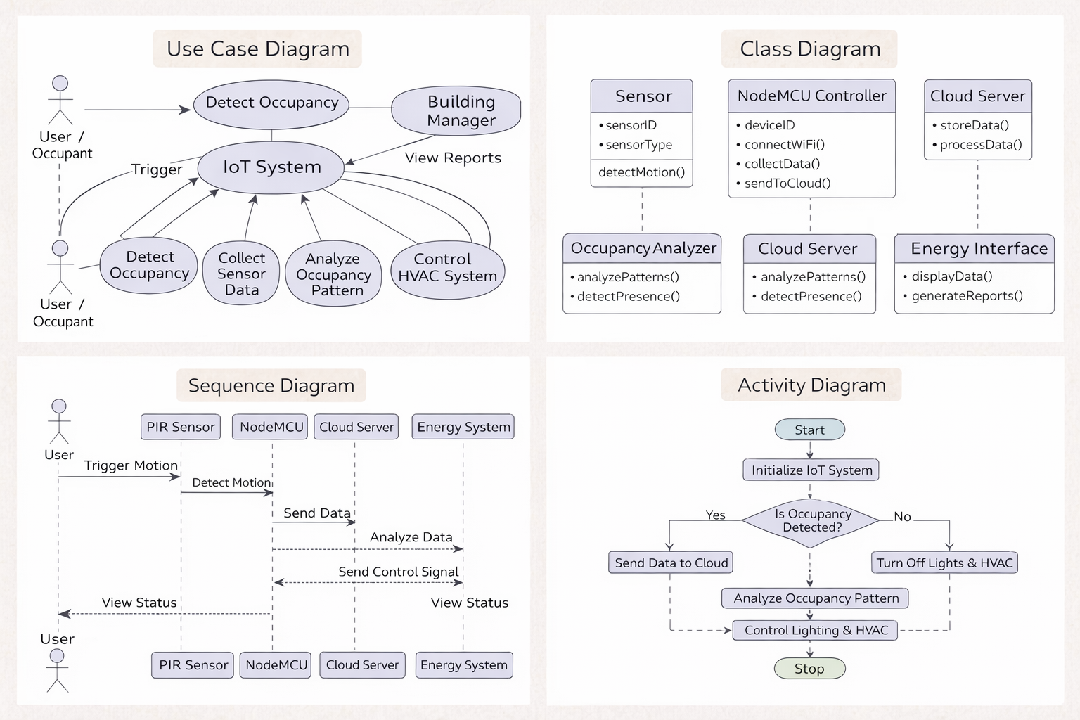
UML DIAGRAMS

Slide 14
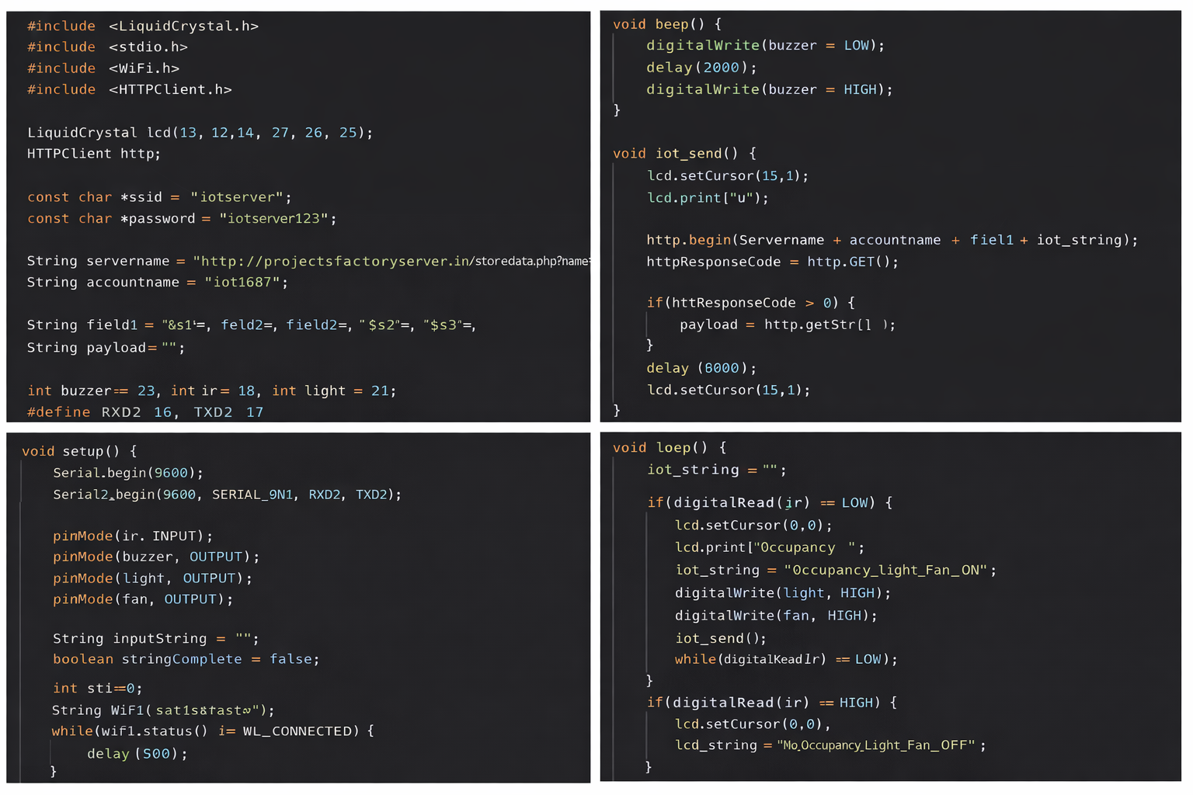
SOURCE CODE

Slide 15
RESULTS
The system successfully detects human presence in a room using a PIR sensor.
When occupancy is detected, the light and fan automatically turn ON, and they turn OFF when no person is present.
The system displays the occupancy status on the LCD and sends the data to the IoT server through WiFi
This implementation helps reduce unnecessary energy consumption and improves efficiency in smart buildings.

Slide 16
CONCLUSION
The IoT-based occupancy monitoring system improves building energy efficiency.
Sensors and microcontrollers enable automated energy control.
Real-time monitoring reduces unnecessary power consumption.
The system supports smart building management.
Overall, the project demonstrates a practical IoT solution.

Slide 17
FUTURE ENHANCEMENTS
Integration of Artificial Intelligence for predictive analysis.
Deployment in large commercial buildings and smart cities.
Improved multi-sensor fusion for higher accuracy.
Integration with renewable energy systems.
Development of a mobile application for monitoring.
Enhanced security and cloud-based analytics.

Slide 18
REFERENCES:
Kemal Akkaya, Ismail Guvenc, Ramazan Aygun, Nezih Pala & Abdullah Kadri. IoT-based Occupancy Monitoring Techniques for Energy-Efficient Smart Buildings. IEEE Wireless Communications and Networking Conference Workshops (WCNCW), 2015.
Mohammad Jabirullah Almas Khan, Mohd Zohaib Ali, Syed Sirajuddin Wajih & Mohd Azhar Hussain. IoT-Based Occupancy Monitoring Techniques for Energy Efficient Smart Buildings. Turkish Online Journal of Qualitative Inquiry (TOJQI), Vol. 12, No. 3, 2021.
P. F. Karjou, et al. Practical Design and Implementation of IoT-Based Occupancy Monitoring Systems for Office Buildings: A Case Study. Energy and Buildings, 2024.
Pratiksha Chaudhari, Yang Xiao, Mark Ming-Cheng Cheng & Tieshan Li. Fundamentals, Algorithms, and Technologies of Occupancy Detection for Smart Buildings Using IoT Sensors. Sensors, 2024

Slide 19
GIT HUB LINK:
https://github.com/santhoshikammari/iot-occupancy-monitoring.git

Slide 20
THANK YOU!!!

