Slide 1
Parental Control software
KEY-LOGGER PROJECT
Presented By:
1. SANTHOSHINI S- Jeppiaar institute of technology- Artificial intelligence and data science

Slide 2
OUTLINE
Problem Statement
Proposed System/Solution
System Development Approach
Algorithm & Deployment
Result (Output Image)
Conclusion
Future Scope
References

Slide 3
Problem Statement
As a parent, it is essential to ensure that your children are safe and secure online. However, with the rise of social media and video sharing platforms, children can be exposed to inappropriate content, cyberbullying, and online predators. Therefore, there is a need for a Parental Control software that can monitor and log children's keystrokes, allowing parents to keep track of their online activity and ensure they are not accessing inappropriate content.

Slide 4
Proposed Solution
A simple keylogger program can be used as a component of a parental control software to monitor and log the keystrokes entered by children on their devices. The program can be configured to run in the background and log all keystrokes, including those entered in web browsers, email clients, and other applications. The logs can then be reviewed by parents to ensure that their children are not accessing inappropriate or harmful content.
The software can be designed to only log keystrokes when the child is using the device and to exclude sensitive information such as passwords. The software can also include features to protect against unauthorized access and to ensure that the logs are securely stored.
By using a simple keylogger program as a component of a parental control software, parents can have greater visibility into their children's online activity and better ensure their safety and well-being.

Slide 5
System Approach
The Parental Control software is implemented using the tkinter library for the GUI and the pynput library for capturing keystrokes.
The program creates a window with two buttons - start and stop. When the start button is clicked, the keylogger starts running in the background, capturing all keystrokes and saving them to a text file and a JSON file.
When the stop button is clicked, the keylogger stops running.

Slide 6
Algorithm & Deployment
Algorithm: The algorithm used in the code can be described as follows:
Initialize the GUI with a window, a start button, and a stop button.
Define functions for starting and stopping the keylogger, as well as functions for capturing keystrokes and saving them to files.
When the start button is clicked, create a listener object using the pynput library, which captures keystrokes, and start the listener. Save the keys to a text file and a JSON file.
When the stop button is clicked, stop the listener and disable the start button.
Deployment: The keylogger program in the code can be deployed as a standalone application on a Windows system. The program requires the pynput library, which can be installed using pip. The program also requires write permissions to the specified output directory.
To deploy the program, the following steps can be taken:
Install the required libraries using pip.
Modify the output directory in the code to a suitable location.
Compile the code into an executable using a tool such as PyInstaller.
Distribute the executable to the target machines.
Configure the output directory and file names on each machine as necessary.

Slide 7
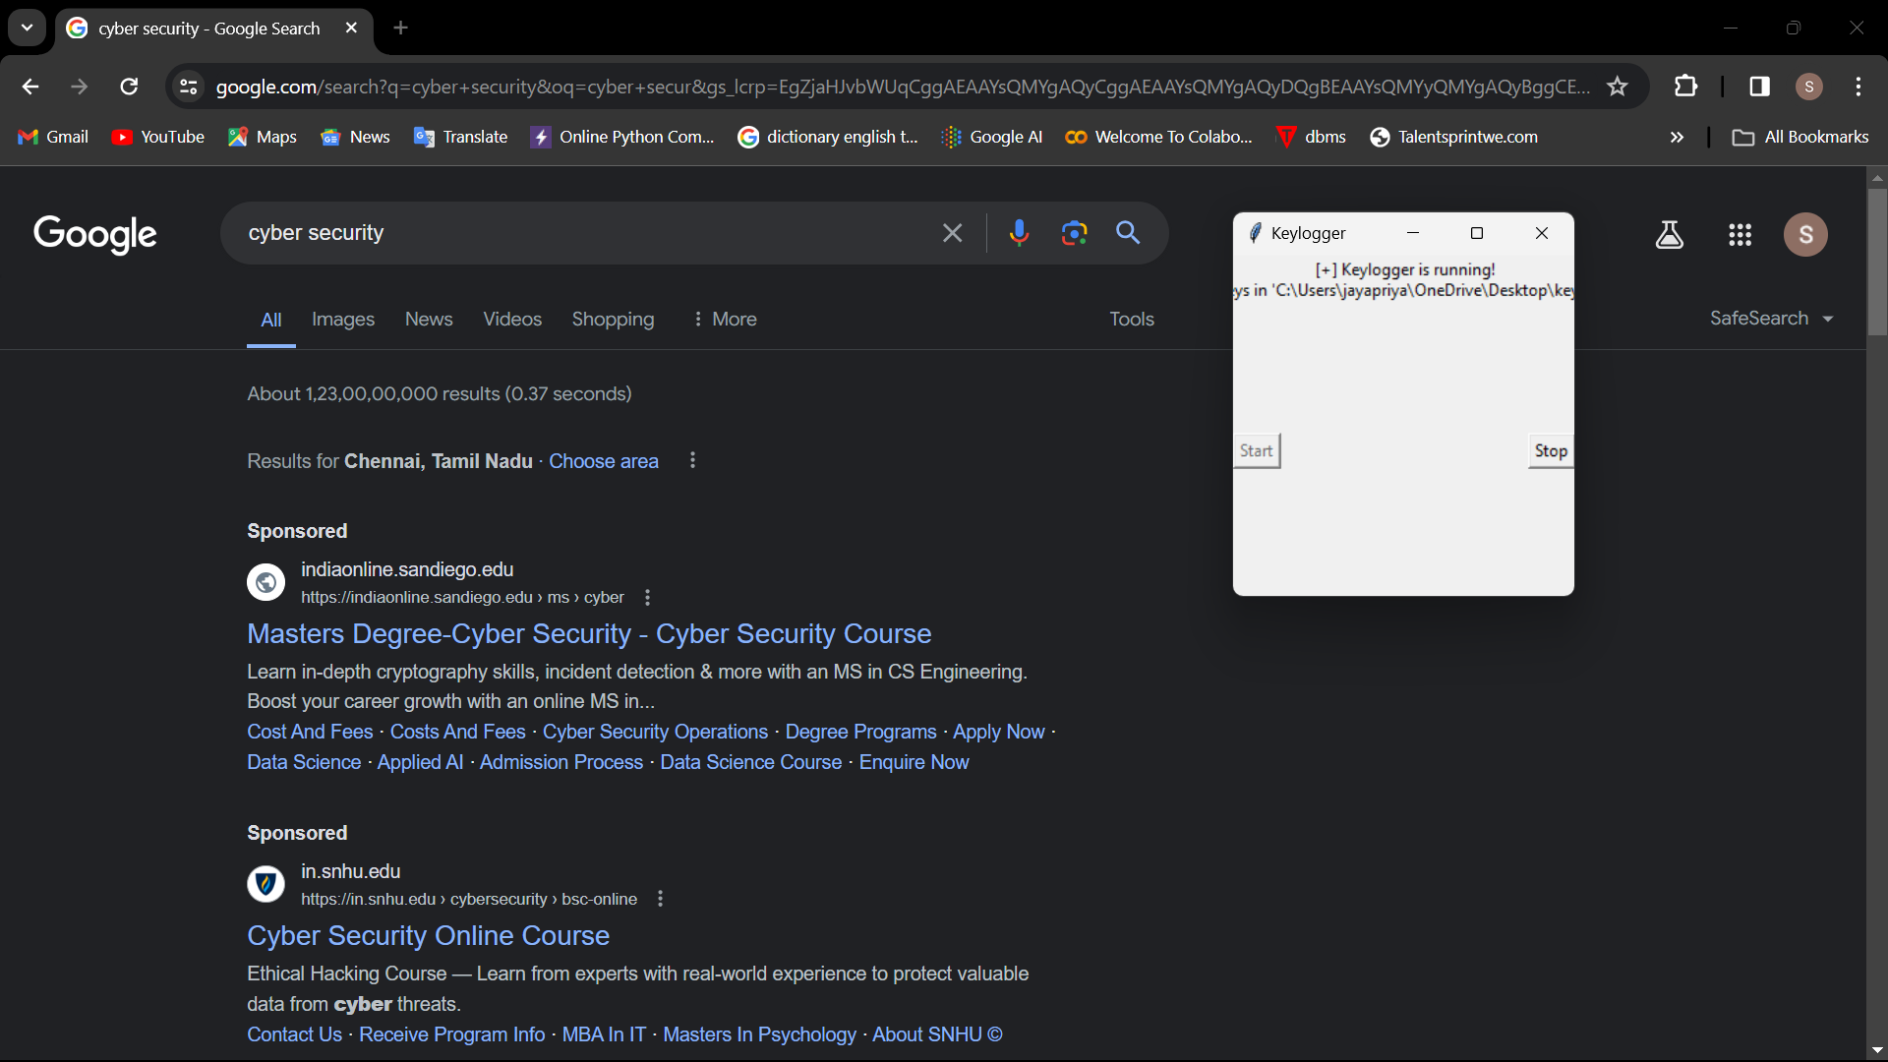
Result

Slide 8
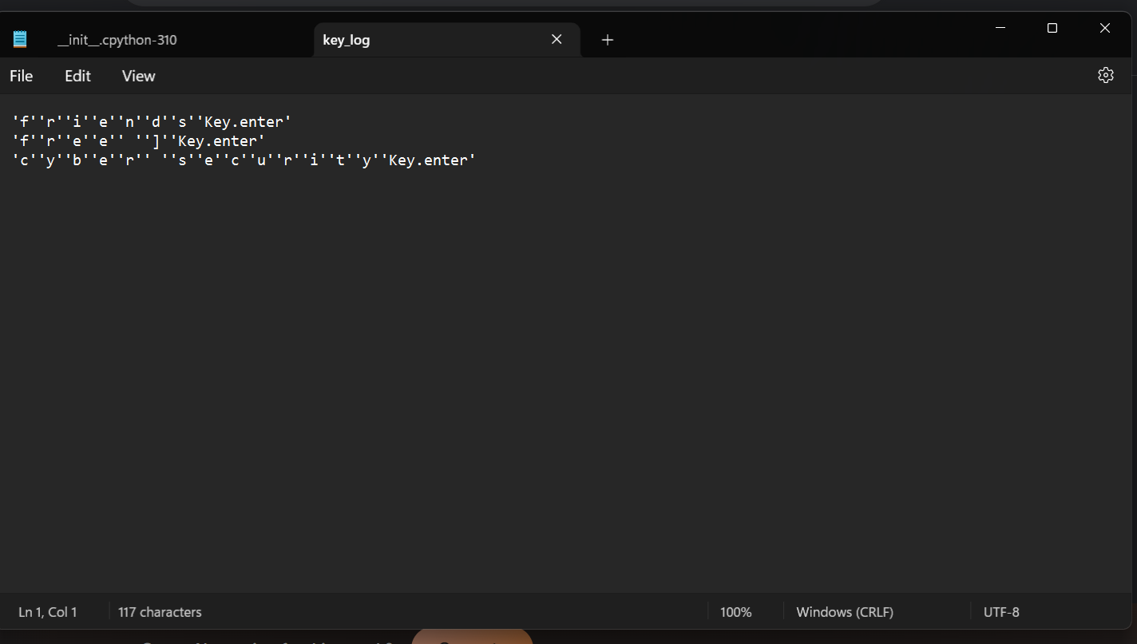

Slide 9
Conclusion
While keyloggers are often associated with malicious intent, they can also be used for legitimate purposes such as parental control or monitoring employee activity. The provided code is an example of a simple keylogger implemented using the Tkinter library for the GUI and the pynput library for capturing keystrokes. The keylogger captures all keystrokes and saves them to a text file and JSON file. The GUI provides a start and stop button for the keylogger.
Overall, the project is a simple yet effective implementation of a keylogger. While there are legitimate uses for keyloggers, it is important to use them ethically and with the consent of all parties involved.

Slide 10
Future scope
Future scope of this keylogger includes expanding its functionality to include capturing mouse clicks, scrolls, and other user inputs. Additionally, the keylogger can be integrated with other monitoring tools to provide a more comprehensive view of user activity. The keylogger can also be modified to detect and alert the user when certain keywords are entered.
In short, the keylogger can be enhanced to provide more detailed information, integrate with other tools, and detect specific user activity. However, it is important to use keyloggers ethically and with the consent of all parties involved.

Slide 11
References
"Keyloggers: What They Are and How to Detect Them" by Norton: https://us.norton.com/internetsecurity-emotet-keyloggers.html
"Python Keylogger with Tkinter and pynput" by Corey Schafer on YouTube: https://www.youtube.com/watch?v=UbRbHKQC4T0
"How to Create a Keylogger with Python" by Kevin Jones on Medium: https://levelup.gitconnected.com/how-to-create-a-keylogger-with-python-b8e4a786608a
"A Simple Keylogger with Tkinter and pynput" by Codingdummy: https://codingdummy.com/python/simple-keylogger-tkinter-pynput/
"Creating a Keylogger with Python" by Jon Bellah on Towards Data Science: https://towardsdatascience.com/creating-a-keylogger-with-python-b5e52683e5f
"Parental Control Software Market Size, Share & Trends Analysis Report by Component, by Deployment Model, by End-use, by Region, and Segment Forecasts, 2021 - 2028" by Grand View Research: https://www.grandviewresearch.com/industry-analysis/parental-control-software-market

Slide 12
THANK YOU

