Slide 1
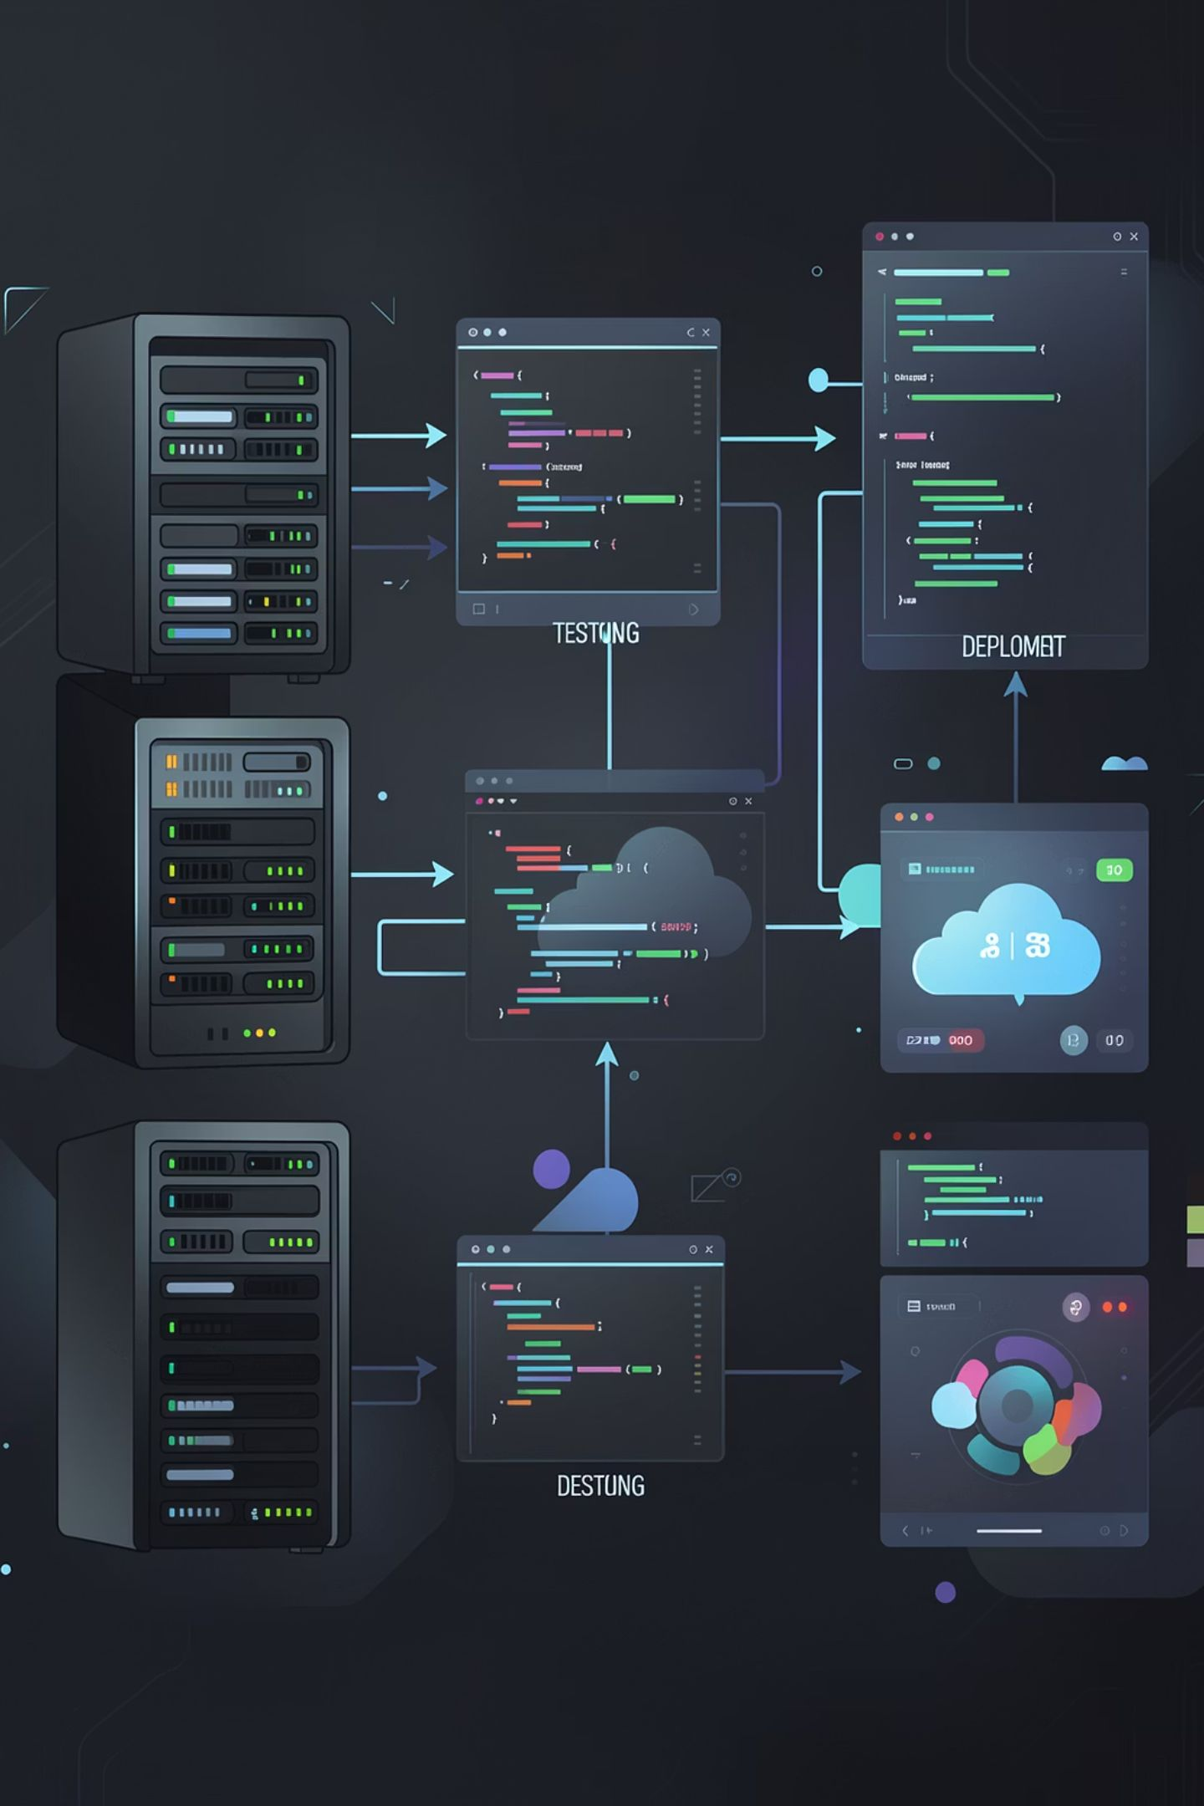
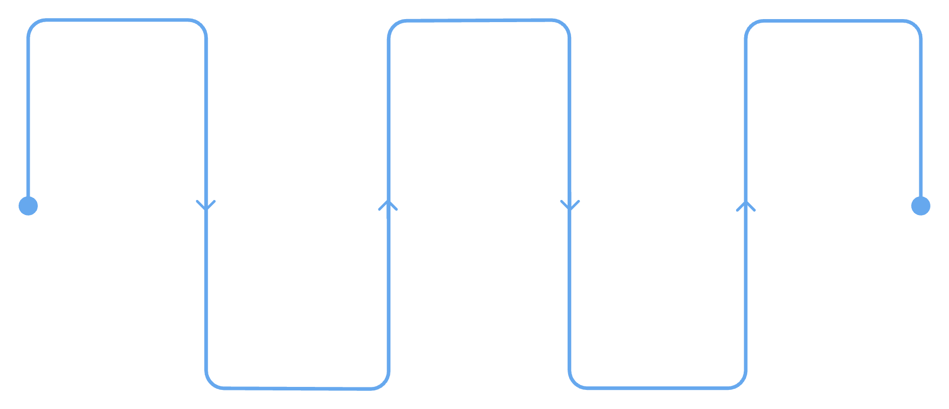
DevOps CI/CD Performance & Delivery Intelligence Dashboard
An Interactive Power BI Analytics Solution for Software Delivery Performance
Code
Test
Monitor
Author and review changes
Run automated validations
Observe performance and logs
Build
Deploy
Compile artifacts and package
Release to target environments
Presented by Santhoshini R. | M.Sc Computer Science

Slide 2
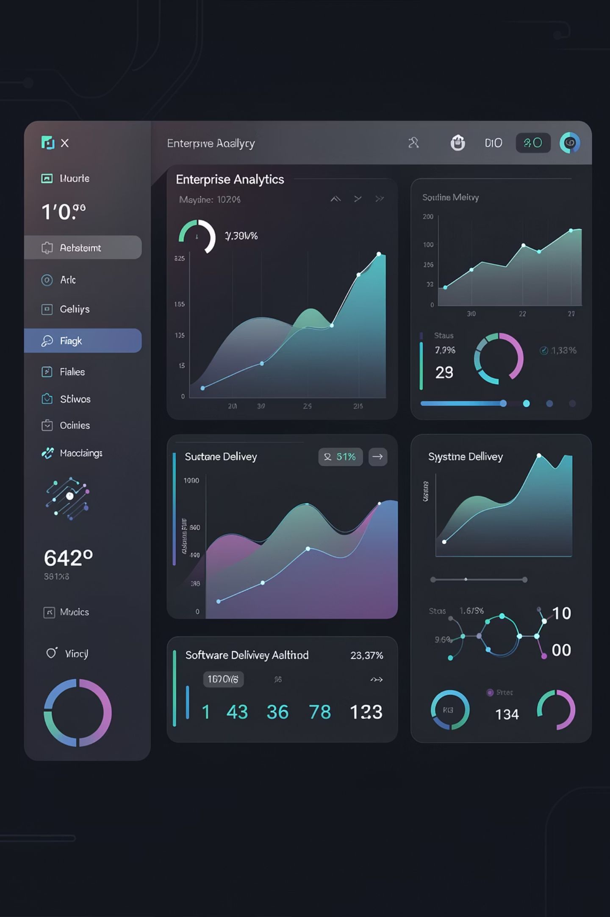
Project Overview
From raw CI/CD data to clear delivery insights
Unified Monitoring
Interactive KPIs
Pipeline, build, testing, deployment, developer & incident data — all in one place
Converts raw operational data into actionable trends and performance views
Issue Detection
Quickly surface failures, delays, quality issues and recurring problems

Slide 3








Dataset Details
application_details
Application & project information
build_details
Build execution and status
deployment_details
Status, environment & duration
developer_details
Developer information
incident_details
Incidents & production issues
infrastructure_usage
Infrastructure & performance usage
pipeline_runs
Execution, status, duration & trigger
test_results
Pass/fail/skipped, coverage & time
DAX
Calculated measures, KPIs & business logic

Slide 4






Power BI Dashboard Pages
Six interactive pages covering the complete software delivery lifecycle
Executive Overview
Pipeline Performance
Overall delivery health & top-level KPIs
Success, failure rates & duration trends
Deployment Intelligence
Testing & Quality
Deployment success & environment performance
Test outcomes, execution time & code coverage

Slide 5






Business Impact
Faster Issue Identification
Locate failing pipelines, tests & deployments quickly
Better Delivery Visibility
Monitor the full software delivery lifecycle in one place
Improved Reliability
Identify recurring failures & incident patterns proactively
Data-Driven Decisions
Support decisions using measurable KPIs
Visibility
Identify Bottlenecks
Take Action
Improve Delivery

Slide 6
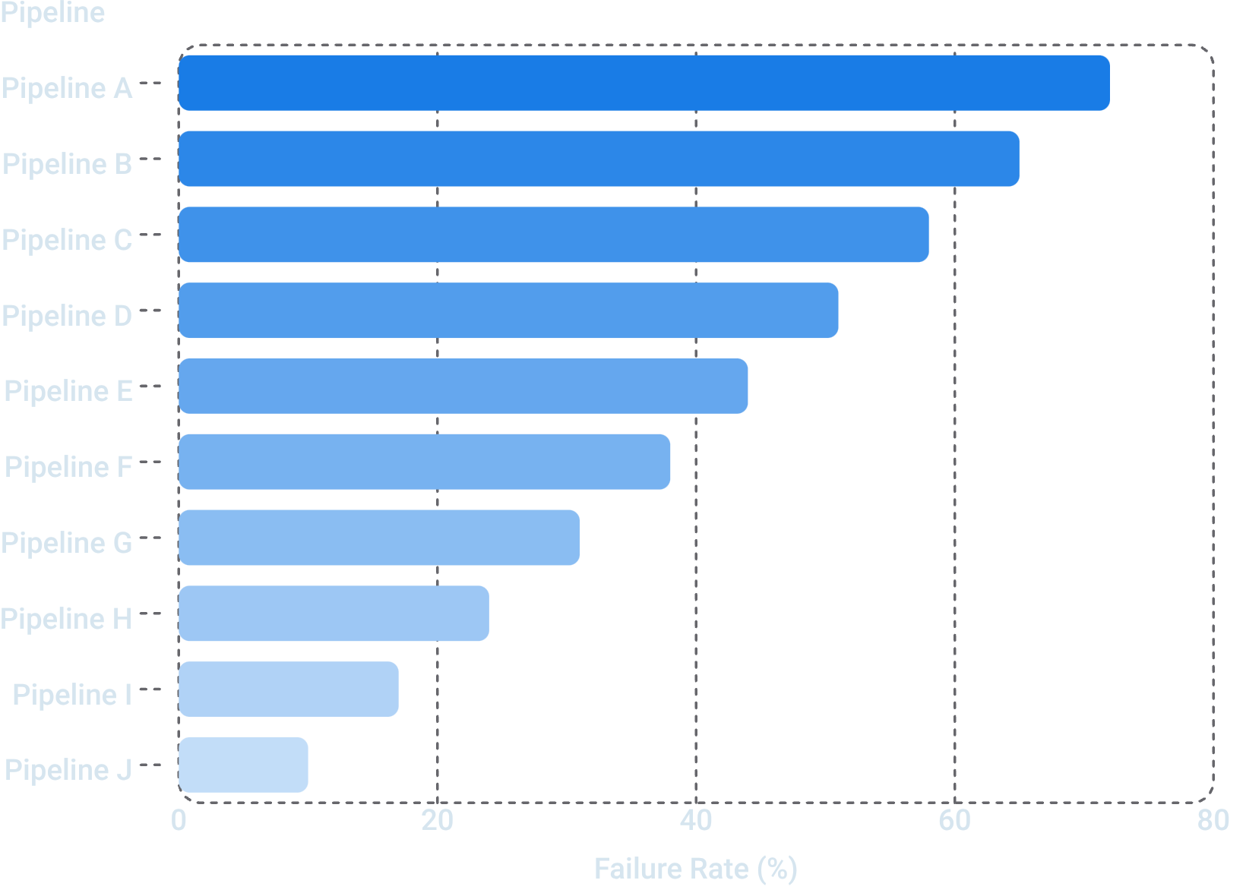

Key Insights
What the Dashboard Reveals
Top failing pipelines by failure rate
Slow CI/CD processes via pipeline duration
Deployment success across environments
Test pass/fail/skipped + code coverage
Recurring application & production incidents
All insights driven by interactive filters — by pipeline, application, developer & environment.
Illustrative example — replace with actual dashboard values

Slide 7
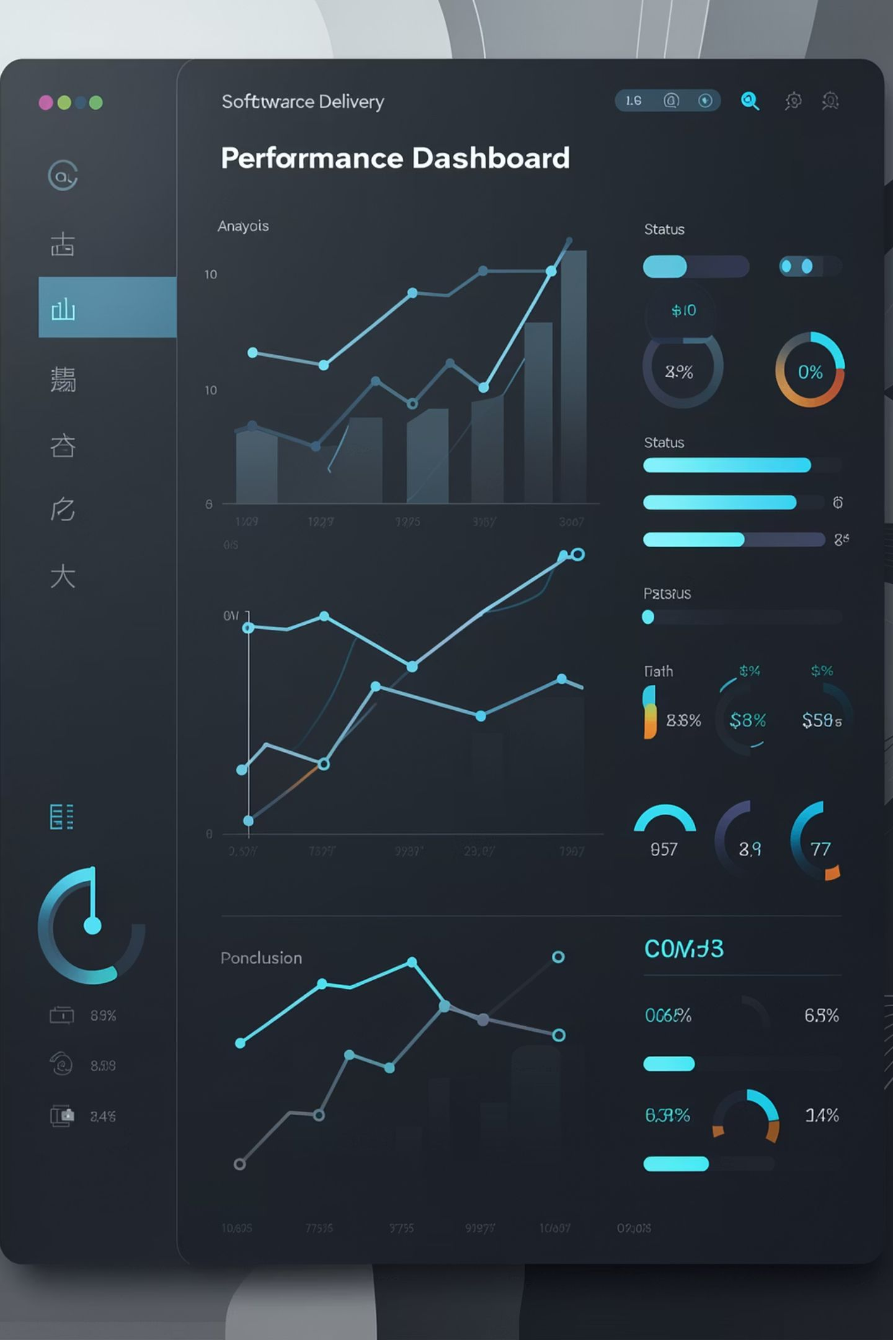




Conclusion
Centralised Analytical View
Single platform for CI/CD performance, reliability & quality
Multi-Dataset Integration
Connects pipeline reliability, testing quality, deployment efficiency & incidents
Interactive Filters
Slice by pipeline, application, developer & environment
Better visibility helps teams understand delivery performance and identify areas for improvement.
Future Scope
Automated Alerts
Real-Time Monitoring
Predictive Failure Analysis
Anomaly Detection

Slide 8

Thank You
Questions & Discussion
DevOps CI/CD Performance & Delivery Intelligence Dashboard
Santhoshini R. | M.Sc Computer Science

