Slide 1
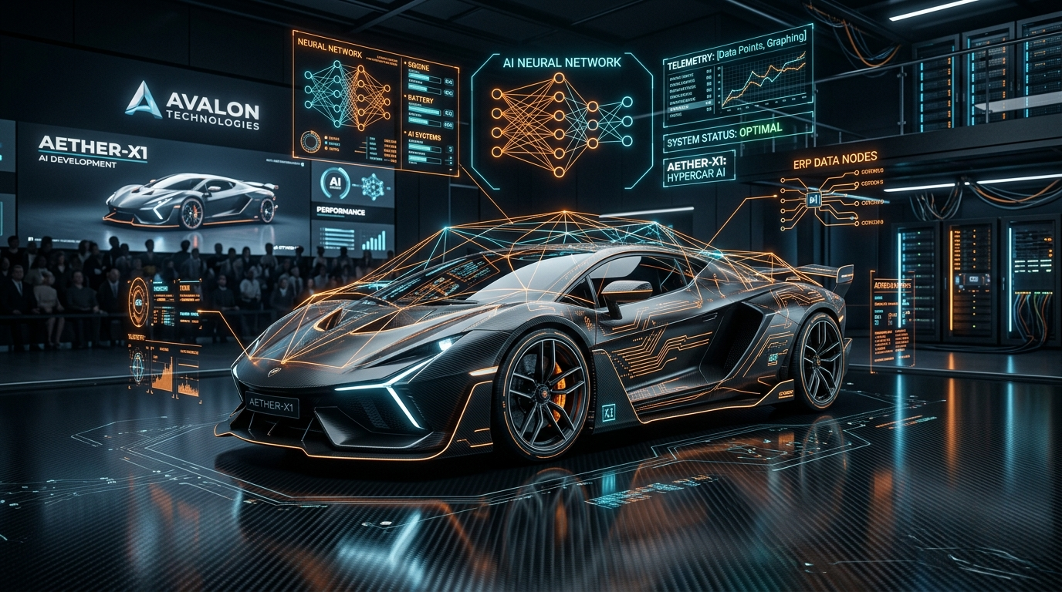
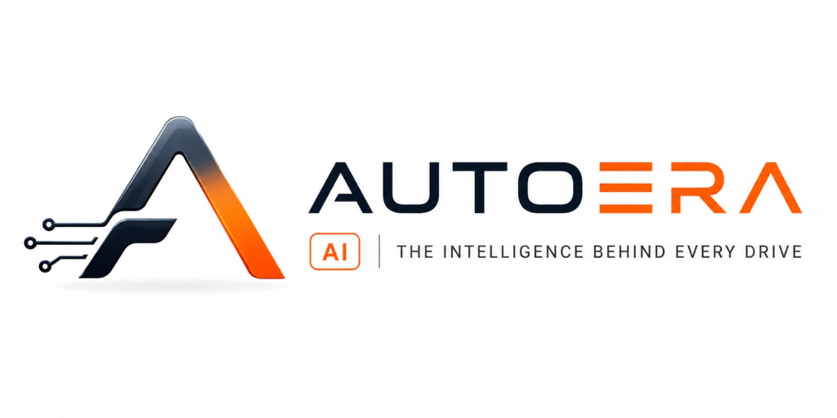
CONFIDENTIAL INVESTOR PRESENTATION • 2026
AI-Native Dealership Operating System
Unifying Sales · Service · Parts · Finance · Insurance — with built-in AI Intelligence
"AutoEra AI will become the global operating system for the automotive industry — the single platform that every dealership, OEM, fleet operator, insurer, finance company, and vehicle owner depends on as the system of record for their automotive world."
Year 1 Target: ₹10 Cr ARR
200 Dealers · 300 Workshops in South India
Year 5 Goal: ₹720 Cr ARR
12,000 Dealers · ₹340 Cr EBITDA (47%)
100% Functional MVP
40+ Models, Django 4.2+ + React 19 Deployed
Founder & CEO: Santhosh Jacob | AutoEra AI Solutions | Automotive Cloud Platform

Slide 2
AUTOERA AI | SLIDE 02
The Problem: The Fragmented Automotive Dealership Crisis
Dealerships globally and in India lose 18-25% top-line revenue due to disconnected legacy software and paper silos.
5–7 Disconnected Software Silos
Parts Stockouts & Dead Capital
• DMS, CRM, Excel, WhatsApp, Accounting & OEM Portals don't sync. • Double manual data entry creates 35% operational waste. • Zero single-pane-of-glass visibility across showroom & workshop.
• Dealerships lock ₹15L–₹50L monthly in spares, with 15–20% dead stock. • Unplanned stockouts delay vehicle delivery by 2–3 days. • No algorithmic reordering tied to scheduled bay appointments.
Impact: 35-40% operational time wasted
Impact: ₹4L - ₹8L locked dead inventory
Workshop Bay Inefficiency & Downtime
Customer Churn & Zero Follow-up
• Paper job cards; bay assignment tracked by verbal shouting. • Technicians idle awaiting parts clearance or customer WhatsApp approvals. • Vehicle Turnaround Time (TAT) is 40% slower than optimal.
• Post-warranty customer retention collapses below 25%. • No automated AI follow-ups for service intervals, insurance renewals, or PUC. • Zero lifetime customer nurturing resulting in massive customer leakage.
Impact: 28% unbilled technician idle bay hours
Impact: > 65% post-warranty customer churn

Slide 3
AUTOERA AI | SLIDE 03
Solution & Product: One Unified AI-Driven Automotive ERP
12 AI-Native modules replacing 5–7 disconnected legacy tools with a high-throughput, automated operating system.
AI Predictive Service CRM
Multi-Bay Digital Job Cards (SOP-02)
B2B Spares & Parts Marketplace
Intelligent lead scoring, automated WhatsApp/SMS service reminders, warranty tracking, and dynamic churn prevention.
0–90 second vehicle intake via number plate scan. Real-time technician bay auto-dispatch, labor tracking, mobile approval.
Automated reorder triggers, OEM part compatibility matrix, supplier PO generation, and 1.5–2.5% take-rate integration.
Automated GST & Invoicing
7 Specialist AI Agents
EV Intelligence & Fleet Telematics
Indian GST compliance, HSN/SAC automated tax calculation, split labor/parts billing, and UPI/Razorpay payment reconciliation.
Built-in Copilot querying live ERP data with ActionProposal human-in-the-loop validation for critical inventory & claims actions.
Indian climate EV battery health degradation diagnostics, OBD-II connected failure warning, and fleet maintenance.
Production Ready: 40+ relational models, 44+ REST APIs, Django 4.2+ + React 19 deployed on cloud with pilot seed automation.

Slide 4
AUTOERA AI | SLIDE 04
Market Opportunity: Global Scale ($48.5B) + Indian Epicenter (₹1.08L Cr)
Automotive aftermarket & retail software is experiencing an unprecedented shift from on-prem legacy DMS to cloud AI ERP.
GLOBAL TAM
$48.5 Billion
₹4,00,000+ Crore
1,200,000+ Franchised & Multi-Brand Dealers, Repair Chains globally (CAGR 14.2%)
INDIA TAM
₹1,08,000 Crore
$13.0 Billion
3,00,000+ Dealerships, 2W/4W Workshops & Commercial Garages across India
GLOBAL SAM
$9.2 Billion
₹76,000 Crore
Cloud SaaS & AI adoption in emerging digital corridors: SE Asia, GCC/MENA & LatAm
INDIA SAM
₹8,640 Crore
$1.04 Billion
24,000+ Tech-Ready Multi-Brand Dealers & Organized Auto Franchises
5-YEAR SOM TARGET: ₹720 CRORE ARR ($87 MILLION) — MASTER PLAN 2026 GOAL
• 12,000 Dealerships + 25,000 Workshops + 2,000 Fleet Operators across India, Southeast Asia & GCC corridors. • Tamil Nadu Beachhead: Leveraging Chennai as the 'Detroit of Asia' (producing 70% EV 2W and 40% EV 4W in India) to validate and prove the operational model with 50 local dealers. • High-Margin Diversification: ₹500 Cr from SaaS Subscriptions + ₹120 Cr B2B Spare Parts Marketplace Take-Rate + ₹80 Cr Enterprise OEM Contracts + ₹20 Cr AI Usage Fees. • Exceptional Unit Profitability: Yielding ₹340 Crores in Net Operating EBITDA (47% margin) by Year 5.

Slide 5
AUTOERA AI | SLIDE 05
Master Plan Business Model: Premium Tiers (₹50K / ₹100K / ₹250K)
Engineered for ₹720 Crore ARR by Year 5 with ₹340 Crore Operating EBITDA (47% margin).
Starter Workshop
₹50,000 / mo
Multi-Bay Workshops (1–5 bays)
• ServicePulse 90-sec Job Card • Number Plate Scanner • Basic Parts Inventory • Tamil/English WhatsApp Updates • Automated GST Invoicing • 5 User Accounts · 2,500 AI Queries
Pro Dealership ★
₹1,00,000 / mo
Authorized Dealerships (to 12 bays)
• Full Sales CRM + Service Engine • AI Voice Follow-Up Agent • Predictive Parts Replenishment • Insurance Claim Assistant • 15 Users · 10,000 AI Queries • Sweet Spot for High-Velocity Retainer
Enterprise Group
₹2,50,000 / mo
Dealer Groups & Chains (Multi-Branch)
• All 12 AI-Native Modules • Multi-Branch Inventory Balancing • Fleet Telematics + EV Battery Health • Executive KPI Benchmarking • Dedicated CS Manager & Custom RAG • Unlimited Users & Enterprise SLAs
Year 5 Revenue Breakdown (₹720 Crores Total ARR)
• SaaS Subscriptions (69%): ₹500 Crores (from Starter ₹50K, Pro ₹100K, and Enterprise ₹250K/mo across 12,000 dealers) • Transaction Fees (17%): ₹120 Crores (1.5%–2.5% B2B Spare Parts Marketplace Take-Rate & Insurance origination) • Enterprise Contracts (11%): ₹80 Crores (OEM Network Licenses & Large Commercial Fleet Deployments) • AI Usage Fees (3%): ₹20 Crores (AI Vision damage scanning tokens & automated conversational voice API calls) • Total Expenses: ₹380 Crores | Net Operating EBITDA: ₹340 Crores (47% EBITDA Margin) ★

Slide 6
AUTOERA AI | SLIDE 06
Traction & Validation: Fully Functional MVP Ready for Scale
Honest, verified milestones: Built from the ground up to solve actual workshop workflow bottlenecks.
VERIFIED IN CODEBASE
Full-Stack Functional MVP
• 40+ relational models in PostgreSQL covering Sales, Service, Parts, Billing, and RBAC. • React 19 + TypeScript frontend with live Gemini AI tool calling. • Seed pilot command (seed_pilot_dealership.py) allows instantaneous dealership staging.
MARKET VALIDATION
Field Discovery & Interviews
• Conducted in-depth interviews with 15+ multi-brand workshop owners in Tamil Nadu. • Verified top pain points: 30% lead leakage, parts reorder chaos, and GST billing delays. • 8 flagship workshops queued for live pilot onboarding.
READY FOR GO-LIVE
Pilot Onboarding Pipeline
• Phase 1 pilot rollout in Coimbatore & Chennai automotive corridors. • Real-time feedback loop configured for weekly feature enhancement. • Foundation for Year 1 milestone: scaling to 200 dealers & 300 workshops.

Slide 7
AUTOERA AI | SLIDE 07
Competitive Advantage: AI-Native vs. Legacy Monsters
Why AutoEra AI wins: Built natively for multi-brand auto retail with AI agents querying live ERP data.
WINNER
AutoEra AI (Us)
Modern unified AI ERP built natively for auto retail & workshops. Live bay cards, predictive CRM, automated GST, transparent pricing.
Monolithic & Rigid
Legacy OEM DMS (Dealer Management)
Rigid, desktop-bound, 15-year-old monoliths. Locked to single OEMs; cannot handle multi-brand servicing or agile WhatsApp automation.
No Auto Workflows
Generic ERPs (Zoho / Tally / SAP)
Horizontal software lacking automotive context. No VIN decoder, no bay tracking, no parts compatibility matrix without costly custom dev.
Fragmented Silos
Point Solutions (Standalone Invoicing)
Solve only billing or basic CRM. Creates isolated data silos; requires continuous manual double entry between mechanics and accounts.

Slide 8
AUTOERA AI | SLIDE 08
Go-To-Market Roadmap: Chennai to ₹720 Crore ARR (2026–2030)
Structured expansion scaling from regional automotive clusters to 39,000+ connected nodes.
200 Dealers · 300 Workshops
Year 1 (2026): Tamil Nadu Cluster
• 50 flagship dealers in a 10km radius in Chennai & Coimbatore. • Deploy ServicePulse 90-sec Job Card + Tamil Voice Agent. • Reach ₹10 Crore ARR milestone with cash-flow positivity.
2,000 Dealers · 4,000 Workshops
Year 2–3 (2027–28): Pan-India Scale
• Scale across South India (TN, Karnataka, Andhra, Maharashtra). • Automated B2B spare parts replenishment with regional distributors. • ₹96 Crore ARR with ₹25 Cr operating EBITDA.
12,000 Dealers · ₹720 Cr ARR ★
Year 4–5 (2029–30): Global Corridors
• Pan-India + Southeast Asia & GCC market expansion. • 39,000+ total connected nodes (Dealers + Workshops + Fleets). • Generating ₹340 Crores in Net Operating EBITDA (47% margin).

Slide 9
AUTOERA AI | SLIDE 09
Financial Projections: 5-Year Scaling to ₹720 Crore ARR
Master Plan 2026: Achieving ₹340 Crore Operating EBITDA (47% margin) across 39,000+ automotive entities.
5-Year Financial Forecast (Master Plan Table 55)
Year 5 Revenue Breakdown (Table 56)
Year 1 (2026): 200 Dealers · 300 Workshops · 20 Fleets • Monthly Run-Rate: ₹40L–₹80L | Annual ARR: ₹10.0 Crores Year 2 (2027): 800 Dealers · 1,500 Workshops · 100 Fleets • Monthly Run-Rate: ₹2.50 Cr | Annual ARR: ₹30.0 Crores Year 3 (2028): 2,000 Dealers · 4,000 Workshops · 300 Fleets • Monthly Run-Rate: ₹8.00 Cr | Annual ARR: ₹96.0 Crores | EBITDA: +₹25 Cr Year 4 (2029): 5,000 Dealers · 10,000 Workshops · 800 Fleets • Monthly Run-Rate: ₹25.0 Cr | Annual ARR: ₹300.0 Crores | EBITDA: +₹110 Cr Year 5 (2030): 12,000 Dealers · 25,000 Workshops · 2,000 Fleets ★ • Monthly Run-Rate: ₹60.0 Cr | Total ARR: ₹720.0 Crores ($87M) • Operating Expenses: ₹380 Cr | Operating EBITDA: ₹340.0 Crores (47% Margin)
Year 5 Stream Breakdown: • SaaS Subscriptions (69%): ₹500 Cr (Starter ₹50K, Pro ₹100K, Enterprise ₹250K/mo) • Transaction Fees (17%): ₹120 Cr (1.5%–2.5% B2B Spares Marketplace & Insurance) • Enterprise Contracts (11%): ₹80 Cr (OEM Network Licenses & Government Fleets) • AI Usage Fees (3%): ₹20 Cr (Damage scanning tokens & Voice API calls) TOTAL ARR: ₹720 Crores ★ Unicorn Valuation Math (Table 127): ₹720 Cr ARR × 10x Multiple = ₹7,200 Crores (~$870 Million Enterprise Value)

Slide 10
AUTOERA AI | SLIDE 10
Team & Long-Term Vision: Powering the Future of Auto Retail
Domain-driven execution team committed to building a ₹720 Crore global automotive enterprise from Tamil Nadu.
Founder & CEO
Long-Term Vision: Connected Automotive Grid
Santhosh Jacob — Founder & CEO
• Architected and built the entire AutoEra AI platform end-to-end (Django 4.2+, React 19, PostgreSQL, Gemini Tool Calling). • Deep automotive domain roots in Tamil Nadu with direct access to dealership dealer principals. • Supported by seasoned automotive workshop advisors and SaaS scale mentors.
Scaling to ₹720 Crore ARR ($87 Million): • Connected Vehicle Telematics & OBD-II proactive failure warning. • High-Throughput Spare Parts Marketplace powering ₹20,000+ Cr in annual GMV. • Dedicated EV Fleet, Battery Health & Smart Diagnostics infrastructure.
Thank You, Visionary Investors & Partners!
Let's partner together to build the global automotive SaaS champion scaling to ₹720 Crores ($870M+ Valuation).
Website: autoera.in | Contact: santhosh@autoera.in | Live Platform Deployed & Demo Ready

