Slide 1
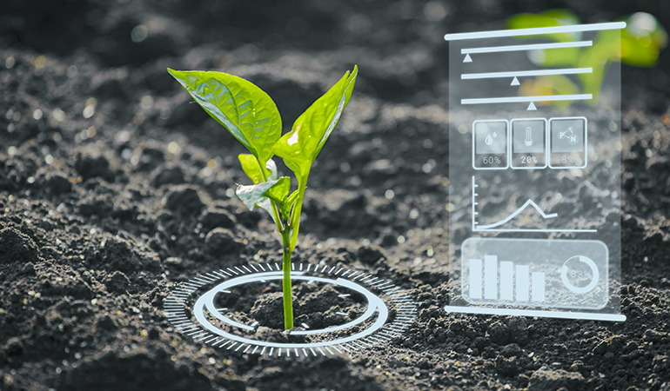
ARDUINO
BASED
WATER
IRRIGATION
MANAGEMENT
SYSTEM

Slide 2

S.NO | TEAM MEMBERS | REGISTER NUMBER
1 | ANANDHAN .R | 421620205003
2 | SANTHOSHKUMAR .S | 421620205032
3 | SHAGUL .M | 421620205003
4 | VISHNU .P | 421620205044
Supervised By Mr.S.RAMESH,M.TECH,AP/IT

Slide 3

Content
Introduction
Objective
Block Diagram
Circuit Components
Flow Chart
Working Steps
Circuit Diagram
Project Script
Discussion & Result
Practical Implementation
Conclusion
Merits

Slide 4
Introduction
Irrigation is the artificial application of water to the land or soil.
Knowing when and how much to water are two critical aspects of the watering process.
To facilitate farming and reduce manual labor, Automatic Irrigation systems have been developed.
These systems aim to impress farmers by utilizing renewable energy sources.

Slide 5
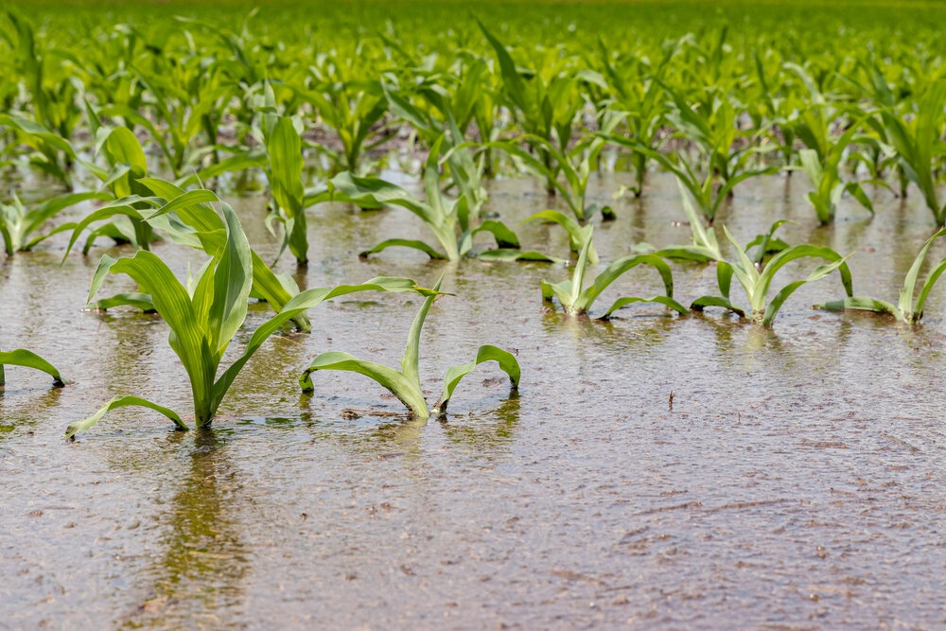
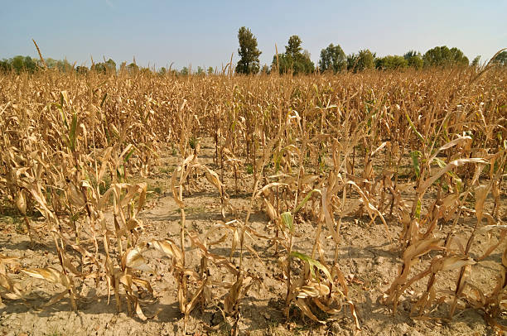

Objective
minimizing manual interventions, preventing excessive wastage of water and electricity, and protecting plants from immediate damage.
Over Irrigation
Under Irrigation
Perfect Irrigation

Slide 6
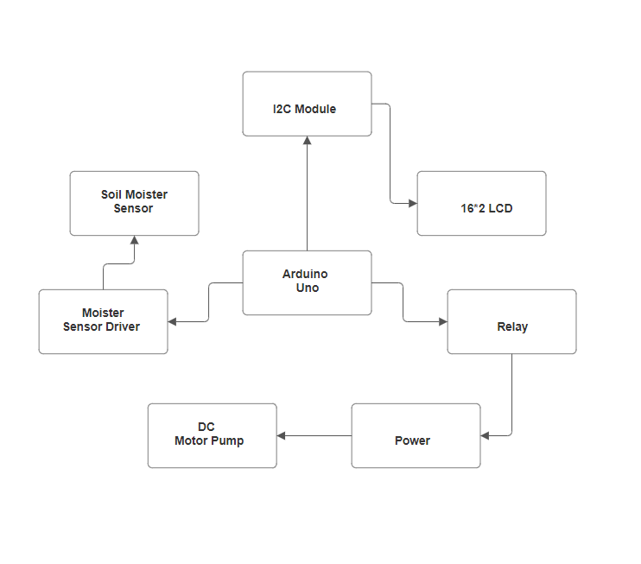
Block Diagram

Slide 7
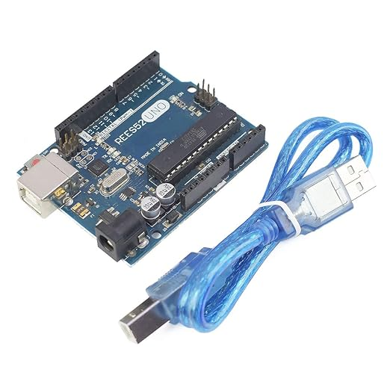
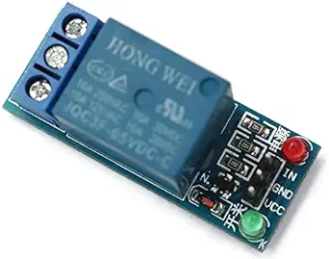
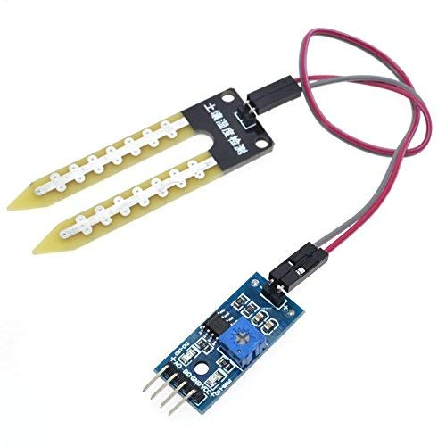
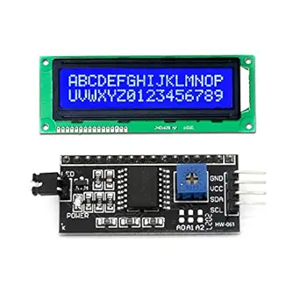
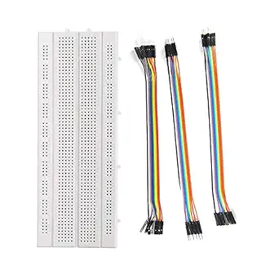
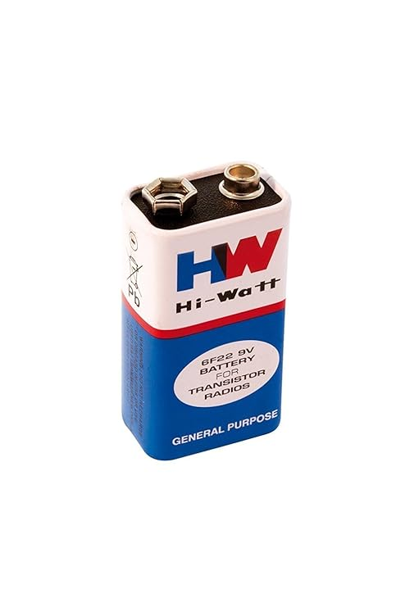
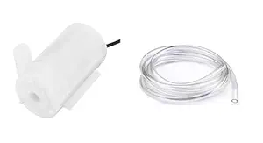
Circuit Components
Arduino UNO with Power Supply
Breadboard
9V Battery
Soil Moisture Sensor
Soil Moisture Driver
16*2 LCD
I2C Module
Driver Relay
Jumper wires
DC Motor Pump with pipe

Slide 8
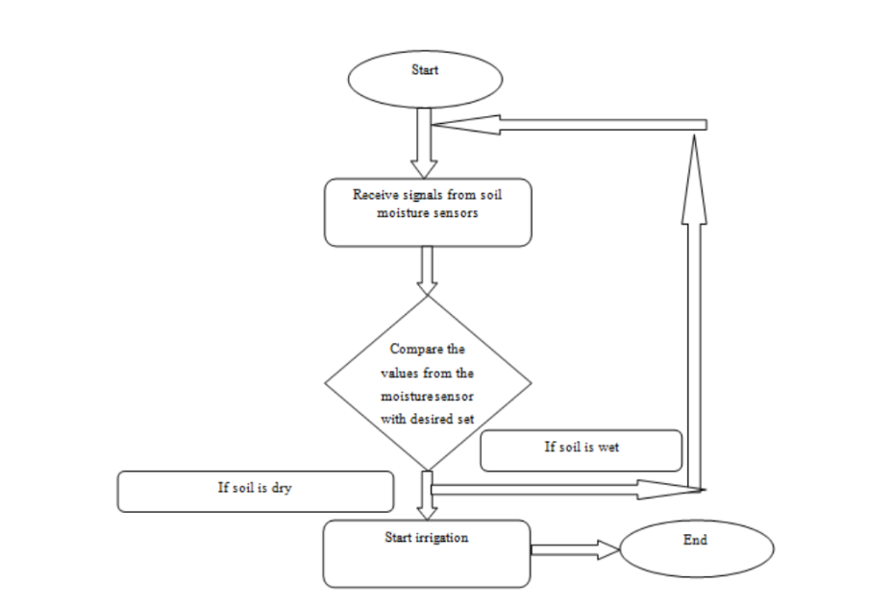
Flow Chart

Slide 9
Working Steps
To connect Arduino UNO with Breadboard 5V & Ground.
To connect VCC & GND Pin of Soil Moisture Sensor with Breadboard VCC, Ground & A0 to Arduino A0 pin.
To connect VCC & GND Pin of I2C Module with Breadboard Power supply and SCL & SDA Pin with Arduino A5 & A4 Pin.
To connect VCC & GND Pin of Relay with Breadboard Power and the Signal IN pin connected to Arduino digital pin 7.
To Connect Motor with Battery And Relay.

Slide 10
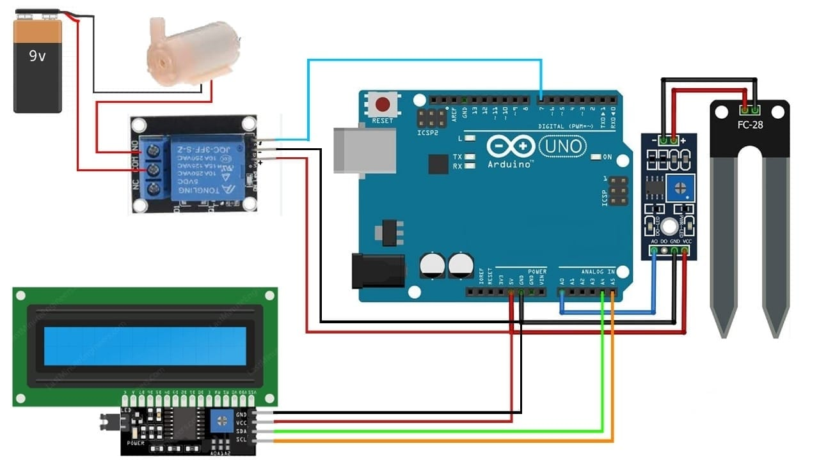
Circuit Diagram

Slide 11
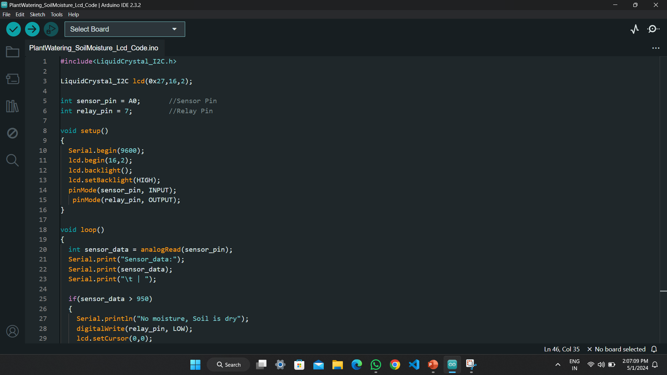
Project Script

Slide 12
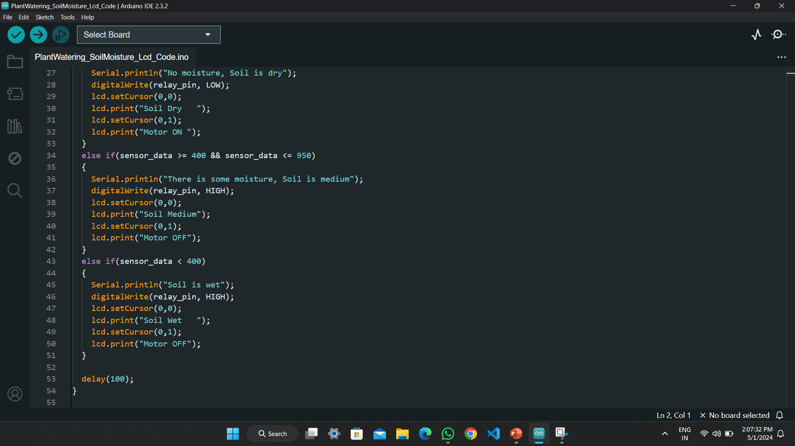
Project Script

Slide 13
Discussion & Result
To control Relay with Motor, Arduino used. It is programmed by Arduino IDE.
To measure the level of soil, The Moisture Sensor senses and send signal in Arduino.
Finally The Pump supply the water to the water, until the desired moisture level is reached.

Slide 14
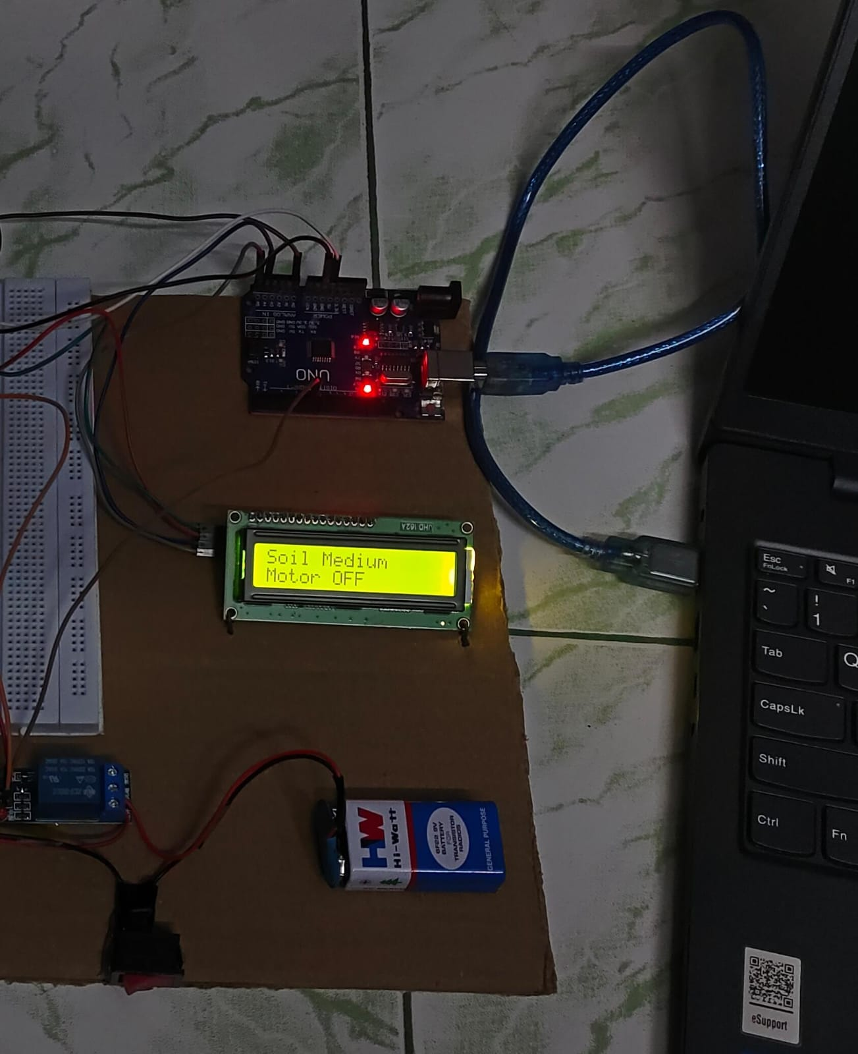
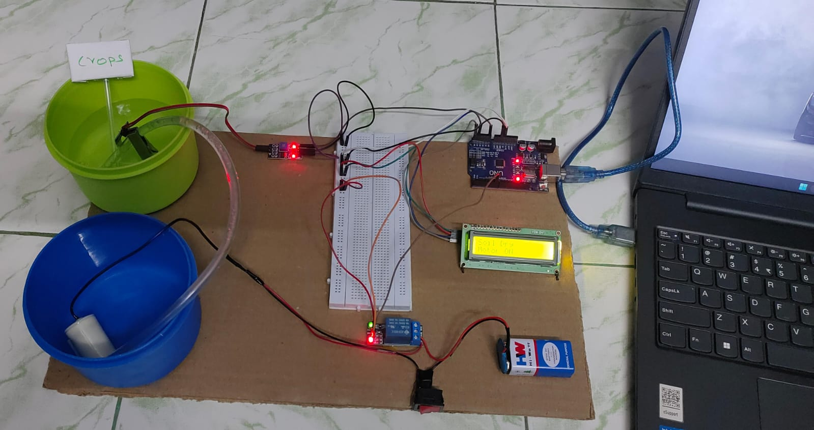
Practical Implementation

Slide 15
Merits
Highly sensitive, works according to the soil condition.
Low cost and reliable circuit.
Complete elimination of manpower.
System can be switched into manual mode whenever required.
Very useful for common people who do not have time to water their plant because of busy life schedule.
This project is very economical in term of cost and power

Slide 16
Conclusion
In present times especially farmers face significant challenges in watering their agricultural fields. Because they have no proper idea about when the power is available so that they the can pump water. Even after then they need to wait until the field is properly watered, which makes them to stop other activities.
Here's an idea that not only assists farmers but also gardeners: a system that senses soil moisture and automatically switches the valve when power is on.

Slide 17


