Slide 1
KONTENA SHOW CASE
Presented By :SANTHOSH KUMAR HIREKERUR

Slide 2
AGENDA
Infrastructure & HA Proxy
Setting up grid
Deploying CBR-TEST application Stack
What we achieved?
What are Remaining?

Slide 3
HA PROXY (Public Proxy)
HOST1
HOST1
HA PROXY (Internal Proxy)
HA PROXY (Internal Proxy)
HOST2
HOST2
HOST3
HOST3
INFRA-GRID
CBR-TEST

Slide 4




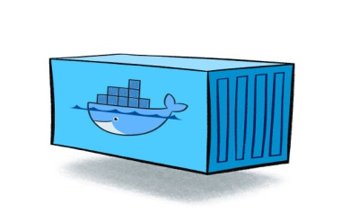
WEBHOOK
>> push grid-routes.json
1. Curl KONTENA_URI and KONTENA_TOKEN
2. Get KONTENA_URI and KONTENA_TOKEN
webhook
./init-server.sh
3. Update docker-compose.xml file

Slide 5
KONTENA SHOW CASE
Presented By :SANTHOSH KUMAR HIREKERUR
catch.santoshkumar@gmail.com
0420- 962626

