Slide 1
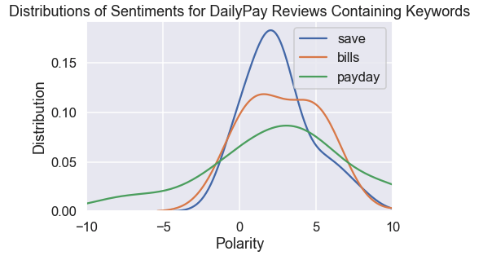
The Effect of Pay Advances on Workers’ Financial Health
The project
Fin-Tech apps increasingly offer possibility to workers to access earned wages before pay-day
Does this improve workers’ financial health?
On the one hand: easier to face financial shocks without relying on high-interests source of loans
On the other: room for over-using the apps, especially with self-control problems
What we did
Analyzing users’ reviews for the apps to understand their valuation of it – do they find them useful?
Challenge! Separate out reviews about technical issues as opposed to actual content of the app.
Preliminary findings
Positive reviews typically describe effects financial health outcomes, while negative reviews tend to pertain to software issues within the app.
Next steps
Partner with one such FinTech company to analyze their data + run an experiment

