Slide 1


Module 3 (Solving Differential Equations: numerical techniques)

Slide 2
Module -3 (prerequisite)
Module 1,2
Ordinary Differential Equations
Newtonian Mechanics
Module -3 (Learning outcome)
Learning of linear and Non-linear Differential Equations
Love affairs, Predator-Prey interactions and SIR model
Numerical Methods-Euler, Runge-Kutta 4
Double Pendulum, Lorenz Oscillator
Chaos theory : A brief and general idea (sensitivity to IC)
Fractal

Slide 4
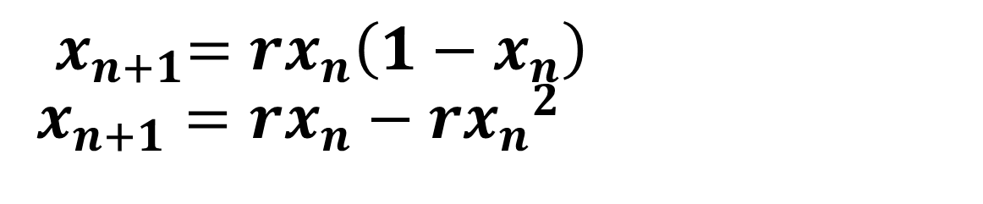
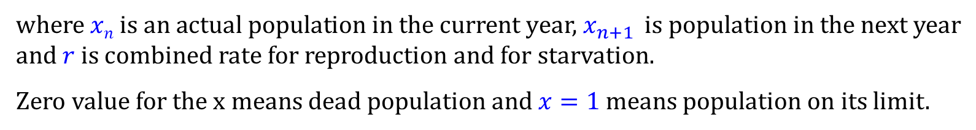
Logistic equation
The logistic equation, also known as Verhulst equation, is a formula for approximating the evolution of an animal population over time.
where $xn$ is an actual population in the current year, $x_{n+1 }$is population in the next year and $r$is combined rate for reproduction and for starvation.
Zero value for the x means dead population and $x=1$means population on its limit.
Notes:
Contrary to the bacteria model, living condition for animals significantly vary during the year. Some species are fertile just for particular season of year, not every existing animal reproduce etc. For this reason, the system might be better described by a discrete difference equation than a continuous differential equation.

Slide 5








Bifurcation diagram of Logistic equation

Slide 6
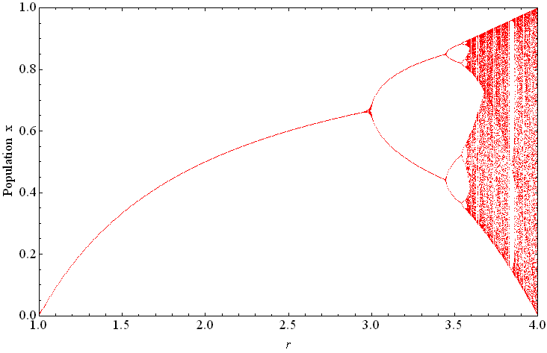
Bifurcation diagram of Logistic equation
For the value r=3 we can observe the first bifurcation (doubling of the functional dependence). Another bifurcations follow for r=3.449, r=3.544 etc.
Notes:
reproduction : where the population will increase at a rate proportional to the current population when the population size is small.
starvation (density-dependent mortality) : where the growth rate will decrease at a rate proportional to the value obtained by taking the theoretical "carrying capacity" of the environment less the current population.
x_{n} is a number between zero and one that represents the ratio of existing population to the maximum possible population.

Slide 7

Bifurcation diagram of Logistic equation
Extinction (r<1): if the growth rate is less than 1 the system "dies„
Fixed point area (1<r<3): the series tends to a single value for any initial x₀
Oscillation area (3<r<3.57): The series jumps between two or more discrete states.
Chaos area (3.57<r<4): the system can evaluate to any position at all with no apparent order
For higher values of r (r>4) all solutions zoom to infinity and the modeling aspects of this function become useless.

Slide 9
Stability and Fixed points of dynamical systems
Daniel Arovas , Phys Dept., University of California, San Diego
Steven Strogatz : Nonlinear Dynamics and Chaos,

Slide 10

Stability and Fixed points of dynamical systems
$$\frac{du}{dt}=f(u)$$

Slide 11

Stability and Fixed points of dynamical systems
$$\frac{du}{dt}=f(u)$$

Slide 12
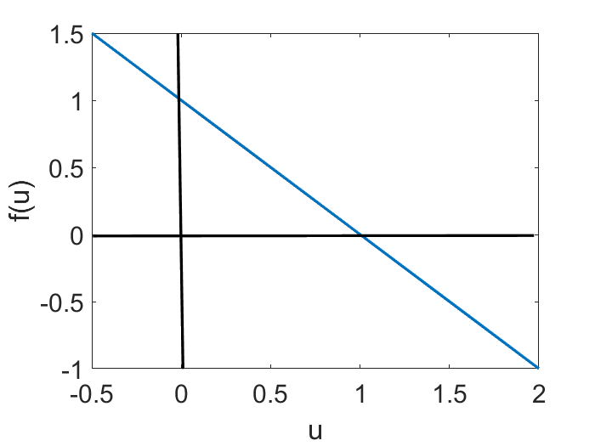

Stability and Fixed points of dynamical systems (Model 1)
$$\frac{du}{dt}=f(u)$$
$$a=b=1$$

Slide 13

Stability and Fixed points of dynamical systems (Model 1)
$$\frac{du}{dt}=f(u)$$
$$u$$

Slide 14
Numerical Solution with Euler Method

Slide 15

Euler’s Method: Tangent Line Approximation
For our first order initial value problem
an alternative is to compute approximate values of the solution y = φ(t) at a selected set of t-values.
Ideally, the approximate solution values will be accompanied by error bounds that ensure the level of accuracy.
In this section, we examine the tangent line method, which is also called Euler’s Method.
$$y^{′}=f(t,y),y(t_{0})=y_{0},$$

Slide 16
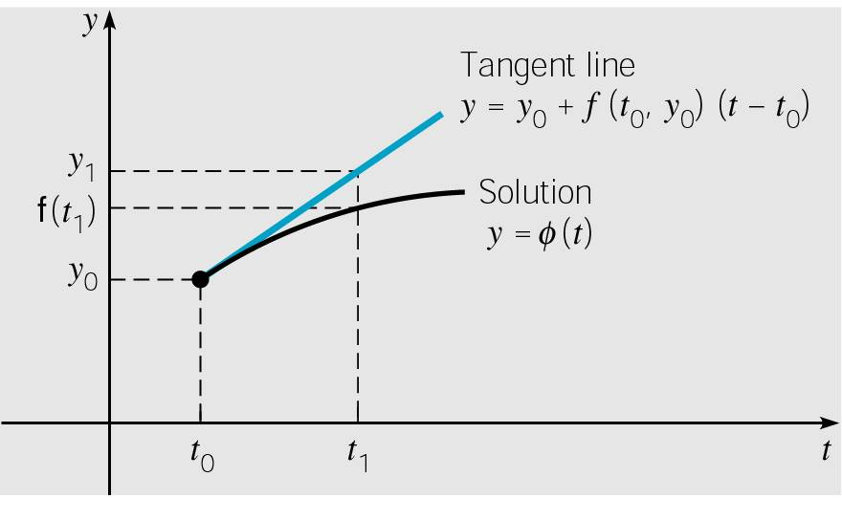



Euler’s Method: Tangent Line Approximation
For the initial value problem
approximating solution: y = φ(t) at initial point t₀.
The line tangent to solution at initial point is thus
Thus, if t₁ is close enough to t₀,
we can approximate φ(t₁) by
$$y^{′}=f(t,y),y(t_{0})=y_{0},$$
$$y=y_{0}+f\left(t_{0},y_{0}\right)\left(t−t_{0}\right)$$
$$y_{1}=y_{0}+f\left(t_{0},y_{0}\right)\left(t_{1}−t_{0}\right)$$
Notes:
The solution passes through initial point (t₀, y₀) with slope
f (t₀, y₀).

Slide 17


Euler’s Method: Tangent Line Approximation
For a point t₂ close to t₁, we approximate φ(t₂) using the line passing through (t₁, y₁) with slope f (t₁, y₁):
Thus we create a sequence y_{n} of approximations to φ(t_{n}):
where f_{n} = f (t_{n}, y_{n}).
For a uniform step size h = t_{n} – t_{n-1}, Euler’s formula becomes
$$y_{2}=y_{1}+f\left(t_{1},y_{1}\right)\left(t_{2}−t_{1}\right)$$
$$y_{1}=y_{0}+f_{0}⋅\left(t_{1}−t_{0}\right) \\ y_{2}=y_{1}+f_{1}⋅\left(t_{2}−t_{1}\right) \\ ⋮ \\ y_{n+1}=y_{n}+f_{n}⋅\left(t_{n+1}−t_{n}\right)$$
$$y_{n+1}=y_{n}+f_{n}h,n=0,1,2,…$$

Slide 18

Euler Method: Model 1 (pseudo code)
$$\frac{du}{dt}=f\left(u\right)=a−bu$$
Inputs: a, b, u0, t0, tf, dt // Initial conditions and step size
N = (tf - t0) / dt // Number of time steps
t = t0
u = u0
For i = 1 to N:
udot = a - b * u // Compute derivative
u = u + udot * dt // Euler update step
t = t + dt // Update time
Print t, u // Output time and state
End For

Slide 19
Stability and Fixed points of dynamical systems (linear stability analysis)

Slide 20

Stability and Fixed points of dynamical systems (linear stability analysis)
$$\dot{u}=f(u)$$
Perturbing around the fixed points:
$$\dot{u}+\dot{ε}=f\left(u+ε\right){\left.​\right|}_{u=u^{∗}}=f\left(u^{∗}\right)+εf^{′}\left(u^{∗}\right)+\frac{ε^{2}}{2!}f^{′′}\left(u^{∗}\right)+O(ε^{3})$$

Slide 21
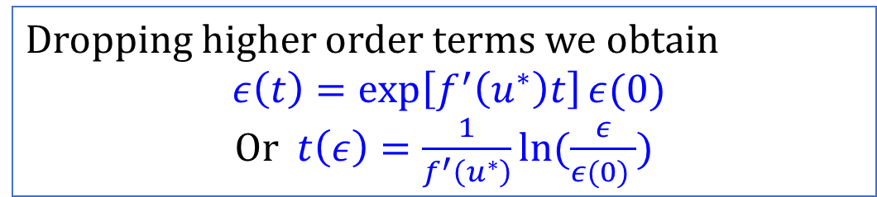

Stability and Fixed points of dynamical systems (linear stability analysis)
$$\dot{u}=f(u)$$
Perturbing (small and linear) around the fixed points:
$$\dot{u}+\dot{ε}=f\left(u+ε\right){\left.​\right|}_{u=u^{∗}}=f\left(u^{∗}\right)+εf^{′}\left(u^{∗}\right)+\frac{ε^{2}}{2!}f^{′′}\left(u^{∗}\right)+O(ε^{3})$$
$$\dot{ε}=εf^{′}\left(u^{∗}\right)$$
The perturbation grows if $f^{′}\left(u^{∗}\right)>0$ and decreases if $f^{′}\left(u^{∗}\right)<0$
Dropping higher order terms we obtain
$ε\left(t\right)=\exp\left[f^{′}\left(u^{∗}\right)t\right]ε(0)$
Or $t\left(ε\right)=\frac{1}{f^{′}\left(u^{∗}\right)}ln⁡(\frac{ε}{ε(0) })$

Slide 22
Stability and Fixed points of dynamical systems (vector flow)
$$\frac{du}{dt}=f(u)$$
$$a=b=1$$
The perturbation grows if $f^{′}\left(u^{∗}\right)>0$ and decreases if $f^{′}\left(u^{∗}\right)<0$

Slide 23
RC Circuit: Charging Capacitor (Model 2)

Slide 24
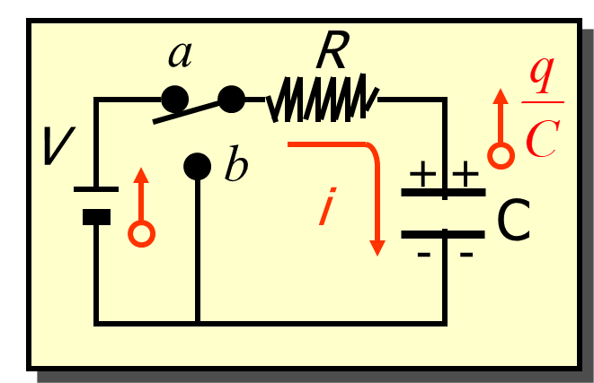

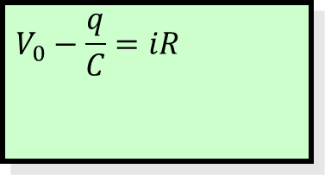
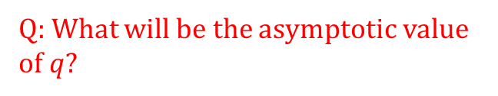

RC Circuit: Charging Capacitor
$$V_{0}−\frac{q}{C}=iR$$
$$V_{0}$$
Q: What will be the asymptotic value of $q$?
$$R\frac{dq}{dt}=V_{0}−\frac{q}{C}$$

Slide 25
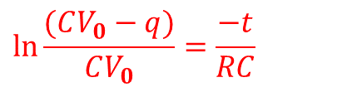
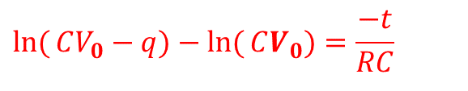
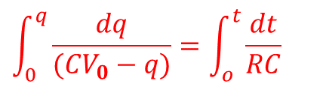
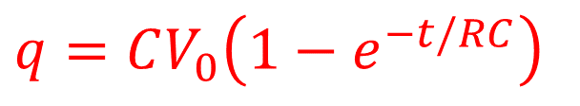
RC Circuit: Charging Capacitor
$$V_{0}−\frac{q}{C}=iR$$
$$V_{0}$$
$$\int_{0}^{q}{\frac{dq}{(CV_{0}−q)}}=\int_{o}^{t}{\frac{dt}{RC}}$$
$$R\frac{dq}{dt}=V_{0}−\frac{q}{C}$$
$$\ln{(}CV_{0}−q)−\ln{(}CV_{0})=\frac{−t}{RC}$$
At time $t = 0: q = CV_{0}(1 − 1); q = 0$
$$\ln{\frac{(CV_{0}−q)}{CV_{0}}}=\frac{−t}{RC}$$
At time $t =∞: q = CV_{0}(1 − 0); qmax = CV_{0}$
$$q=CV_{0}\left(1−e^{−t/RC}\right)$$
The charge q rises from zero initially to its maximum value $qmax = CV_{0}$

Slide 26
RC Circuit: Charging Capacitor
1. Initialize parameters:
- Set R = [resistance value]
- Set C = [capacitance value]
- Set Δt = [time step size]
- Set t_final = [final simulation time]
- Set V_0 = [input voltage]
- Set q = 0 (initial charge on the capacitor)
2. Compute the number of iterations:
- N = t_final / Δt
3. Loop over each time step:
for n = 0 to N-1:
a. Compute the rate of change of charge:
dq_dt = (V_0 - q / C) / R
b. Update the charge:
q = q + Δt * dq_dt
c. Compute the capacitor voltage:
V_C = q / C
d. Update time:
t = (n + 1) * Δt
e. (Optional) Store or print results:
print("Time:", t, "Charge:", q, "Voltage across capacitor:", V_C)

Slide 27
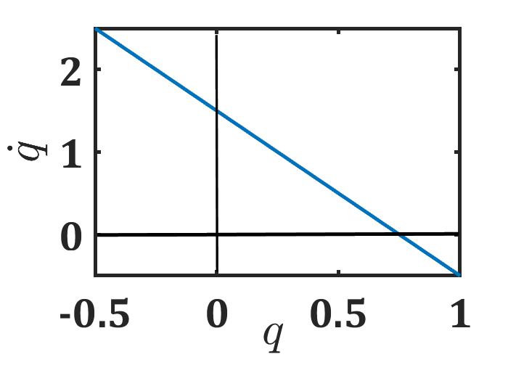

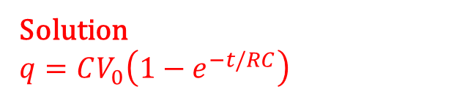

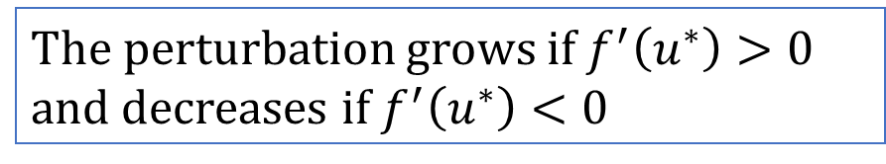




Interpreting a differential equation as a vector field Flows on the Line
$$f(q)$$
$$R\frac{dq}{dt}=V_{0}−\frac{q}{C}$$
$\dot{q}=f\left(q\right)=\frac{V}{R}−\frac{q}{CR}$
Solution
$$q=CV_{0}\left(1−e^{−t/RC}\right)$$
$$f\left(q\right)>0$$
$$q^{∗}$$
$$f\left(q\right)<0$$
$$V_0=1.5;C=0.5;R=1$$
The perturbation grows if $f^{′}\left(u^{∗}\right)>0$ and decreases if $f^{′}\left(u^{∗}\right)<0$

Slide 28
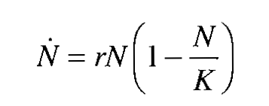

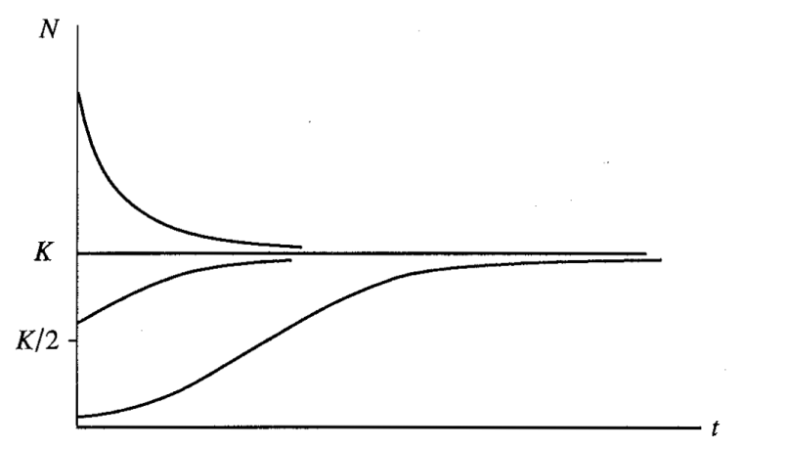
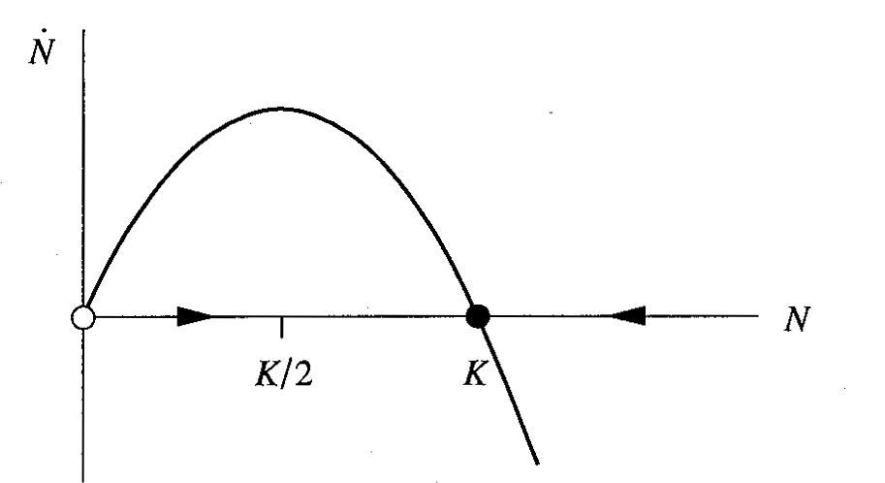
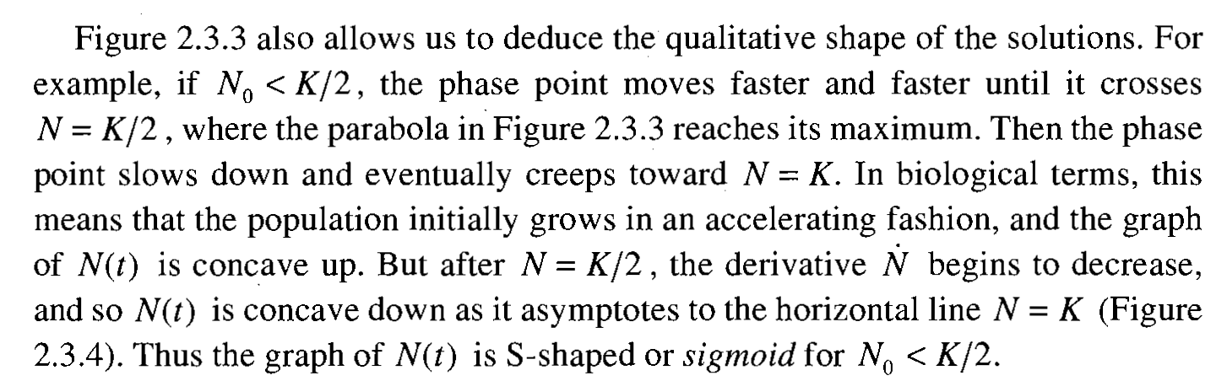
Logistic equation (Model 3)
Interpreting a differential equation as a vector field Flows on the Line
Analysis of Fixed points
Per Capita Growth Rate
Carrying Capacity

Slide 29
Logistic equation (Model 3)
Interpreting a differential equation as a vector field Flows on the Line
Analysis of Fixed points
Per Capita Growth Rate
Carrying Capacity
Analytical Calculation

Slide 30
Logistic equation (Model 3)
Interpreting a differential equation as a vector field Flows on the Line
Input: r (growth rate), x0 (initial value), dt (time step), N (number of iterations)
Output: x values over time
1. Initialize:
x ← x0 # Initial condition
t ← 0 # Initial time
2. Loop for N steps:
a. Compute dx/dt = r * x * (1 - x)
b. Update x using Euler’s method:
x ← x + dt * (r * x * (1 - x))
c. Update time: t ← t + dt
d. Store (t, x) for plotting (optional)
3. End loop
4. Return x values

Slide 32
Interpreting differential eqn as vector field (Model 4)

Slide 33




Elementary Physics Problems :vibrations of a mass hanging from a spring (Model 5)
$$m\frac{ⅆ^{2}x}{ⅆt^{2}}+kx=0$$
As we have to deal with nonlinear ode , we have to understand the vector field.
To find the vector field we will detect the state of the systems in each time i.e current position and velocity.
The systems (left) assign a vector $\left(\dot{x,}\dot{v}\right)=\left(v, −ω^{2}x\right)$ at each point $\left(x,v\right),$ and therefore represents a vector field on the phase plane.
Plot it
$$\frac{ⅆx}{ⅆt}=v$$
$$\frac{ⅆv}{ⅆt}=−\frac{k}{m}x={−ω}^{2}x$$
Try With Euler method
Strogatz, Chapter 5

Slide 34
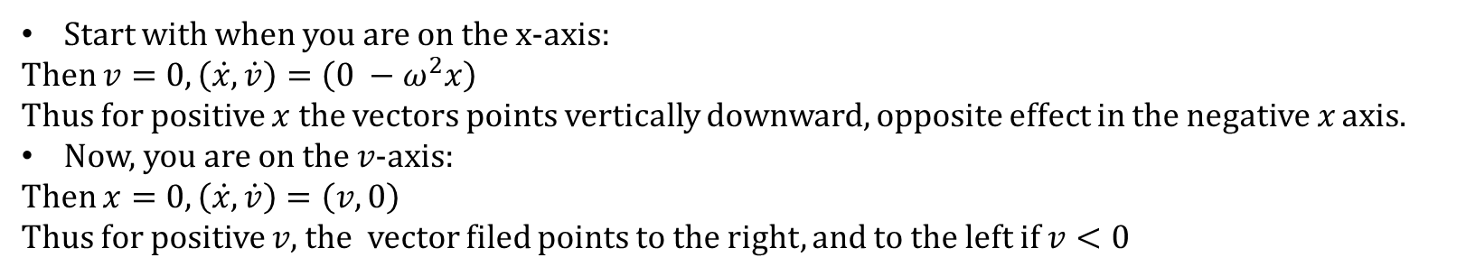


Elementary Physics Problems :vibrations of a mass hanging from a spring
$$m\frac{ⅆ^{2}x}{ⅆt^{2}}+kx=0$$
As we have to deal with nonlinear ode , we have to understand the vector field.
To find the vector field we will detect the state of the systems in each time i.e current position and velocity.
The systems (left) assign a vector $\left(\dot{x,}\dot{v}\right)=\left(v, −ω^{2}x\right)$ at each point $\left(x,v\right),$ and therefore represents a vector field on the phase plane ($x vs y$, here $x vs v$).
Plot it
$$\frac{ⅆx}{ⅆt}=v$$
$$\frac{ⅆv}{ⅆt}=−\frac{k}{m}x={−ω}^{2}x$$
Start with when you are on the x-axis:
Then $v=0,\left(\dot{x,}\dot{v}\right)=\left(0 −ω^{2}x\right)$
Thus for positive $x$ the vectors points vertically downward, opposite effect in the negative $x$ axis.
Now, you are on the $v$-axis:
Then $x=0,\left(\dot{x,}\dot{v}\right)=\left(v, 0\right)$
Thus for positive $v$, the vector filed points to the right, and to the left if $v<0$

Slide 35
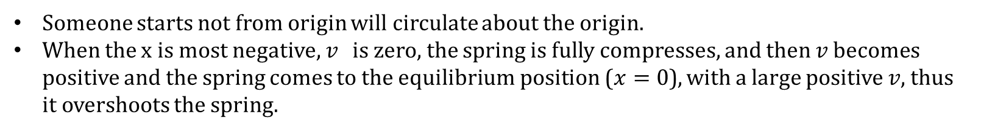
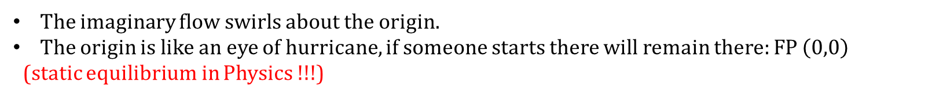
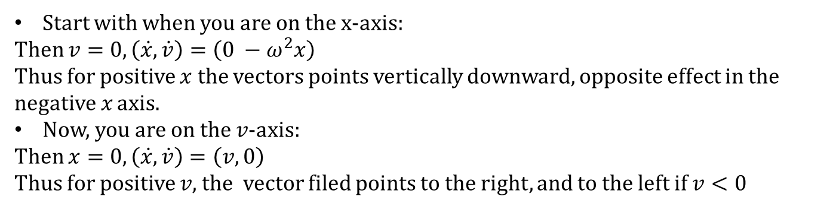
Elementary Physics Problems :vibrations of a spring hanging from a spring
$$m\frac{ⅆ^{2}x}{ⅆt^{2}}+kx=0$$
Start with when you are on the x-axis:
Then $v=0,\left(\dot{x,}\dot{v}\right)=\left(0 −ω^{2}x\right)$
Thus for positive $x$ the vectors points vertically downward, opposite effect in the negative $x$ axis.
Now, you are on the $v$-axis:
Then $x=0,\left(\dot{x,}\dot{v}\right)=\left(v, 0\right)$
Thus for positive $v$, the vector filed points to the right, and to the left if $v<0$
$$\frac{ⅆx}{ⅆt}=v$$
$$\frac{ⅆv}{ⅆt}=−\frac{k}{m}x=−ω^{2}x$$
The imaginary flow swirls about the origin.
The origin is like an eye of hurricane, if someone starts there will remain there: FP $\left(0,0\right)$
(static equilibrium in Physics !!!)
Someone starts not from origin will circulate about the origin.
When the x is most negative, $v$ is zero, the spring is fully compresses, and then $v$ becomes positive and the spring comes to the equilibrium position ($x=0$), with a large positive $v$, thus it overshoots the spring.

Slide 36
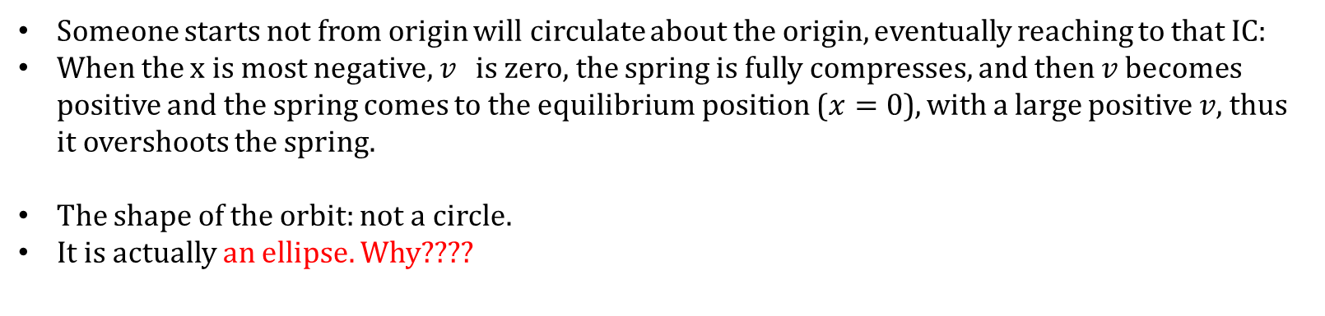
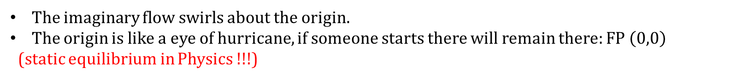


Elementary Physics Problems :vibrations of a mass hanging from a spring
$$m\frac{ⅆ^{2}x}{ⅆt^{2}}+kx=0$$
$$\frac{ⅆx}{ⅆt}=v$$
$$\frac{ⅆv}{ⅆt}=−\frac{k}{m}x=ω^{2}x$$
The imaginary flow swirls about the origin.
The origin is like a eye of hurricane, if someone starts there will remain there: FP $\left(0,0\right)$
(static equilibrium in Physics !!!)
Someone starts not from origin will circulate about the origin, eventually reaching to that IC:
When the x is most negative, $v$ is zero, the spring is fully compresses, and then $v$ becomes positive and the spring comes to the equilibrium position ($x=0$), with a large positive $v$, thus it overshoots the spring.
The shape of the orbit: not a circle.
It is actually an ellipse. Why????
$w^{2}x^{2}+v^{2}=c$ is constant (conservation of energy)

Slide 37
2-d linear model (concept of star, node, line of fixed points, and saddle points)

Slide 38


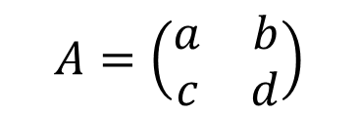
2-d linear model (concept of star, node, line of fixed points, and saddle points)
$$\frac{ⅆx}{ⅆt}=Ax$$
$$A=\left(\begin{matrix}a & b \\ c & d\end{matrix}\right)$$
$$A=\left(\begin{matrix}a & 0 \\ 0 & −1\end{matrix}\right)$$

Slide 39







2-d linear model (concept of star, node, line of fixed points, and saddle points) (Model 6)
$$\frac{ⅆx}{ⅆt}=Ax$$
$$A=\left(\begin{matrix}a & b \\ c & d\end{matrix}\right)$$
$$A=\left(\begin{matrix}a & 0 \\ 0 & −1\end{matrix}\right)$$
$$\frac{ⅆx}{ⅆt}=ax$$
$$\frac{ⅆy}{ⅆt}=−y$$
$$x=x_{0}e^{at}$$
$$y=y_{0}e^{−t}$$
When $a<0$, $x$ decays (actually both) exponentially. Therefore, both will reach to zero.

Slide 40
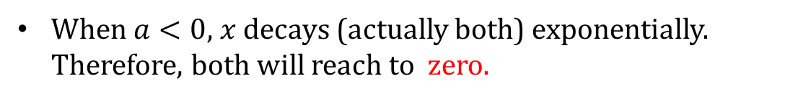
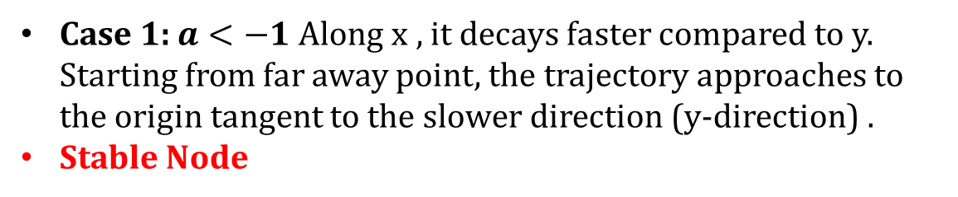
2-d linear model (concept of star, node, line of fixed points, and saddle points)
When $a<0$, $x$ decays (actually both) exponentially. Therefore, both will reach to zero.
Case 1: $a<−1$Along x , it decays faster compared to y. Starting from far away point, the trajectory approaches to the origin tangent to the slower direction (y-direction) .
Stable Node

Slide 41
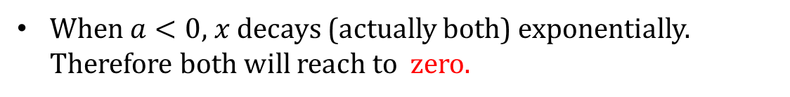
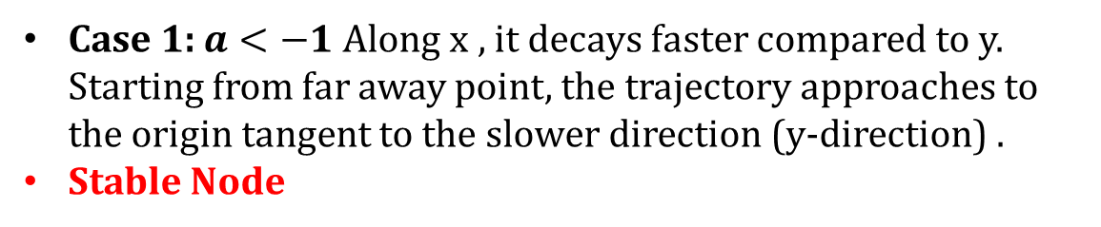
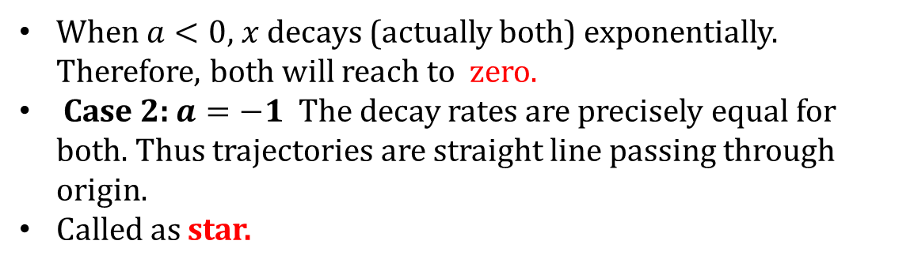
2-d linear model (concept of star, node, line of fixed points, and saddle points)
When $a<0$, $x$ decays (actually both) exponentially. Therefore both will reach to zero.
Case 1: $a<−1$Along x , it decays faster compared to y. Starting from far away point, the trajectory approaches to the origin tangent to the slower direction (y-direction) .
Stable Node
When $a<0$, $x$ decays (actually both) exponentially. Therefore, both will reach to zero.
Case 2: $a=−1$ The decay rates are precisely equal for both. Thus trajectories are straight line passing through origin.
Called as star.

Slide 42
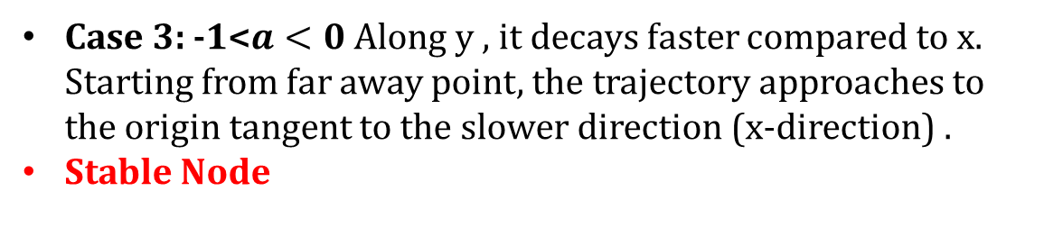
2-d linear model (concept of star, node, line of fixed points, and saddle points)
Case 3: -1<$a<0$Along y , it decays faster compared to x. Starting from far away point, the trajectory approaches to the origin tangent to the slower direction (x-direction) .
Stable Node

Slide 43
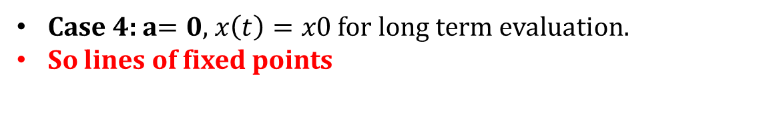
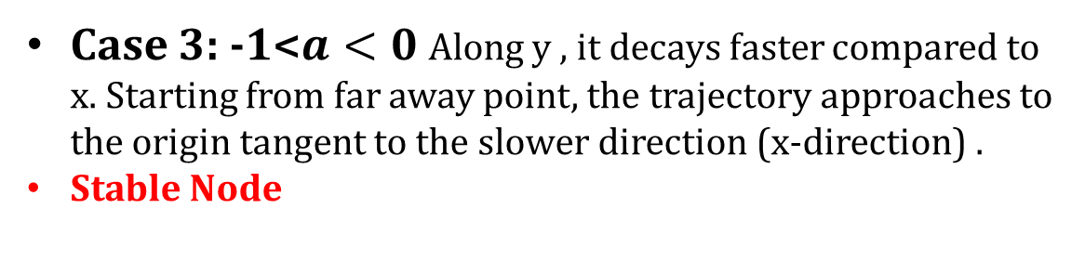
2-d linear model (concept of star, node, line of fixed points, and saddle points)
Case 3: -1<$a<0$Along y , it decays faster compared to x. Starting from far away point, the trajectory approaches to the origin tangent to the slower direction (x-direction) .
Stable Node
Case 4: a$=0$, $x\left(t\right)=x0$for long term evaluation.
So lines of fixed points

Slide 44
2-d linear model (concept of star, node, line of fixed points, and saddle points)

Slide 45
Classification of linear systems

Slide 46

Classification of linear systems
$$x\left(t\right)=e^{λt}v$$

Slide 47

Classification of linear systems
$$x\left(t\right)=e^{λt}v$$

Slide 48

Classification of linear systems
$$x\left(t\right)=e^{λt}v$$

Slide 49
Classification of linear systems
$$x\left(t\right)=e^{λt}v$$

Slide 50
Solving Initial Value Problem (Model 7)

Slide 51
Solving Initial Value Problem (Model 7)

Slide 52
Solving Initial Value Problem

Slide 53
Solving Initial Value Problem

Slide 54
Love Affairs (Model 8)

Slide 55
Love Affairs

Slide 56
Love Affairs
Never ending cycles of love and hate
Governing system has center at (0,0)
They manage love simultaneously one quarter of time

Slide 59

Overall Target
Numerical solution of nonlinear ordinary
differential equations
Modelling disease, emergence of chaos,
chaos in physical systems
Me after every single differential equations test.

