Slide 1



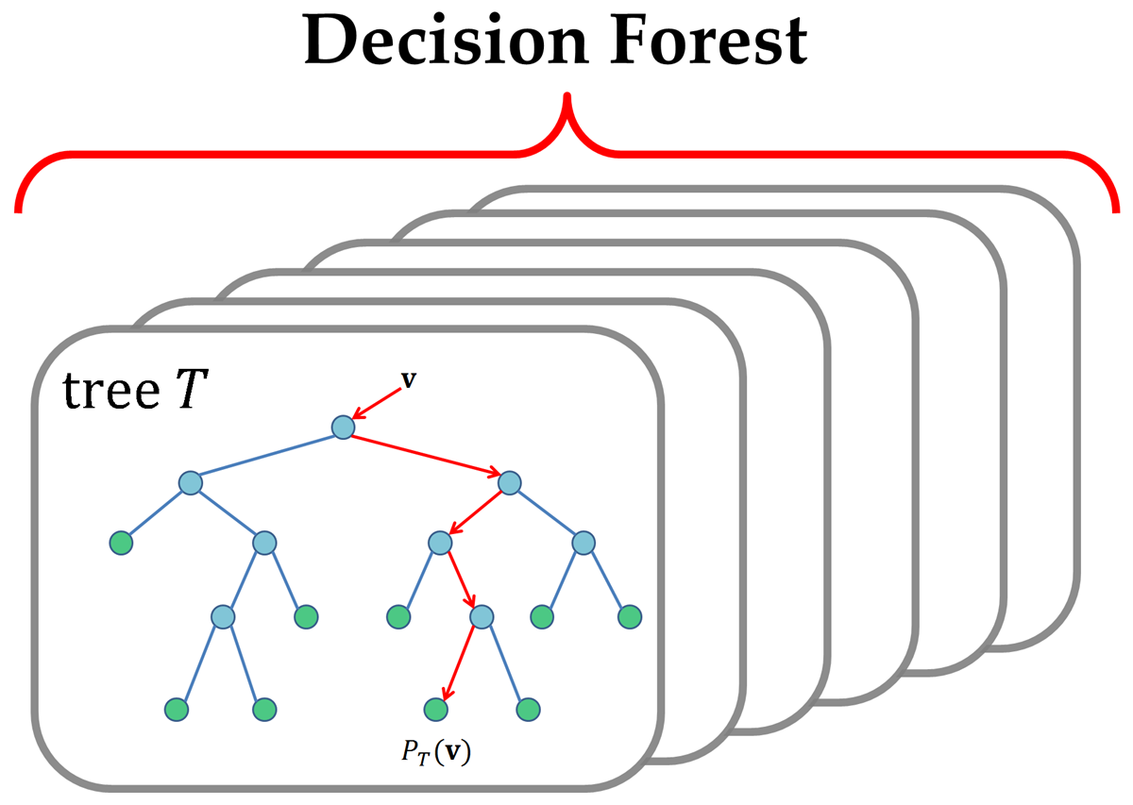


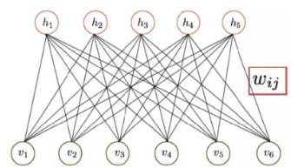
DP Review.com
flickr
Online Channel
Purpose Classifier
Klachaks DB
USER ITEM TABLE
User & Feature Rating Predictor
Offline Channel
Recommender
Systems

Slide 2
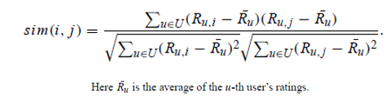

Slide 3
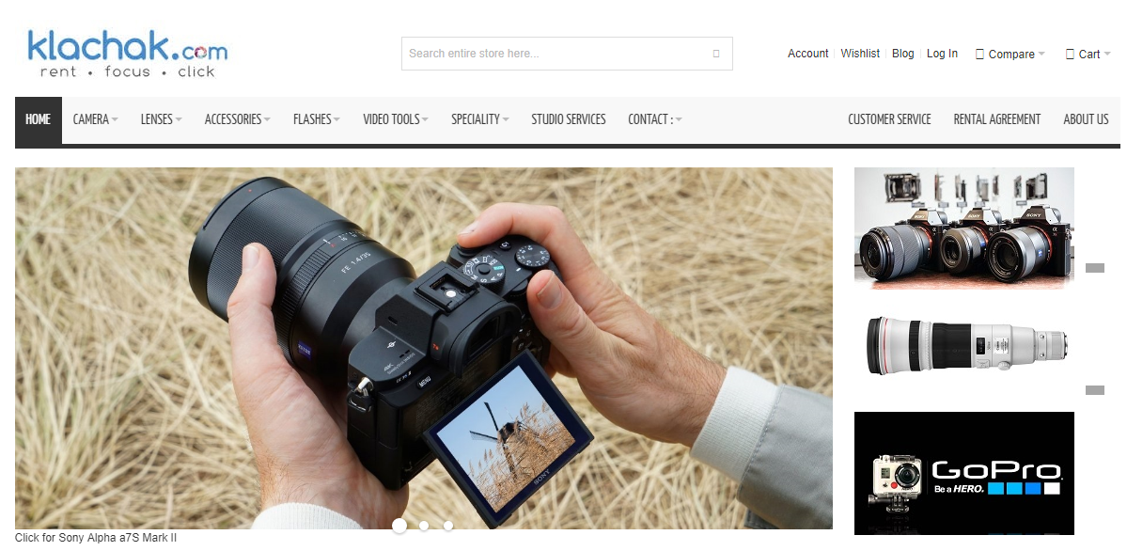
User : JD

Slide 4
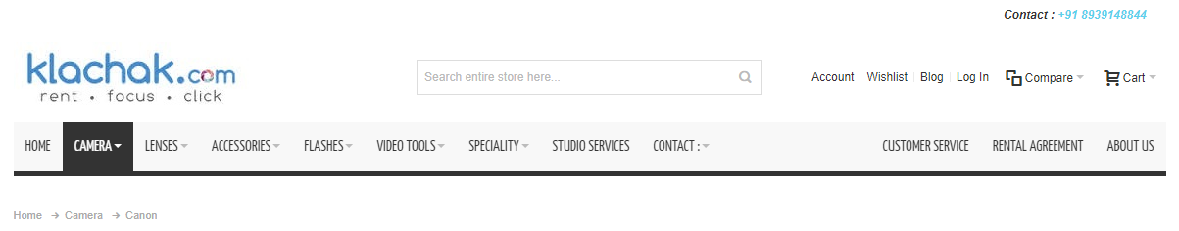
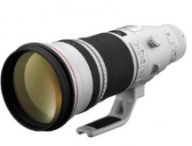
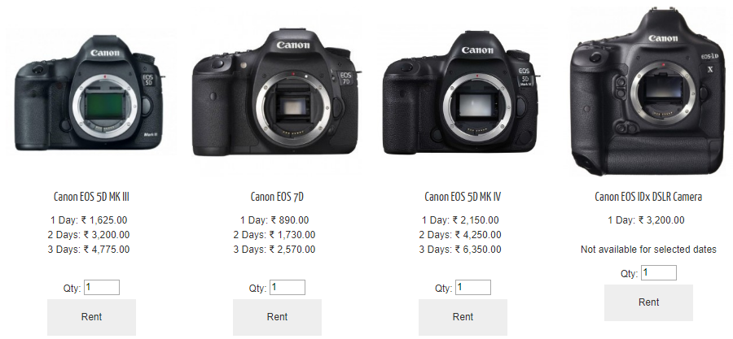









User : JD
You may also be Interested to…
32
NA
12

