Slide 1
PARIS : A HOT CULTURE OF FASHION
SANTHOSH NARAYANAN (59)

Slide 2
CONTENTS
HISTORY OF THE FASHION CAPITAL
EMERGING OF HAUTE COUTURE
PARISIAN DESIGNER’S OF 20TH CENTURY
PARIS VS THE WORLD
PRESENT DAY SCENARIO

Slide 3
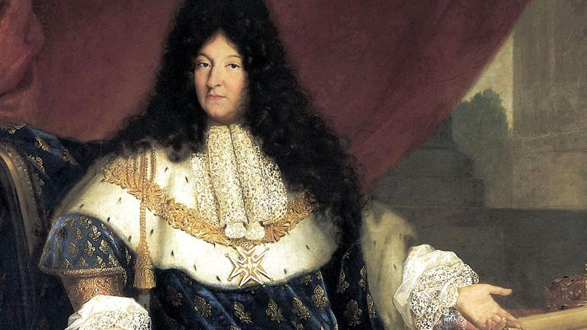
King Louis XIV (1) (The real mastermind)

Slide 4
The Great History
KING LOUIS XIV’s VISION
Understood that fashion was a potent weapon in establishing France's cultural pre-eminence.
Exercised control over his aristocrats for being dressed in appropriate fashion.
Role of king’s chief minister, Jean-Baptiste Colbert

Slide 5
Emerging Of Haute Couture
Role of the foreign investors in building the fashion economy of Paris
What is meant by the term Haute Couture ?
How Haute Couture emerged ?
Transformation of fashion from small-scale to large-scale.
The great Englishman Charles Frederick Worth.
Rise in number of jobs and rise in national economy due to the production of confection.

Slide 6
Parisian Designers of 20th Century
Golden era of the fashion designing
Designers such as Paul Poieret, Gabrielle (Coco) Chanel, Madeleine Vionnet, Jeanne Lanvin, and Elsa Schiaparelli were some of the most celebrated fashion designers of the time.
Implementation of new techniques boosted up the fashion industry of paris.
Aftermath of World war I(1914-1918) and World war II(1939-1945) and the threats that Paris got from America.
Reshaping of the Economy after the war.

Slide 7
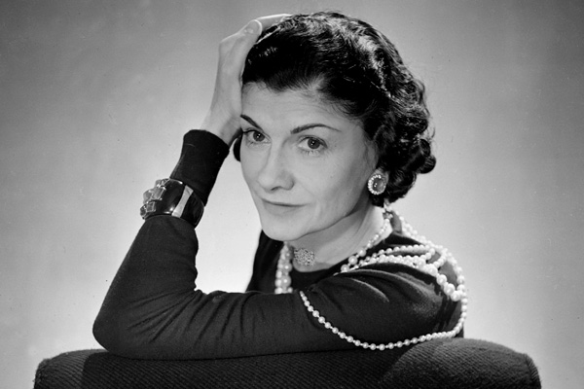
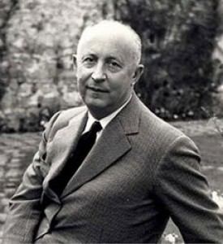
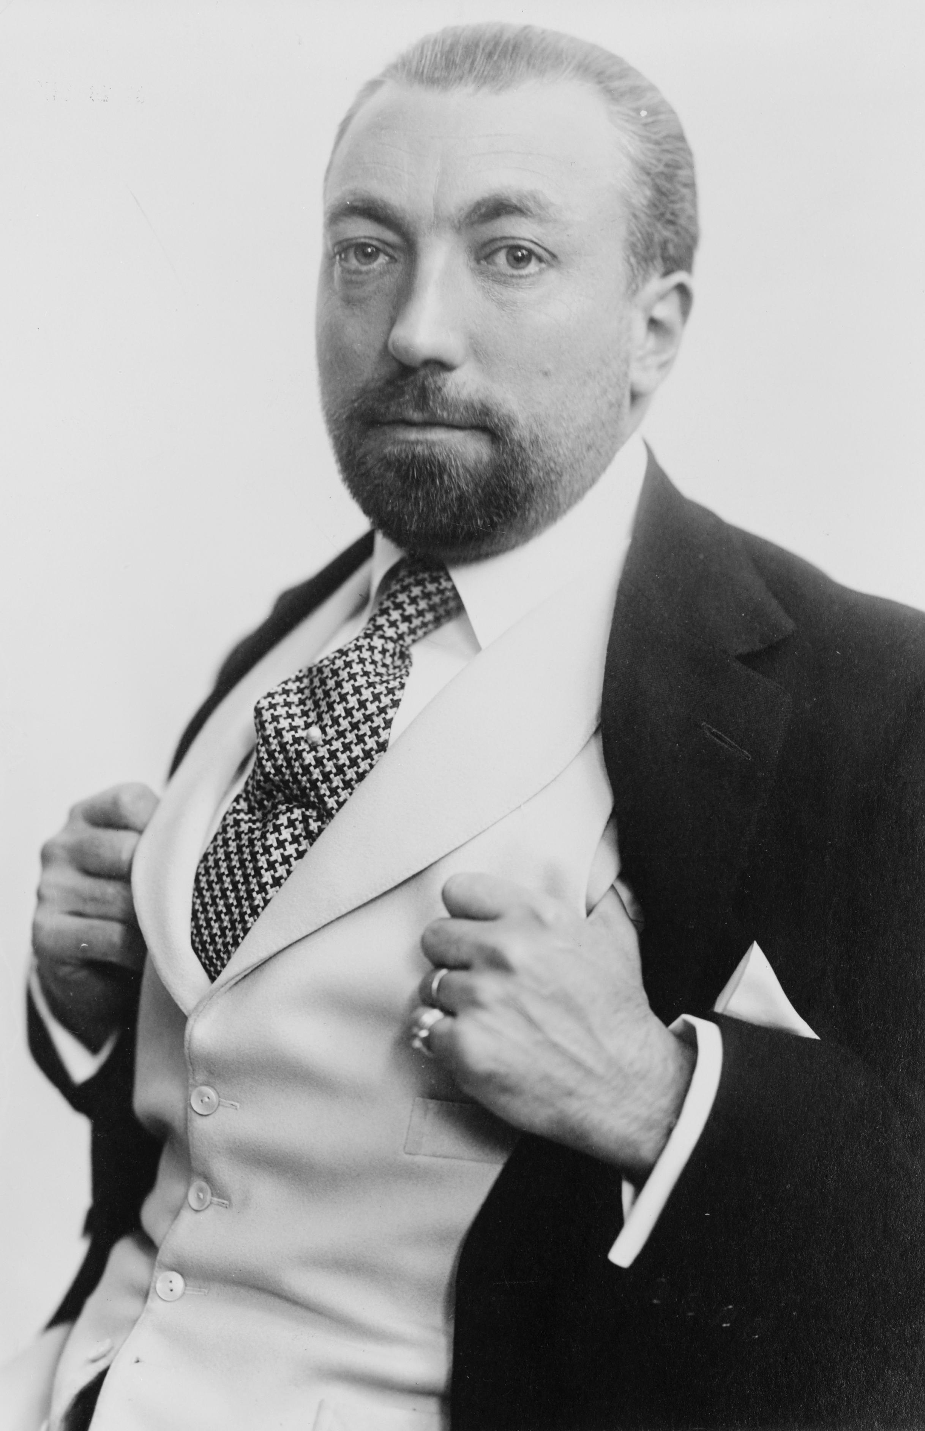
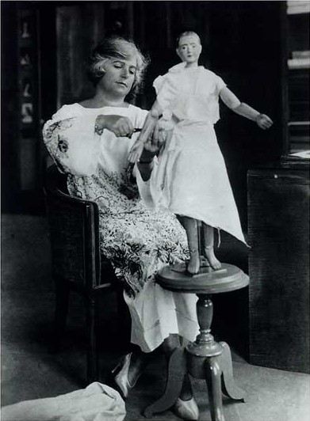
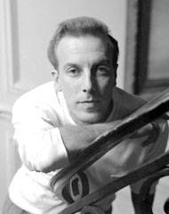
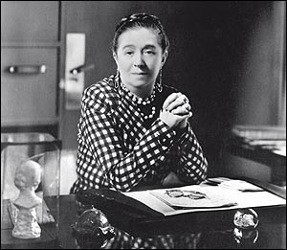
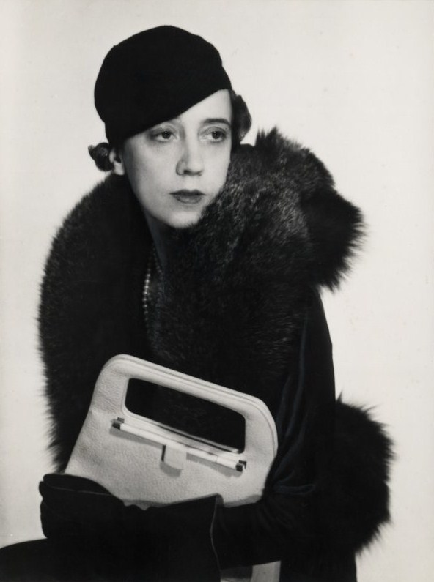
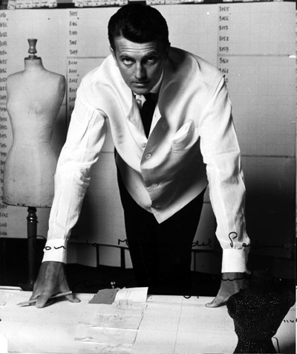
Madeliene
Vionet
Coco Chanel
Christian Dior
Paul Pioret
Givenchy
Jacques Fath
Jeanne Lanvin
Elsa Schiaparelli

Slide 8
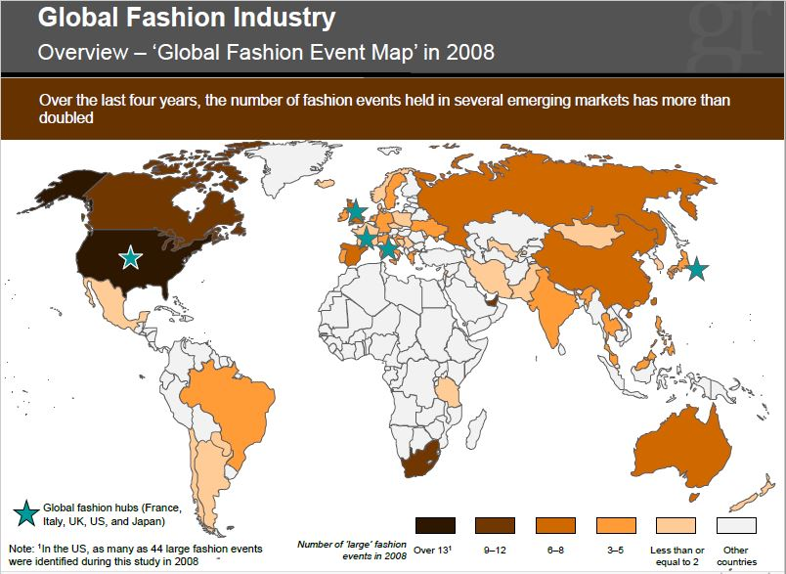
Paris VS The World

Slide 9
Present Day Scenario
Millions of Euros | Year 2007 | Year 2008 | Year 2009
Wines and Spirits | 3,226 | 3,126 | 2,740
Fashion and Leather Goods | 5,628 | 6,010 | 6,302
Perfumes and Cosmetics | 2,731 | 2,868 | 2,741
Watches and Jewellery | 833 | 879 | 764
Selective Retailing | 4,164 | 4,376 | 4,533
Other activities and eliminations | (101) | (66) | (27)
Total | 16,481 | 17,193 | 17,053

Slide 10
Main Factors of growth
Practicing of the rich old culture of haute couture
Fashion shows : The event is held to showcase Spring-Summer and Autumn-Winter collections at the respective times of each year. Top Fashion houses display their works in this event with the elite fashion connoisseurs present to marvel at the creations. Dior Homme, Louis Vuitton, Comme des Garcons Homme Plus, Paul Smith are just some of the big names associated with this event from a list of several others.
Increase in number of foreign Investors

Slide 11
References
Paris Fashion: A Cultural History by Valerie Steele.
http://fashion-history.lovetoknow.com/clothing-around-world/paris-fashion
http://www.grailresearch.com/pdf/Blog/Global_Fashion_Industry_Growth_in_Emerging_Markets_260.pdf
https://wiki.nus.edu.sg/display/Fashion/Economic+Analyisis+of+Fashion+Retail
http://topyaps.com/top-10-famous-fashion-shows-of-the-world

Slide 12
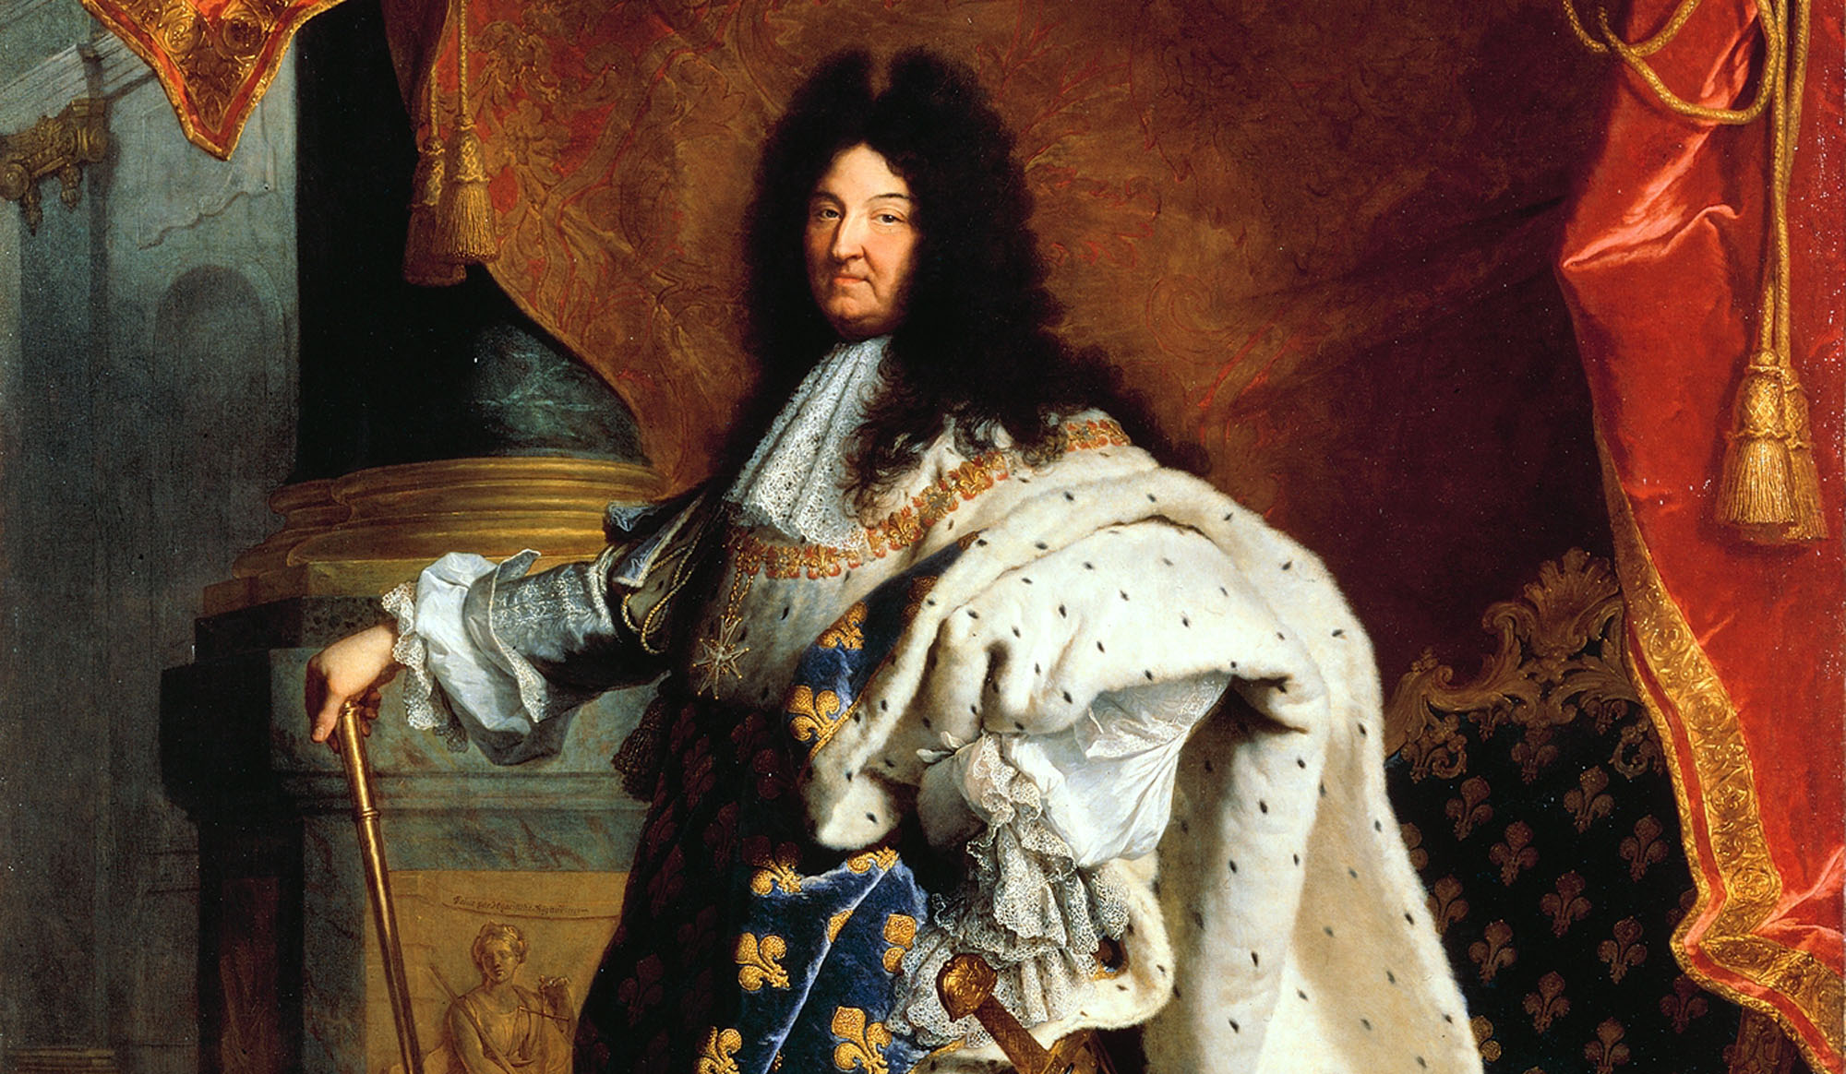
Thank you!!!

