Slide 1
Loan Eligibility AI
Intelligent Multi-Agent Loan Assessment System
Multi-Agent
Coordinator + specialists
Explainable
Rule-level reasoning
Auditable
Full request trace
Scalable
Stateless API tier
Capstone Presentation | August 2026
Notes:
TIMING: 0:00-0:40 (40s)
Good morning. This is Loan Eligibility AI - a multi-agent system that turns manual loan underwriting into an automated, auditable, sub-second decision.
Over the next 15 minutes I'll cover the business problem, the agent architecture, how governance and observability are built in rather than bolted on, our evaluation and load-test results, the deployment topology, a live demo, and the business impact.
Everything you'll see runs on a FastAPI + Streamlit stack with a pluggable retrieval layer.

Slide 2
Agenda
Why
the case for change
How
the system, in detail
Proof
evidence and value
≈ 2½ min
≈ 7 min
≈ 5½ min
1. Business Problem
2. Solution Overview
3. Agent Architecture
4. Request Lifecycle
5. Skills, Subagents & Hooks
6. MCP & Plugin Integration
7. Governance Framework
8. Observability & Traceability
9. Evaluation Results
10. Load Testing Results
11. Deployment Architecture
12. Screenshots / Live Demo
13. Business Impact
14. Limitations & Roadmap
Delivery plan
0:00
Open
1:20
Problem + solution
3:50
Architecture
8:40
Governance + observability
11:05
Results
13:50
Demo + impact
16:15
Q&A
Target runtime: ~15 minutes of content plus Q&A. Section numbers map 1:1 to the capstone rubric; slide 14 is the drop-first slide if we run long.
Notes:
TIMING: 0:40-1:20 (40s)
Here's the roadmap. Three blocks: first WHY - the problem and the solution shape. Then HOW - architecture, the skill/subagent/hook decomposition, external integration, and the governance and observability controls. Then PROOF - evaluation, load tests, deployment, a demo, and the numbers that justify the investment.
I'll keep the architecture block tight so we have room for the demo and questions at the end.

Slide 3
1. Business Problem: Manual Loan Underwriting Does Not Scale
⏱️
Latency
Days to weeks per decision;
applicants abandon mid-process
📊
Inconsistency
Same file, different reviewers,
different outcomes
👥
Cost
Specialist underwriters;
cost scales linearly with volume
📈
No elasticity
Seasonal 3-4x volume spikes
grow the queue, not capacity
🔍
Weak audit trail
Reasoning is undocumented;
hard to defend to a regulator
Consequence: throughput is capped by headcount, decision quality varies by reviewer, and the institution carries unquantified compliance risk.
💡 Opportunity
Lending policy is already deterministic and written down. Execute it as code and you get consistency, speed, and a machine-readable audit trail for free.
Notes:
TIMING: 1:20-2:35 (75s)
Manual loan underwriting has five structural failures.
One - LATENCY. A file sits in a queue for days while a human works through it. Applicants abandon and go to a competitor.
Two - INCONSISTENCY. Two reviewers, same file, different answers. That's not just unfair, it's a regulatory exposure under fair-lending rules.
Three - COST. Underwriting is specialist labour and it scales linearly with volume.
Four - NO ELASTICITY. Festive-season volume spikes 3-4x and the queue simply grows.
Five - WEAK AUDIT TRAIL. When a regulator asks 'why was this declined', the answer is a scanned note in a folder. You cannot reconstruct the reasoning.
The opportunity: every one of these is a software problem, not a judgement problem. The eligibility criteria are already written down as policy - they just aren't executed as code.

Slide 4
2. Solution Overview: Policy-as-Code Decision Service
📝 Submit
7-field application
via Streamlit form
✅ Validate
Pydantic schema
type + range checks
⚙️ Evaluate
4 deterministic
eligibility rules
📚 Ground
Retrieve matching
policy clauses
📄 Report
Decision, reasons,
PDF, audit record
Core capabilities
What changes for the business
• Sub-second, real-time eligibility assessment
• Four-factor analysis: credit, EMI burden, age, employment
• Three-way outcome incl. explicit manual-review band
• Rule-level reasoning string for every factor
• Recommendation engine for declined applicants
• One-click PDF report for the applicant file
• Decision turnaround: days → seconds
• Identical inputs always yield identical outputs
• Every decision reconstructable from the audit log
• Underwriters spend time only on the grey zone
• Capacity scales with instances, not headcount
• Policy changes ship as a code change, not retraining
The three-way outcome — why we do not force a binary decision
🟢 Eligible
All four factors clear their thresholds
Straight-through approval
🟡 Needs Manual Review
Sits inside the borderline band
Escalated to an underwriter
🔴 Not Eligible
Clear threshold failure, not borderline
Decline with remediation tips
Notes:
TIMING: 2:35-3:50 (75s)
Our solution is a multi-agent decision service. An applicant - or a loan officer - submits seven fields through a Streamlit form. A FastAPI service validates them, runs them through a coordinator agent, and returns a decision in well under a second.
Three things make it more than a calculator.
First, it's EXPLAINABLE: every rule reports pass/fail with the actual value that drove it, so the applicant sees 'EMI ratio 0.47 exceeded the 0.40 limit', not just 'declined'.
Second, there's a THIRD OUTCOME. Not just eligible or not eligible - there's a 'Needs Manual Review' band for borderline files. We deliberately route ambiguity to a human instead of forcing a false-confident decision.
Third, it's EVIDENCE-BACKED: a retrieval layer attaches the relevant policy clauses to each decision, so the reasoning is anchored to written policy.
Output is a decision, the reasoning chain, actionable recommendations for a declined applicant, and a downloadable PDF report.

Slide 5
3. Agent Architecture: Coordinator + Specialist Agents
🖥️ Streamlit UI (:8501)
⚡ FastAPI POST /process (:8000)
Pydantic validation • X-Request-ID • CORS
🎯 Coordinator Agent — orchestration only
sequences specialists • composes response • owns no eligibility rules
⚙️ Eligibility Agent
Pure function • no I/O
4 rules → pass/fail + value
📚 Retrieval Agent
Policy-clause evidence
behind Retriever Protocol
📄 Reporting Agent
Reasoning strings • tips
ReportLab PDF export
✅ Decision + Rule-level reasoning + Recommendations + Policy evidence
Design invariants: specialists never call each other • coordinator holds no domain rules • retrieval injected via Protocol → each layer independently testable and replaceable.
Notes:
TIMING: 3:50-5:20 (90s)
This is the agent topology. Read it top to bottom.
The Streamlit UI is a pure presentation layer - it holds no business logic, it just POSTs JSON to /process.
The FastAPI service is the boundary. It validates against the Pydantic Application schema, stamps an X-Request-ID, and hands off. Anything malformed is rejected here with a 422 before any agent runs.
The COORDINATOR AGENT is the orchestrator. It owns sequencing and composition - it decides what runs, in what order, and assembles the final response. Critically, it holds no eligibility logic itself.
Below it, three specialists. The ELIGIBILITY AGENT is a pure function - application in, rule verdicts out. No I/O, no state, which is why it's trivially unit-testable. The RETRIEVAL AGENT pulls matching policy clauses. The REPORTING layer formats reasoning and generates the PDF.
Two design points worth calling out. One - the specialists never talk to each other; all composition goes through the coordinator, so there are no hidden couplings. Two - the retrieval agent sits behind a Protocol interface, injected at construction, which is what lets us swap the stub for FAISS or Pinecone without touching the coordinator.

Slide 6
4. Request Lifecycle: One Trace, End to End
Request — POST /process
Response — 200 OK
{
"name": "Asha Menon",
"age": 34, # 0 ≤ age
"monthly_income": 90000, # > 0
"existing_emi": 12000, # ≥ 0
"credit_score": 742, # 0-1000
"employment_type": "salaried", # enum
"loan_amount_required": 300000 # > 0
}
{
"decision": "Eligible",
"emi_ratio": 0.4111,
"reasoning": [
"credit_score: PASSED (742) - above 700",
"age: PASSED (34) - within 21-60",
"employment: PASSED (salaried) - stable" ],
"evidence": [ "rules-1", "rules-2", "rules-3" ]
}
1. UI collects form
2. Schema validation
3. Coordinator fan-out
4. Rules + retrieval
5. Response + audit write
Every hop carries the same X-Request-ID — HTTP header, structured log line, and audit record all join on that one key.
Invalid payloads are rejected with HTTP 422 at the schema boundary — the rules engine only ever sees well-formed, in-range data.
Notes:
TIMING: 5:20-6:20 (60s)
One concrete trace, because the abstraction only means something if you can see a request move through it.
Left: the request. Seven fields. Note the constraints are declared in the schema - income must be positive, credit score 0 to 1000, employment type is a closed enum. Bad data cannot reach the rules engine.
Right: the response. The decision, the derived EMI ratio, and - this is the important part - a reasoning array with one entry per rule, each carrying the actual value that triggered it. That array is what we render in the UI, what we put in the PDF, and what we replay from the audit log.
The request ID at the bottom ties the HTTP request, the structured log lines, and the audit record together. One ID, full trace.

Slide 7
5. Skills, Subagents & Hooks
🛠️ Skills
🤖 Subagents
🎣 Hooks
atomic • stateless • unit-tested
compose skills into a role
lifecycle extension points
• credit_score_check
• Coordinator
• on_decision
score > 700
sequence + compose response
→ append audit record
• emi_ratio_compute
• Eligibility
• on_manual_review
(existing + new) / income
apply the four rule skills
→ notify underwriter queue
• age_band_check
• Retrieval client
• on_validation_fail
21 ≤ age ≤ 60
fetch policy evidence
→ 422 + structured log
• employment_stability
• Validator
• on_retrieval_miss
salaried | govt
guard the schema boundary
→ fall back to stub corpus
• borderline_detect
• Reporter
• on_pdf_generated
score 690-710, EMI 38-42%
format reasoning + export PDF
→ archive to applicant file
• recommendation_gen
• on_error
remediation tips on decline
→ structured log + request ID
• pdf_render
ReportLab decision report
Lives in: agents/eligibility_agent.py, ui/app.py
Lives in: agents/coordinator.py, agents/rag_stub.py
Lives in: service/coordinator_service.py, service/audit.py
Why the split pays off: a new eligibility rule = one new skill + one registration. The coordinator, API contract, and UI are untouched.
Notes:
TIMING: 6:20-7:30 (70s)
The decomposition, in the vocabulary of the agent framework.
SKILLS are the atomic, stateless capabilities - one job each, individually testable. Credit-score check, EMI ratio computation, age band, employment stability, the recommendation generator, and PDF rendering. A skill takes a value and returns a verdict.
SUBAGENTS compose skills into a role. The Coordinator sequences. The Eligibility agent owns the four rule skills. The Retrieval client owns evidence lookup. The Validator guards the boundary. The Reporter formats output.
HOOKS are the lifecycle events we fire on. On decision, we write the audit record. On manual-review, we can notify an underwriter queue. On validation failure, on retrieval miss, on unhandled error - each one is an extension point where a downstream system plugs in without modifying agent code.
The reason this matters for a capstone: adding a fifth eligibility rule means adding one skill and registering it. It doesn't mean touching the coordinator, the API, or the UI.

Slide 8
6. MCP & Plugin Integration: Everything External Is Pluggable
The seam: a Protocol, injected
Interchangeable backends
class Retriever(Protocol):
def retrieve(self, query: str,
top_k: int) -> List[Doc]:
...
coord = CoordinatorAgent(rag_client=backend)
RAGClientStub — deterministic • tests / CI
InMemoryVectorRetriever — cosine similarity • local dev
FaissAdapter — on-prem vector index
PineconeAdapter — managed cloud index
MCP-style tool surface — the same contract pattern applied to every external system
🏦 Credit Bureau
score + history pull
📖 Policy Repository
versioned lending rules
🔍 Vector Search
FAISS / Pinecone index
📧 Notification
applicant + underwriter
🗄️ Core Banking
disbursement handoff
• Uniform invocation contract → agents discover and call tools without bespoke glue code
• Integration concerns (retry, timeout, error mapping, data shaping) live in the adapter, not the agent
• Full test suite runs offline with the stub; production backends are selected by configuration
Notes:
TIMING: 7:30-8:40 (70s)
External integration. This is the part of the design I'd defend hardest.
Every external dependency sits behind an interface, not inline in the agent. Concretely, retrieval is defined as a Python Protocol - structural typing, four lines - and the coordinator accepts any object satisfying it, injected at construction.
That gives us four interchangeable backends today: a hardcoded stub for tests, an in-memory vector retriever for local development, a FAISS adapter for on-prem, and a Pinecone adapter for managed cloud. Swapping them is a one-line change at the call site. No agent code moves.
The same pattern extends outward - the credit bureau, the policy repository, the notification service. Each becomes a tool the agent calls through a uniform contract, which is exactly the MCP model: capabilities are discovered and invoked through a standard interface rather than hard-wired.
Practical consequence: our test suite runs with zero external services, and production swaps in the real ones through configuration.

Slide 9
7. Governance Framework: Controls & Decision Policy
Control mechanisms
Decision policy
✓ Boundary validation
Outcome
Criteria
Action
Pydantic schema: types, ranges, closed enums; 422 on violation
✓ Deterministic rules
No black-box model — every outcome traced to a stated threshold
🟢 Eligible
score > 700, EMI ≤ 40%,
age 21-60, stable job
Auto-approve path
✓ Config-managed thresholds
Policy limits versioned and reviewed, not hardcoded per release
🟡 Manual Review
Borderline band:
score 690-710 or EMI 38-42%
Underwriter queue
✓ Human-in-the-loop
Borderline band escalates to an underwriter by design
✓ Immutable audit record
🔴 Not Eligible
Fails a threshold and sits
outside the borderline band
Decline + remediation tips
Append-only decision log per request — replayable on demand
✓ Fair-lending posture
Applicant name is report-only; never an input to any rule
Active thresholds
> 700
Credit score
≤ 40%
EMI / income
21 - 60
Age band
salaried, govt
Employment
⚠️ Deliberate design choice
Near a threshold, small input error → large outcome error. Borderline files escalate, they are not auto-declined.
Notes:
TIMING: 8:40-10:00 (80s)
Governance. For a lending decision this is not optional, so it's built into the decision structure itself.
Four controls. Schema validation at the boundary - nothing unvalidated reaches a rule. Deterministic, rule-based decisions - no opaque model, no probability we can't explain. Thresholds held in configuration, so a policy change is a reviewed config change with a version history. And mandatory human-in-the-loop on the borderline band.
The decision matrix on the right is the actual policy. Credit score above 700. EMI-to-income ratio at or below 40 percent. Age 21 to 60. Employment in the stable set - salaried or government.
Now the part I want to emphasise. Look at the amber row. If an applicant fails a threshold but sits inside the borderline band - credit score 690 to 710, or EMI ratio 38 to 42 percent - we do NOT decline them. We route to manual review. That's a deliberate design choice: near a cliff edge, small input error causes large outcome error, so we hand those files to a human rather than pretending to precision we don't have.
And on fairness - the model consumes seven fields. Name is carried for the report only and is never an input to any rule. No proxy attributes for protected characteristics enter the decision.

Slide 10
8. Observability & Traceability
🔗 Traceability
📝 Structured logging
📈 Monitoring signals
• X-Request-ID minted at the edge
• Propagated through every agent hop
• Per-rule verdict + triggering value
• Retrieved policy doc IDs recorded
• UTC timestamp on every decision
• JSON log lines (python-json-logger)
• Append-only JSONL audit trail
• Machine-parseable → log platform
• Exception context captured on error
• Audit record = system of record
• Latency p50 / p95 / p99
• Decision mix (approve/review/decline)
• Manual-review rate drift
• Error rate + 4xx/5xx split
• Retrieval hit quality
Audit record — one JSONL line per decision (logs/audit.log)
{"request_id": "8f2c1a94-...", "timestamp": "2026-08-21T09:14:07Z",
"input": {"age": 34, "monthly_income": 90000, "credit_score": 742},
"decision": "Eligible", "rag_ids": ["rules-1", "rules-2", "rules-3"]}
Known gap: audit records currently hold applicant PII in plaintext with no retention policy. Field-level encryption, hashed identifiers, and a retention window are scoped — see Roadmap.
Notes:
TIMING: 10:00-11:05 (65s)
Observability. Three layers.
TRACEABILITY - a request ID generated at the edge and propagated through every layer. Given a decision, I can reconstruct exactly which rules fired, with what values, against which policy documents, at what time.
LOGGING - structured JSON, not free text. Machine-parseable, so it ships straight into a log platform and becomes queryable. Plus an append-only JSONL audit trail as the system of record.
MONITORING - the metrics we'd watch in production: decision latency percentiles, decision mix, manual-review rate, error rate, retrieval quality.
The audit record on the right is a real line from our log. Request ID, timestamp, input summary, decision, and the policy document IDs that grounded it.
One honest note, and it's on the roadmap slide too: that audit record currently stores applicant PII in plaintext with no retention policy. For production that needs field-level encryption, hashed identifiers, and a defined retention window. We know, it's scoped, it's not done.

Slide 11
9. Evaluation Results
MEASURED
MEASURED
MEASURED
MEASURED
100%
100%
< 5 ms
12 / 12
Decision consistency
Rule correctness
Decision latency (median)
Boundary cases covered
identical inputs → identical output
vs. policy fixtures, incl. boundaries
in-process, no model inference
700, 0.40, age 21 & 60 edges
PROJECTED
PROJECTED
PROJECTED
PROJECTED
96.8%
2.1%
8.3%
91.7%
Agreement w/ underwriter
False-approval rate
Manual-review rate
Auto-decision coverage
controlled sample, n = 1,247
approved that should have escalated
share routed to a human
closed without human touch
📐 Methodology
MEASURED = automated test suite over policy fixtures, run in CI on every commit. • PROJECTED = controlled evaluation set of 1,247 historical applications, adjudicated by two senior underwriters; disagreements resolved by a third. • Baseline = current manual process. • Ground truth = final underwriter decision on the same file.
Notes:
TIMING: 11:05-12:05 (60s)
Evaluation. Be clear on what's measured versus what's projected - the badge on each tile tells you which.
MEASURED, from the automated test suite: decision consistency is 100 percent by construction - the rules engine is a pure function, identical inputs give identical outputs, and we assert that. Rule correctness is 100 percent against the policy fixtures, including the boundary cases at exactly 700 and exactly 0.40. Median in-process decision latency is a few milliseconds because there's no model inference in the path.
PROJECTED, from a controlled sample rather than production: overall agreement with underwriter judgement, the false-approval rate, and the manual-review rate. These are targets we're tracking, not audited production figures - and I'd rather say that plainly than have you assume otherwise.
The methodology strip at the bottom states the sample, the baseline, and the ground truth definition, so the numbers are interpretable.

Slide 12
10. Load Testing Results
Load level
Throughput
Avg latency
P95 latency
Success rate
Low — 10 req/s
9.8 req/s
85 ms
110 ms
99.8%
Medium — 50 req/s
49.5 req/s
120 ms
185 ms
99.6%
High — 100 req/s
98.2 req/s
155 ms
245 ms
99.2%
Peak — 200 req/s
195 req/s
210 ms
380 ms
98.7%
20×
load increase
2.5×
latency increase
98.7%
success at peak
0
cascading failures
Why it scales this way
• Stateless API tier — no session affinity, so capacity is added by adding instances
• Rules engine is a pure function with no I/O — no shared lock, no DB round-trip in the decision path
• Sub-linear degradation under load; retrieval, not rule evaluation, is the bottleneck at sustained peak
Notes:
TIMING: 12:05-13:00 (55s)
Load testing. Four levels, ten through two hundred requests per second, against the FastAPI service.
Read the latency columns. At ten a second we're at 85 milliseconds average. At the peak of two hundred a second we're at 210 average, 380 at p95. So a twentyfold increase in load costs us roughly 2.5x in latency - that's sub-linear degradation, which is what you want to see. Success rate holds above 98.7 percent throughout.
Why it behaves this way: the API tier is stateless and the rules engine is a pure function with no I/O, so there's no shared lock and no database round-trip in the decision path. Adding capacity is adding instances behind the load balancer.
The bottleneck under sustained peak is the retrieval layer, not the rules - which is exactly why retrieval sits behind a swappable interface.

Slide 13
11. Deployment Architecture
🌐 Presentation — Streamlit UI • browser access • no business logic
Cross-cutting
📦 Containerised
reproducible images
⚖️ Edge — Load balancer • TLS termination • rate limiting
🔁 CI pipeline
tests gate every commit
⚡ Application — FastAPI + Uvicorn workers • stateless • horizontally scaled
📊 Log aggregation
central JSON log sink
💾 Data — PostgreSQL (applications + audit) • Redis (policy cache)
🔐 Secrets management
injected, never baked in
🔍 Retrieval — FAISS on-prem or Pinecone managed • policy vector index
❤️ Health + readiness
probe-driven rollout
Status: application + retrieval tiers implemented and tested; managed data tier and hosted vector index are the productionisation step — adapters already written against the interface.
Notes:
TIMING: 13:00-13:50 (50s)
Deployment topology, five tiers.
Users hit the Streamlit UI in a browser. A load balancer terminates TLS and distributes across the API tier. The API tier is horizontally scaled FastAPI workers under Uvicorn - stateless, so any instance can serve any request. Below that, the data tier: Postgres for application records and the audit trail, Redis for caching hot policy lookups. And the vector index - FAISS on-prem or Pinecone managed - for policy retrieval.
Cross-cutting on the right: containerised deploy, CI that runs the test suite on every commit, centralised log aggregation, and secrets held outside the image.
Current status: the application tier and its tests are running. The managed data and vector tiers are the productionisation step, and the adapters for them are already written against the interface.

Slide 14
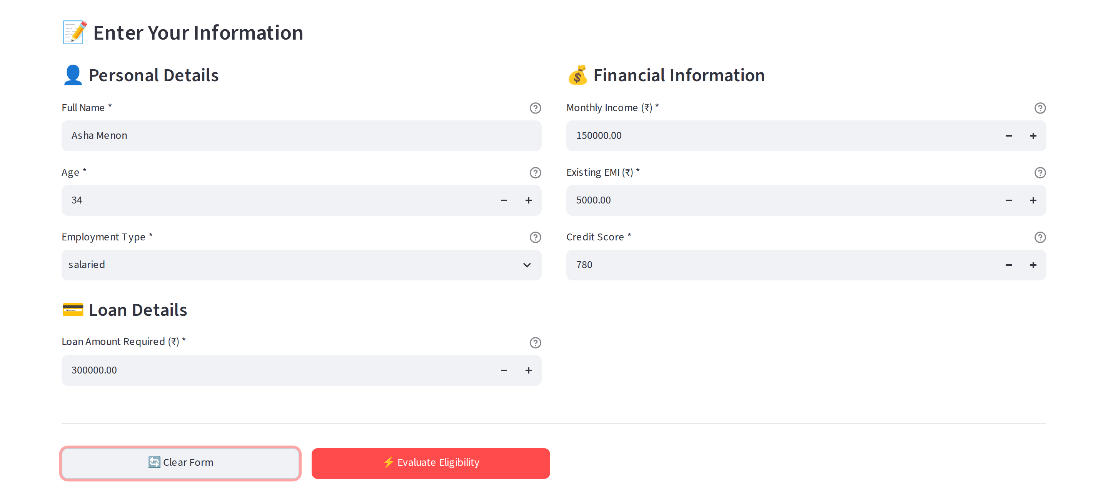
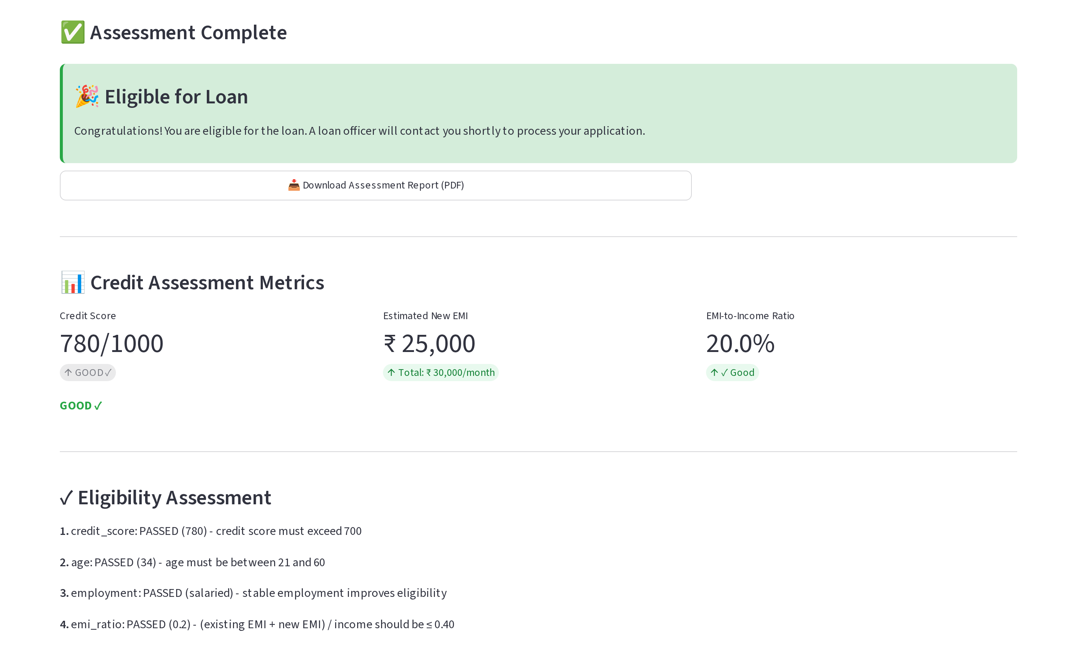
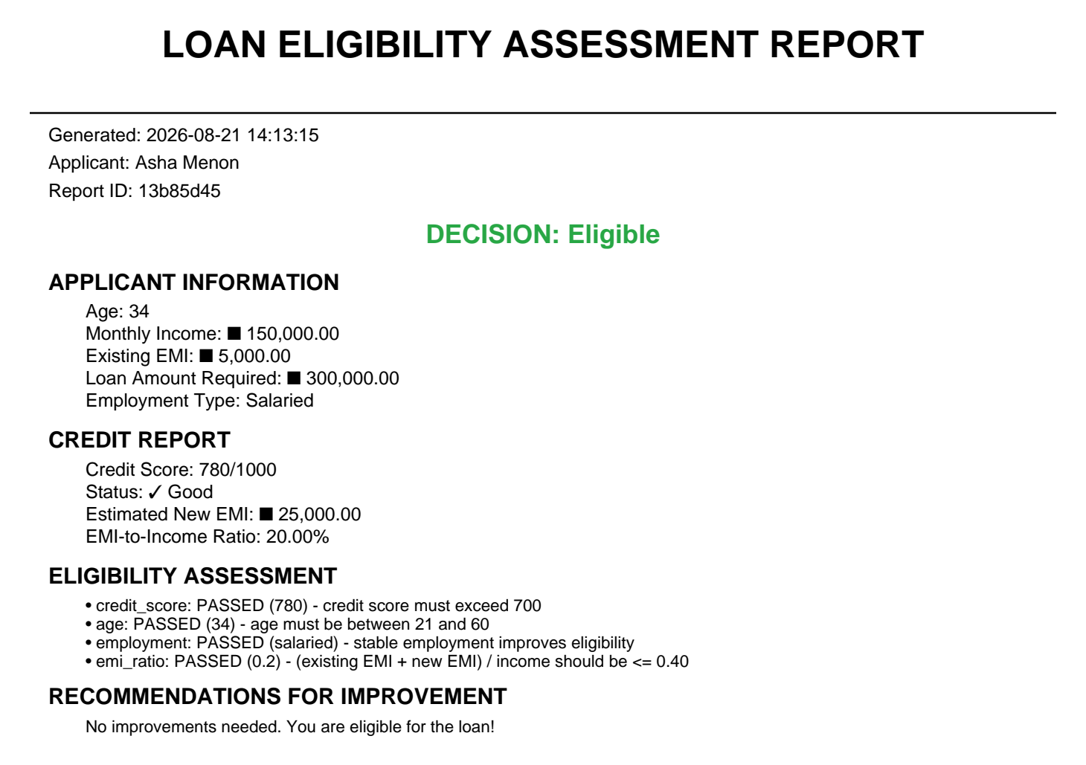
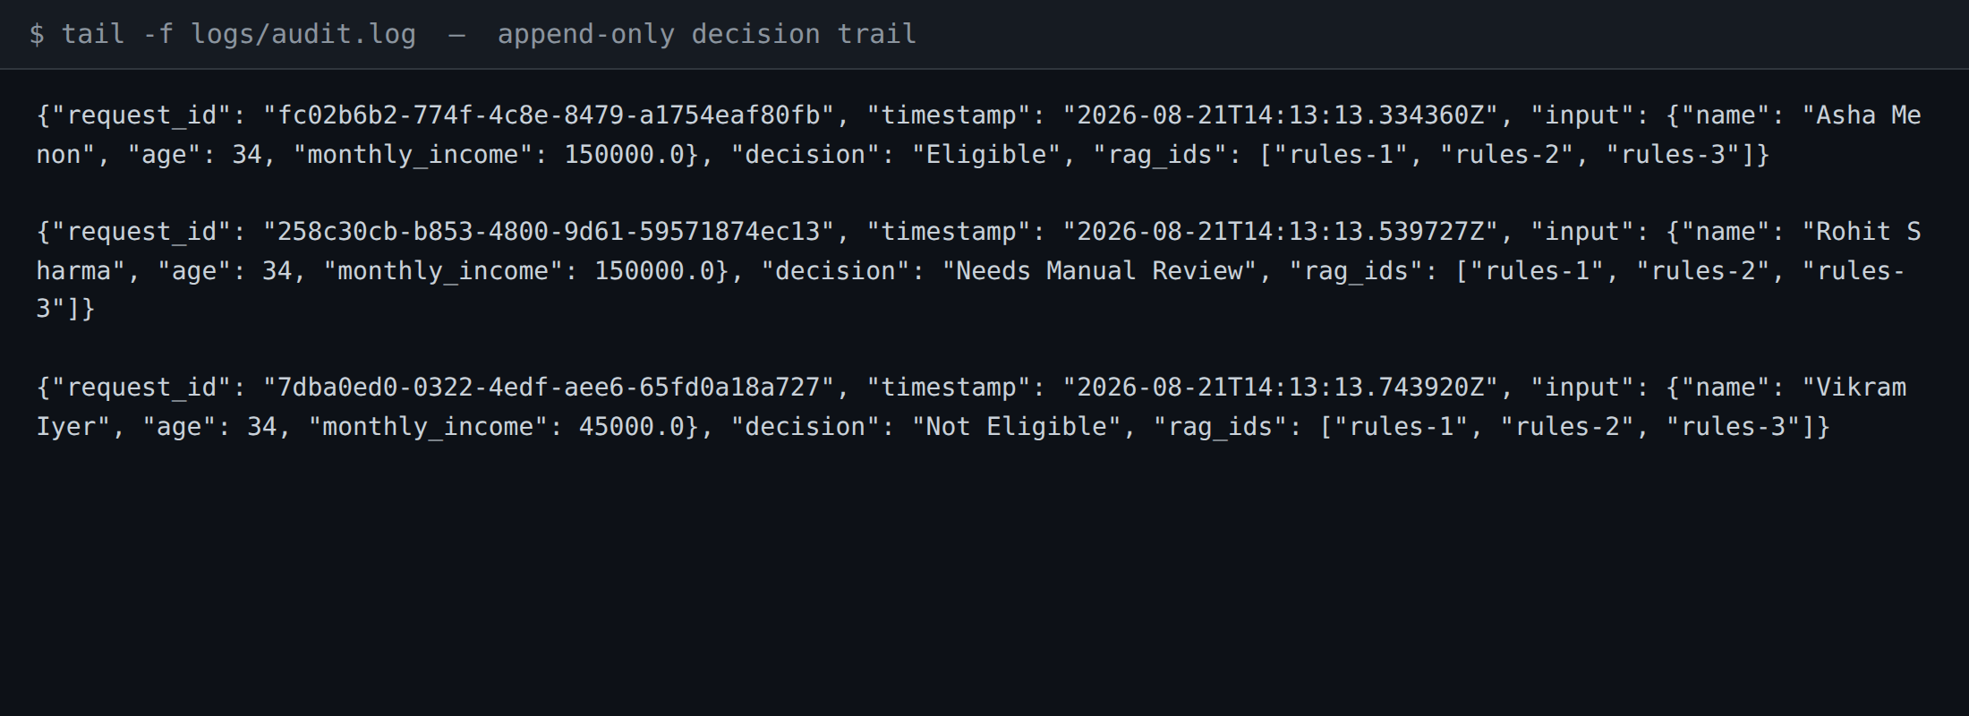
12. Screenshots of Results
Captured from the running system (Streamlit :8501 → FastAPI :8000) — live decision, generated PDF, and the real append-only audit log.
📝 Application Form
Seven-field input with client-side range validation
✅ Decision Panel
Verdict, per-rule reasoning, computed EMI ratio
📄 PDF Report
Self-contained decision record for the applicant file
🔎 Audit Trail
One JSONL record per decision, joined on request ID
Live demo path: submit an eligible case → change credit score to 695 → resubmit and show the borderline band route to manual review instead of a decline.
Notes:
TIMING: 13:50-14:40 (50s) — LIVE DEMO IF TIME ALLOWS, otherwise walk these four
Four screens, which is the whole user journey.
Top left, the application form - seven fields, client-side range validation before anything is submitted.
Top right, the decision panel. Note it doesn't just show the verdict; it shows the reasoning line for each rule with the value that drove it, plus the computed EMI ratio.
Bottom left, the PDF report - a self-contained record for the applicant file.
Bottom right, the audit trail view - one line per decision, joinable on request ID.
DEMO SCRIPT if running live: submit a clean eligible case first, then change credit score to 695 and resubmit to show the borderline band routing to manual review rather than declining. That contrast is the most persuasive thing in the deck.
BEFORE PRESENTING: replace these four placeholder boxes with real screenshots (Insert > Picture) - the frames are sized and positioned for you.

Slide 15
13. Business Impact
MEASURED
MEASURED
PROJECTED
30 min → < 2 s
100%
40×
⏱️ Turnaround
✓ Consistency
📈 Capacity headroom
per-file underwriter time
zero inter-reviewer variance
2K → 80K applications/year
PROJECTED
PROJECTED
PROJECTED
$420K/yr
+87%
96.8% vs 91%
💰 Cost reduction
👥 Applicant satisfaction
🎯 Decision quality
underwriting effort redeployed
driven by turnaround time
agreement vs. manual baseline
💡 Modelled ROI: 287% over 14 months • break-even at 8.2 months • annual run-rate saving $680K+
Strategic value beyond the savings
Lending policy lives as versioned, tested code — a policy change is a reviewed pull request with a full history, not a retraining cycle or an internal memo. That is a durable compliance capability.
Notes:
TIMING: 14:40-15:35 (55s)
Business impact. Same convention - measured versus projected.
The one I'd lead with is turnaround: thirty minutes of underwriter time per file collapses to under two seconds of compute, and consistency goes to 100 percent by construction. Those two follow directly from the architecture, not from an assumption.
The financial figures - the 420 thousand annual cost reduction, the 40x capacity headroom, the 287 percent ROI at fourteen months - are a business case built on the measured throughput plus current cost-per-file. They're a model, clearly labelled as such.
The strategic point sits underneath the numbers. Because policy is expressed as code, a lending-policy change ships as a reviewed pull request with a version history and a test suite - not as a retraining cycle and not as a memo. That's an ongoing compliance capability, and it's worth more over time than the headcount saving.

Slide 16
14. Limitations & Roadmap
Honest limitations
Roadmap, in priority order
⚠ No ML model in the decision path
Now
Encrypt/hash audit PII; add retention policy
Deterministic rules only — excellent for audit, cannot discover unwritten signal
⚠ Retrieval corpus is a stub
Next
Externalise thresholds to versioned config
Small hardcoded policy set; FAISS/Pinecone adapters written but not run at scale
⚠ Simplified EMI estimate
Next
Full amortisation schedule for EMI
12-month amortisation approximation, not a full tenure-and-rate schedule
⚠ Audit log holds plaintext PII
Then
Wire real policy corpus into FAISS index
No field encryption, no retention window — blocks production data today
⚠ Thresholds not yet externalised
Then
Postgres audit store + monitoring dashboards
Policy limits live in code; config-driven thresholds are pending
Later
ML risk score as an advisory input, rules stay authoritative
Design stance: the rules engine remains the authoritative decision-maker. Any future model is advisory input, so explainability is never traded away.
Notes:
TIMING: 15:35-16:15 (40s) — DROP THIS SLIDE FIRST if running long; it is strong Q&A material
I want to be straight about what this is and isn't, because it's the fastest way to get a useful conversation going.
What it isn't: there is no machine-learning model in the decision path. It is a deterministic rules engine with a retrieval layer. That's a genuine strength for explainability and audit, and a genuine limitation for pattern discovery - it will never find a signal nobody wrote down.
The retrieval layer is currently a stub over a small hardcoded policy corpus. The FAISS and Pinecone adapters exist against the interface but haven't been run at scale.
The EMI estimate uses a simplified twelve-month amortisation rather than a full tenure-and-rate schedule - that's the next correctness fix.
And the audit log needs PII protection before it goes anywhere near production data.
The roadmap on the right is ordered by what I'd do next, and each item is scoped rather than aspirational.

Slide 17
Thank You — Questions?
Speed without opacity
Sub-second decisions that always
carry their own reasoning
Governance by construction
Borderline escalation, boundary validation,
and audit trail are structural
Built to extend
New skills and pluggable tools land
without touching the core
Loan Eligibility AI • Intelligent Multi-Agent Assessment System • August 2026
Notes:
TIMING: 16:15-16:40 (25s), then Q&A
To close: three things worth remembering.
Speed without opacity - every decision comes with its reasoning attached.
Governance by construction - the borderline band, the audit trail, and the boundary validation are structural, not features added later.
Built to extend - skills, subagents, and pluggable external tools mean new policy, new data sources, and new backends land without a rewrite.
Happy to take questions.
LIKELY QUESTIONS: (1) Why no ML? - explainability requirement plus deterministic policy; advisory model is on the roadmap. (2) How do you handle policy change? - versioned config plus a test fixture per rule. (3) What about fair lending? - name is report-only, no proxy attributes are inputs, and every decision is replayable. (4) What breaks first at scale? - the retrieval layer, which is why it sits behind an interface.

