Slide 1

PROJECT ENTITLED
“COUNTERFEIT PRODUCT IDENTIFICATION USING BLOCKCHAIN”
Submitted in partial fulfillment for the requirements for the award of degree of
BACHELOR ENGINEERING
of
COMPUTER SCIENCE AND ENGINEERING
For the Academic Year 2022-23
Submitted by:
Santhosh Raaj G 1MJ19CS145
Shilpa DK 1MJ19CS151
S Saranya 1MJ19CS140
Shuchitha S 1MJ19CS158
Under the Guidance of
Ms. Anusha S
Assistant Professor, Department of CSE
MVJ College of Engineering, Bangalore
Approved by AICTE |Affiliated to VTU | Recognized by UGC with 2(f) & 12(B) status |Accredited by NBA and NAAC

Slide 2
CONTENTS
Abstract
Introduction
Problem Statement
Existing System
Proposed System
Implementation
Working
Hardware & Software Requirements
Applications
Future Aspect
Conclusion

Slide 3
ABSTRACT
In the recent days, as the use of E-commerce is increasing, the consumers are more prone on buying fraud or fake products. The project "COUNTERFEIT PRODUCT IDENTIFICATION USING BLOCKCHAIN" aims to address the growing concern of fraudulent or fake products in the e-commerce industry. By leveraging blockchain technology, the project intends to enable the identification of counterfeit products and authenticate genuine ones. The primary objective is to reduce and ultimately eliminate the presence of counterfeit goods in the market.The process begins by placing a product under a scanner for identification purposes. The scanner reads the QR codes that are generated at the manufacturing level. These QR codes serve as a means to distinguish between fake and genuine products. To ensure transparency and traceability, the product details contained within the QR code are added to a blockchain network.By utilizing blockchain technology, the project enables the tracking of the product from its origin, creating a verifiable and immutable record. This process allows for the certification of the product as either counterfeit or authentic. Consumers can utilize this system to verify the authenticity of a product before making a purchase, mitigating the risk of buying fraudulent goods.
Approved by AICTE |Affiliated to VTU | Recognized by UGC with 2(f) & 12(B) status |Accredited by NBA and NAAC

Slide 4
PROBLEM STATEMENT
In the recent days, as the use of E-commerce is increasing, the consumers are more prone on buying fraud or fake products. More than 76% of the consumers buy fake products unknowingly. The intermediates imitate the logos or the products with a cheaper quality of the famous brands. Hence there is a need for identifying the difference between the counterfeit goods and the original goods. A fake product identification systems may be prolonged overdue, an imperative factor of failure and more than one counterfeits of fake products because of intermediaries make it difficult for the consumers or users to determine whether or not the product is original/authenticate.
Approved by AICTE |Affiliated to VTU | Recognized by UGC with 2(f) & 12(B) status |Accredited by NBA and NAAC

Slide 5
INTRODUCTION
To address the problem statement, our project, "Counterfeit Product Identification Using Blockchain", proposes an approach to combat the expansion of counterfeit products in the e-commerce industry. By utilizing the power of blockchain technology, we aim to provide a secure and transparent system for identifying counterfeit products and certifying the authenticity of genuine goods. The primary objective of our project is to reduce and eventually eliminate the circulation of counterfeit products in the market. We recognize the urgency of developing effective mechanisms to ensure that consumers can make informed purchasing decisions and have confidence in the products they buy online. The solution involves leveraging the unique properties of blockchain technology to create an immutable and decentralized record of product information. By incorporating QR codes at the manufacturing level, our system enables the identification and verification of products throughout their lifecycle. When a product is subject for analysis, it undergoes a scanning process where the QR code embedded within the product is read by a specialized scanner. This scanner interfaces with the blockchain network, accessing the product's details stored securely on the blockchain. Through this process, the system can determine whether the product is genuine or counterfeit, providing consumers with accurate and trustworthy information.
Approved by AICTE |Affiliated to VTU | Recognized by UGC with 2(f) & 12(B) status |Accredited by NBA and NAAC

Slide 6
LITERATURE SURVEY
Fake Product Detection System Using Blockchain
Published in : Dec 2022
Authors : Aadeesh Bali, Amrit Singh and Sunandan Gupta
This project aims to combat the issue of fake products by utilizing blockchain technology. The supply chain of each product is stored at manufacturers level of its transaction using QR codes.The By leveraging blockchain's transparency and immutability, this solution provides a reliable means of tracking and verifying product authenticity.
2. Fake Product Detection Using Blockchain Technology
Published in : July 2022
Authors :Nruthya Ganapathy B, Keerthan Kumar, Poojary Shreya Jaya, Rajath D Shetty, Dr. Shreekumar T
In this project with massive emerging trends in wireless technology, QR codes and Barcodes provides a technique to cut down the practice of counterfeiting the products. By leveraging blockchain technology, the system aims to enhance the authentication process and reduce instances of fake products. QR codes and barcodes provide a robust and efficient method for identifying and validating product authenticity.
Approved by AICTE |Affiliated to VTU | Recognized by UGC with 2(f) & 12(B) status |Accredited by NBA and NAAC

Slide 7
3. Fake Product Identification Using Blockchain
Published in : June 2022
Authors : Pooja K, Prof. Alamma B H
This project employs blockchain technology and the InterPlanetary File System (IPFS) to detect fake products. The system tracks product ownership and ensures the integrity of the supply chain using the distributed web file system provided by IPFS. By leveraging blockchain and IPFS, the project aims to provide a secure and transparent solution for identifying counterfeit products.
4. Fake Product Detection Using Blockchain Technology
Published in : 2021
Authors : Tejaswini Tambe ,Sonali Chitalkar, Manali Khurud , Madhavi Varpe , S. Y. Raut
In this project, in response to the increasing prevalence of counterfeiting, this project utilizes QR codes and the SHA-256 algorithm along with blockchain technology. By leveraging the robustness of QR codes and the cryptographic security of the SHA-256 algorithm, the system provides a reliable means of detecting and combating fake products.

Slide 8
5. Blockchain In Fake Product Identification System Using QR code
Published in : 2020
Authors : Udhaya Nila and Abalin Luther Aathi Vignesh
Focusing on the identification of medication authenticity, this project utilizes blockchain technology and QR codes. The system records the journey of the product from the manufacturer to the user, ensuring transparency and reliability. By utilizing QR codes for product data handling, the system enables users to verify the authenticity of scanned products and detects counterfeit items.

Slide 9
EXISTING SYSTEM
Disadvantages of existing system :
Checking for counterfeit goods only at the manufacturing level.
Lack of Transparency: The existing system for product identification and verification often lacks transparency. Consumers have limited access to reliable information about the authenticity of products, making them vulnerable to purchasing counterfeit goods.
Inefficient Tracking: Without a robust system in place, it becomes challenging to track the entire supply chain and trace the origin of products. This lack of traceability increases the risk of counterfeit products entering the market unnoticed.
Limited Authentication Methods: Existing systems may rely on traditional authentication methods, such as serial numbers or labels, which can be easily replicated or tampered with by counterfeiters. This limitation undermines the effectiveness of product verification.

Slide 10
PROPOSED SYSTEM
This project focuses to develop the identification of the fake products using the blockchain, and unique QR(quick response) codes.
This can be used by the particular users at particula level of the supplychain, includes the manufacturer, seller and the consumer.
A unique QR code will be generated at the manufacturing level of the product which will indicate the ProductSerialNumber(PSN).
The QR Code generated will be stored in the blockchain network. Since blockchain is decentralized and immutable, it is ensured that the QR Codes or the products are not altered or replaced for sales malpractices.
As the lifecycle of the product starts, the data is added to the blockchain network, hence the product is tracked from its origin with the help of the QR code generated by the manufacturer.
Similarly, the seller and consumer will also be able to verify the product as counterfeit or authenticate just by scanning the QR code on the product.
Approved by AICTE |Affiliated to VTU | Recognized by UGC with 2(f) & 12(B) status |Accredited by NBA and NAAC

Slide 11
HARDWARE & SOFTWARE REQUIRED
The following requirements are required for the implementation of the project:
HARDWARE REQUIREMENTS
computer with the latest requirements
Scanner/camera
Hard Disk : 120 GB
Monitor : 12” LED
Input devices : Keyboard, Mouse
RAM : 4GB
2. SOFTWARE REQUIREMENTS
Operating System : Windows 10, 64-bits Operating System
Coding Language : Python,Selenium
Software Tool : VS Code, Ganache
API : OpenCV, Ethereum blockchain network
Approved by AICTE |Affiliated to VTU | Recognized by UGC with 2(f) & 12(B) status |Accredited by NBA and NAAC

Slide 12
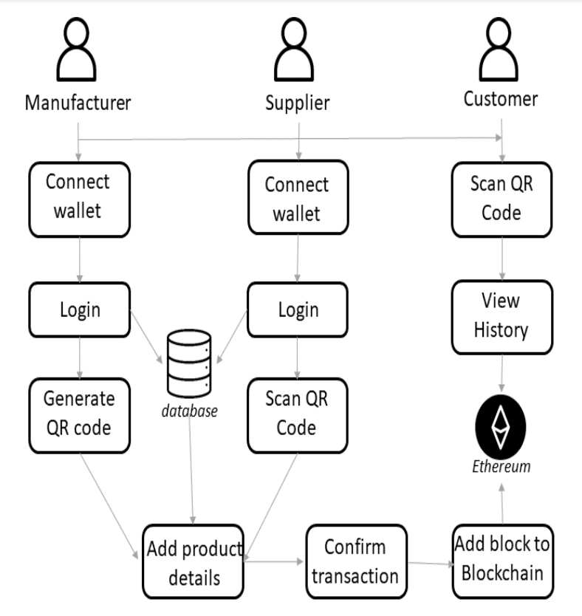
IMPLEMENTATION
The below diagram shows the system architecture of the project for the easier visualization of the implementation.
Fig 1 : System Architecture
Fig 1 : System Architcture
Approved by AICTE |Affiliated to VTU | Recognized by UGC with 2(f) & 12(B) status |Accredited by NBA and NAAC

Slide 13
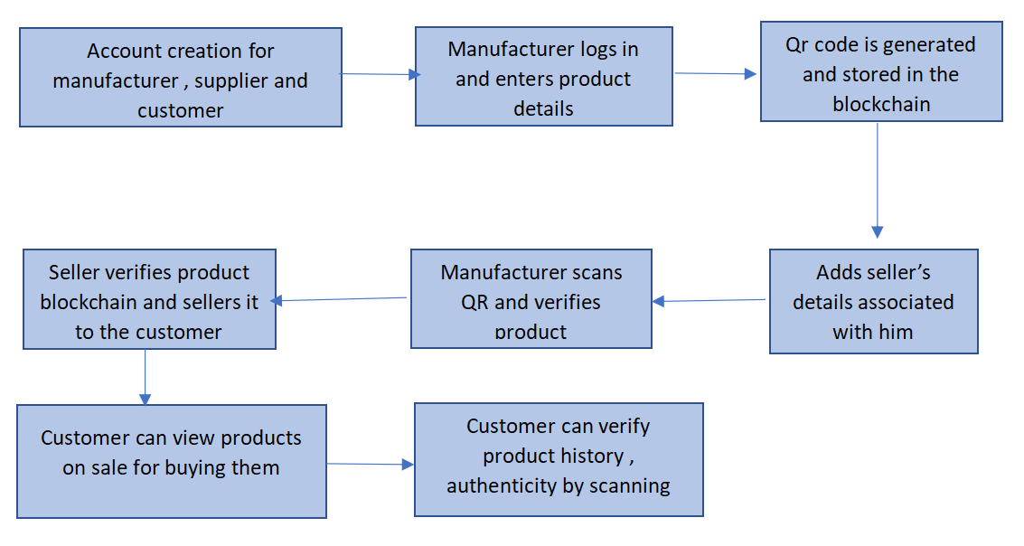
WORKING
The below diagram shows the system flow of the project for easier understanding and visualization of the above content.
Fig 2 : System Flow
Fig 2 : System Workflow
Approved by AICTE |Affiliated to VTU | Recognized by UGC with 2(f) & 12(B) status |Accredited by NBA and NAAC

Slide 14
ADVANTAGES
Advantages of the proposed system are:
Enhanced Transparency: The proposed system leverages blockchain technology, providing a transparent and immutable record of product information. This transparency allows consumers to verify the authenticity of products by accessing reliable and tamper-proof data on the blockchain.
Efficient Tracking: By utilizing QR codes and blockchain, the proposed system enables efficient tracking of products throughout the supply chain. Manufacturers, sellers, and consumers can easily trace the product's journey, ensuring its legitimacy and minimizing the risk of counterfeit goods.
Secure Authentication: The integration of QR codes and blockchain technology offers a robust authentication method. QR codes provide a unique identifier for each product, while blockchain ensures the integrity and immutability of the associated data. This combination enhances the security and reliability of product verification.
Consumer Empowerment: The proposed system empowers consumers by providing them with a means to verify the authenticity of products before making a purchase. By scanning the QR code and accessing the blockchain records, consumers can make informed decisions, mitigating the risk of buying counterfeit goods and protecting their interests.
Approved by AICTE |Affiliated to VTU | Recognized by UGC with 2(f) & 12(B) status |Accredited by NBA and NAAC

Slide 15
ADVANTAGES
Counterfeit Elimination: With the ability to track products from their origin, the proposed system contributes to the reduction and elimination of counterfeit products from the market. By establishing a transparent and trustworthy ecosystem, the system deters counterfeiters and safeguards the reputation of genuine manufacturers and sellers.
Improved Consumer Trust: By implementing a reliable product identification system, the proposed solution enhances consumer trust in the e-commerce marketplace. Consumers can confidently purchase products, knowing that they are authentic and meet their expectations, fostering long-term trust and loyalty..
Approved by AICTE |Affiliated to VTU | Recognized by UGC with 2(f) & 12(B) status |Accredited by NBA and NAAC

Slide 16
APPLICATIONS
Some of the applications of Counterfeit Product Identification using Blockchain are:
Consumer Goods: The project can be implemented in the consumer goods industry to combat the issue of counterfeit products. It allows consumers to verify the authenticity of the goods they purchase, ensuring they are getting genuine and safe products.
Pharmaceuticals: Counterfeit drugs pose a significant threat to public health. By applying this project in the pharmaceutical industry, consumers can verify the authenticity of medications, reducing the risk of consuming counterfeit or substandard drugs.
Luxury Goods: The luxury goods industry often faces challenges with counterfeit products. Implementing this project enables customers to verify the authenticity of luxury items such as designer bags, watches, and accessories, protecting their investment and brand reputation.
Automotive Parts: The automotive industry can benefit from this project by ensuring the authenticity of critical components and spare parts. It helps prevent the use of counterfeit parts that may compromise vehicle safety and performance.
Electronics: With the increasing market for electronic devices, the risk of counterfeit electronics has grown. Implementing this project allows consumers to verify the authenticity of electronic products, reducing the chances of purchasing counterfeit or faulty devices.
Approved by AICTE |Affiliated to VTU | Recognized by UGC with 2(f) & 12(B) status |Accredited by NBA and NAAC

Slide 17
CONCLUSION
In conclusion, the project "Counterfeit Product Identification Using Blockchain" presents a solution to overcome the growing problem of counterfeit products. By leveraging blockchain technology, unique QR codes, and secure data storage, the project aims to provide a reliable and transparent system for product authentication.Through the implementation of the project, we have successfully demonstrated the feasibility and effectiveness of using blockchain for counterfeit product identification. The integration of hardware and software requirements, such as scanners/cameras, computer systems, and coding languages, has facilitated the smooth functioning of the system.The project's applications extend across various industries, offering benefits to manufacturers, sellers, and consumers. By ensuring the authenticity of products, the project enhances consumer trust, protects brand reputation, and mitigates the financial and health risks associated with counterfeit goods. Looking ahead, the future scope of the project is promising. Further technological advancements, such as IoT integration and machine learning algorithms, can enhance the system's capabilities in detecting and preventing counterfeit products. Collaboration with regulatory authorities, industry stakeholders, and payment providers can strengthen the project's impact and facilitate wider adoption.
Approved by AICTE |Affiliated to VTU | Recognized by UGC with 2(f) & 12(B) status |Accredited by NBA and NAAC

Slide 18
FUTURE ASPECTS
The future of counterfeit product identification using blockchain is promising, with several potential developments that could enhance the capabilities and adoption of this technology:
Integration with Internet of Things (IoT) devices: By integrating blockchain technology with IoT devices, it is possible to create a more comprehensive and automated system for tracking and verifying the authenticity of products.
Smart contracts for supply chain management: Smart contracts are self-executing contracts with the terms of the agreement between buyer and seller being directly written into lines of code. This can be used for supply chain management by automating payment, delivery, and verification processes.
Interoperability between different blockchain systems: To be truly effective, blockchain-based fake product identification solutions will need to be interoperable with other blockchain systems. This will enable seamless tracking of products across different supply chains, and allow for greater transparency and accountability.
Overall, the future of counterfeit product identification using blockchain is bright, with the potential to revolutionize the way we verify the authenticity of products and prevent fraud in supply chains.
Approved by AICTE |Affiliated to VTU | Recognized by UGC with 2(f) & 12(B) status |Accredited by NBA and NAAC

Slide 19
Thank You !!!

