Slide 1

EASWARI ENGINEERING COLLEGE
Bharathi Salai, Ramapuram, Chennai – 600 089, Tamil Nadu, India
Department of Computer Science and Design
Subject: Full Stack Development | Subject Code: ____________
National Philately
A MERN-Stack Philately Community & Collection Platform
Submitted by: Santhosh Raj S (Roll No: ____________)
Submitted to: Divyanjali
Review 1 & 2 | MERN Stack Project

Slide 2
AGENDA
Scope of This Review
Requirements (Functional & Non-Functional)
Detailed System Architecture
Use Case & ER Diagrams
Module Description & Tech Stack
UI Design, Frontend & Backend
Database & API Integration
Real-Stamp Data Pipeline
Progress (100%), Screenshots & Challenges
Agenda
Review 1 & 2 | MERN Stack Project

Slide 3
01
REQUIREMENTS
Functional & Non-Functional Requirements
Functional Requirements
Non-Functional Requirements
User registration, login and JWT sessions
Role-based dashboards: Admin vs Collector
Core feature: browse, search and manage the stamp catalogue
Stamp CRUD via REST APIs (admin only) + image upload
Search, filter & sort: text, year, decade, range, country, category, theme, series
Community: posts, likes, comments, follows, private profiles
Notifications and 10 auto-earned achievements
Collection Gaps + Stamp Passport computed live
Performance: catalogue queries answered in well under 2 seconds
Scalability: stateless API, Mongo indexes on hot fields
Security: bcrypt hashing, JWT, adminOnly role middleware
Usability: responsive Tailwind UI, mobile bottom navigation
Availability: MongoDB with a restorable seed (npm run seed)
Maintainability: MVC code, shared taxonomy, no runtime third-party APIs
Testability: 203 API checks, 11 UI flows, 14 browser checks
Requirements
Review 1 & 2 | MERN Stack Project

Slide 4
02
ARCHITECTURE
System Architecture (Detailed)
CLIENT TIER
APPLICATION TIER
DATA TIER
React 18, Vite, Context API
Axios, React Router, Tailwind CSS
StampArt SVG fallback
⇄
Node.js + Express 4 REST API
Middleware: protect, adminOnly, taxonomy validation
base64 image upload
⇄
MongoDB + Mongoose ODM
11 models, indexes, seeded catalogue
HTTP requests flow from the browser, through Express routes and middleware, to MongoDB - JSON responses and stamp images return along the same path.
Image path: admin posts a base64 data URL -> magic-byte check -> file in server/public/stamps -> read-only /api/stamps/files. External calls happen only at build time in scripts/fetch-stamps.js (Wikimedia Commons); the running app never calls a third-party API.
Architecture
Review 1 & 2 | MERN Stack Project

Slide 5
03
USE CASE
Use Case Diagram
Browse and search stamps
Rules
Visitor
View stamp detail
Filter by country, year, category
Actors: Visitor, Collector, Admin
Browse is open without login
Any write (collect, post, CRUD) <<include>> authenticate
Create / edit stamp <<include>> taxonomy validation (400 on bad category, theme or country)
Admin-only routes sit behind the adminOnly middleware
View gaps / passport <<extend>> the collection feature
Register / login
Build a collection
Collector
Post, like, comment, follow
View gaps and passport
Manage settings and privacy
Create, edit, delete stamps
Admin
Upload stamp image
Manage series, users, posts
View platform stats
Use Case
Review 1 & 2 | MERN Stack Project

Slide 6
04
ER DIAGRAM
ER Diagram / Database Design
User
Collection
Relationships
name, username, email, password (hash), role, isPrivate
user *, stamp * (unique pair)
user 1:N posts, comments, notifications
user N:1 collection N:1 stamp (many-to-many)
user N:N follow N:N user
stamp N:1 country, stamp N:1 series
user N:N achievement N:N user via UserAchievement
Referenced, not embedded: counts stay live
Text index on name, person, description
Stamp
Post
name, category, theme, country *, series *, year
content, user *, stamp *, likes[]
Follow
UserAchievement
follower *, following * (unique pair)
user *, achievement *, earnedAt
* = foreign key - 11 models in total (Country, Series, Comment, Notification, Achievement also exist)
ER Diagram
Review 1 & 2 | MERN Stack Project

Slide 7
05
MODULES
Module Description
Module | Key Functions | Routes / Pages
User Management | Registration, login, JWT sessions, roles, settings, privacy | /login, /register, /settings
Catalogue (core) | Stamp CRUD, taxonomy validation, filters, facets, timeline | /explore, /stamp/:id, /timeline
Countries & Series | Country explorer, detail with timeline, series detail | /countries, /countries/:iso2
Community | Posts, likes, comments, follows, saved posts, private profiles | /community, /profile/:username
Collection Intelligence | Gaps by country and series, stamp passport progress | /collection/gaps, /collection/passport
Admin | Manage stamps, series, users, posts; image upload; stats | /admin, /admin/stamps, /admin/users
Notifications & Badges | In-app alerts, per-event preferences, 10 achievements | /notifications, profile badges
Modules
Review 1 & 2 | MERN Stack Project

Slide 8
06
TECH STACK
Technology Stack
MongoDB
Express.js
React.js
Node.js
NoSQL Database
Backend Framework
Frontend Library
Runtime Environment
Supporting Tools
Mongoose (ODM) - JWT & bcryptjs (auth/security) - Axios (HTTP client) - React Router v6
Vite build + Tailwind CSS - dotenv configuration - VS Code, npm, Git & GitHub
Build-time tooling: scripts/fetch-stamps.js (Wikimedia Commons), e2e-test.js (203 checks), svg-render-test.js, generate-preview.js
Tech Stack
Review 1 & 2 | MERN Stack Project

Slide 9
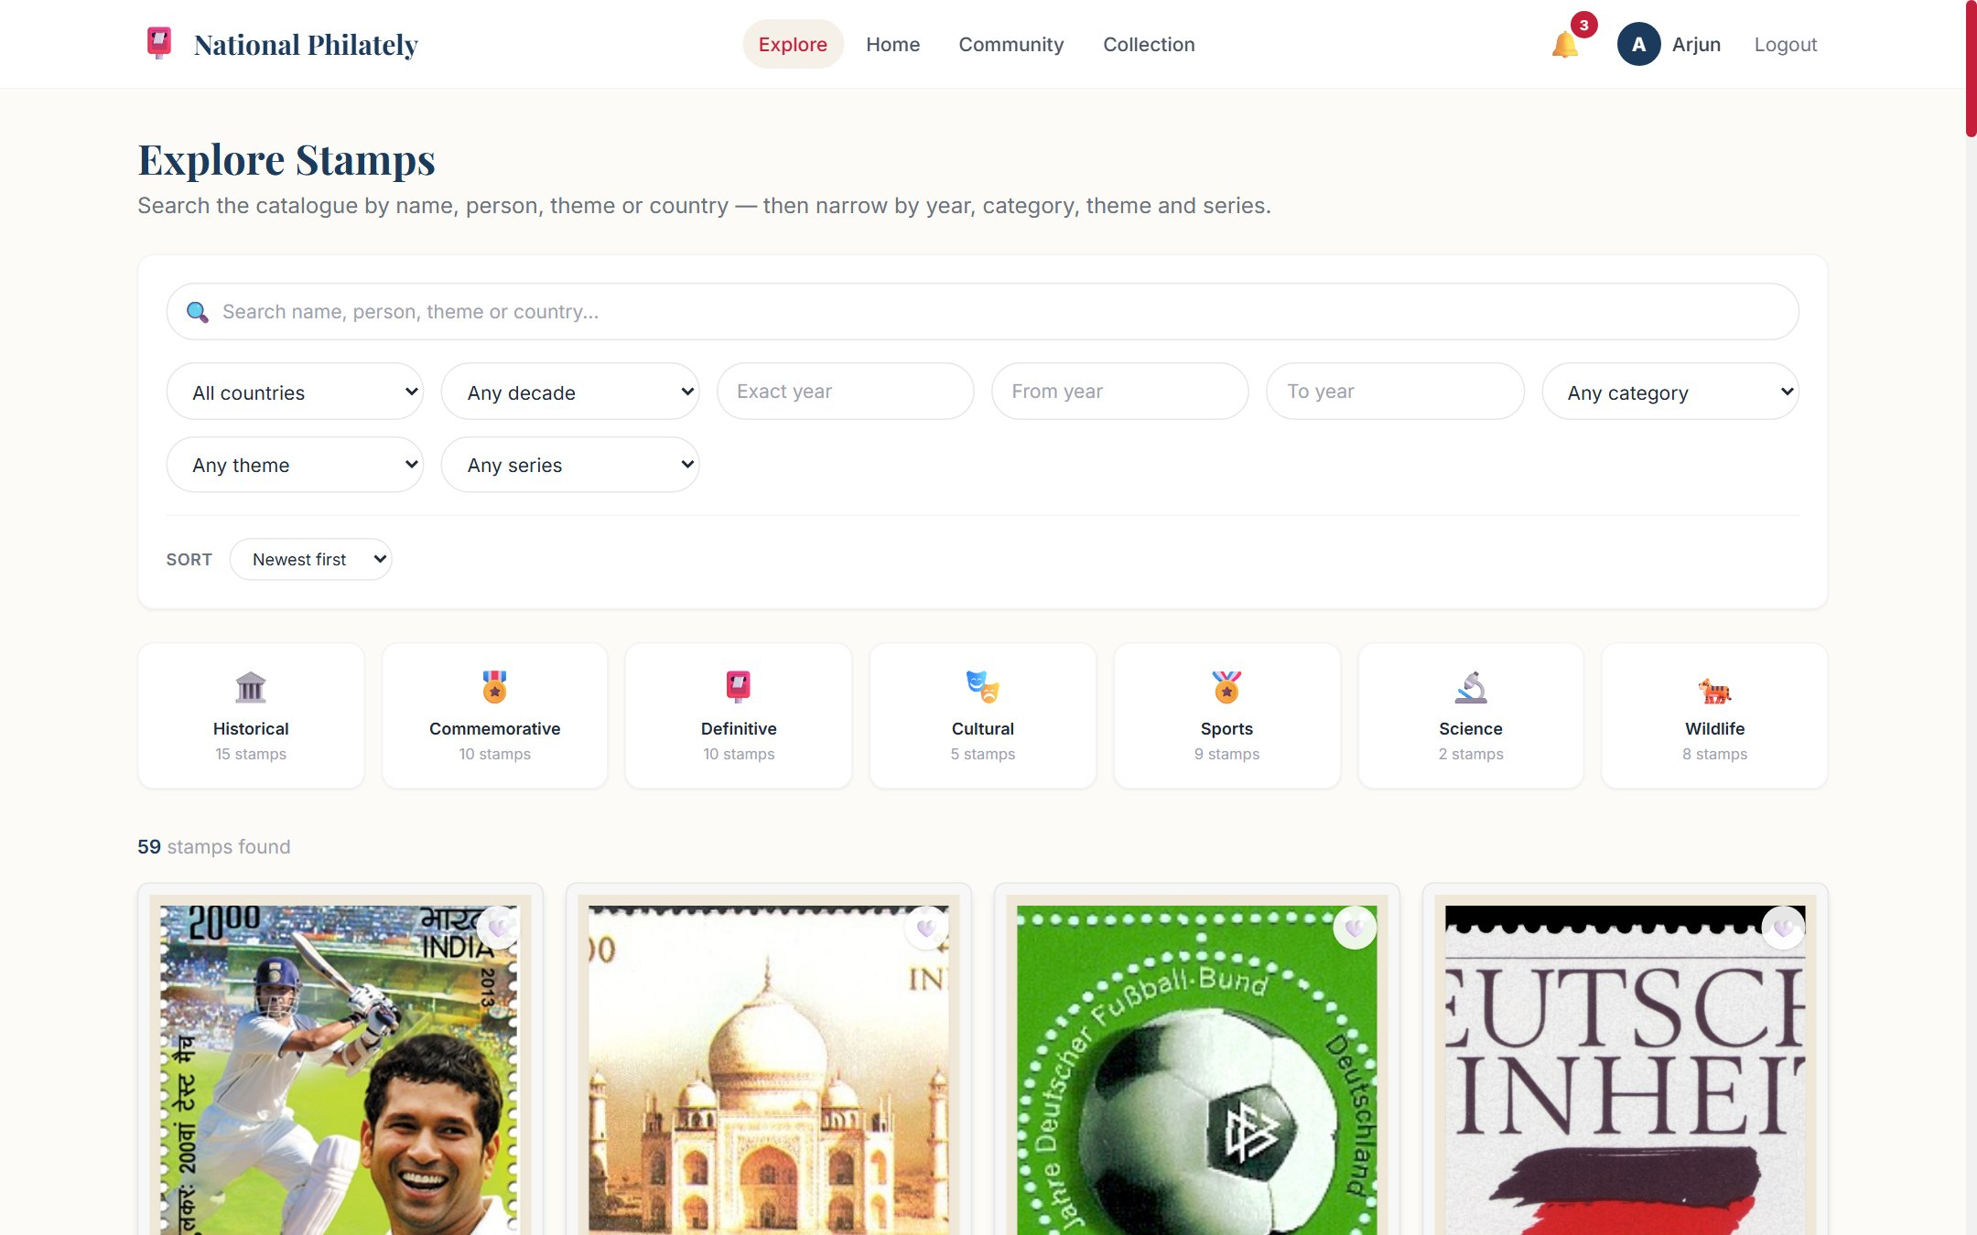
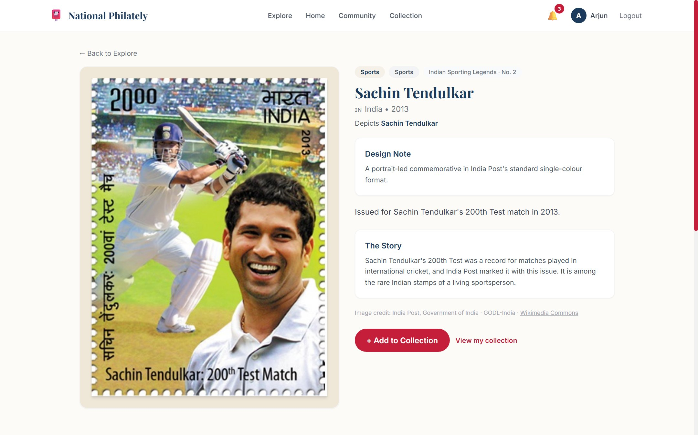
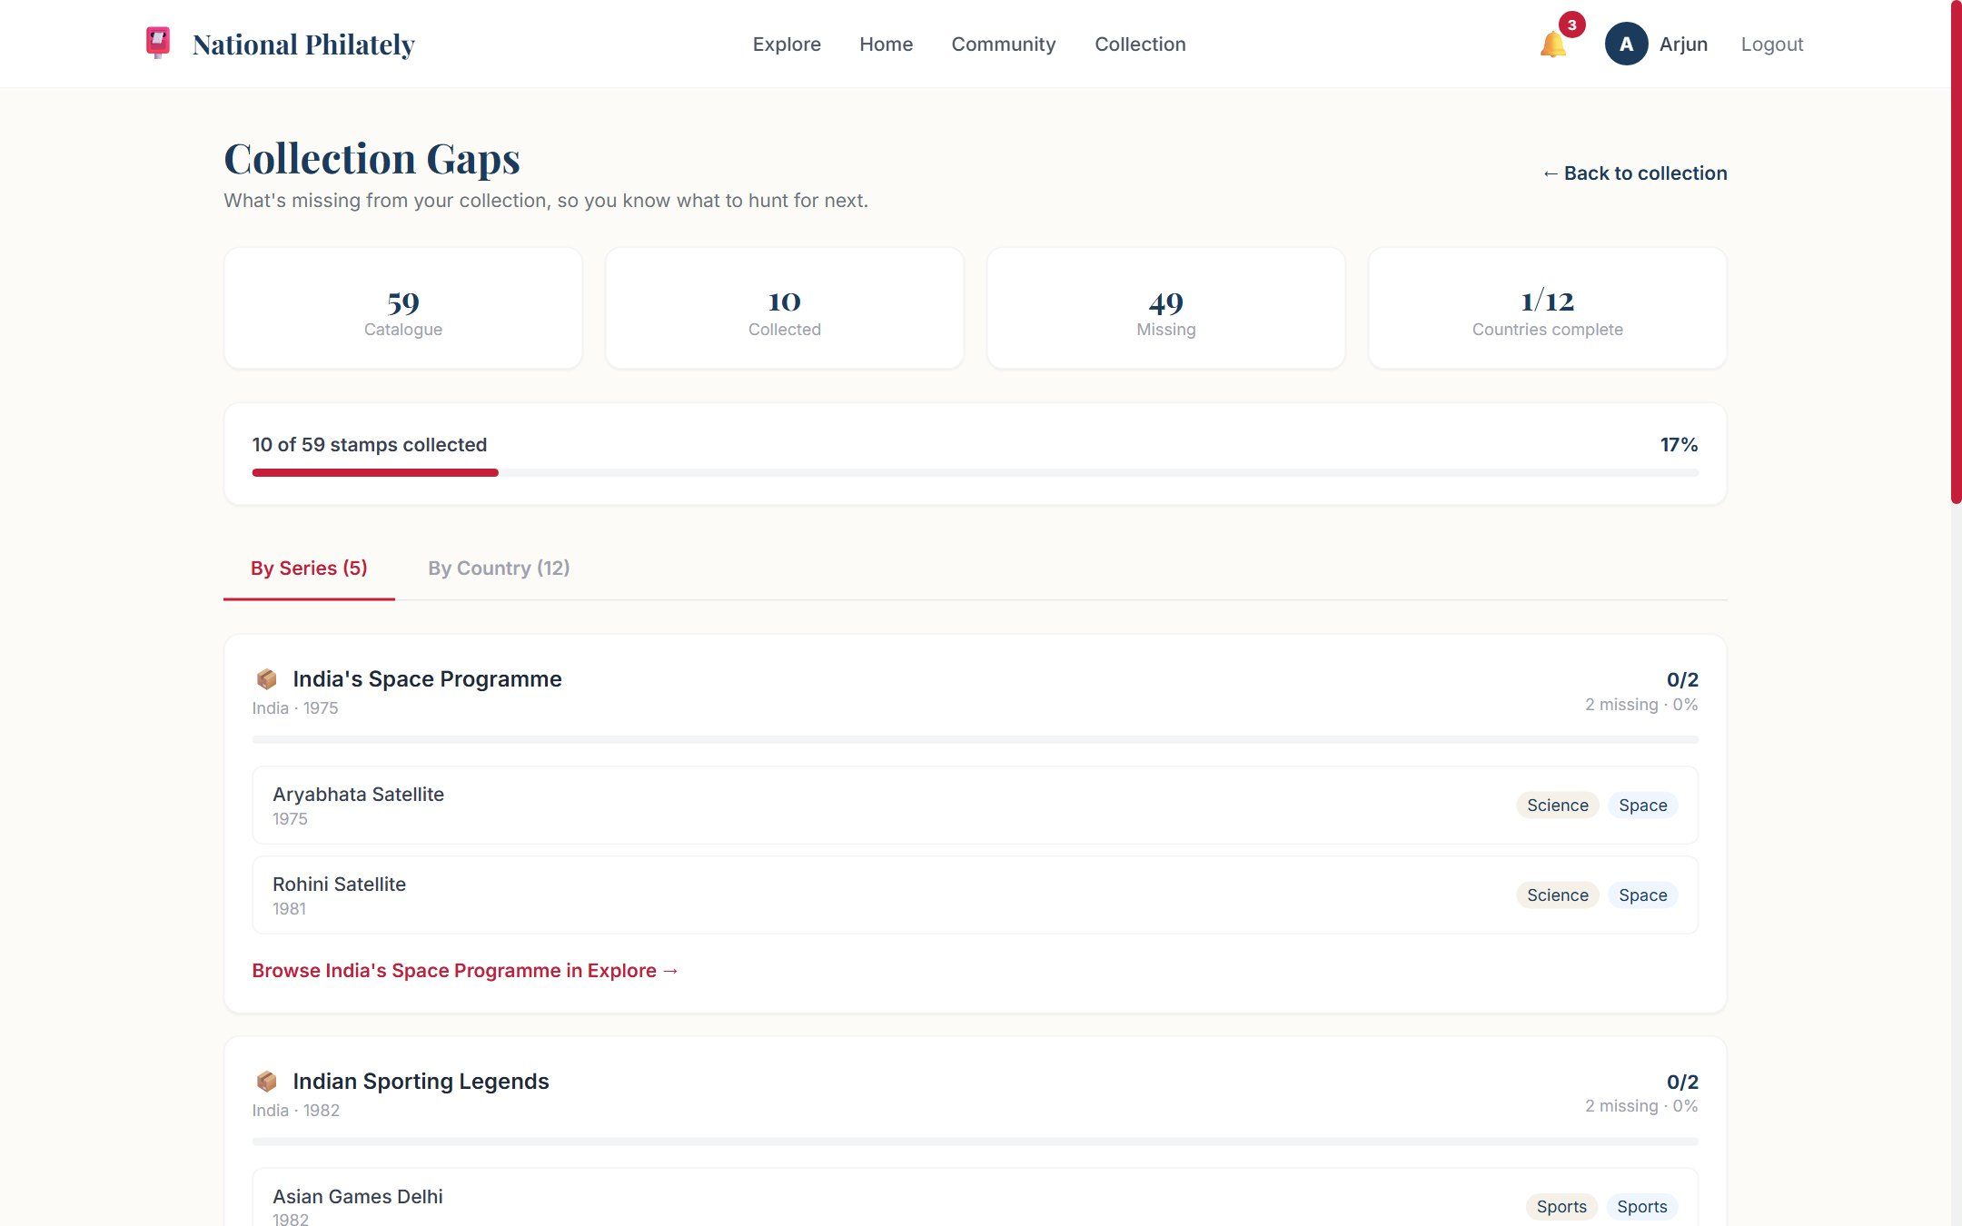
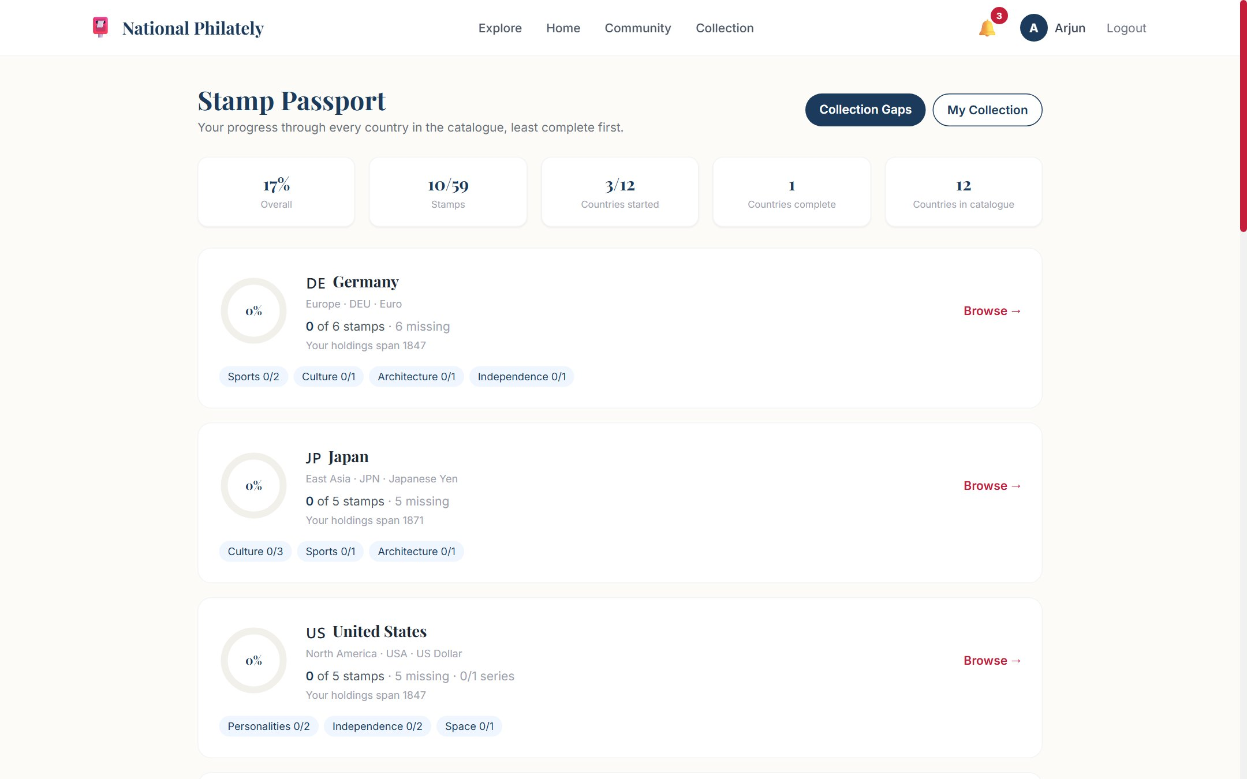
07
UI DESIGN
UI Design / Wireframes
Key screens (14)
Landing, Login, Join Free
Home - continue exploring, trending posts
Explore - filter panel, chips, category tiles
Stamp detail - image, story, attribution, related
Countries, Country detail, Timeline
Community feed, Create post, Saved
Profile - public and private states
Collection gaps (by series / by country)
Stamp passport - per-country progress
Settings - profile, interests, privacy, notifications, password
Admin - dashboard, users, stamps, posts
Palette: postal teal/navy, Cambria headings, Inter body
Explore - filters, chips, category tiles
Stamp detail - image, story, attribution
Collection gaps
Stamp passport
UI Design
Review 1 & 2 | MERN Stack Project

Slide 10
08
FRONTEND
Frontend Development
React 18 functional components and hooks, React Router v6 with 14 guarded routes
Component set: Navbar, Footer, StampCard, StampImage, PostCard, CommentSection, CollectionGrid, AchievementBadge, Modal
State via Context API - token in localStorage, Axios attaches the bearer token
Two-art layer: real scan in StampImage when stamp.image exists, otherwise deterministic StampArt SVG (hashed from name + year)
Deep links: country / year / series query params arrive from Gaps, Passport, Country Detail and Stamp Detail as dismissible chips
Responsive Tailwind layout with bottom navigation on mobile; production build passes (130 modules, ~340 kB JS)
Completed screens: Landing, Login, Register, Home, Explore, Stamp detail, Countries, Country detail, Timeline, Community, Profile, Gaps, Passport, Settings, Admin.
Frontend
Review 1 & 2 | MERN Stack Project

Slide 11
09
BACKEND
Backend Development
Node.js + Express 4 server in MVC layout: routes -> middleware -> controllers -> models
9 controllers, 11 models, one route file per resource; env config through dotenv
Middleware: protect (JWT), adminOnly (403), centralised error handler carrying status codes
taxonomy.js validates category, theme and region on every write - invalid values return 400
Search server-side across name, person, theme, description, story and countryName with escaped regex
Image upload without extra dependencies: base64 data URL, magic-byte check, 4 MB cap, read-only static mount
Filters compose: country (name / ISO-2), exact year, decade, from-to range, category, theme, series, sort and countOnly.
Backend
Review 1 & 2 | MERN Stack Project

Slide 12
10
DATABASE
Database Integration
Local MongoDB database national_philately, Mongoose schemas for each of the 11 collections
Collections: User, Country, Series, Stamp, Collection, Post, Comment, Follow, Notification, Achievement, UserAchievement
Relationships via referencing: Stamp -> Country, Stamp -> Series, Collection -> User + Stamp, Post -> Comment
Indexes: text (name, person, description), category+theme, year, series+seriesNumber, viewCount desc
Unique compound keys on Follow and UserAchievement so badges can never be granted twice
Seed data: 12 countries, 7 series, 59 stamps, 6 users, 10 posts, 26 collection items, 18 earned badges
Seed loads data/stamps.json (the resolved Wikimedia catalogue) and fails if any image file is missing - a broken catalogue cannot ship.
Database
Review 1 & 2 | MERN Stack Project

Slide 13
11
API
API Development
Method | Endpoint | Description
POST | /api/auth/register, /api/auth/login | Create account / issue JWT
GET | /api/stamps?search=&year=&category= | Catalogue with composable filters, sort, countOnly
GET | /api/stamps/facets | Distinct categories, themes and years for the filter UI
GET | /api/stamps/:id | Stamp detail with country and series populated
POST / PUT / DELETE | /api/stamps[/:id] | Admin CRUD, taxonomy validation (400 on bad input)
POST | /api/stamps/upload | Base64 image -> file, returns /api/stamps/files url (admin)
GET | /api/collection/gaps | Missing stamps grouped by country and by series
GET | /api/collection/passport | Per-country progress, percent, category coverage
GET | /api/users/:username | Profile, collection, posts, achievements, follow state
GET | /api/admin/stats | Totals for the admin dashboard (admin only)
API
Review 1 & 2 | MERN Stack Project

Slide 14
12
STATUS
Module-wise Implementation Status
User Authentication
100%
Frontend UI (14 screens)
100%
Backend APIs
100%
Database Integration
100%
Admin Module + Image Upload
100%
Notifications (in-app)
85%
Status
Review 1 & 2 | MERN Stack Project

Slide 15
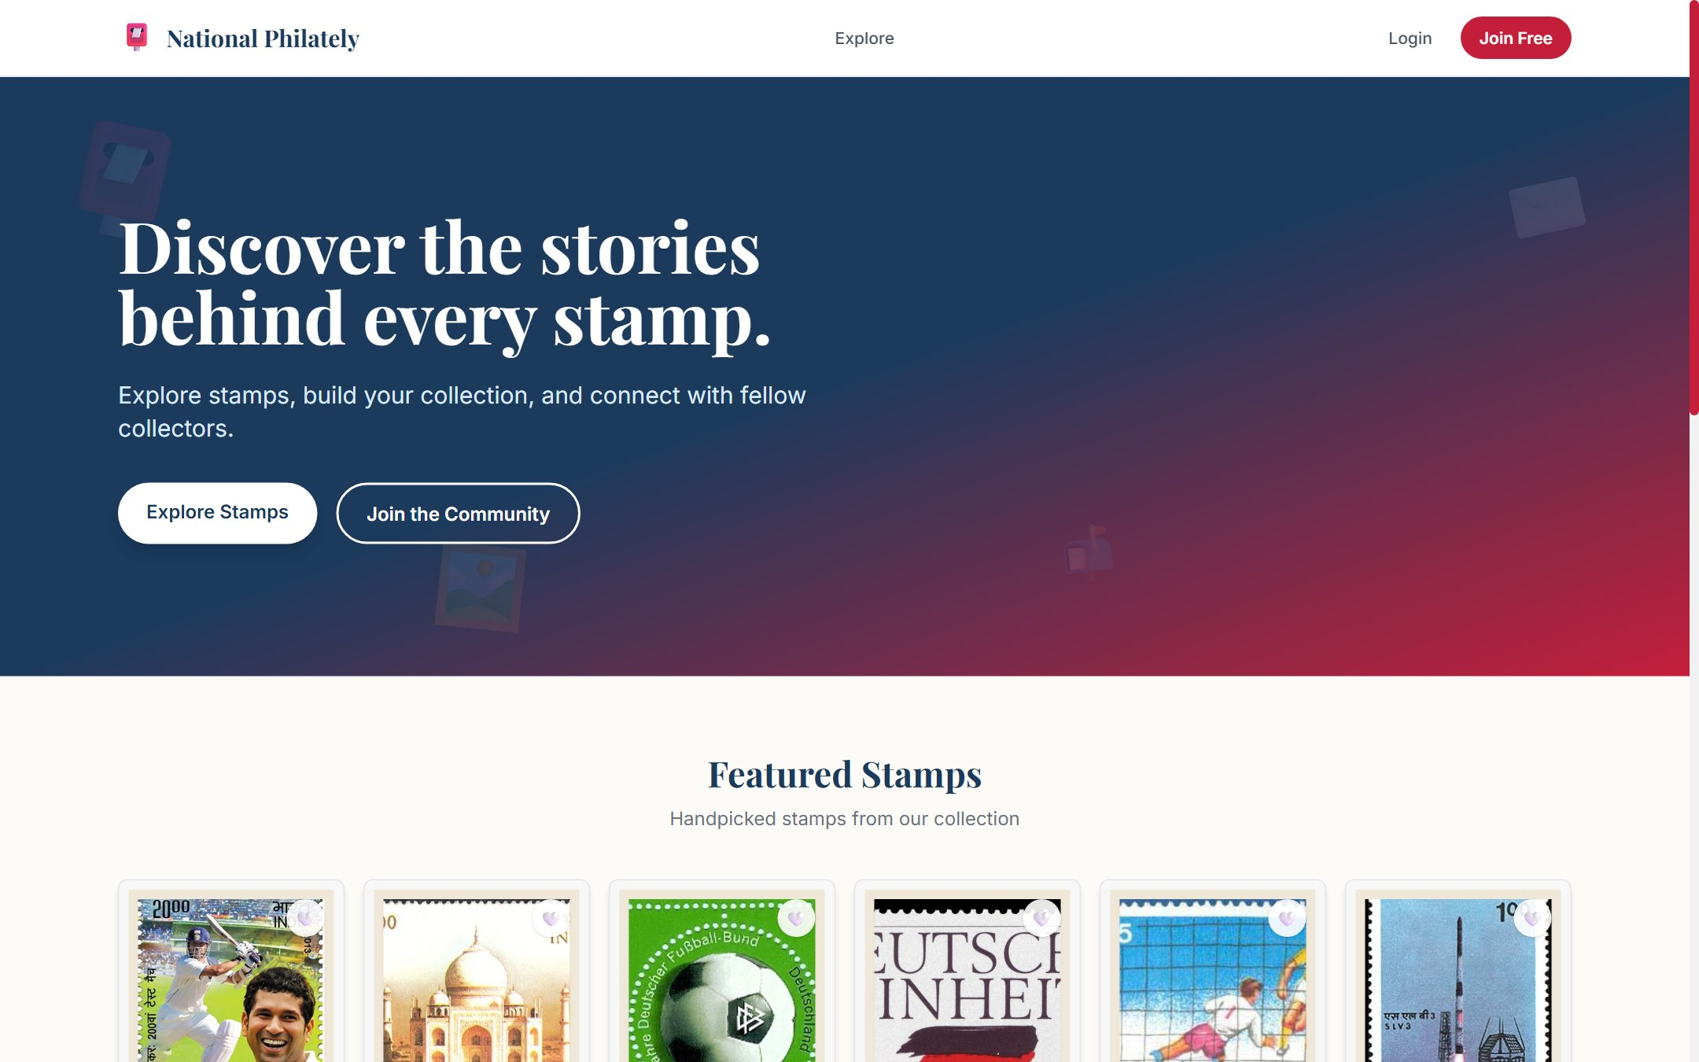
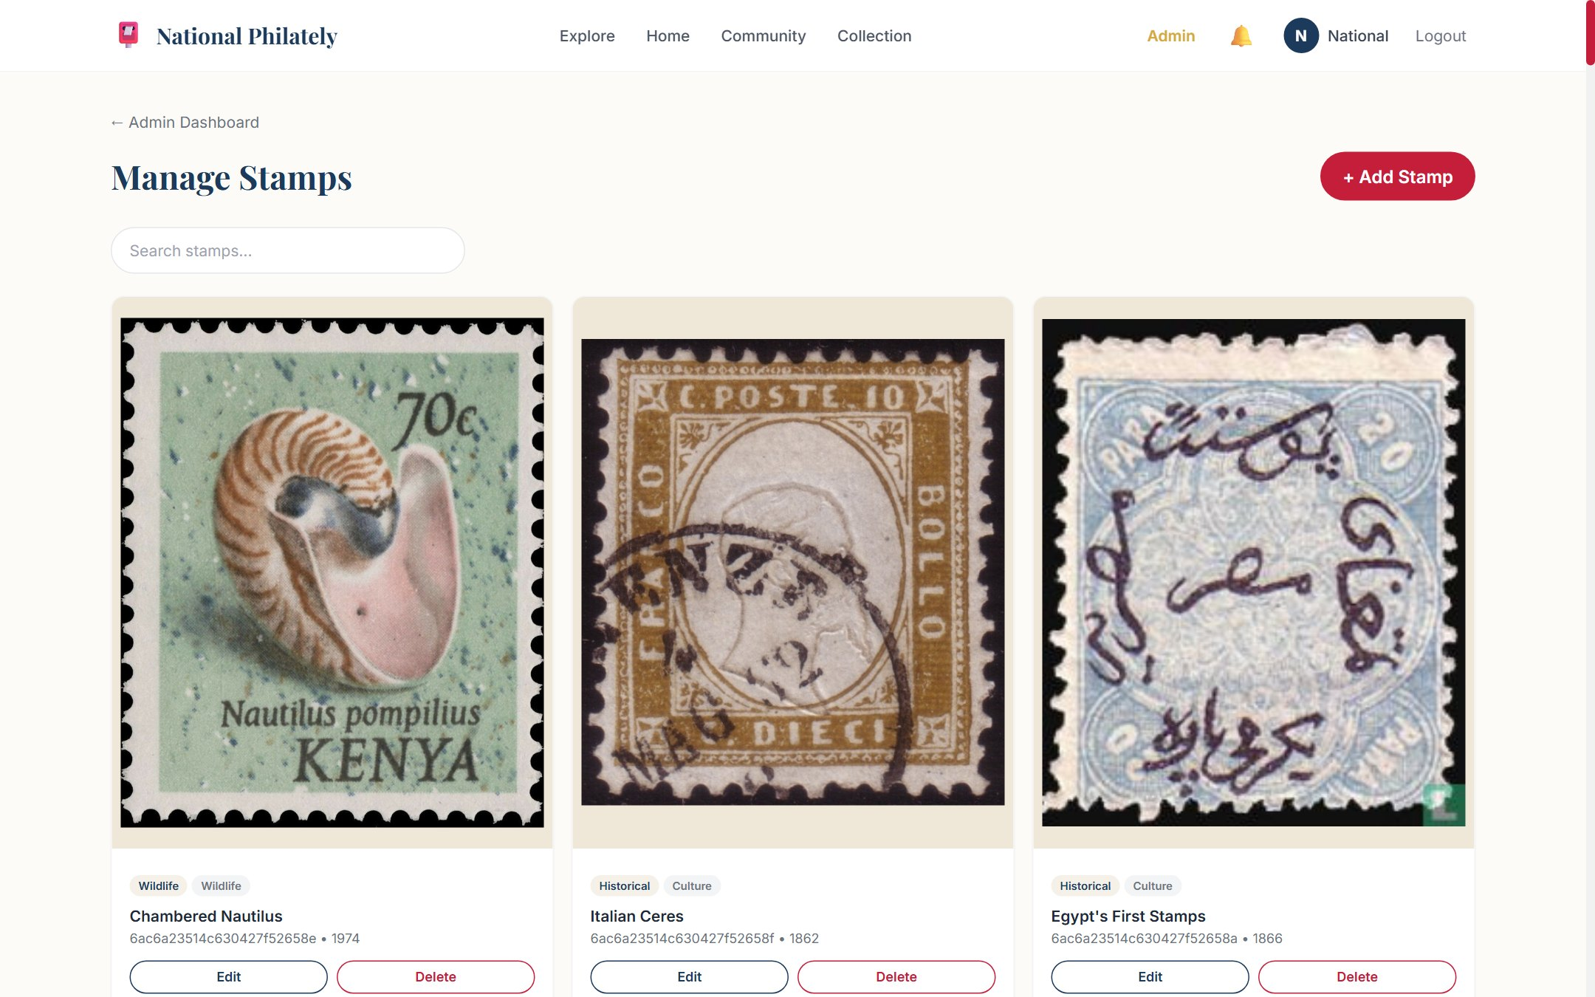
13
SCREENSHOTS
Screenshots
Landing page
Explore - filters and results
Admin - stamps with images and upload
Stamp detail - image and attribution
Screenshots
Review 1 & 2 | MERN Stack Project

Slide 16
14
CHALLENGES
Challenges Faced & Solutions
Challenge | Solution Adopted
Wikimedia rate-limited the 59 image downloads (HTTP 429, 10-minute ban) | Honour Retry-After with capped backoff, then skip and resume: re-runs only fetch the stragglers
Achievement badges could be granted twice under parallel requests | Unique compound indexes on Follow / UserAchievement plus a parallel-unlock test asserting one row per badge
Deep-link filters (year + decade, country + year) silently returned partial results | Single query builder that merges year modes and returns an empty set instead of a wrong one
Image upload without adding a multer dependency | Base64 data URL endpoint with magic-byte detection, 4 MB cap and read-only static file serving
Catalogue size hardcoded in tests broke every time stamps were added | Tests derive expected counts from data/stamps.json and probe every image over HTTP 200
A stamp must never render as a broken image box | StampImage falls back to the deterministic StampArt SVG; seed fails loudly if an image file is missing
Challenges
Review 1 & 2 | MERN Stack Project

Slide 17
15
NEXT STEPS
Remaining Work & Plan
Email notifications for achievements and follows (in-app notifications are complete)
Image uploads for community posts (stamps already support upload)
Refresh-token flow instead of re-login when the JWT expires
Deploy: Render / Railway for the API, Netlify / Vercel for the client, MongoDB Atlas for data
Accessibility pass: focus states, aria labels, colour contrast
Integration and user-acceptance testing with real collectors, then final documentation and demo
Next Steps
Review 1 & 2 | MERN Stack Project

Slide 18
16
REFERENCES
References
# | Reference
1 | MongoDB, Express.js, React and Node.js - official documentation
2 | Mongoose ODM guides: schema design, indexes and populated relations
3 | JSON Web Token (RFC 7519) and bcryptjs password hashing
4 | Wikimedia Commons API, image reuse and licence pages for every catalogue entry
5 | React Router v6, Context API, Vite and Tailwind CSS documentation
6 | Project README: install, seed, test and data-pipeline instructions
References
Review 1 & 2 | MERN Stack Project

