Slide 1
NATIONAL PHILATELY
A MERN STACK STAMP CATALOGUE & COLLECTOR COMMUNITY
Project Review 2 - System Design, Build & Demonstration
MongoDB | Express.js | React.js | Node.js
[Student Name | Roll No | Batch] Guide: [Guide Name]
59 stamps - 12 countries - 7 series - 203 automated API checks

Slide 2
A G E N D A
01
Requirements
Functional & non-functional
02
Architecture
Three-tier client / app / data
03
Use Case & ER
Actors, entities, relationships
04
Modules & Tech Stack
What each module does
05
UI, Frontend & Backend
Screens, components, APIs
06
Database & API Integration
11 models, real endpoints
07
Data Pipeline
59 real stamps from Wikimedia Commons
08
Status, Screens & Challenges
Progress, evidence, solutions
Review 2 | National Philately - MERN Stack Project

Slide 3
01
R E Q U I R E M E N T S
FUNCTIONAL REQUIREMENTS
NON-FUNCTIONAL REQUIREMENTS
▪ User registration, login and JWT sessions
▪ Role-based access: Admin vs Collector
▪ Core feature: browse, search and manage a stamp catalogue
▪ Stamp CRUD via REST APIs (admin only), with image upload
▪ Search, filter & sort: text, year, decade, range, country, category, theme, series
▪ Community: posts, likes, comments, follows, private profiles
▪ Notifications and 10 auto-earned achievements
▪ Collection intelligence: gaps and passport computed live
▪ Performance: catalogue and filter queries answered in well under 2 s
▪ Security: bcrypt hashing, stateless JWT, role middleware on every admin route
▪ Usability: responsive Tailwind UI, bottom navigation on mobile
▪ Availability: local MongoDB with seeded, restorable data (npm run seed)
▪ Maintainability: MVC layout, shared taxonomy, no runtime third-party APIs
▪ Testability: 203 API checks, 11 UI flows, 14 browser checks in the test suite
Review 2 | National Philately - MERN Stack Project

Slide 4
02
S Y S T E M A R C H I T E C T U R E
CLIENT TIER
React 18 + Vite
React Router
Context API (auth state)
Axios with bearer token
Tailwind CSS
StampArt SVG fallback
APPLICATION TIER
Node.js + Express 4
REST controllers (MVC)
protect / adminOnly middleware
taxonomy validation
base64 image upload
static /api/stamps/files
DATA TIER
MongoDB + Mongoose
11 models
text + compound indexes
referenced docs
seeded catalogue
(12 / 7 / 59 / 6)
Request flow: browser -> Axios -> Express route -> middleware (auth, validation) -> controller -> Mongoose -> MongoDB, JSON back along the same path.
Image flow: admin uploads a base64 data URL -> magic-byte check -> written to server/public/stamps -> served read-only at /api/stamps/files/<file>.
Build-time only: scripts/fetch-stamps.js talks to the Wikimedia Commons API. The running app makes no external API calls.
Review 2 | National Philately - MERN Stack Project

Slide 5
03
U S E C A S E D I A G R A M
Browse & search stamps
RELATIONSHIPS
▪ Collector must authenticate before any write (<<include>>).
▪ Create stamp includes taxonomy validation (400 on bad category / theme / country).
▪ Browse is open to anonymous visitors (no login).
▪ View gaps and View passport extend the collection feature.
▪ Admin actions run behind the adminOnly middleware.
Visitor
View stamp detail
Filter by country / year
View countries & timeline
Collector
Register / login
Build collection
Post, like, comment, follow
See gaps & passport
Manage settings & privacy
Admin
Create / edit / delete stamp
Upload stamp image
Manage series
Moderate users & posts
View platform stats
Review 2 | National Philately - MERN Stack Project

Slide 6
04
E R D I A G R A M / D A T A B A S E D E S I G N
User
Collection
Stamp
name, username, email,
password(hash), role, isPrivate
user *, stamp *
(unique pair)
name, category, theme,
country *, series *, year
Post
Follow
Country
content, image, user *,
stamp *, likes[]
follower *, following *
(unique pair)
name, iso2, iso3, flag,
region, currency
Comment
UserAchievement
Series
post *, user *, content
user *, achievement *
earnedAt (unique pair)
name, category, theme,
issuedFrom / To, totalStamps
Relations: user 1:N posts/comments - user N:1 collection N:1 stamp - user N:N follow N:N user - stamp N:1 country - stamp N:1 series - user 1:N notifications - user N:N achievement N:N user (UserAchievement)
Design notes: referenced (not embedded) for country / series / stamp so counts stay live; * marks a foreign key; Notification and Achievement models omitted from the drawing for space.
Review 2 | National Philately - MERN Stack Project

Slide 7
05
M O D U L E D E S C R I P T I O N
Module | Key functions | Routes / pages
User Management | Registration, login, JWT sessions, roles, settings, privacy | /login, /register, /settings
Catalogue (core) | Stamp CRUD, taxonomy validation, filters, facets, timeline | /explore, /stamp/:id, /timeline
Countries & Series | Country explorer, detail with timeline, series detail | /countries, /countries/:iso2
Community | Posts, likes, comments, follows, saved posts, private profiles | /community, /profile/:username
Collection Intelligence | Collection gaps by country/series, stamp passport pages | /collection/gaps, /collection/passport
Admin | Manage stamps, series, users, posts; image upload; stats | /admin, /admin/stamps, /admin/users
Notifications & Badges | In-app alerts, per-event preferences, 10 achievements | /notifications, badges in profile
Review 2 | National Philately - MERN Stack Project

Slide 8
06
T E C H N O L O G Y S T A C K
MongoDB
NoSQL database
Express.js
Backend framework
React.js
Frontend library
Node.js
Runtime environment
Vite + Tailwind
Build & styling
SUPPORTING TOOLS
▪ Mongoose ODM for schema & validation
▪ JWT + bcryptjs for auth and password hashing
▪ Axios on the client, native fetch in tests
▪ React Router v6 for client-side routing
▪ Postman for manual API checks
▪ Git / GitHub for version control
BUILD-TIME TOOLING
▪ scripts/fetch-stamps.js - Wikimedia Commons fetch + validate
▪ svg-render-test.js - deterministic StampArt assertions
▪ e2e-test.js - 203 API checks against a live server
▪ Playwright-style CDP scripts for UI flows
▪ generate-preview.js - stamp contact sheet
Review 2 | National Philately - MERN Stack Project

Slide 9
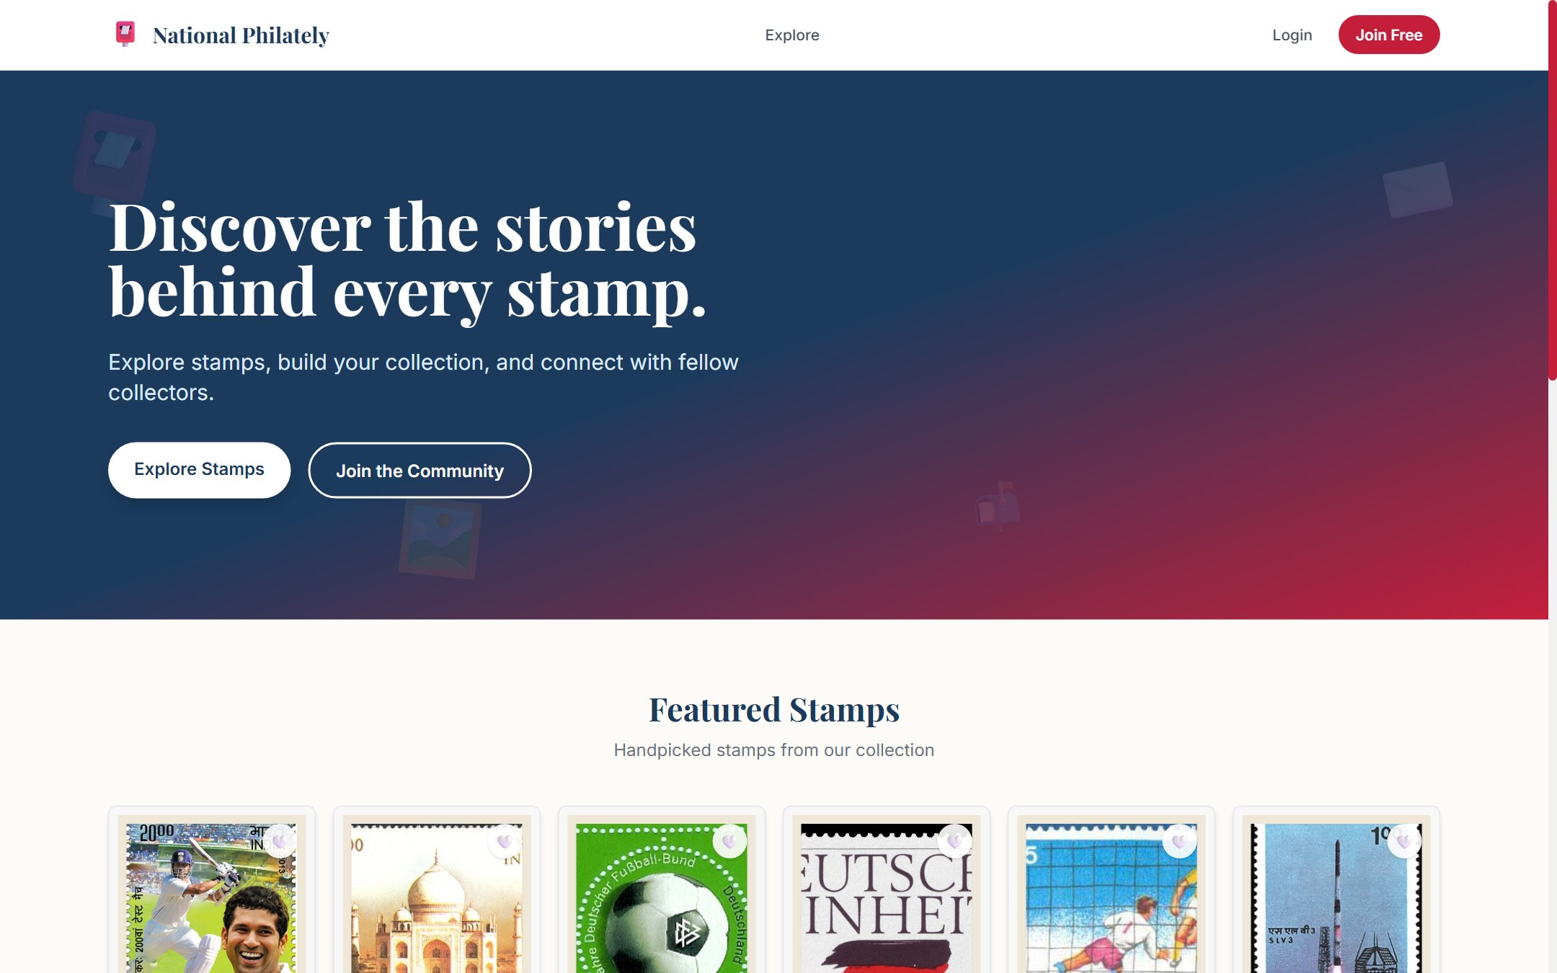
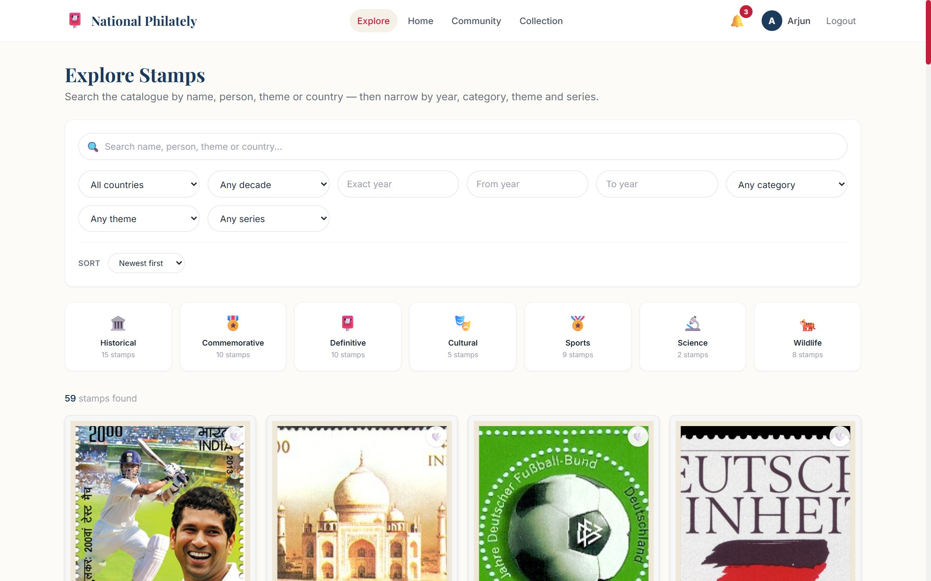
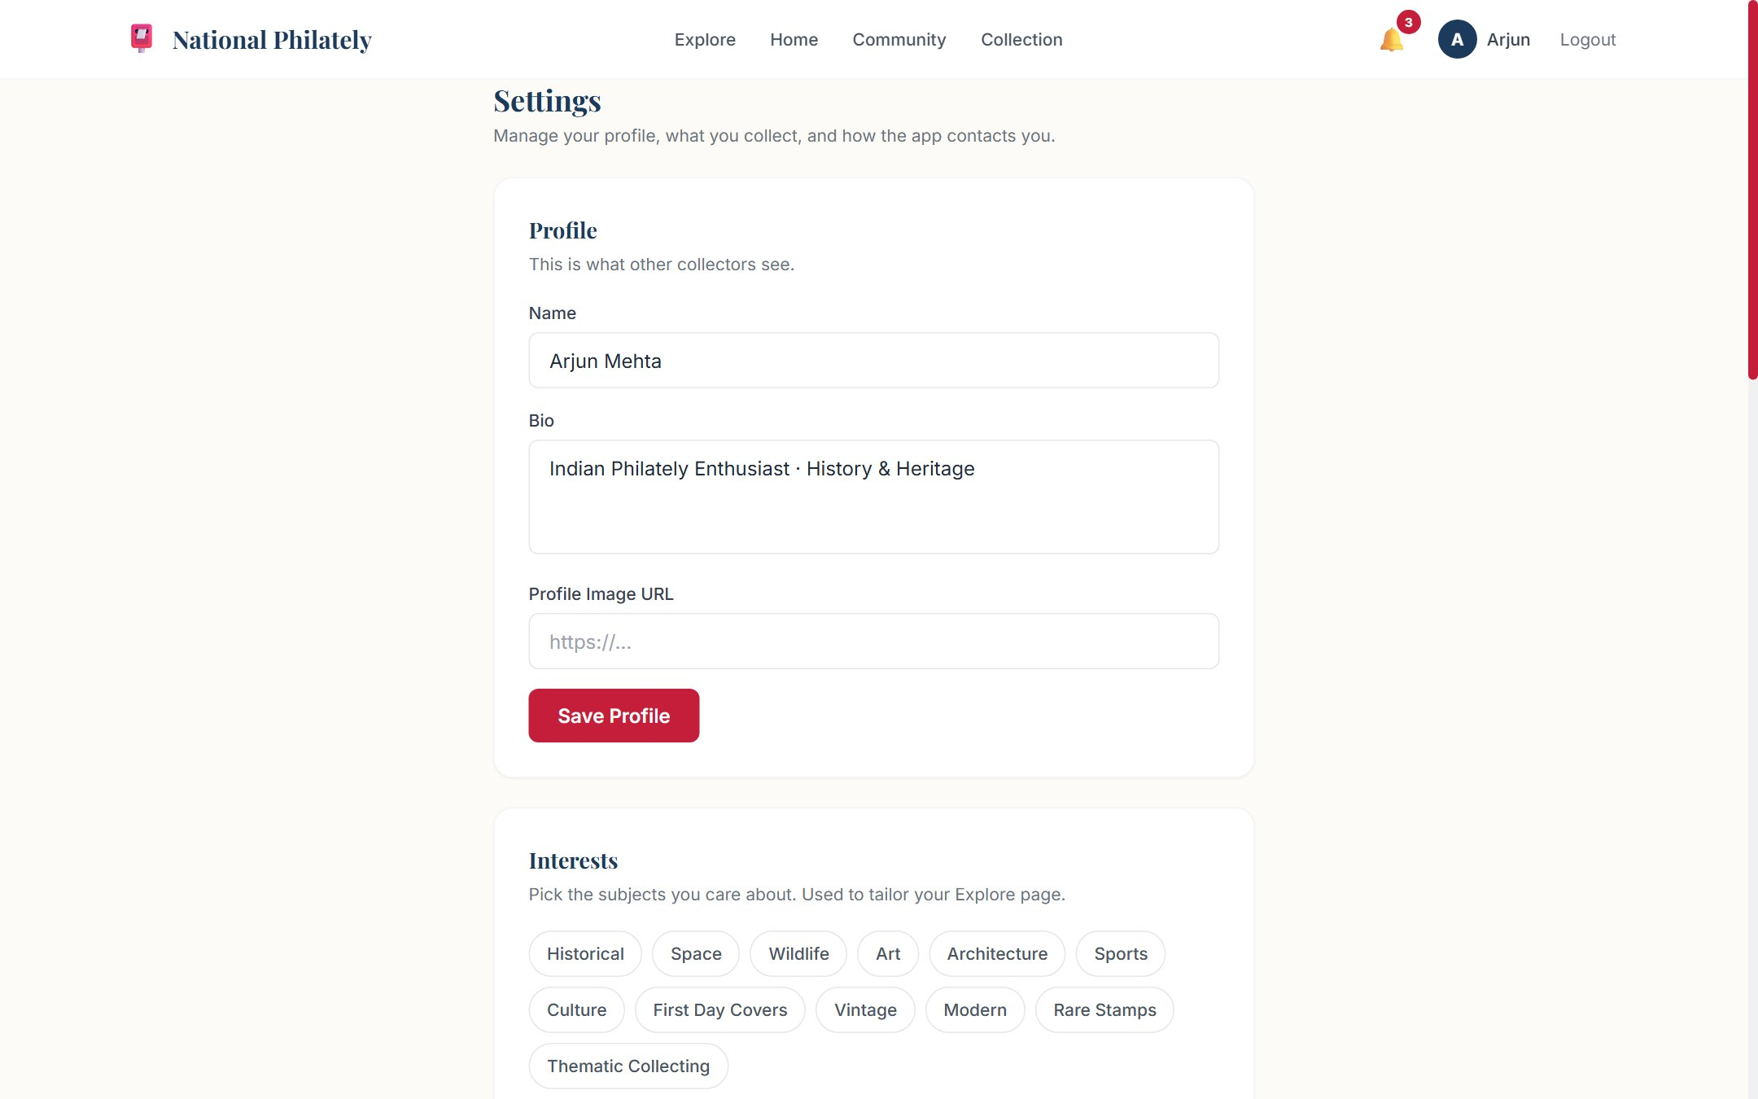
07
U I D E S I G N / S C R E E N S
KEY SCREENS (14)
▪ Landing, Login, Join Free
▪ Home - continue exploring, trending posts
▪ Explore - filter panel, chips, category tiles
▪ Stamp Detail - image, story, attribution, related
▪ Countries + Country Detail + Timeline
▪ Community feed, Create Post, Saved
▪ Profile - public and private states
▪ Collection Gaps (by series / country)
▪ Stamp Passport - per-country progress
▪ Settings - profile, interests, privacy, notifications, password
▪ Admin - dashboard, users, stamps, posts
Landing page
Design notes: postal cream/navy palette, Inter + Playfair type, responsive grid with bottom navigation below the md breakpoint, dismissible deep-link filter chips.
Review 2 | National Philately - MERN Stack Project

Slide 10
08
F R O N T E N D D E V E L O P M E N T
▪ React 18 functional components + hooks only
▪ React Router v6: 14 routes, guarded by auth and role
▪ Context API for the auth session (token in localStorage)
▪ Axios wrapper attaches the bearer token and normalises errors
▪ Reusable UI: Navbar, StampCard, StampImage, PostCard, CollectionGrid, AchievementBadge, Modal
▪ Two-art layer: StampImage shows the real scan when present, otherwise deterministic StampArt SVG
▪ StampArt renders a 100% procedural SVG stamp: perforated edge, guilloche panel, colour by category, emblem by theme - hashed from name + year so output is deterministic
▪ Deep links: country / year / series query params from Gaps, Passport, Country Detail and Stamp Detail, rendered as dismissible chips
▪ Responsive Tailwind build, no CSS framework lock-in
▪ Production build passes: 130 modules, ~340 kB JS bundle
Review 2 | National Philately - MERN Stack Project

Slide 11
09
B A C K E N D D E V E L O P M E N T
▪ Express 4 server, MVC layout: routes -> middleware -> controllers -> models
▪ 9 controllers, 11 models, one route file per resource
▪ Auth middleware: protect (JWT) and adminOnly (403)
▪ Centralised error handler: status codes travel with the message
▪ Single taxonomy module validates category / theme / region on every write
▪ Search built server-side: name, person, theme, description, story, countryName with escaped regex
▪ Filters compose: country, exact year, decade, from/to range, category, theme, series, sort, countOnly
▪ Image upload without extra dependencies: base64 data URL validated by magic bytes, 4 MB cap, stored under public/stamps
▪ Read-only static mount for images with dotfiles denied
▪ Config via .env (dotenv); no secrets in the repo
Review 2 | National Philately - MERN Stack Project

Slide 12
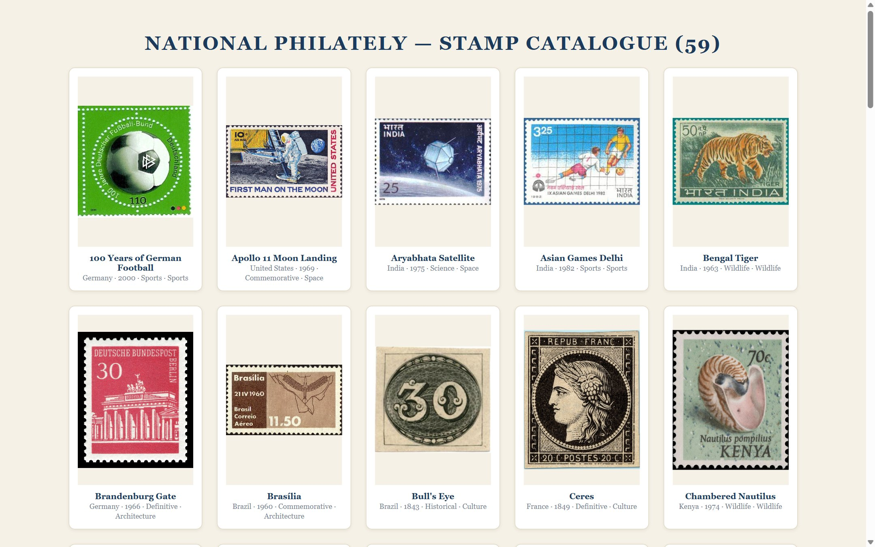
10
D A T A B A S E I N T E G R A T I O N
COLLECTIONS (11 MODELS)
User, Country, Series, Stamp, Collection, Post, Comment, Follow, Notification, Achievement, UserAchievement
INDEXES
▪ text index: name, person, description
▪ category + theme, year, series + seriesNumber
▪ viewCount descending for Popular sorting
▪ unique compound keys on Follow and UserAchievement (race-safe badges)
SEEDED DATA (npm run seed)
12 countries - 7 series - 59 stamps - 6 users - 10 posts - 26 collection items - 18 earned badges
Seed loads data/stamps.json, the resolved Wikimedia catalogue, and fails loudly if any image file is missing.
stamp-preview.html - contact sheet of all 59 stamps
Review 2 | National Philately - MERN Stack Project

Slide 13
11
A P I D E V E L O P M E N T
Method | Endpoint | Description
POST | /api/auth/register | login | Create account / issue JWT
GET | /api/stamps?search=&year=&category= | Catalogue with composable filters, sort, countOnly
GET | /api/stamps/facets | Distinct categories, themes, years for the filter UI
GET | /api/stamps/:id | Stamp detail with country + series populated
POST | PUT | DELETE | /api/stamps[/:id] | Admin CRUD with taxonomy validation (400 on bad input)
POST | /api/stamps/upload | Base64 image -> file, returns /api/stamps/files url (admin)
GET | /api/collection/gaps | Missing stamps grouped by country and by series
GET | /api/collection/passport | Per-country progress, percent, category coverage
GET | /api/users/:username | Profile, collection, posts, achievements, follow state
GET | /api/admin/stats | Totals for the admin dashboard (admin only)
Review 2 | National Philately - MERN Stack Project

Slide 14
12
R E A L - S T A M P D A T A P I P E L I N E
1. MANIFEST
stamp-manifest.json
59 pinned entries
every field curated
2. FETCH
scripts/fetch-stamps.js
Commons API + download
resume, backoff on 429
3. VALIDATE
enum, countries, themes
gandhi / space invariants
59 / 59 pass
4. SEED
data/stamps.json
-> Mongoose
image files on disk
WHY IT MATTERS
▪ Every stamp is a real scan from Wikimedia Commons with its Commons page, designer credit and licence shown on the detail page.
▪ No random placeholders: the catalogue is pinned, not discovered at runtime, so the demo is reproducible.
▪ Wikimedia rate-limits hard (HTTP 429, 10-minute hint) - the fetcher honours Retry-After, skips and resumes from disk on the next run.
▪ Missing image file at seed time = hard failure, so a broken catalogue can never ship silently.
▪ Generated StampArt remains the fallback for any stamp without an image, and is covered by its own SVG tests.
Review 2 | National Philately - MERN Stack Project

Slide 15
13
M O D U L E - W I S E I M P L E M E N T A T I O N S T A T U S
User Authentication
100%
Frontend UI (14 screens)
100%
Backend APIs
100%
Database Integration
100%
Admin Module + Image Upload
100%
Collection Intelligence
100%
Testing (API / UI / SVG)
100%
Notifications (in-app)
85%
Email Notifications
20%
Deployment
10%
Evidence: 203 API checks, 11 UI flow checks, 14 browser checks and the StampArt SVG suite all pass on the current build.
Review 2 | National Philately - MERN Stack Project

Slide 16
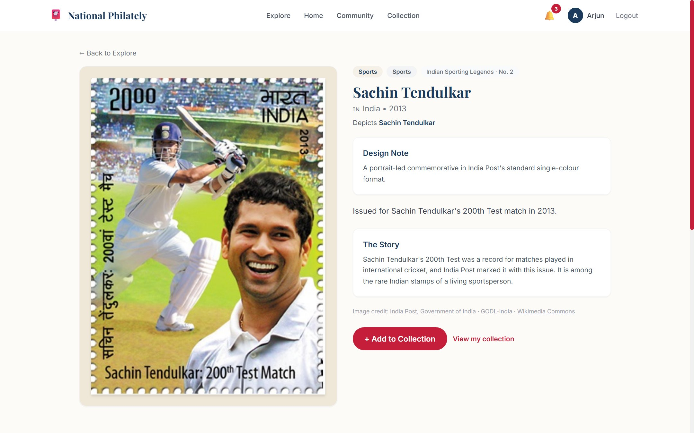
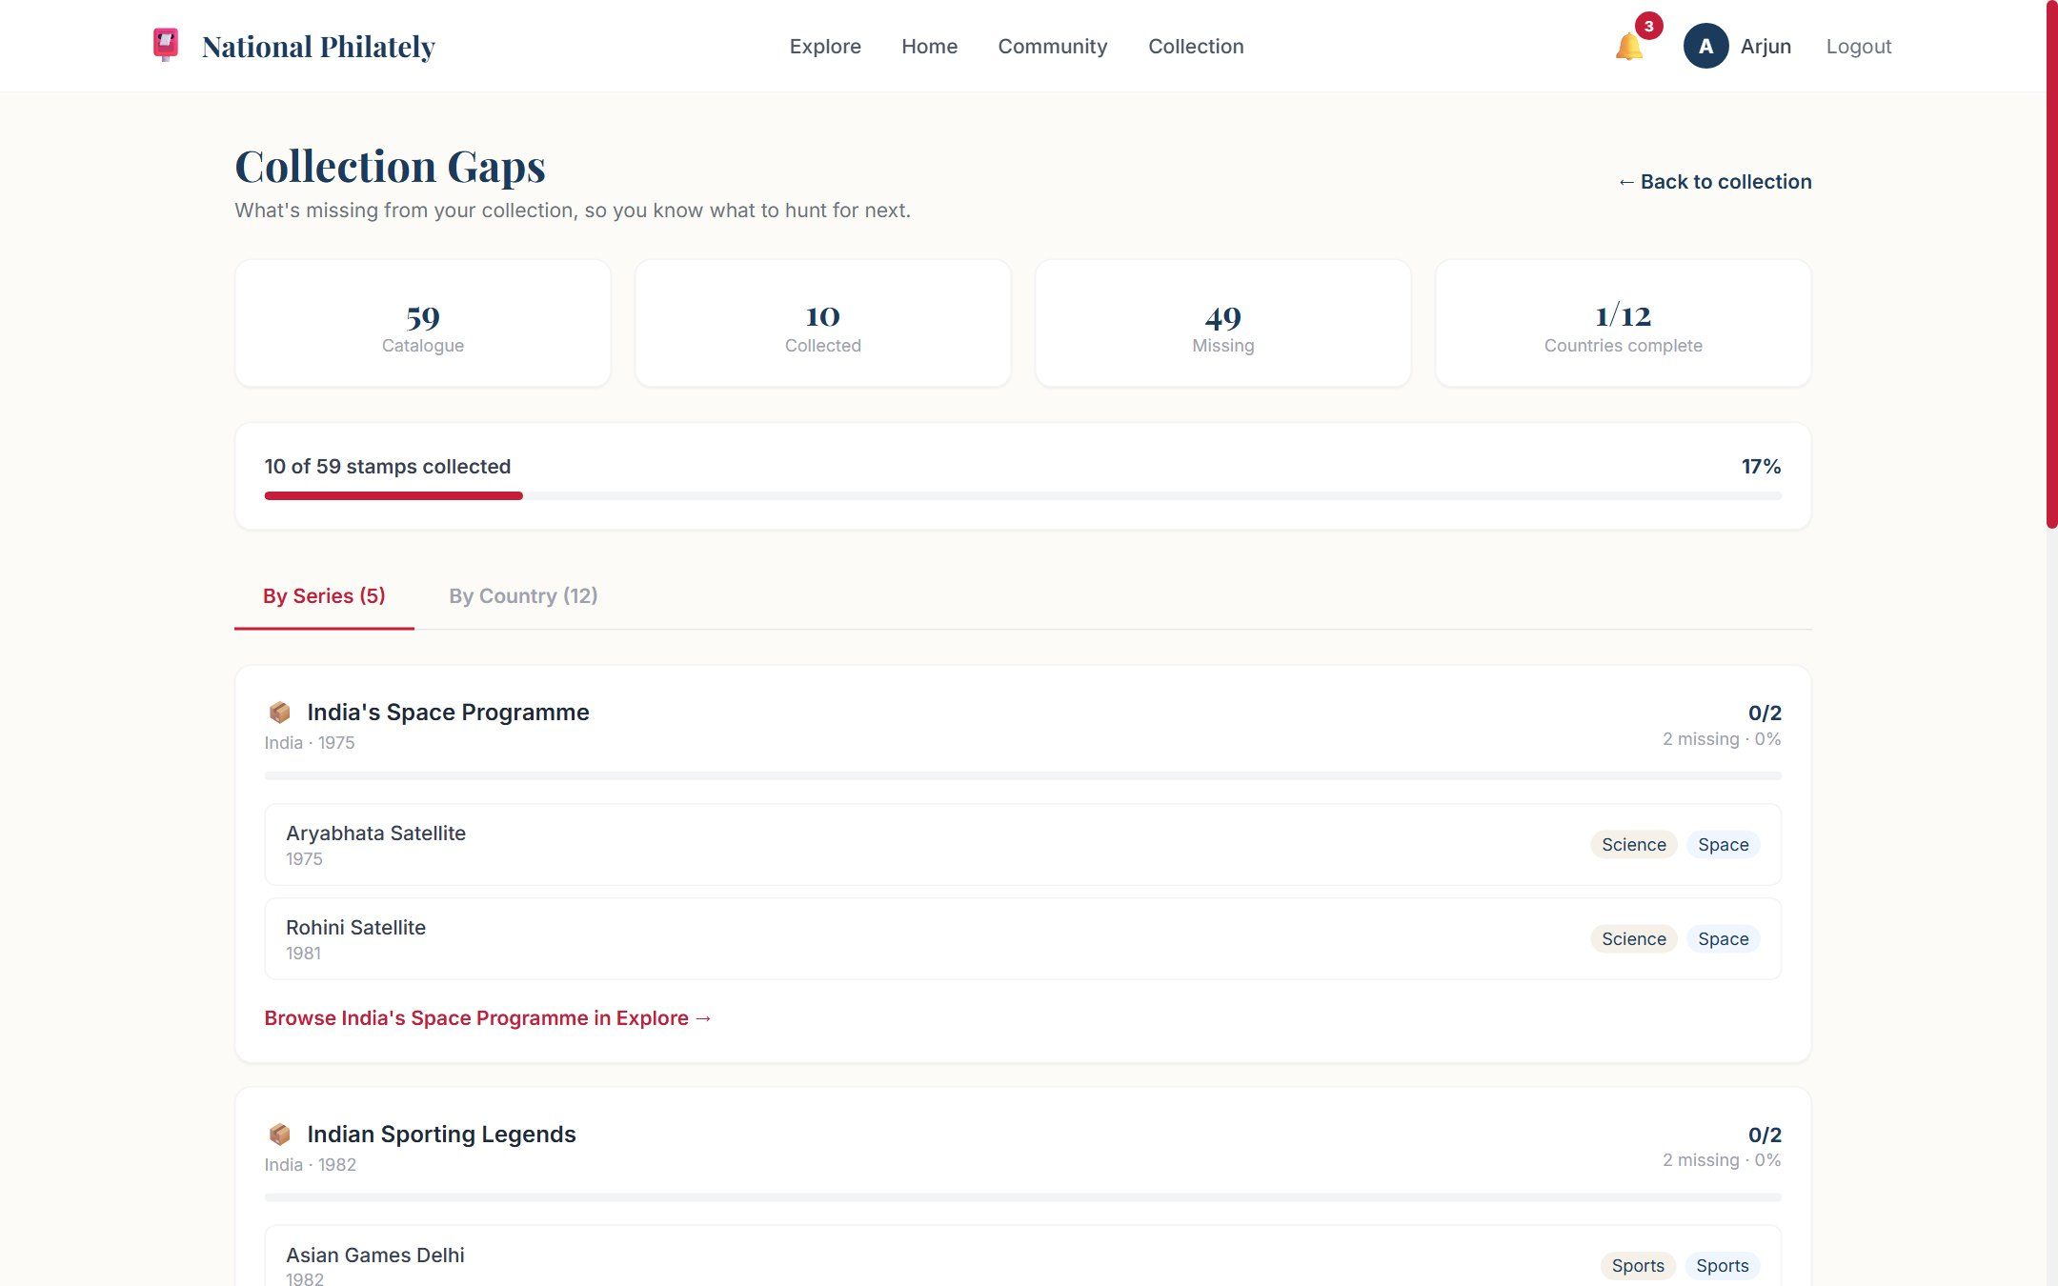
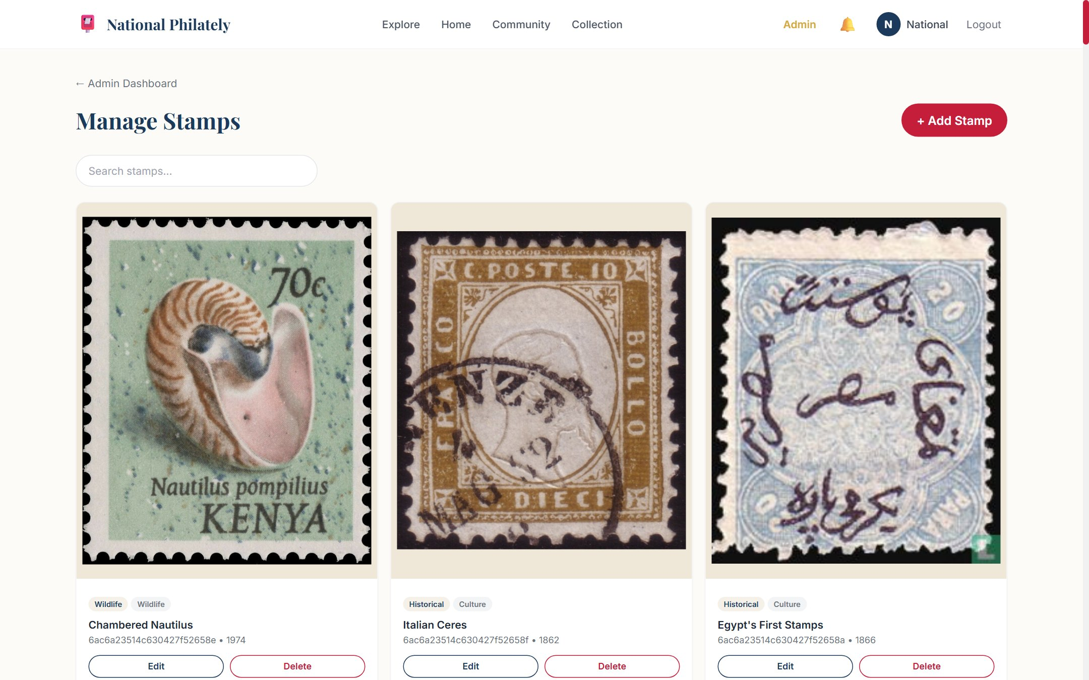
14
S C R E E N S H O T S
Explore - filters, chips, category tiles
Stamp Detail - image, story, attribution
Collection Gaps - what is missing
Admin - stamp table with images & upload
Review 2 | National Philately - MERN Stack Project

Slide 17
15
C H A L L E N G E S F A C E D & S O L U T I O N S
Challenge | Solution adopted
Wikimedia returned HTTP 429 with a 10-minute ban while downloading 59 images | Honour Retry-After, cap backoff, skip and resume from disk; re-runs fetch only the stragglers
Achievement badges could unlock twice under parallel requests | Unique compound indexes on Follow / UserAchievement + parallel-unlock test asserting one row per badge
Deep-link filters (year + decade, country + year) silently returned partial results | Single buildQuery that merges year modes and returns an empty set instead of a wrong one
No multer dependency for image upload | Base64 data URL endpoint with magic-byte detection, 4 MB cap, read-only static file serving
Catalogue size hardcoded in tests kept breaking when stamps were added | Tests derive expected counts from data/stamps.json and probe every image over HTTP
Stamp images must never render as a broken box | StampImage falls back to deterministic StampArt SVG; seed fails if an image file is missing
Review 2 | National Philately - MERN Stack Project

Slide 18
16
R E M A I N I N G W O R K & P L A N
▪ Email notifications for achievements and follows (in-app is done)
▪ Image uploads for community posts
▪ Refresh-token flow instead of re-login on JWT expiry
▪ Deploy: Render / Railway for the API, Netlify / Vercel for the client, MongoDB Atlas for data
▪ Integration and user-acceptance testing with real collectors
▪ Accessibility pass: focus states, aria labels, colour contrast
▪ Optional: MongoDB aggregation for richer stats on the admin dashboard
▪ Final documentation, slide deck and demo script for the viva
▪ Repo hygiene: README, screenshots, seed instructions already in place
Review 2 | National Philately - MERN Stack Project

Slide 19
17
R E F E R E N C E S
# | Reference
1 | MongoDB, Express.js, React, Node.js - official documentation
2 | Mongoose ODM guides: schema design, indexes, populated relations
3 | JSON Web Token (RFC 7519) and bcryptjs password hashing
4 | Wikimedia Commons API, image reuse and licence pages for every catalogue entry
5 | React Router v6, Context API and Vite build documentation
6 | Tailwind CSS documentation and the project README (build, seed, test instructions)
Every stamp image links back to its Wikimedia Commons file page; credit and licence are displayed on the stamp detail page.
Review 2 | National Philately - MERN Stack Project

