Slide 1
MyGovt – AI-Powered Tamil Nadu Citizen Services Platform
A PostgreSQL / PostGIS / pgvector database system for schemes, services and complaint management
Student(s): [STUDENT NAME 1 – to be filled] [STUDENT NAME 2 – to be filled]
Register no.: [REGISTER NO. 1 – to be filled] [REGISTER NO. 2 – to be filled]
BCSE302L – Database Systems (Lab: BCSE302P)
Faculty: [FACULTY NAME – to be filled]
(bracketed text = placeholders to fill)

Slide 2
Abstract and Problem Statement
• Tamil Nadu citizens face scattered scheme, service and complaint information on many department websites.
• MyGovt keeps it in one PostgreSQL database and adds a web app, eligibility checker, grounded assistant and officer console.
• Complaints are routed to the responsible authority; every status change is recorded by a database trigger.
• Government records are 'provisional' – the schema forbids marking them verified without a source document.
MyGovt · BCSE302P Database Systems Lab · 2

Slide 3
Objectives and Scope
• Normalised schema: departments, jurisdictions, schemes, services, citizens, complaints
• Integrity via PRIMARY KEY, FOREIGN KEY, UNIQUE, NOT NULL, CHECK
• Automation: triggers (complaint history, append-only audit), views (SLA, performance)
• Demonstrate SELECT / INSERT / UPDATE / DELETE, joins, aggregates, subqueries, transactions
• Scope: database + API + web UI. Not in scope: verifying records against official sources, production hosting
MyGovt · BCSE302P Database Systems Lab · 3

Slide 4
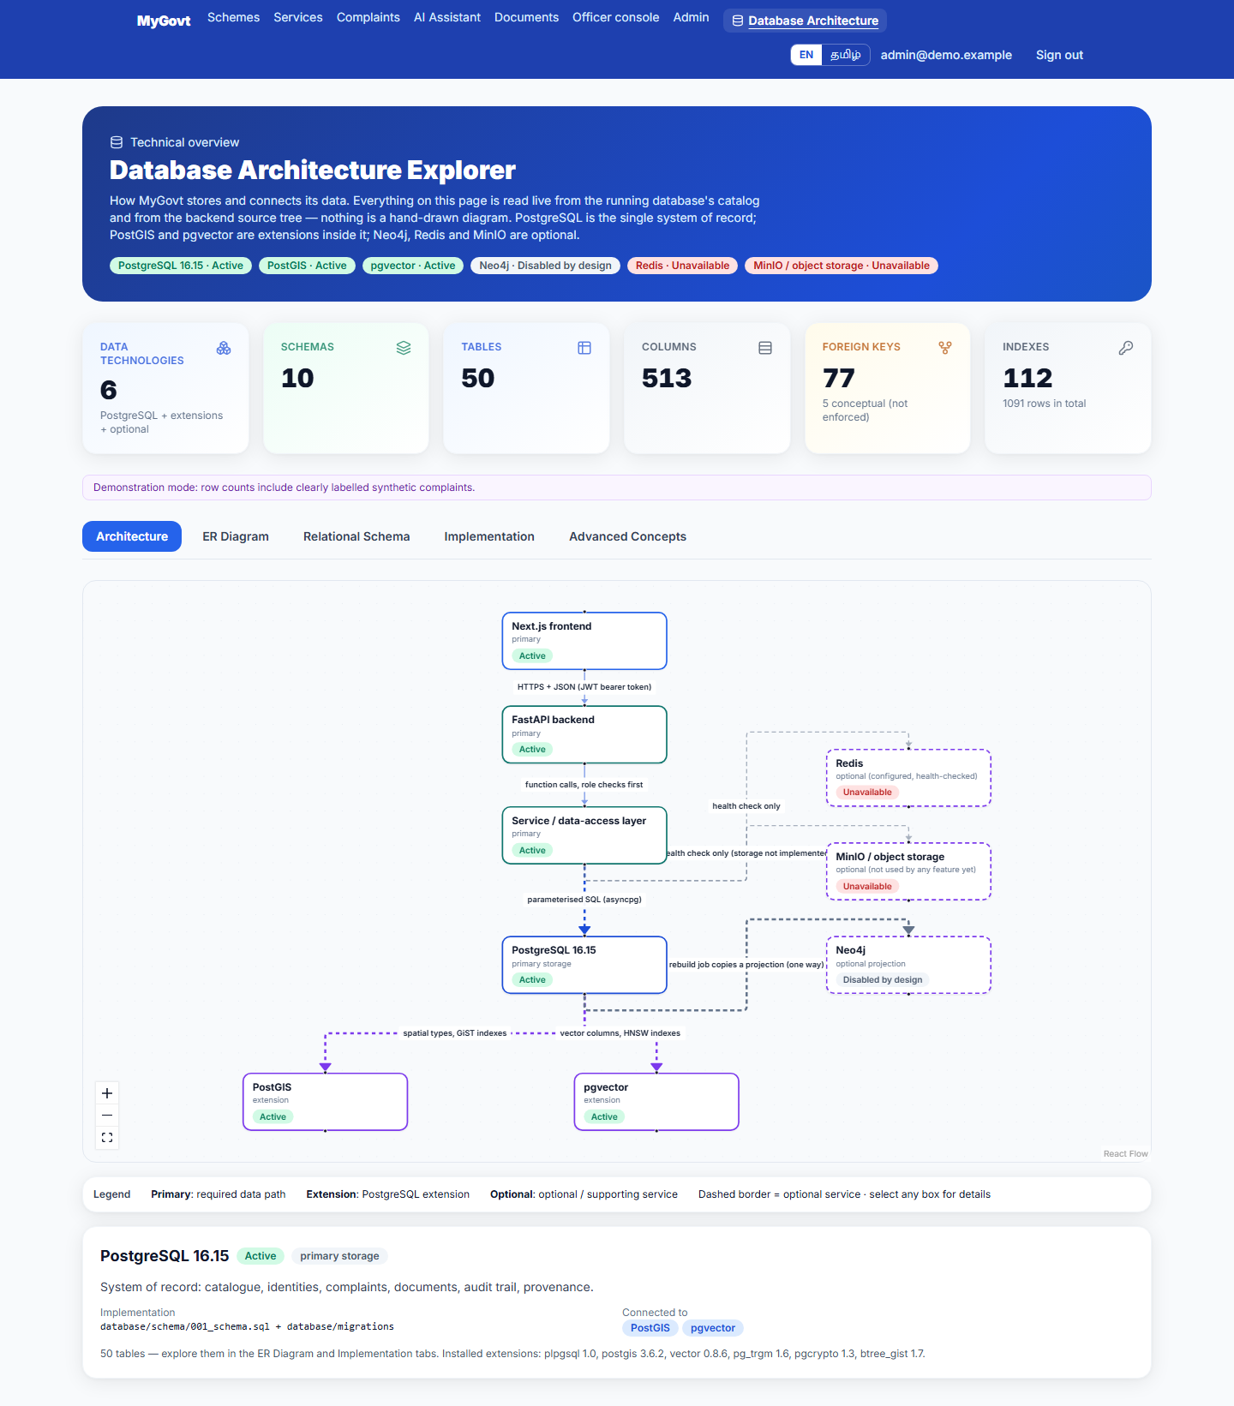
System Architecture
Generated by the Database Architecture Explorer from the running system
MyGovt · BCSE302P Database Systems Lab · 4

Slide 5
Workflow
• Citizen files a complaint → API validates (CHECK / FK constraints)
• Routing: category + jurisdiction → department and authority (frozen on the row)
• INSERT / UPDATE of status → trigger writes complaints.complaint_history
• Officer (department-scoped) assigns / progresses the complaint; allowed transitions enforced by a state machine
• Views report SLA breaches and department performance; audit log is append-only
MyGovt · BCSE302P Database Systems Lab · 5

Slide 6
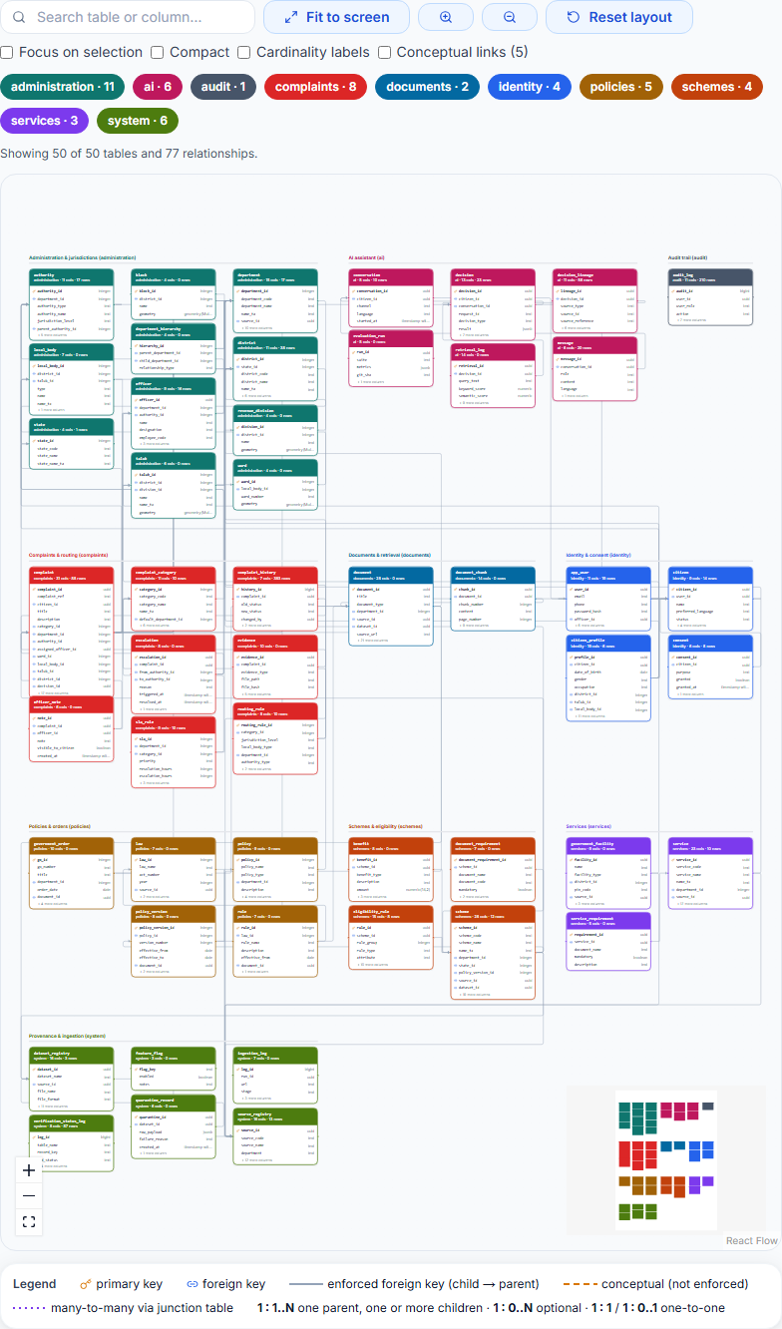
ER Diagram – 50 tables, 10 schemas
MyGovt · BCSE302P Database Systems Lab · 6

Slide 7
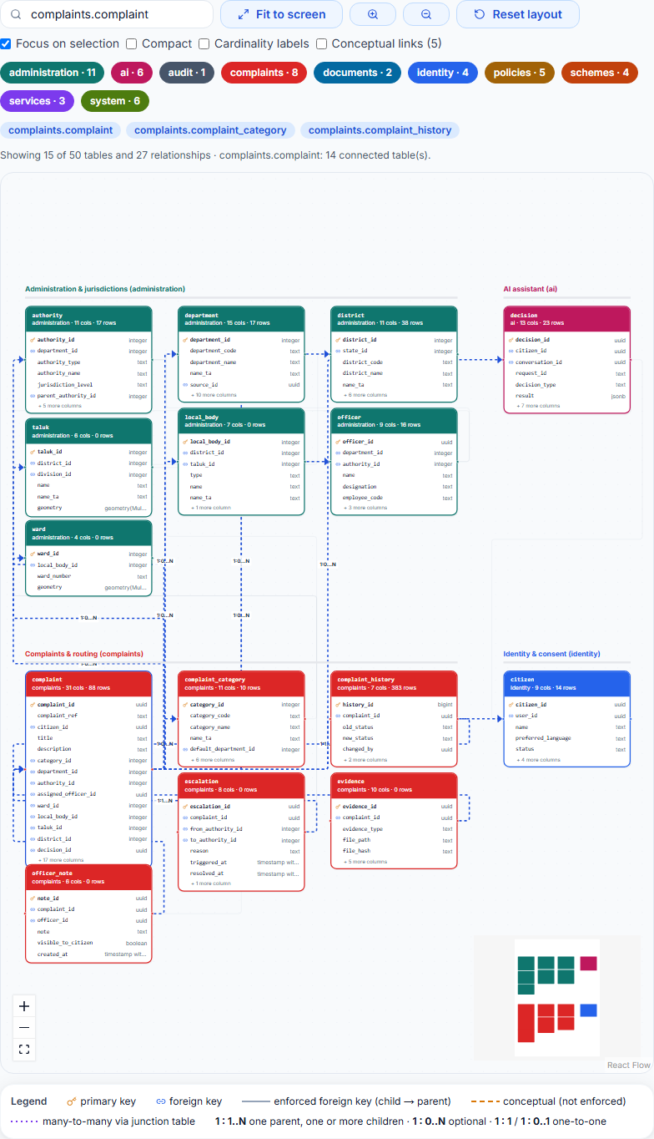
ER Diagram – Complaint focus
MyGovt · BCSE302P Database Systems Lab · 7

Slide 8
Relational Schema
• DEPARTMENT(PK:department_id, department_code UQ, department_name, status, verification_status)
• AUTHORITY(PK:authority_id, FK:department_id, authority_name, parent_authority_id …)
• SCHEME(PK:scheme_id, scheme_code UQ, scheme_name, scheme_level, FK:department_id, status …)
• ELIGIBILITY_RULE(PK:rule_id, FK:scheme_id, rule_type, operator, value …)
• COMPLAINT(PK:complaint_id, complaint_ref UQ, FK:citizen_id, FK:category_id, FK:department_id, FK:authority_id, status, priority …)
• COMPLAINT_HISTORY(PK:history_id, FK:complaint_id, old_status, new_status, changed_at …)
MyGovt · BCSE302P Database Systems Lab · 8

Slide 9
Normalization
• 1NF: primary key + atomic columns on every core table
• 2NF: single-column surrogate keys; junction tables hold only foreign keys
• 3NF: names and SLAs stored once (department, category) and referenced by FK
• Deliberate denormalization: complaint stores department_id AND authority_id (routing result frozen for history)
• Honest note: 3NF is the designer's analysis – the catalog cannot prove functional dependencies
MyGovt · BCSE302P Database Systems Lab · 9

Slide 10
Database Implementation – DBMS
• PostgreSQL 16.15 + PostGIS 3.6.2, pgvector 0.8.6, pg_trgm, pgcrypto, btree_gist
• 10 schemas · 50 tables · 513 columns · 77 foreign keys · 13 triggers
• Indexes: B-tree, GIN (full text), GiST (spatial), HNSW (vector)
• Created by 001_schema.sql + migrations 002–008; seed 002_verified_seed_data.sql
MyGovt · BCSE302P Database Systems Lab · 10

Slide 11
CREATE TABLE – administration.department
CREATE TABLE administration.department (
department_id serial PRIMARY KEY,
department_code text UNIQUE NOT NULL,
department_name text NOT NULL,
name_ta text,
description text,
website_url text,
contact_email text,
contact_phone text,
status text NOT NULL DEFAULT 'active',
source_id uuid REFERENCES system.source_registry(source_id)
);
MyGovt · BCSE302P Database Systems Lab · 11

Slide 12
CREATE TABLE – schemes.scheme
CREATE TABLE schemes.scheme (
scheme_id uuid PRIMARY KEY DEFAULT gen_random_uuid(),
scheme_code text UNIQUE NOT NULL,
scheme_name text NOT NULL,
name_ta text,
short_description text,
full_description text,
scheme_level text NOT NULL CHECK (scheme_level IN ('central','state','district')),
department_id int REFERENCES administration.department(department_id),
state_id int REFERENCES administration.state(state_id),
category text,
benefits_summary text,
application_url text,
official_url text,
status text NOT NULL DEFAULT 'active' CHECK (status IN ('active','closed','suspended','draft')),
effective_from date,
effective_to date,
policy_version_id int REFERENCES policies.policy_version(policy_version_id),
source_id uuid REFERENCES system.source_registry(source_id),
dataset_id uuid REFERENCES system.dataset_registry(dataset_id),
verified_at timestamptz, -- last verified against an official source
embedding vector(1024),
tsv tsvector,
created_at timestamptz NOT NULL DEFAULT now(),
updated_at timestamptz NOT NULL DEFAULT now()
);
MyGovt · BCSE302P Database Systems Lab · 12

Slide 13
CREATE TABLE – complaints.complaint
CREATE TABLE complaints.complaint (
complaint_id uuid PRIMARY KEY DEFAULT gen_random_uuid(),
complaint_ref text UNIQUE NOT NULL DEFAULT
('MYG-' || to_char(now(),'YYYY') || '-' || lpad(nextval('complaints.complaint_seq')::text, 6, '0')),
citizen_id uuid NOT NULL REFERENCES identity.citizen(citizen_id),
title text NOT NULL,
description text NOT NULL,
language text,
category_id int REFERENCES complaints.complaint_category(category_id),
category_confidence numeric(4,3),
department_id int REFERENCES administration.department(department_id),
authority_id int REFERENCES administration.authority(authority_id),
assigned_officer_id uuid REFERENCES administration.officer(officer_id),
priority text NOT NULL DEFAULT 'medium' CHECK (priority IN ('low','medium','high','critical')),
status text NOT NULL DEFAULT 'submitted' CHECK (status IN
('submitted','needs_triage','classified','assigned','in_progress','resolved','closed','rejected','escalated','reopened')),
is_corruption_report boolean NOT NULL DEFAULT false,
is_anonymous boolean NOT NULL DEFAULT false,
latitude double precision,
longitude double precision,
location geometry(Point,4326),
ward_id int REFERENCES administration.ward(ward_id),
local_body_id int REFERENCES administration.local_body(local_body_id),
taluk_id int REFERENCES administration.taluk(taluk_id),
district_id int REFERENCES administration.district(district_id),
decision_id uuid, -- FK added after ai.decision exists
created_at timestamptz NOT NULL DEFAULT now(),
updated_at timestamptz NOT NULL DEFAULT now(),
due_date timestamptz,
escalation_due_at timestamptz,
resolved_at timestamptz
);
MyGovt · BCSE302P Database Systems Lab · 13

Slide 14
CREATE TABLE – complaints.complaint_history
CREATE TABLE complaints.complaint_history (
history_id bigserial PRIMARY KEY,
complaint_id uuid NOT NULL REFERENCES complaints.complaint(complaint_id) ON DELETE CASCADE,
old_status text,
new_status text NOT NULL,
changed_by uuid, -- app_user.user_id, NULL = system
remarks text,
changed_at timestamptz NOT NULL DEFAULT now()
);
MyGovt · BCSE302P Database Systems Lab · 14

Slide 15
Sample records – INSERT statements
INSERT INTO administration.department (department_code, department_name, status)
VALUES ('REVT', 'Revenue Department', 'active');
INSERT INTO administration.department (department_code, department_name, status)
VALUES ('HLTH', 'Health and Family Welfare Department', 'active');
INSERT INTO administration.department (department_code, department_name, status)
VALUES ('EDUC', 'School Education Department', 'active');
INSERT INTO complaints.complaint_category (category_code, category_name, default_sla_hours)
VALUES ('CAT-POW', 'Power Outage / Electricity Fault', 24);
INSERT INTO complaints.complaint_category (category_code, category_name, default_sla_hours)
VALUES ('CAT-WAT', 'Water Supply Disruption', 24);
INSERT INTO complaints.complaint_category (category_code, category_name, default_sla_hours)
VALUES ('CAT-ROA', 'Road Damage / Potholes', 72);
MyGovt · BCSE302P Database Systems Lab · 15

Slide 16
SQL query – INNER JOIN: schemes with their department
SELECT s.scheme_name, d.department_name, s.verification_status FROM
schemes.scheme s JOIN administration.department d ON
d.department_id = s.department_id ORDER BY s.scheme_name LIMIT 8;
scheme_name | department_name
| verification_status
------------------------------------------------------------+-----------------
--------------------------+---------------------
Amma Baby Care Kit | Health and
Family Welfare Department | provisional
Amma Unavagam (Subsidized Canteens) | Municipal
Administration and Water Supply | provisional
Anytime Anywhere Land Records (e-Services) | Revenue
Department | provisional
Chief Minister Breakfast Scheme | School Education
Department | provisional
Chief Minister Comprehensive Health Insurance (CMCHIS) | Health and
Family Welfare Department | provisional
Disability Pension Scheme (Differently Abled Welfare) | Social Welfare
and Women Empowerment | provisional
Indira Gandhi National Old Age Pension Scheme (IGNOAPS ... | Social Welfare
and Women Empowerment | provisional
Kalaignar Magalir Urimai Thogai | Social Welfare
and Women Empowerment | provisional
(8 rows)
MyGovt · BCSE302P Database Systems Lab · 16

Slide 17
SQL query – Aggregate + GROUP BY: complaints per department
SELECT d.department_name, count(*) AS total, count(*) FILTER (WHERE
c.status IN ('resolved','closed')) AS resolved, round(100.0 *
count(*) FILTER (WHERE c.status IN ('resolved','closed')) /
count(*), 1) AS resolved_pct FROM complaints.complaint c JOIN
administration.department d ON d.department_id = c.department_id
GROUP BY d.department_name ORDER BY total DESC;
department_name | total | resolved | resolved_pct
---------------------------------------------+-------+----------+-------------
-
Municipal Administration and Water Supply | 30 | 11 | 36.7
Health and Family Welfare Department | 14 | 6 | 42.9
Revenue Department | 11 | 6 | 54.5
Energy Department (TANGEDCO) | 9 | 4 | 44.4
Rural Development and Panchayat Raj | 7 | 2 | 28.6
Department of Agriculture & Farmers Welfare | 7 | 4 | 57.1
School Education Department | 5 | 2 | 40.0
Social Welfare and Women Empowerment | 3 | 3 | 100.0
(8 rows)
MyGovt · BCSE302P Database Systems Lab · 17

Slide 18
SQL query – Subquery: departments with more complaints than the average department
SELECT department_name FROM administration.department WHERE
department_id IN (SELECT department_id FROM complaints.complaint
GROUP BY department_id HAVING count(*) > (SELECT avg(n) FROM
(SELECT count(*) AS n FROM complaints.complaint GROUP BY
department_id) t)) ORDER BY department_name;
department_name
-------------------------------------------
Health and Family Welfare Department
Municipal Administration and Water Supply
Revenue Department
(3 rows)
MyGovt · BCSE302P Database Systems Lab · 18

Slide 19
DML – INSERT a department
INSERT INTO administration.department (department_code,
department_name, status) VALUES ('RPT-DEMO', 'Report
Demonstration Department', 'active') RETURNING
department_id, department_code, department_name;
department_id | department_code | department_name
---------------+-----------------+---------------------------------
21 | RPT-DEMO | Report Demonstration Department
(1 row)
MyGovt · BCSE302P Database Systems Lab · 19

Slide 20
DML – UPDATE it
UPDATE administration.department SET department_name = 'Report
Demo Department (renamed)', website_url =
'https://example.org' WHERE department_code = 'RPT-DEMO'
RETURNING department_code, department_name, website_url;
department_code | department_name | website_url
-----------------+----------------------------------+------------------
---
RPT-DEMO | Report Demo Department (renamed) |
https://example.org
(1 row)
MyGovt · BCSE302P Database Systems Lab · 20

Slide 21
DML – DELETE it
DELETE FROM administration.department WHERE department_code =
'RPT-DEMO';
DELETE 1
MyGovt · BCSE302P Database Systems Lab · 21

Slide 22
Constraint: UNIQUE
INSERT INTO administration.department (department_code,
department_name) SELECT department_code, 'duplicate' FROM
administration.department LIMIT 1;
ERROR: UniqueViolationError: duplicate key value violates unique
constraint "department_department_code_key"
DETAIL: Key (department_code)=(REVT) already exists.
MyGovt · BCSE302P Database Systems Lab · 22

Slide 23
Constraint: FOREIGN KEY
INSERT INTO schemes.scheme (scheme_code, scheme_name,
scheme_level, department_id) VALUES ('X-2', 'Orphan scheme',
'state', 99999);
ERROR: ForeignKeyViolationError: insert or update on table "scheme"
violates foreign key constraint "scheme_department_id_fkey"
DETAIL: Key (department_id)=(99999) is not present in table
"department".
MyGovt · BCSE302P Database Systems Lab · 23

Slide 24
Constraint: CHECK
INSERT INTO schemes.scheme (scheme_code, scheme_name,
scheme_level) VALUES ('X-1', 'Bad level', 'galactic');
ERROR: CheckViolationError: new row for relation "scheme" violates
check constraint "scheme_scheme_level_check"
DETAIL: Failing row contains (f13100a0-567b-40a1-a8f6-d34ffdc46289,
X-1, Bad level, null, null, null, galactic, null, null, null, null,
null, null, active, null, null, null, null, null, null, null,
'bad':1 'level':2, 2026-10-19 23:46:50.389423+05:30, 2026-10-19
23:46:50.389423+05:30, null, null, 100% State, provisional).
MyGovt · BCSE302P Database Systems Lab · 24

Slide 25
Advanced Concepts – overview
• Functions (7, PL/pgSQL): resolve_jurisdiction, log_status_change, refresh_tsv, touch_updated_at, block_mutation, fill_location, log_verification_change
• Triggers (13): complaint history, append-only audit log, updated_at, search vectors, verification log
• Views: v_sla_breached, v_department_performance
• Procedure: PostgreSQL CALL demonstrated with an illustrative procedure (scratch DB only – the app itself has none)
• Transactions: BEGIN / COMMIT / ROLLBACK / SAVEPOINT
MyGovt · BCSE302P Database Systems Lab · 25

Slide 26
Trigger – complaint history
CREATE OR REPLACE FUNCTION complaints.log_status_change() RETURNS trigger AS $$
BEGIN
IF TG_OP = 'INSERT' THEN
INSERT INTO complaints.complaint_history(complaint_id, old_status, new_status, remarks)
VALUES (NEW.complaint_id, NULL, NEW.status, 'created');
ELSIF NEW.status IS DISTINCT FROM OLD.status THEN
INSERT INTO complaints.complaint_history(complaint_id, old_status, new_status)
VALUES (NEW.complaint_id, OLD.status, NEW.status);
END IF;
RETURN NEW;
END $$ LANGUAGE plpgsql;
CREATE TRIGGER trg_complaint_history AFTER INSERT OR UPDATE OF status ON complaints.complaint
FOR EACH ROW EXECUTE FUNCTION complaints.log_status_change();
MyGovt · BCSE302P Database Systems Lab · 26

Slide 27
Trigger in action
UPDATE complaints.complaint SET status = 'assigned' WHERE
complaint_ref = 'SYN-7-000019' RETURNING complaint_ref, status;
old_status | new_status | remarks
------------+------------+---------
NULL | submitted | created
submitted | classified | NULL
classified | assigned | NULL
(3 rows)
UPDATE of status fired the trigger → new row in complaint_history
MyGovt · BCSE302P Database Systems Lab · 27

Slide 28
Trigger – append-only audit log
UPDATE audit.audit_log SET action = 'tampered' WHERE action
= 'report.demo';
ERROR: RaiseError: audit_log is append-only
MyGovt · BCSE302P Database Systems Lab · 28

Slide 29
View – v_department_performance
SELECT department_id, total, resolved, sla_breached FROM
complaints.v_department_performance ORDER BY total DESC
LIMIT 5;
department_id | total | resolved | sla_breached
---------------+-------+----------+--------------
7 | 30 | 11 | 13
2 | 14 | 6 | 7
1 | 11 | 6 | 4
13 | 9 | 4 | 3
4 | 7 | 4 | 1
(5 rows)
MyGovt · BCSE302P Database Systems Lab · 29

Slide 30
Stored procedure (illustrative) – CREATE
CREATE OR REPLACE PROCEDURE complaints.close_stale_resolved(p_days integer)
LANGUAGE plpgsql AS $$
DECLARE n integer;
BEGIN
UPDATE complaints.complaint SET status = 'closed'
WHERE status = 'resolved' AND resolved_at < now() - make_interval(days => p_days);
GET DIAGNOSTICS n = ROW_COUNT;
RAISE NOTICE '% resolved complaint(s) older than % days were closed', n, p_days;
COMMIT;
END $$;
Created on the scratch database only; not part of the application
MyGovt · BCSE302P Database Systems Lab · 30

Slide 31
Stored procedure – CALL
CALL complaints.close_stale_resolved(7);
-- before:
status | count
----------+-------
closed | 35
resolved | 3
(2 rows)
-- after:
status | count
----------+-------
closed | 35
resolved | 3
(2 rows)
CALL
NOTICE: 0 resolved complaint(s) older than 7 days were closed
MyGovt · BCSE302P Database Systems Lab · 31

Slide 32
Transactions – ROLLBACK
-- BEGIN a transaction
BEGIN;
-- UPDATE inside the transaction
UPDATE complaints.complaint SET priority = 'critical' WHERE
complaint_ref = 'DEMO-0003' RETURNING complaint_ref, priority;
-- ROLLBACK
ROLLBACK;
complaint_ref | priority
---------------+----------
DEMO-0003 | medium
(1 row)
After ROLLBACK the priority is unchanged (medium)
MyGovt · BCSE302P Database Systems Lab · 32

Slide 33
Transactions – SAVEPOINT and COMMIT
-- BEGIN, UPDATE, SAVEPOINT, second UPDATE
BEGIN; UPDATE complaints.complaint SET priority = 'high' WHERE complaint_ref
= 'DEMO-0003'; SAVEPOINT sp1; UPDATE complaints.complaint SET priority =
'low' WHERE complaint_ref = 'DEMO-0003';
-- ROLLBACK TO SAVEPOINT then COMMIT
ROLLBACK TO SAVEPOINT sp1; COMMIT;
complaint_ref | priority
---------------+----------
DEMO-0003 | high
(1 row)
Only the first update persisted
MyGovt · BCSE302P Database Systems Lab · 33

Slide 34
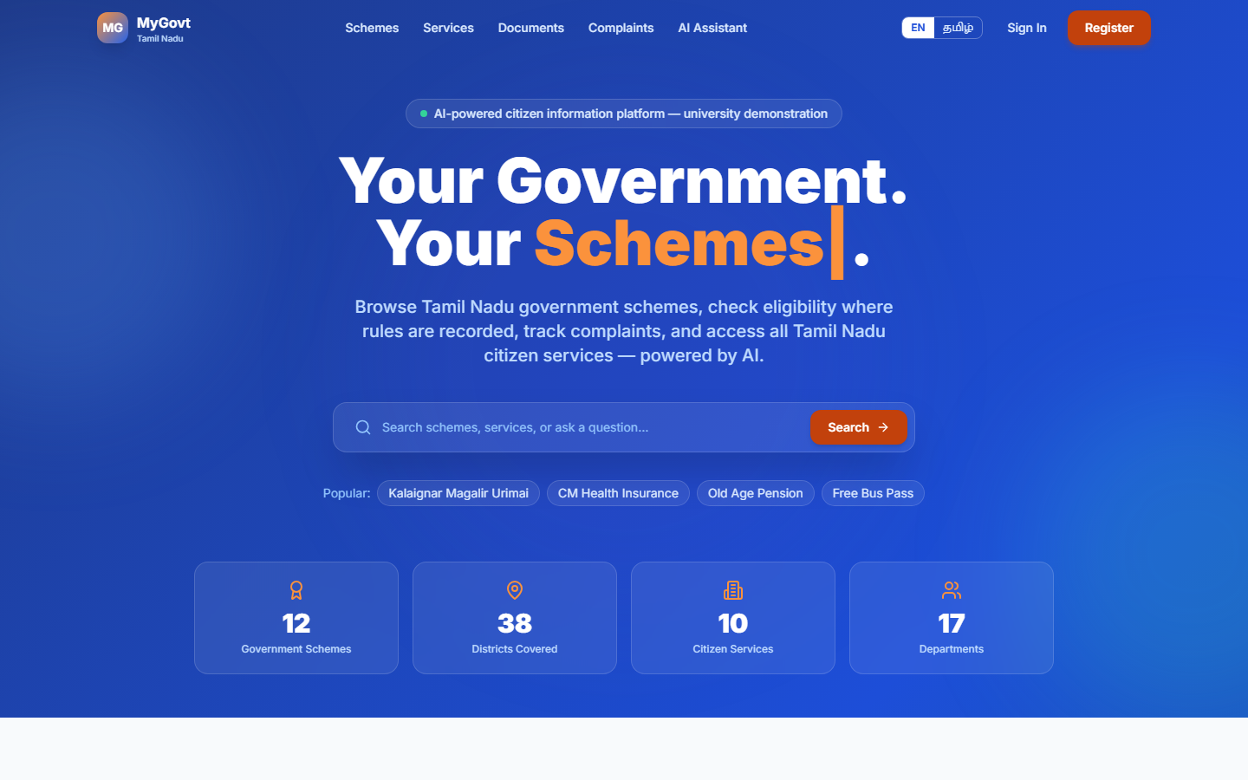
Application – Landing
MyGovt · BCSE302P Database Systems Lab · 34

Slide 35
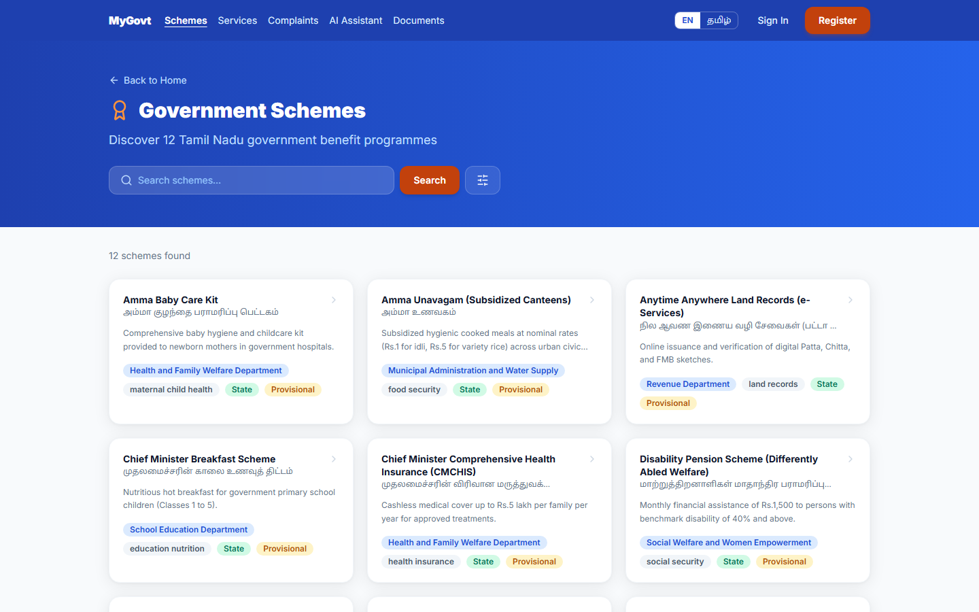
Application – Scheme search
MyGovt · BCSE302P Database Systems Lab · 35

Slide 36
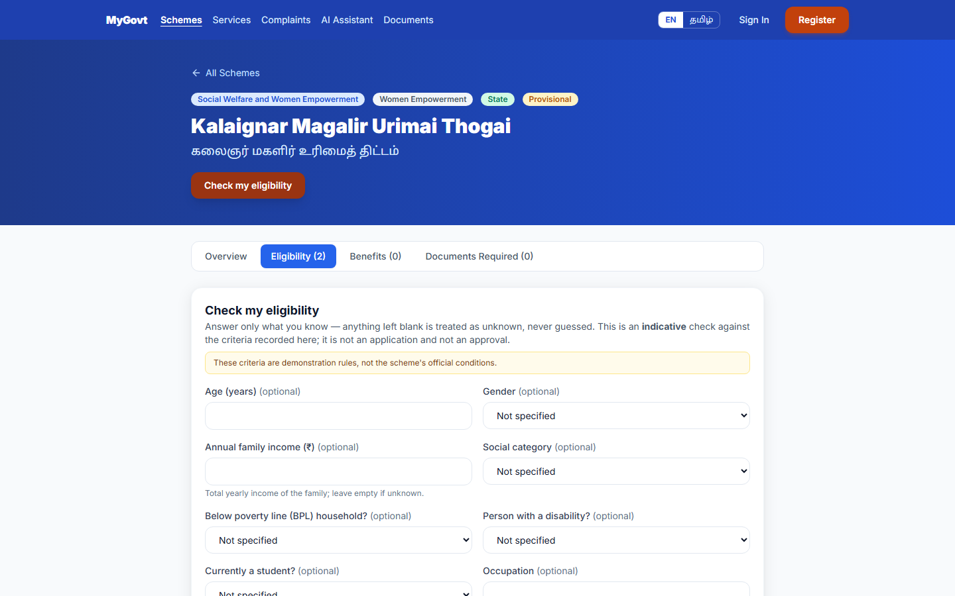
Application – Eligibility checker
MyGovt · BCSE302P Database Systems Lab · 36

Slide 37
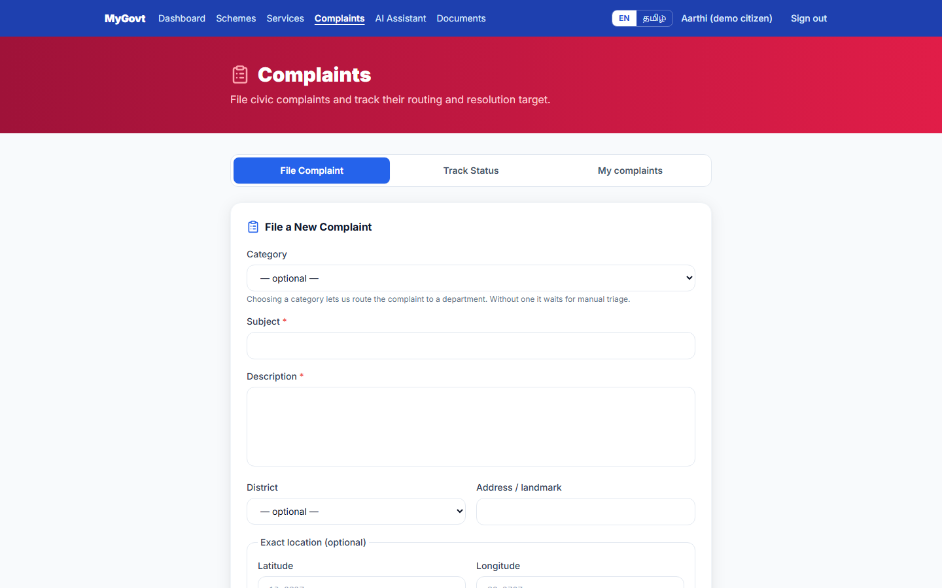
Application – File a complaint
MyGovt · BCSE302P Database Systems Lab · 37

Slide 38
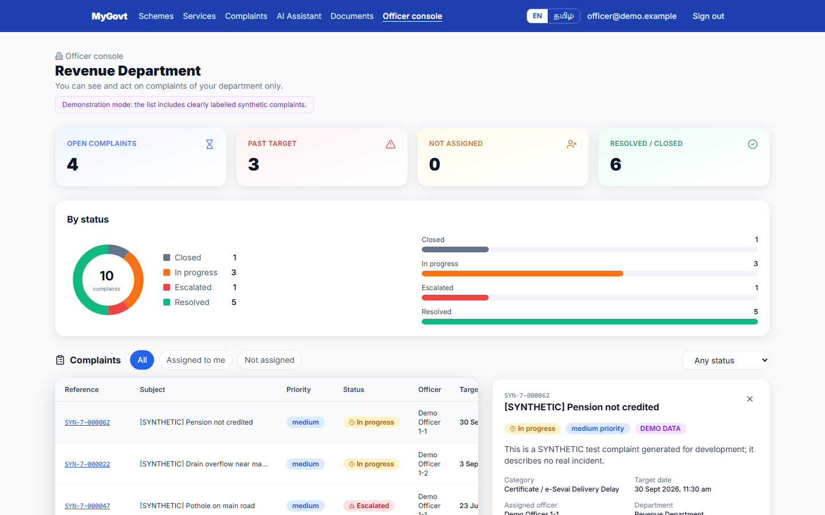
Application – Officer complaint detail
MyGovt · BCSE302P Database Systems Lab · 38

Slide 39
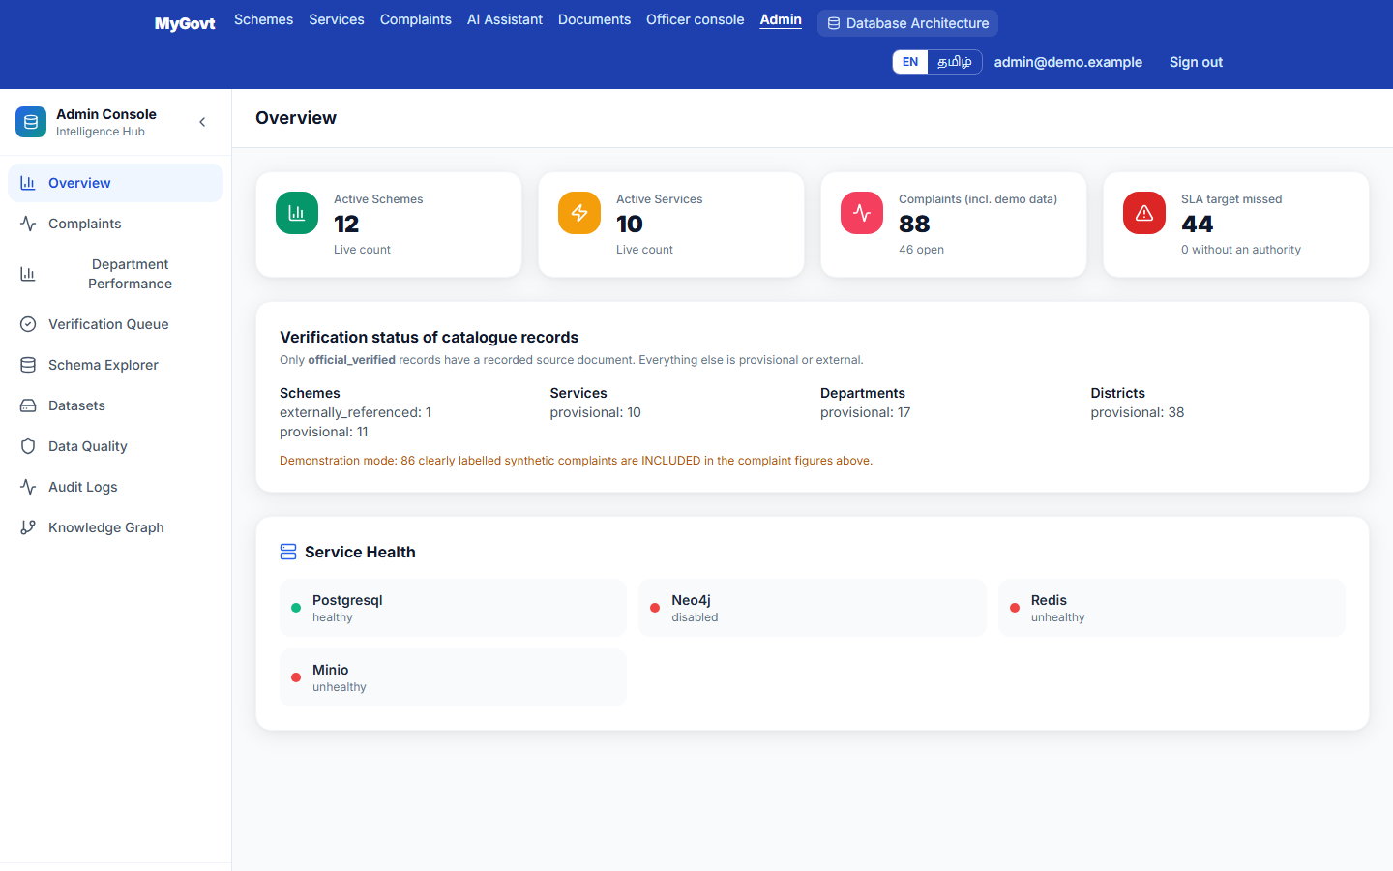
Application – Administrator overview
MyGovt · BCSE302P Database Systems Lab · 39

Slide 40
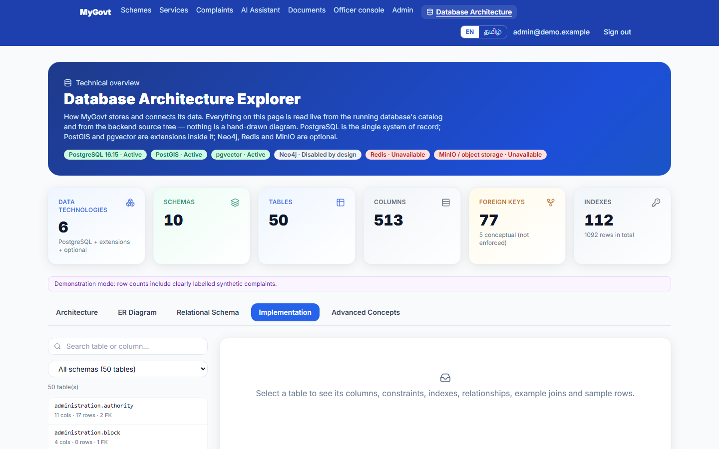
Database structure – Implementation browser
MyGovt · BCSE302P Database Systems Lab · 40

Slide 41
Testing and Results
Check | Result
Backend tests | 525 collected (133 unit)
Browser end-to-end | 103 Playwright tests
Hosted CI (run 39298767536) | 10 / 10 jobs passed
System audit | 15 routes · 530 controls · 67 API ops · 56 consistency checks
SQL evidence | 47 statements executed; only deliberate violations error
MyGovt · BCSE302P Database Systems Lab · 41

Slide 42
Conclusion and Future Enhancement
• A working database-backed platform: 50 tables, enforced integrity, triggers, views, spatial and vector search
• Limits: records provisional (0 officially verified); 3NF argued not proven; no stored procedure in app; boundaries not loaded
• Future: verify records with official documents · load jurisdiction boundaries · partition audit/history · notifications · mobile app
MyGovt · BCSE302P Database Systems Lab · 42

Slide 43
References
• PostgreSQL 16 documentation – postgresql.org/docs/16
• PostGIS documentation – postgis.net
• pgvector – github.com/pgvector/pgvector
• Silberschatz, Korth, Sudarshan – Database System Concepts
• Elmasri, Navathe – Fundamentals of Database Systems
• Project repository – github.com/santhoshraja-15/My-Govt
MyGovt · BCSE302P Database Systems Lab · 43

