Slide 1

DEPARTMENT OF COMPUTER SCIENCE AND ENGINEERING
Professional Training I
Project Automobile Sales and Services Analysis
GUIDE:
Ms.Sandhiya S
PROJECT STUDENT:
Santhosh.R-44111004
14 September 2026
School of Computing - CSE

Slide 2
AGENDA
Abstract
Introduction
Objective
System Architecture / Ideation Map
Module Implementation
Results and Discussions
Conclusion
References
14 September 2026
School of Computing - CSE

Slide 3
Abstract
Focus: Analysis of Indian automobile sales and service records.
Tools: Data processing via Google Colab (Python) and visualization via Power BI.
Outcome: Actionable insights into top-selling regions, service cost averages, and frequent vehicle maintenance needs.

Slide 4
Introduction
Context: The automotive industry generates massive datasets across vehicle sales and aftermarket services.
Problem: Dealerships struggle to manually extract business insights from raw operational data.
Solution: An automated analytics pipeline to track revenue, customer satisfaction, and service center workload.

Slide 5
Objective
dentify top-performing Indian states and vehicle categories by sales revenue.
Determine the most frequent service requests and calculate average customer billing.
Build an interactive Power BI dashboard for real-time data filtering and business monitoring.

Slide 6
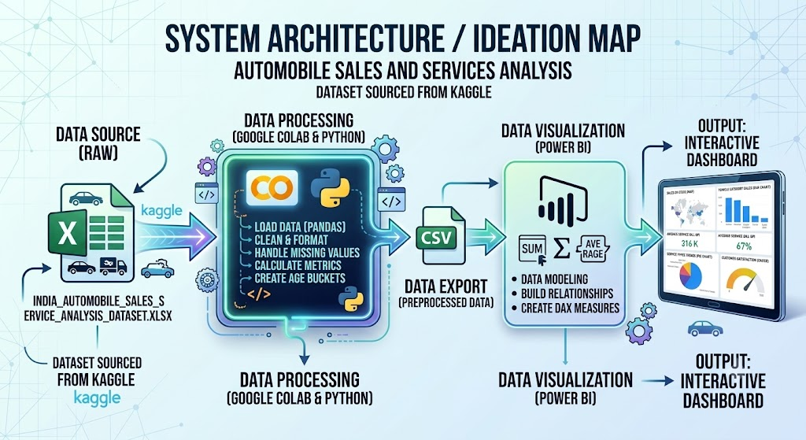
System Architecture / Ideation Map

Slide 7
Module Implementation
Preprocessing Module: Python scripts to clean nulls, correct data types, and group age brackets.
Analysis Module: Aggregating total sales by state and calculating average service costs.
Reporting Module: Designing Power BI slicers for Year, State, and Fuel Type to enable dynamic user exploration.

Slide 8
Results and Discussions
Sales Leaders: Karnataka, West Bengal, and Kerala generated the highest estimated sales value.
Service Trends: "Accident Repair" emerged as the most frequent service type across centers.
Cost Metrics: The average customer service bill was calculated at approximately ₹9,204.

Slide 9
Conclusion
Summary: The project successfully transformed raw automotive data into a clear, visual business intelligence tool.
Impact: Dealerships can use these metrics to optimize spare parts inventory and target high-revenue regions.
Future Scope: Integrating machine learning in Python to predict future sales trends and preventative maintenance schedules.

Slide 10
References
Dataset Source: India_Automobile_Sales_Service_Analysis_Dataset.xlsx (Sourced from Kaggle).
Software: Google Colab (Python, Pandas documentation).
Visualization: Microsoft Power BI Official DAX Reference Guide.

