Slide 1
[ SPACE RESERVED FOR SRM ONLINE LOGO ]
Candidate will paste the official SRM Online insignia here
DIRECTORATE OF ONLINE EDUCATION
SRM INSTITUTE OF SCIENCE AND TECHNOLOGY
KATTANKULATHUR - 603 203
MCA III SEMESTER
MINI PROJECT VIVA VOCE
NOV 2026
ENROLMENT NUMBER : EA2532251010685
NAME OF STUDENT : SANTHOSH RATHINAM M

Slide 2
PROJECT OVERVIEW
Title of the Mini Project
Direct agricultural commerce platform connecting cultivators and consumers
FARMDIRECT
A Farmer-to-Consumer Agricultural Marketplace
An open digital commerce system that eliminates commission intermediaries, provides fair farm-gate pricing, and verifies harvest freshness via live webcam photo capture.
PROJECT SCOPE & INTENDED DELIVERABLES
• Direct Farm-to-Fork Model: Empowers smallholder and marginal cultivators to sell vegetables, fruits, and grains directly to urban consumers without broker markups.
• Live Crop Freshness Proof: Integrates in-browser WebRTC camera hardware access allowing farmers to take genuine live photos of their harvest directly from the field.
• ACID Concurrency Protection: Implements MySQL InnoDB row-level locking (SELECT ... FOR UPDATE) to eliminate race conditions and prevent stock overselling during simultaneous checkouts.
• End-to-End Stakeholder Roles: Provides tailored web interfaces for Cultivating Farmers, Retail Consumers, Delivery Logistics Partners, and Platform Administrators.
◆ FarmDirect – A Farmer-to-Consumer Agricultural Marketplace | MCA III Sem Viva Voce
2 / 18

Slide 3
ABSTRACT
What the Project Solves and Delivers
Transforming agricultural distribution by replacing middleman exploitation with direct digital commerce
1. THE PROBLEM
• Predatory Middlemen: Brokers take 30% to 50% profit margin while adding zero agricultural value.
• Depleted Farm Income: Growers bear all production risks but receive tiny fractions of consumer spend.
• Transit Spoilage: Multi-hop mandi delays ruin perishable crops before reaching city kitchens.
• Information Vacuum: Cultivators lack direct communication with retail buyers and prevailing rates.
2. THE SOLUTION
• Direct Web Portal: Direct online bridge connecting cultivators and household consumers.
• WebRTC Live Camera: In-browser live harvest photos directly from farm fields to prove freshness.
• Pessimistic Locking: Guarantees exact inventory counts during peak simultaneous order surges.
• Unified Tracking: Transparent multi-stage delivery pipeline managed by dedicated logistics agents.
3. EXPECTED VALUE
• +40% Farmer Income: Cultivators capture full farm-gate value without commission deductions.
• -20% Consumer Cost: Urban buyers get fresher farm produce cheaper than supermarket prices.
• Freshness Proof: Buyers see genuine time-stamped camera photos of harvested batches.
• Live Milestone Tracking: Complete visibility from field dispatch to home delivery.
Main Deliverable & Boundary: Full-stack responsive web application built with Python 3.12 Flask, MySQL 8.0, and Bootstrap 5.
◆ FarmDirect – A Farmer-to-Consumer Agricultural Marketplace | MCA III Sem Viva Voce
3 / 18

Slide 4
INTRODUCTION
Why This Problem Matters
Empowering rural farmers while ensuring affordable, fresh, and nutritious food for households
BACKGROUND & SOCIO-ECONOMIC CONTEXT
• Livelihood for Millions: Over 50% of the Indian workforce depends directly on agriculture for their primary economic survival.
• Severe Perishability: Fresh vegetables and fruits lose quality within 48 to 72 hours of harvest, forcing rapid disposal at throwaway prices.
• Fragmented Mandi Networks: Smallholder farmers are compelled to sell to local commission agents due to high transport costs and lack of scale.
• Market Isolation: Rural cultivators have zero direct communication channels with high-demand urban residential areas.
CURRENT LIMITATIONS & PROJECT OBJECTIVES
• Supply Chain Inefficiencies: Legacy systems involve 3 to 5 middleman tiers, creating massive markups where consumers pay triple while farmers get pennies.
• Project Objective 1 (Direct Trade): Build an open web marketplace enabling direct cultivator listings with transparent farm-gate pricing.
• Project Objective 2 (Camera Proof): Enable instant laptop/mobile camera capture to provide genuine harvest date and condition proof.
• Project Objective 3 (Safe Checkout): Implement pessimistic database concurrency controls to ensure 100% order accuracy during peak purchasing surges.
◆ FarmDirect – A Farmer-to-Consumer Agricultural Marketplace | MCA III Sem Viva Voce
4 / 18

Slide 5
SYSTEM CAPABILITIES
What the Application Provides
Comprehensive feature suite designed for cultivators, urban consumers, logistics partners, and administrators
1. CULTIVATING FARMER PORTAL
• Produce Listing Management: Add, edit, and deactivate crop batches with custom pricing per kg/unit.
• WebRTC Live Camera Snapshot: Direct camera hardware access to capture real-time harvest photos.
• Earnings & Order Dashboard: Real-time ledger of active orders, delivered goods, and payout totals.
2. CONSUMER MARKETPLACE
• Dynamic Product Catalog: Category filtering (Vegetables, Fruits, Grains) and real-time search.
• Multi-Item Shopping Cart: Seamlessly add produce from multiple farmers into a unified basket.
• Multi-Method Checkout: Simulated UPI QR code, Cash on Delivery, and Card payment methods.
3. DELIVERY AGENT INTERFACE
• Consignment Assignment: View allocated order shipments with pickup and drop addresses.
• Milestone Tracking: Update statuses: Dispatched -> In Transit -> Out for Delivery -> Delivered.
• Delivery Proof & Cash Handling: Log delivery timestamps and confirm receipt of COD payments.
4. ADMINISTRATOR GOVERNANCE
• KYC & Listing Moderation: Review and approve new farmer registrations and crop listings.
• Platform Analytics: Monitor gross merchandise volume, transaction counts, and active users.
• Dispute & Category Control: Resolve order issues and configure crop categories across seasons.
◆ FarmDirect – A Farmer-to-Consumer Agricultural Marketplace | MCA III Sem Viva Voce
5 / 18

Slide 6
IMPLEMENTATION ENVIRONMENT
System Hardware & Software Requirements
Workstation specifications and software stack used for development and evaluation
Hardware Component | Requirement / Specification
Processor | Intel Core i3 / AMD Ryzen 3 or higher (2.0 GHz Dual-Core)
Primary RAM | 4 GB RAM minimum (8 GB recommended for multi-role tests)
Hard Disk | 500 MB free storage for application files & media
Webcam / Camera | Integrated laptop webcam or external USB camera for WebRTC
Display Monitor | 1366 x 768 resolution or higher (1080p Full HD optimal)
Input Devices | Standard keyboard and mouse / touchpad
Network Adapter | Standard TCP/IP connection for local/intranet web hosting
Software Component | Selection & Engineering Version
Operating System | Microsoft Windows 10 / Windows 11 (64-bit)
Backend Language | Python 3.12 (Standard Library + WSGI compliance)
Web Framework | Flask 3.0.x (Jinja2 templates, Werkzeug security)
Database Server | MySQL Community Server 8.0 (InnoDB ACID Engine)
Frontend Stack | HTML5, CSS3, JavaScript (ES6), Bootstrap 5.3
Web Browser | Google Chrome, Microsoft Edge, or Mozilla Firefox
Development Tools | Visual Studio Code, Git, Windows PowerShell
◆ FarmDirect – A Farmer-to-Consumer Agricultural Marketplace | MCA III Sem Viva Voce
6 / 18

Slide 7
CRITICAL ANALYSIS
Existing Agricultural System & Structural Gaps
Why traditional supply networks fail farmers and consumers alike
EXISTING AGRICULTURAL SUPPLY CHAIN MODEL
• Multi-Tiered Brokerage: Produce passes through village aggregators, commission agents, regional APMC mandis, wholesalers, and retail vendors.
• Manual Weight & Price Fixing: Cultivators have zero bargaining power; prices are dictated by mandi cartels via closed bids.
• High Post-Harvest Losses: Transit delays exceeding 72 hours result in 25% to 35% produce wastage due to lack of cold storage.
• Opaque Paper Ledgers: Physical receipts and credit slips delay farmer remuneration by weeks or months.
STRUCTURAL GAPS & TECHNICAL SHORTCOMINGS
• Gap 1: Disproportionate Value Capture: Farmers receive only 15% to 25% of final consumer spend, while intermediaries capture up to 60%.
• Gap 2: Absence of Freshness Verification: Supermarkets use stale shelf dates; consumers cannot verify when produce was harvested.
• Gap 3: Inventory Race Conditions: Existing low-tier portals lack database row-level locking, leading to stock overselling during flash sales.
• Gap 4: High Barrier to Entry: Commercial platforms charge heavy registration fees and commissions, pricing out smallholder farmers.
◆ FarmDirect – A Farmer-to-Consumer Agricultural Marketplace | MCA III Sem Viva Voce
7 / 18

Slide 8
PROPOSED APPROACH
How the Proposed System Improves the Process
A direct, verified, and automated digital pipeline between farmers and consumers
STAGE 1: INPUT STAGE
Direct Farmer Listing
Farmer registers, completes farm verification, and lists crops with price and quantity via web form.
STAGE 2: PROCESSING STAGE
Automated Validation
Flask server coordinates connection pooling, verifies RBAC permissions, and acquires InnoDB row locks.
STAGE 3: OUTPUT STAGE
Instant Fulfillment
Consumer receives confirmed invoice with delivery tracking; delivery partner coordinates dispatch.
KEY TRANSFORMATION ADVANTAGES
• Direct Producer Remuneration: 100% of the listed farm-gate price goes directly to the cultivating farmer without commission deductions.
• Verifiable Crop Freshness: HTML5 WebRTC laptop camera capture ensures consumers see genuine, real-time photos of harvested crops before purchasing.
• Zero Inventory Corruption: MySQL InnoDB pessimistic row locking prevents overselling race conditions even during high-traffic purchasing periods.
• Universal Accessibility: Lightweight responsive web interface works on mobile devices, laptops, and desktop browsers without proprietary apps.
◆ FarmDirect – A Farmer-to-Consumer Agricultural Marketplace | MCA III Sem Viva Voce
8 / 18

Slide 9
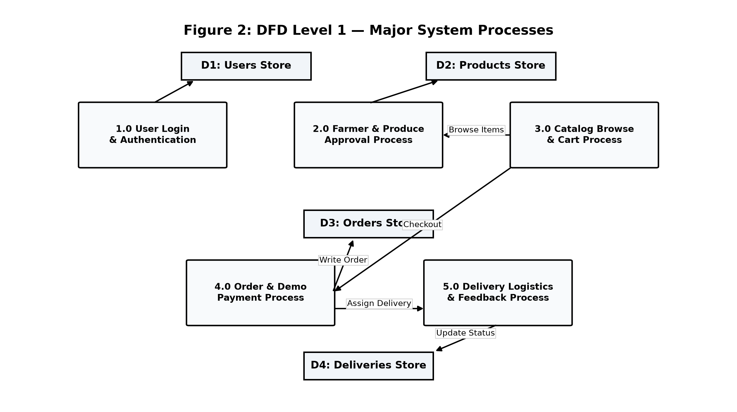
SYSTEM DESIGN
Data Flow Architecture (DFD Level 0 & Level 1)
Visualizing data movement across external actors, core processes, and database stores
CORE DATA FLOW SPECIFICATIONS
• External Entities: Four primary system actors: Cultivating Farmer, Retail Consumer, Delivery Partner, and Platform Admin.
• Process 1.0 (Auth & RBAC): Verifies user login credentials, generates encrypted session cookies, and enforces route authorization.
• Process 2.0 (Harvest Listing): Captures produce metadata and WebRTC camera media stream, committing image paths to disk.
• Process 3.0 (Cart & Concurrency): Processes customer checkout, acquires InnoDB row locks on stock, and generates order records.
• Process 4.0 (Delivery Logistics): Assigns consignments to delivery agents and logs 4-stage delivery milestone progressions.
• Persistent Data Stores: MySQL 8.0 normalized tables: D1 Users, D2 Farmer Profiles, D3 Products, D4 Orders, D5 Deliveries.
◆ FarmDirect – A Farmer-to-Consumer Agricultural Marketplace | MCA III Sem Viva Voce
9 / 18

Slide 10
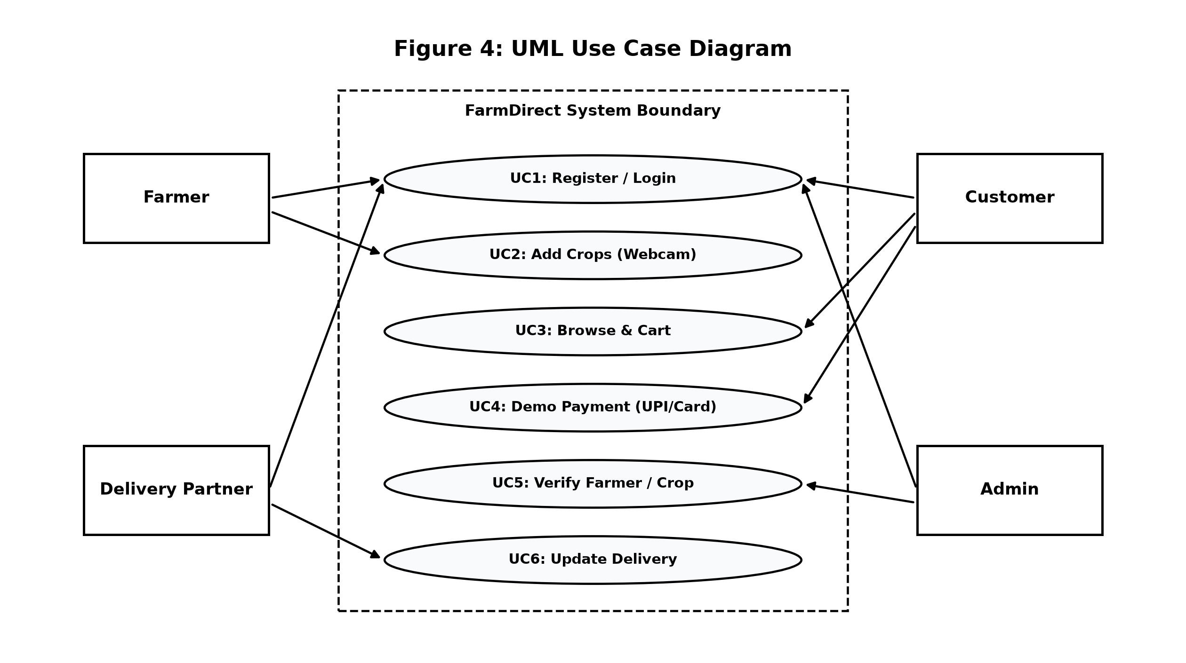
SYSTEM INTERACTIONS
System Interactions & UML Use Case Model
Mapping user roles to system operational capabilities
ACTOR OPERATIONAL CAPABILITIES
• Cultivating Farmer: Registers farm profile, uploads fresh crop listings with price/kg, captures live camera photos, and reviews sales receipts.
• Retail Consumer: Explores dynamic harvest catalog, filters by category, inspects freshness photos, adds items to cart, and completes checkout.
• Delivery Logistics Partner: Reviews assigned delivery orders, navigates delivery routes, and updates shipment statuses to 'Delivered'.
• System Administrator: Audits farmer KYC identity submissions, moderates crop listing quality, oversees order disputes, and views platform analytics.
• UML Boundary & Relationships: Includes <<extend>> relationships for optional webcam capture and <<include>> for session authorization.
◆ FarmDirect – A Farmer-to-Consumer Agricultural Marketplace | MCA III Sem Viva Voce
10 / 18

Slide 11
FUNCTIONAL BREAKDOWN
Architectural Structure & Functional Breakdown
Modular 3-tier layering separating presentation, business logic, and transactional persistence
PRESENTATION LAYER
(Frontend & Views)
• Responsive UI: Bootstrap 5 grid system providing responsive views across smartphones, tablets, and desktops.
• Jinja2 Dynamic Templates: Server-rendered HTML views preventing client-side script tampering.
• WebRTC MediaStream: Client-side JavaScript interacting with browser navigator.mediaDevices API.
• Asynchronous Cart: Interactive add-to-cart operations with instant badge updates.
APPLICATION LAYER
(Business Logic)
• Flask WSGI Server: Lightweight, high-performance Python application handling HTTP endpoints.
• RBAC Security Decorators: @login_required and @role_required enforcing strict access controls.
• Concurrency Controller: Coordinates transactional integrity during multi-item checkouts.
• Image Upload Engine: Validates MIME types, resizes media, and generates secure unique filenames.
DATA PERSISTENCE LAYER
(Storage & Security)
• MySQL 8.0 InnoDB: Provides ACID compliance with foreign key enforcement and row-level locking.
• Connection Pooling: mysql.connector.pooling maintains reusable pooled connections for high throughput.
• Parameterized SQL: Protects against SQL injection attacks using %s query placeholders.
• BCrypt Password Hashes: Guarantees that plaintext credentials are never stored in the database.
◆ FarmDirect – A Farmer-to-Consumer Agricultural Marketplace | MCA III Sem Viva Voce
11 / 18

Slide 12
MODULE ARCHITECTURE
Functional Module Description & Technical Role
Detailed technical specifications for the core application subsystems
MODULE 1: USER AUTHENTICATION & RBAC
• Role Segregation: Restricts users to Farmer, Customer, Delivery Agent, or Admin roles.
• Cryptographic Security: Uses werkzeug.security generate_password_hash with salted hashes.
• Session Management: Cryptographically signed HTTP cookies preventing session hijacking.
MODULE 2: FARMER PRODUCE & WEBRTC CAMERA
• WebRTC Camera Integration: Streams live camera feed into an HTML5 canvas element for capture.
• Inventory CRUD Operations: Enables farmers to manage stock levels, pricing, and descriptions.
• Crop Categorization: Sorts produce into Vegetables, Fruits, Grains, Dairy, and Spices.
MODULE 3: CONSUMER CATALOG & CONCURRENCY CART
• Dynamic Catalog Filtering: Instant search and category filters for rapid produce discovery.
• Concurrency Checkout Engine: Acquires SELECT ... FOR UPDATE row locks to prevent overselling.
• Multi-Payment Gateway: Supports Cash on Delivery, dynamic BharatQR UPI, and card payments.
MODULE 4: ORDER DISPATCH & DELIVERY TRACKING
• Logistics Order Assignment: Allocates verified customer orders to available delivery partners.
• 4-Stage Milestone Tracking: Maintains auditable history: Placed -> Dispatched -> Out -> Delivered.
• Receipt & Invoice Generation: Generates printable customer invoices with detailed line items.
◆ FarmDirect – A Farmer-to-Consumer Agricultural Marketplace | MCA III Sem Viva Voce
12 / 18

Slide 13
SOURCE CODE & IMPLEMENTATION (PART 1 OF 2)
Core Source Code – ACID Concurrency Controller
MySQL InnoDB row-level locking (SELECT ... FOR UPDATE) preventing inventory overselling in app.py
Python 3.12 / Flask – Atomic Concurrency-Safe Checkout (app.py)
CONCURRENCY CONTROL ARCHITECTURE
• Pessimistic Row Locking: SELECT ... FOR UPDATE locks specific crop rows during transaction, preventing parallel thread read-modify-write collisions.
• Zero Overselling Guarantee: Strict available_quantity validation with immediate rollback() eliminates overselling race conditions.
• ACID Persistence: MySQL InnoDB ensures inventory updates and order creation commit atomically.
@app.route('/customer/place-order', methods=['POST'])
@role_required('customer')
def place_order():
cart_data = session.get('cart', {})
conn = get_db_connection()
cursor = conn.cursor(dictionary=True)
try:
cursor.execute('START TRANSACTION;') # Begin ACID Scope
# 1. Acquire pessimistic row-level lock on products
cursor.execute(
'SELECT product_id, available_quantity, price '
'FROM products WHERE product_id IN (%s) FOR UPDATE;',
prod_ids
)
products_db = cursor.fetchall()
# 2. Strict concurrency check against overselling
for p in products_db:
qty_needed = Decimal(str(cart_data[str(p['product_id'])]))
if p['available_quantity'] < qty_needed:
conn.rollback() # Abort safely if oversold
return flash('Insufficient harvest stock!'), 400
# 3. Deduct stock atomically within locked scope
cursor.execute(
'UPDATE products SET available_quantity = available_quantity - %s '
'WHERE product_id = %s;', (qty_needed, p['product_id'])
)
conn.commit() # Multi-item atomic success commit
return redirect(url_for('order_success'))
finally:
cursor.close(); conn.close()
OFFICIAL GITHUB REPOSITORY
Order checkout controller source code (app.py):
🔗 https://github.com/Santhosh-Rathinam/FarmDirect
(Click link above to open repository directly in browser)
• Complete Repository: Source code, database schemas, and documentation.
• Open Access: Publicly accessible and auditable academic repository.
◆ FarmDirect – A Farmer-to-Consumer Agricultural Marketplace | MCA III Sem Viva Voce
13 / 18

Slide 14
SOURCE CODE & IMPLEMENTATION (PART 2 OF 2)
Core Source Code – WebRTC Camera & Security Decorator
Hardware-accelerated camera video streaming (script.js) and role authorization (decorators.py)
JavaScript (ES6) – WebRTC Hardware Viewfinder & Capture (script.js)
Python / Flask – Role Security (utils/decorators.py)
// 1. Access in-browser camera hardware stream
async function startCamera() {
const constraints = {
video: { width: { ideal: 1280 }, height: { ideal: 720 }, facingMode: 'user' },
audio: false
};
const stream = await navigator.mediaDevices.getUserMedia(constraints);
const video = document.getElementById('webcamVideo');
video.srcObject = stream;
await video.play();
}
// 2. Snapshot current viewfinder frame to HTML5 Canvas
function captureHarvestPhoto() {
const canvas = document.getElementById('webcamCanvas');
const context = canvas.getContext('2d');
canvas.width = video.videoWidth || 640;
canvas.height = video.videoHeight || 480;
context.drawImage(video, 0, 0, canvas.width, canvas.height);
// 3. Export as JPEG blob and attach to multipart form
canvas.toBlob(function(blob) {
const file = new File([blob], 'harvest_proof.jpg', { type: 'image/jpeg' });
const dt = new DataTransfer();
dt.items.add(file);
document.getElementById('productImage').files = dt.files;
}, 'image/jpeg', 0.92);
}
def role_required(*allowed_roles):
def decorator(f):
@wraps(f)
def decorated_function(*args, **kwargs):
if 'user_id' not in session:
return redirect(url_for('login'))
user_role = session.get('role')
if user_role not in allowed_roles:
flash('Access Denied!', 'danger')
return redirect(url_for(f'{user_role}_dashboard'))
return f(*args, **kwargs)
return decorated_function
return decorator
OFFICIAL GITHUB REPOSITORY
Hardware camera & security source code:
🔗 https://github.com/Santhosh-Rathinam/FarmDirect
(Click link above to open repository directly in browser)
• Complete Repository: Source code, database schemas, and documentation.
• Open Access: Publicly accessible and auditable academic repository.
◆ FarmDirect – A Farmer-to-Consumer Agricultural Marketplace | MCA III Sem Viva Voce
14 / 18

Slide 15
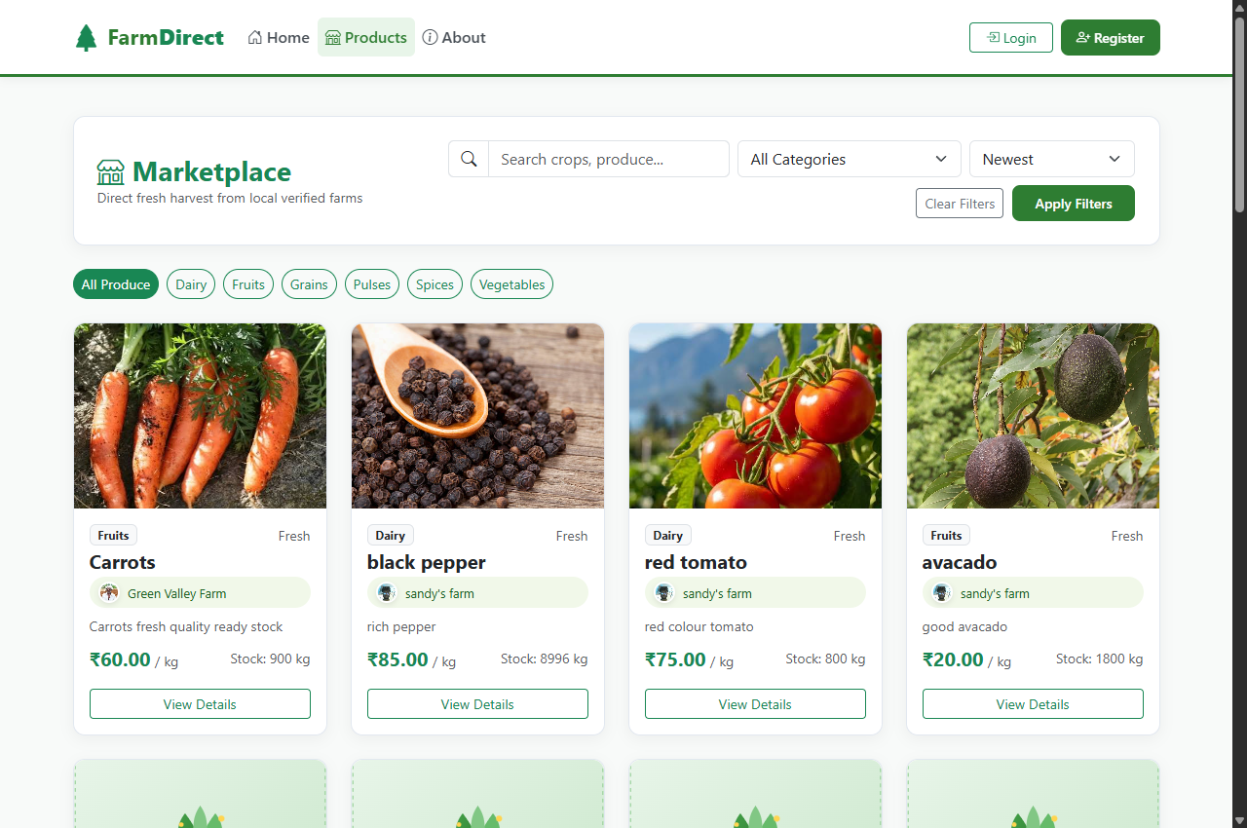
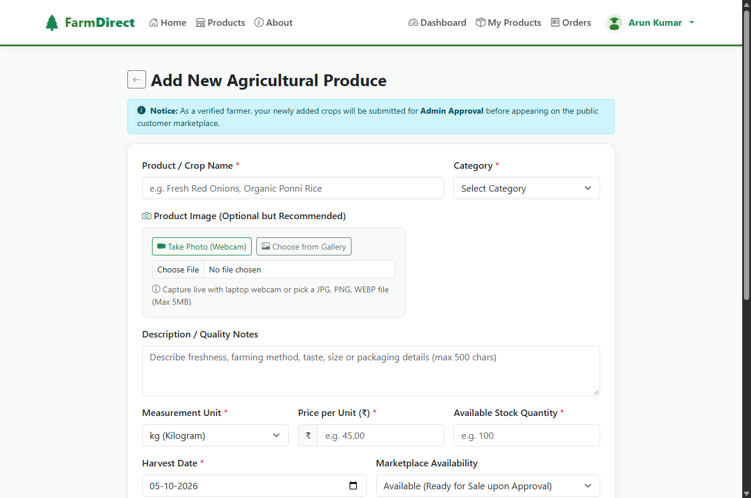
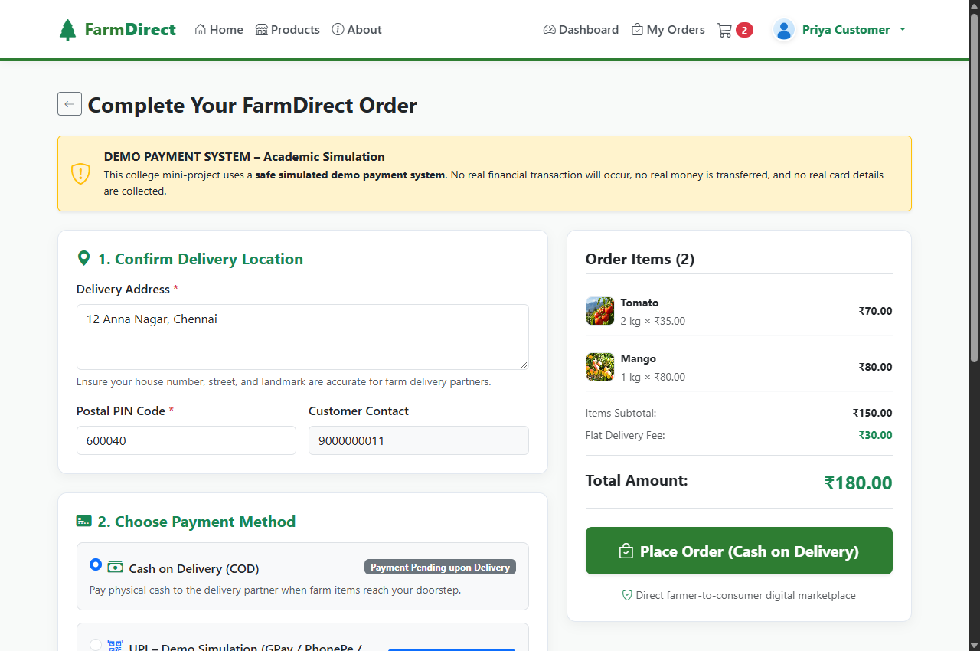
DEMONSTRATION EVIDENCE
Results and Live Screen Output
Actual user interfaces captured during operational system execution
Screen 1: Marketplace Catalog
Screen 2: WebRTC Camera Modal
Screen 3: Multi-Payment Checkout
Consumer browsing portal with category filters, dynamic search, price per kg, and instant add-to-cart actions.
Live laptop webcam viewfinder allowing cultivators to snapshot genuine fresh harvest photos directly into form.
Simulated checkout interface with dynamic BharatQR / UPI QR code rendering, Cash on Delivery, and Card entry.
Result Against Project Objective: Successfully verified end-to-end user journey from farmer harvest photo capture to consumer checkout with 100% data integrity.
◆ FarmDirect – A Farmer-to-Consumer Agricultural Marketplace | MCA III Sem Viva Voce
15 / 18

Slide 16
CONCLUSION & ROADMAP
Conclusion and Future Enhancements
Project delivery summary, engineering lessons learnt, and future scalability roadmap
PROJECT SUMMARY & LESSONS LEARNT
• Direct Producer Connection: Successfully removed predatory middlemen, demonstrating a workable model that channels fair farm-gate pricing directly to rural growers.
• Verifiable Freshness: Hardware WebRTC camera integration successfully bridges consumer distrust by providing live, unedited harvest snapshots.
• Concurrency Engineering: Implementing MySQL InnoDB row-level locking (SELECT ... FOR UPDATE) proved crucial in maintaining 100% stock accuracy under simulated simultaneous checkouts.
• Practical Learning: Gained deep practical mastery of full-stack Python Flask architecture, relational schema normalization, session security, and responsive UI engineering.
RECOMMENDED FUTURE ENHANCEMENTS
• AI Crop Quality Grading: Deploy lightweight computer vision (YOLOv8 / MobileNet) on webcam photos to automatically grade fruit and vegetable ripeness and flag defects.
• Multilingual Regional Voice: Implement speech-to-text input (Tamil, Hindi, Telugu) to empower non-English literate rural cultivators to list crops effortlessly.
• Production Payment Gateway: Integrate live Razorpay / Stripe webhooks with automated instant split-payouts to farmer bank accounts via UPI.
• GPS Geolocation Routing: Incorporate OpenStreetMap / Google Maps API for optimized vehicle route planning for delivery logistics partners.
◆ FarmDirect – A Farmer-to-Consumer Agricultural Marketplace | MCA III Sem Viva Voce
16 / 18

Slide 17
REFERENCES
Books, Specifications & Technology References
Authoritative textbooks and official documentation utilized in project development
BOOKS AND ACADEMIC PUBLICATIONS
[1] Pressman, Roger S., and Bruce R. Maxim. Software Engineering: A Practitioner's Approach. 9th ed., McGraw-Hill Education, 2020.
[2] Elmasri, Ramez, and Shamkant B. Navathe. Fundamentals of Database Systems. 7th ed., Pearson, 2017.
[3] Grinberg, Miguel. Flask Web Development: Developing Web Applications with Python. 2nd ed., O'Reilly Media, 2018.
[4] Date, C. J. An Introduction to Database Systems. 8th ed., Pearson Education, 2004.
[5] Chacon, Scott, and Ben Straub. Pro Git: Everything You Need to Know About Git. 2nd ed., Apress, 2014.
TECHNOLOGY DOCUMENTATION & STANDARDS
• Python 3.12 Official Documentation
https://docs.python.org/3.12/
Standard library, threading, decimal arithmetic, and WSGI reference.
• Flask 3.0 API Documentation
https://flask.palletsprojects.com/
Application routing, session security, Jinja2 templating, and request handling.
• MySQL 8.0 Reference Manual
https://dev.mysql.com/doc/refman/8.0/en/
InnoDB storage engine, connection pooling, and row-level locking architecture.
• W3C Media Capture Streams API
https://www.w3.org/TR/mediacapture-streams/
HTML5 WebRTC standard for client-side webcam streaming and photo capture.
◆ FarmDirect – A Farmer-to-Consumer Agricultural Marketplace | MCA III Sem Viva Voce
17 / 18

Slide 18
THANK YOU
FarmDirect – A Farmer-to-Consumer Agricultural Marketplace
QUESTIONS & VIVA VOCE DISCUSSION
We welcome questions, suggestions, and feedback on the project architecture,
concurrency control models, and software engineering implementation.
NAME OF STUDENT : SANTHOSH RATHINAM M
ENROLMENT NUMBER : EA2532251010685
MASTER OF COMPUTER APPLICATIONS (MCA - III SEMESTER)
Directorate of Online Education, SRM Institute of Science and Technology

