Slide 1
MCS Training-CTLE
ChavallaSanthosh

Slide 2
Background Theory

Slide 3
Differential CTLE

Slide 4
Design: Procedure of designing, parameters given , what did you design for? difference b/w design and sims, how to simulate
Role/Responsibilities in project?, Challenges faced in the project

Slide 5
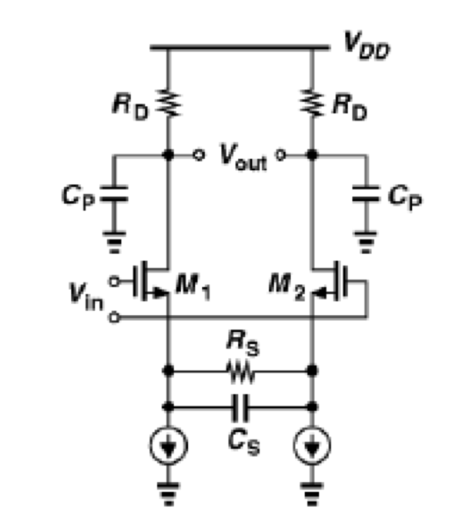
2-pole one zero
poles/zeros by
inspection does not
always work
1
2
small signal model ctle: symmetric with load capacitance
one half is similar to CS stage
1
2
Vout1-vout2/vin1-vin2= vout1/vin1=vout2/vin2
Vin1 and vin2 are differential
2*
2

Slide 6
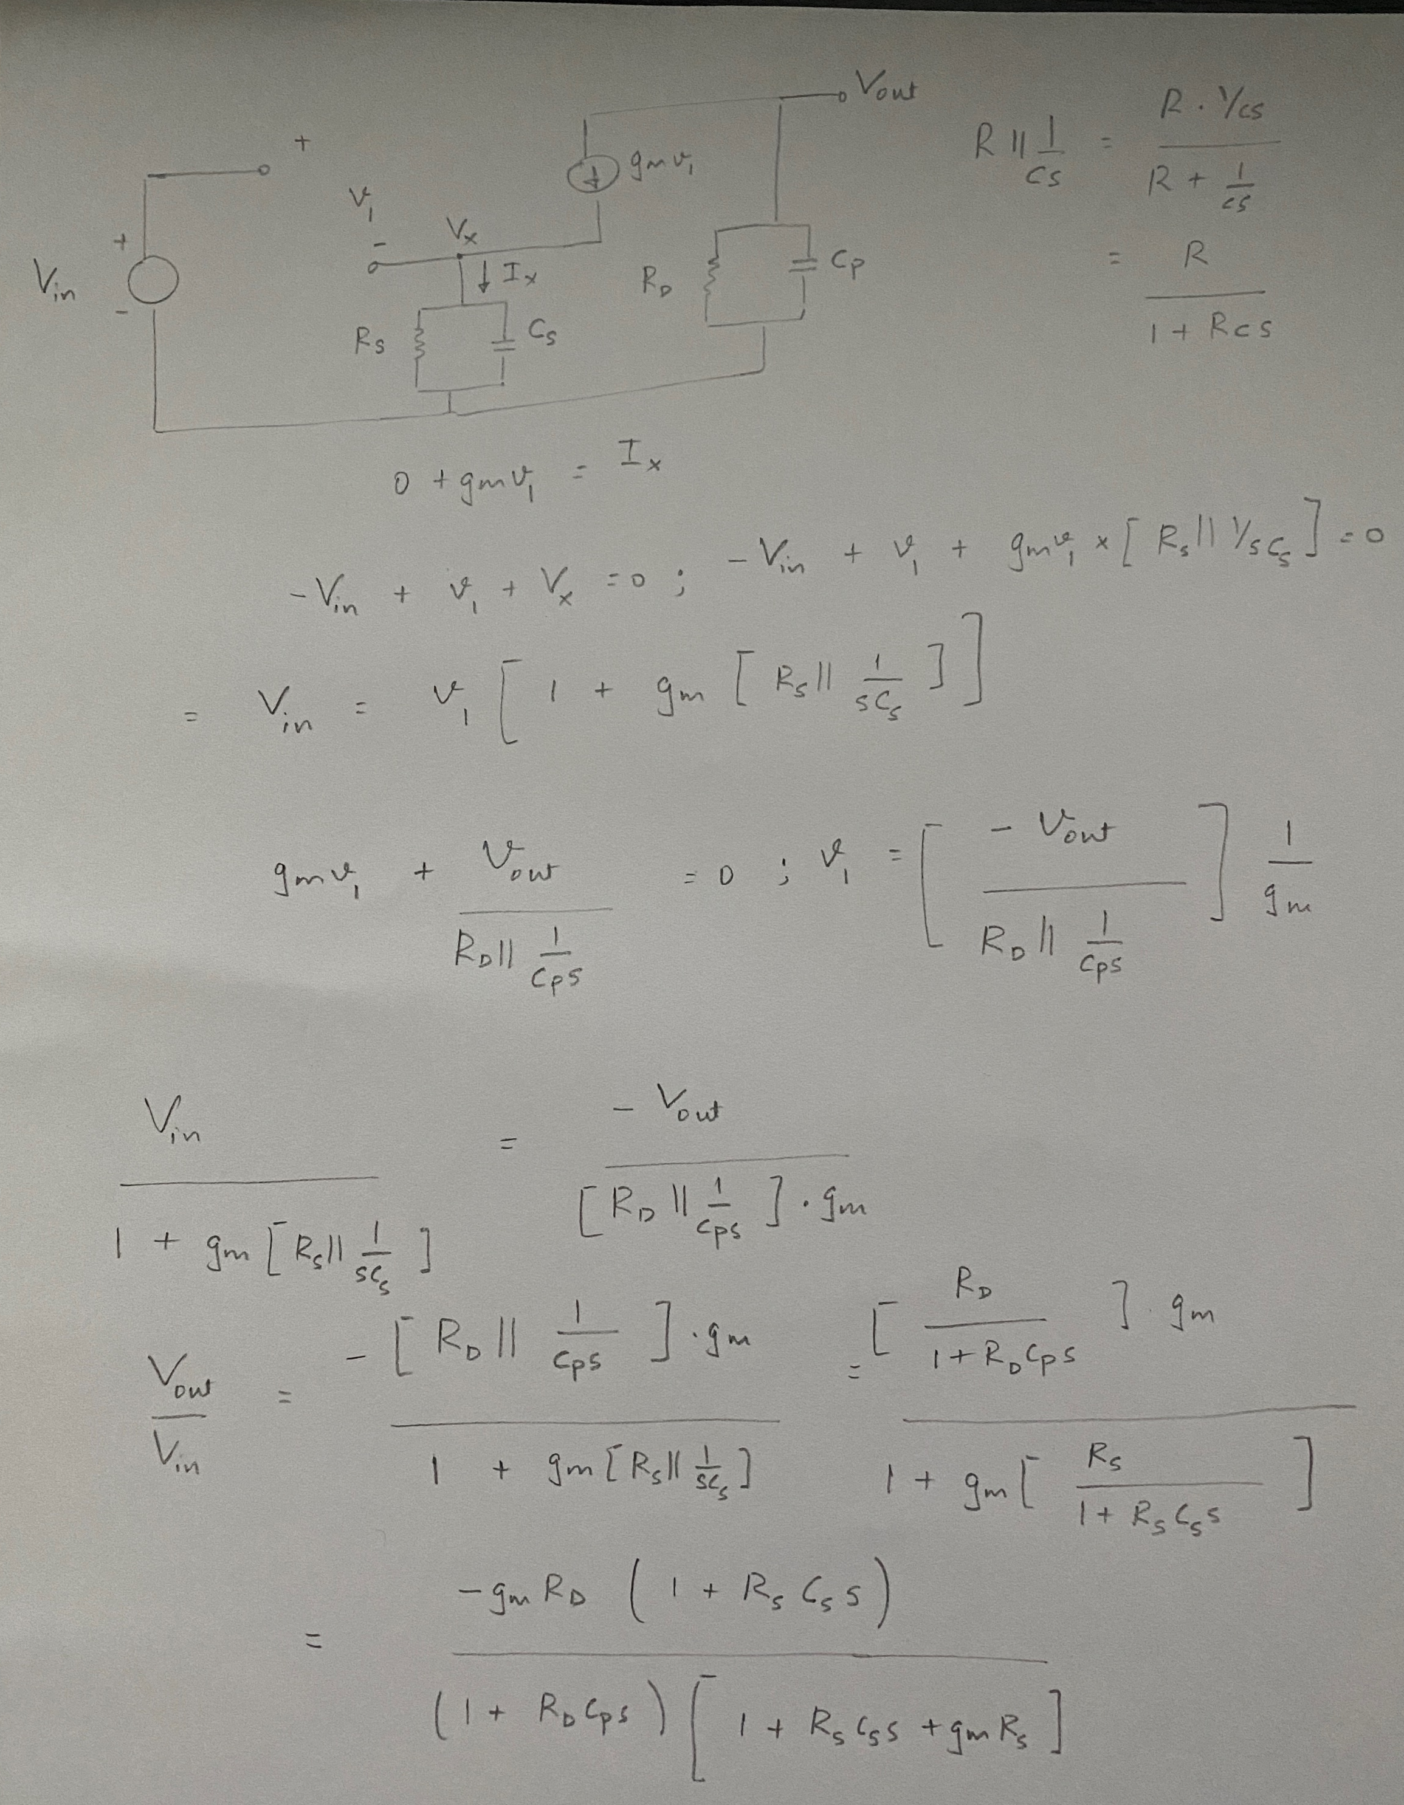
Small signal voltage gain:
One zero and two poles

Slide 7
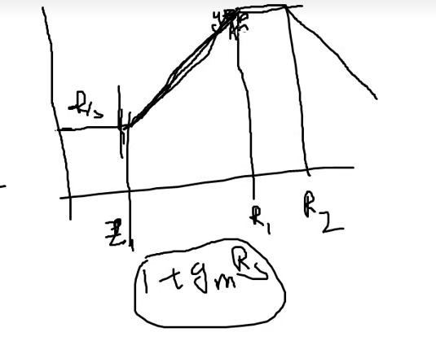
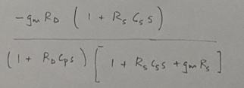
peak: gmrd
Boost: Boost : (1+gmrs)=12dB (AC gain- DC gain) use :(1+sRdCp=1)
DC gain(magnitude): (gmrd)/(1+gmrs), by substituting s=0 in the gain equation
given in the previous slide
DC Gain
AC Gain approximation: write eq for mag and substitute s by pole freq
Pole due to load capacitance
In design, even though both poles are at same
frequency there is a region of flat response because
The effect of zero and pole starts early

Slide 8
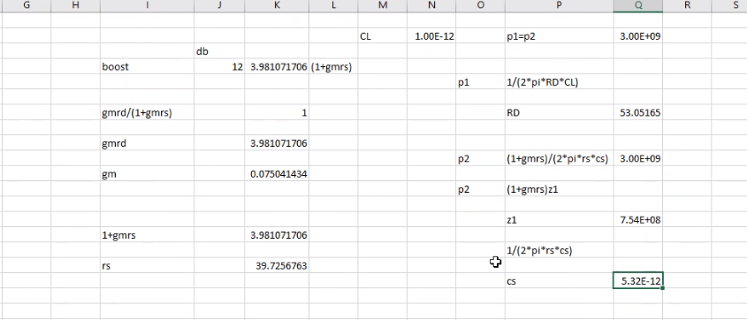
Given Parameters/Design Parameters
CL=1pf, load capacitance
p1=p2=3.0GHz
boost =12dB @ 3.0GHz
Zeros and poles are negative from transfer function
Need to understand Bode plots.
1
1
2
dc gain=0
3
5
4
6

Slide 9
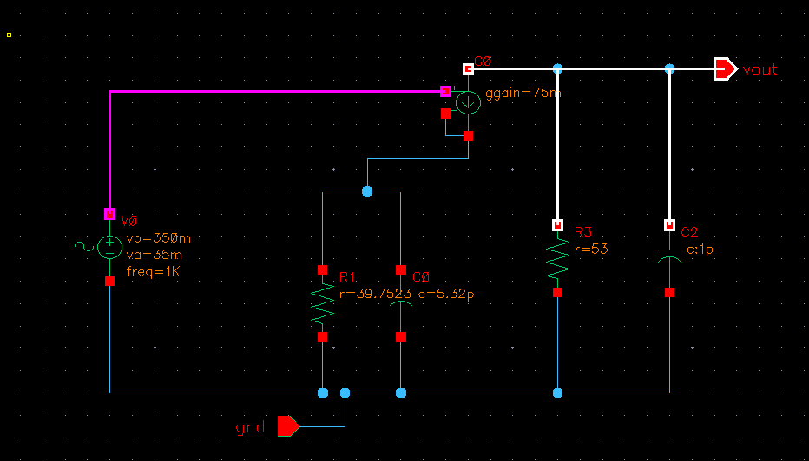
Small signal model

Slide 10
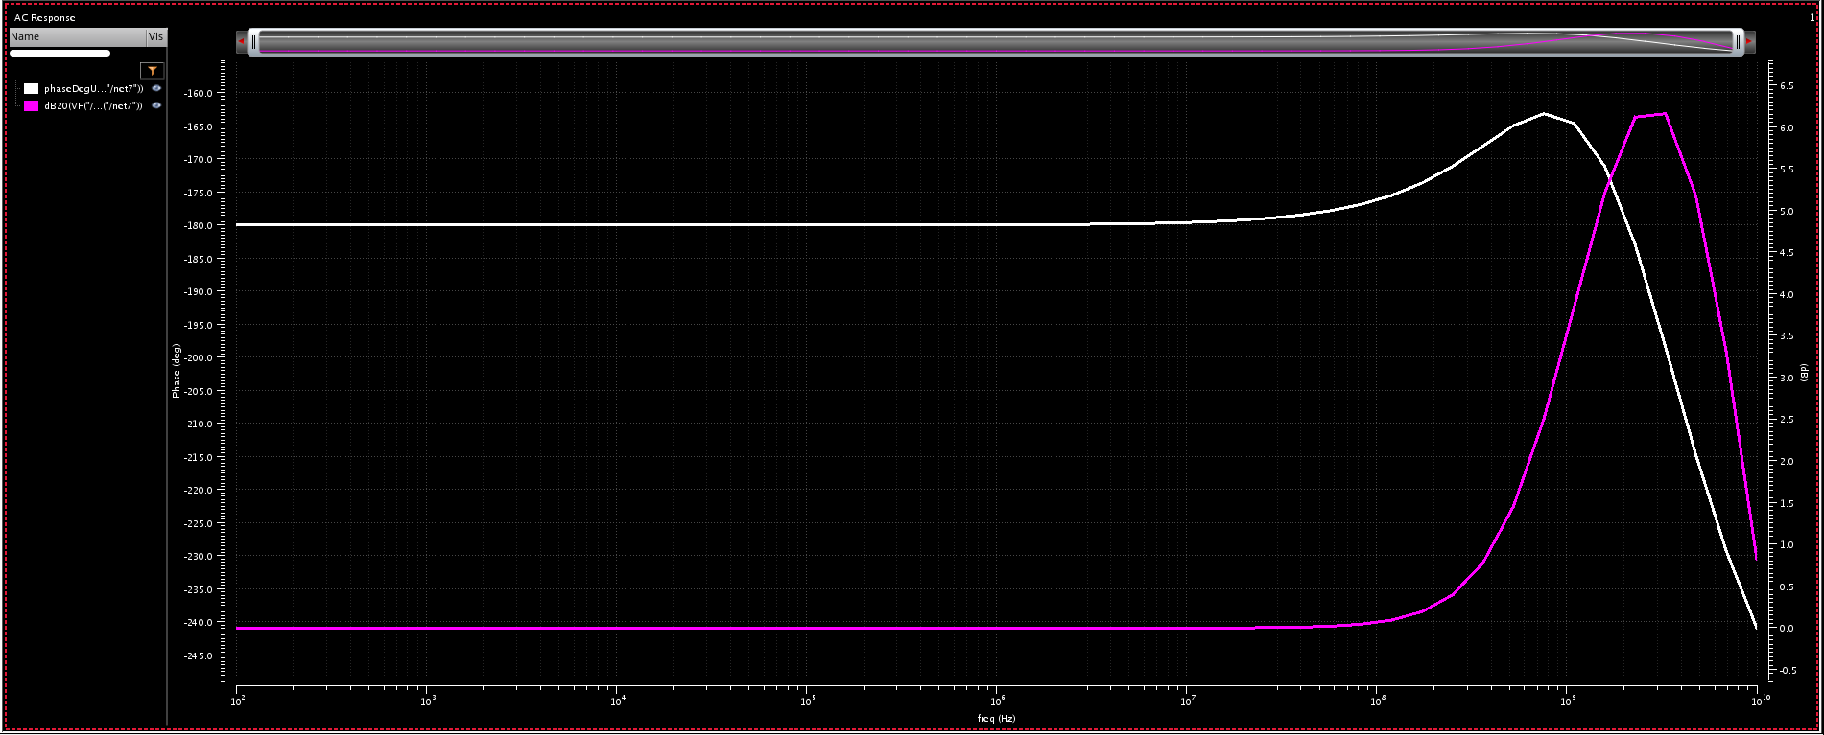
Frequency response of one half of CTLE
Difference b/w design and simulation:
1. the effect of zero has started earlier than used in design and similarly for pole
2. Hence the required boost of 12 dB is not achieved, achieved 6dB boost instead

Slide 11
