Slide 1

Minor project presentation on
Fault diagnosis of an impeller using Convolutional Neural Networks
Under the esteemed guidance of
Mr. M. Satyadev
Assistant professor,
Dept. of Mechanical Engineering,
RGUKT Nuzvid.
Presented by
K. Mahesh(N200391)
G. Sravanthi(N200637)
P. Santhosh Reddy(N200885)
U. Vamsi Krishna(N200174)
P. Suresh(N200314)
A. Nithin(N190869)
Department of mechanical engineering
Rajiv Gandhi University of Knowledge and Technologies
Nuzvid.

Slide 2
INTRODUCTION :
Mechanical systems in Industry 4.0 demand:
Automatic monitoring
Data-driven decision making
Fault detection without human intervention
Rotating machines → impellers, gears, bearings
Failures cause:
Down time costs ₹10 lakh–₹50 lakh/hr
Quality rejection
Safety risks
Need for a deep-learning-based classifier for detection.

Slide 3
PROBLEM STATEMENT :
Industries face challenges in identifying small or hidden defects in impellers.
Manual inspection requires trained personnel and is prone to fatigue-based errors.
Complex surface geometries make small cracks hard to detect.
Lack of real-time feedback causes delays in quality control.

Slide 4

OBJECTIVES:
Develop a CNN model capable of binary classification (defective vs. non-defective).
Create a well-structured and labeled dataset from impeller front-view images.
Preprocess data to increase robustness under varying lighting and orientation.
Train the model using optimized hyperparameters.
Evaluate performance using metrics such as accuracy, precision, recall, and confusion matrix.
Propose possible real-time implementation for industries.

Slide 5
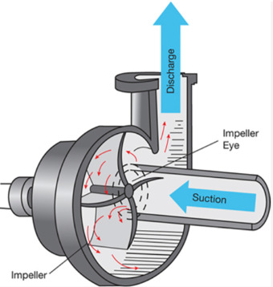
WHAT IS AN IMPELLER?
Impellers are the key rotating components in submersible pumps.
Their structural integrity directly impacts pump efficiency and service life.
Traditional visual inspection is subjective, slow, and prone to errors.
Machine learning, especially CNN’s can automate defect detection from images.

Slide 6
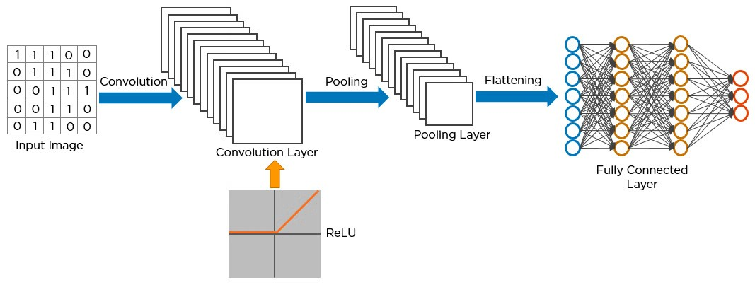
WHAT IS CNN??
Convolutional Neural Networks (CNNs) are deep
learning models designed to automatically analyze and
understand images.
They extract useful patterns and features from raw
pixels and classify them effectively.
Key Points:
Convolution Layers: Detect basic features like edges, curves
and textures.
Pooling Layers: Reduce image size while keeping important features.
Flattening: Converts feature maps into a single vector.
Fully Connected Layers: Combine features to make final classification.
Output Layer: Produces the final prediction (defective or non-defective).
CNNs are widely used because they learn features automatically and work extremely well for image-based fault detection.

Slide 7
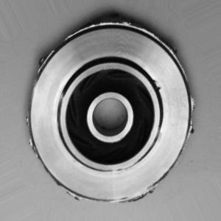
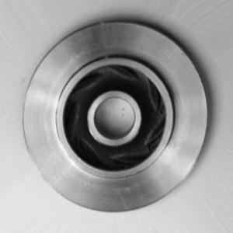
DATA-SET DESCRIPTION:
TRAIN DATA
Total train images: 6633
ok_front : 2875
def_front : 3758
TEST DATA
Total test images: 715
ok_front : 262
def_front : 453
Class Distribution & Imbalance:
Total OK images: 3,137
Total defective images: 4,211
Imbalance ratio: ~1.34
Dataset contains 34% more defective images than OK images.
Yet both classes contain sufficient samples for learning.
CNN can still learn well due to large sample size per class.

Slide 8
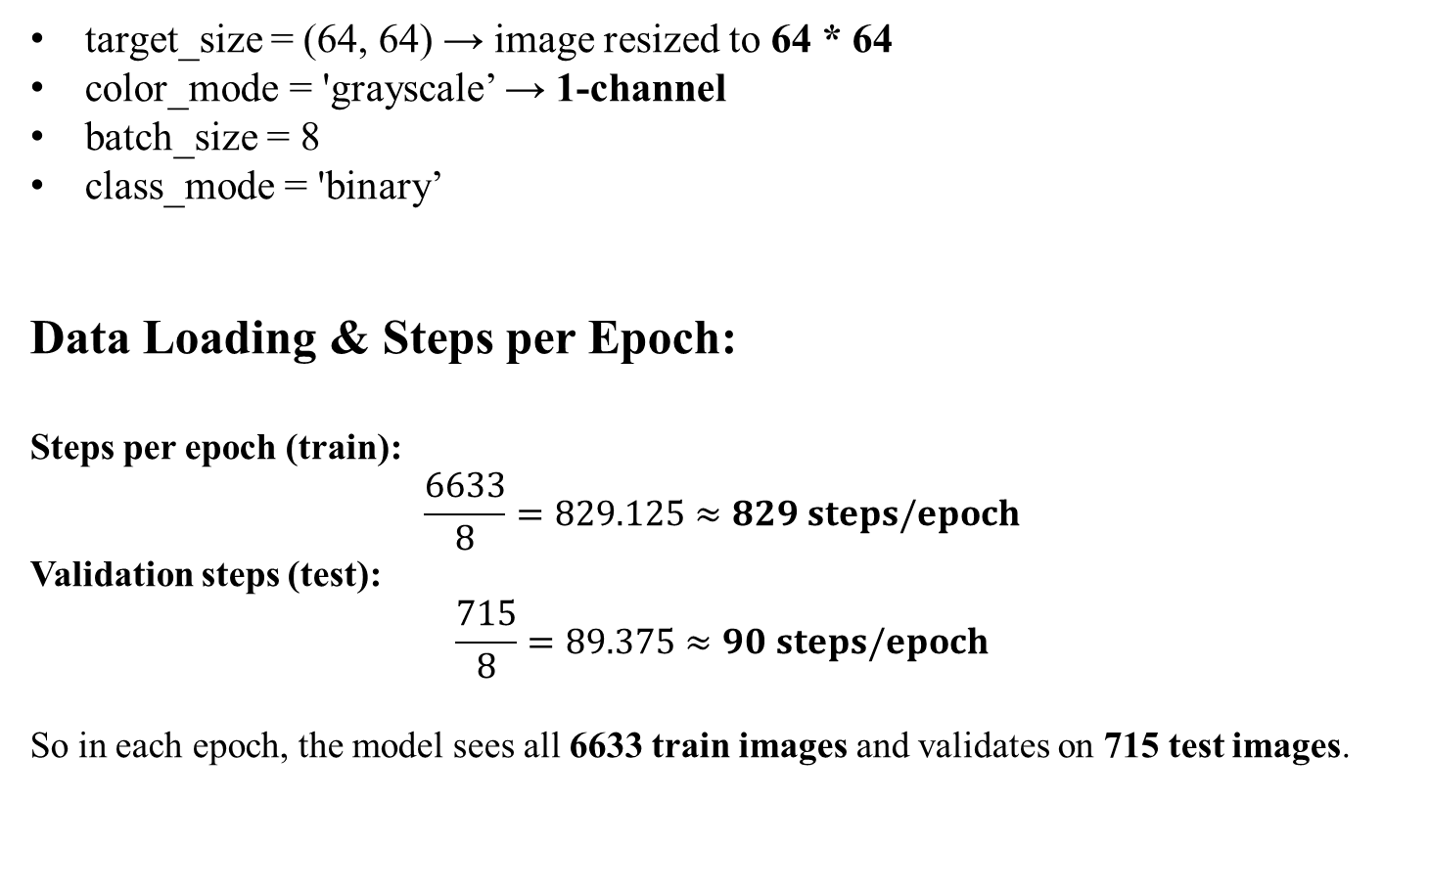
Preprocessing & Augmentation:
target_size = (64, 64) → image resized to 64 * 64
color_mode = 'grayscale’ → 1-channel
batch_size = 8
class_mode = 'binary’
Data Loading & Steps per Epoch:
Steps per epoch (train):
$$\frac{6633}{8}=829.125≈829 steps/epoch$$
Validation steps (test):
$$\frac{715}{8}=89.375≈90 steps/epoch$$
So in each epoch, the model sees all 6633 train images and validates on 715 test images.

Slide 9
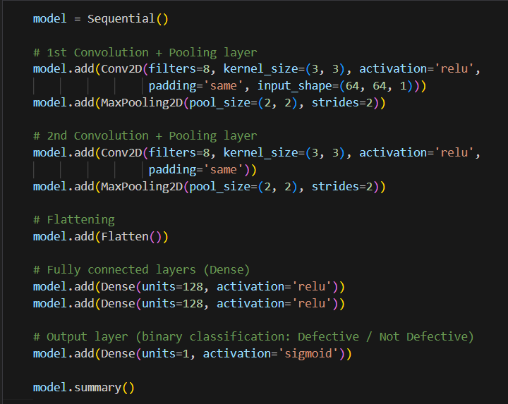
CNN Architecture (2 Convolution Layers):
The CNN used is simple and lightweight, consisting of:
Two convolution layers (feature extraction)
Two max-pooling layers (dimensionality reduction)
Flatten layer
Two dense layers (classification)
Final sigmoid neuron for binary classification

Slide 10
Feature Map Dimensions:
Image size flow through the network:
Input: 64 × 64 × 1
After 1st pooling: 32 × 32 × 8
After 2nd pooling: 16 × 16 × 8
Flattening produces 2,048 features
These become inputs to the fully connected layers.
Convolution Layer Parameter Calculations:
First Convolution Layer:
Filters: 8
Kernel: 3 × 3
Input channels: 1
Total parameters = (3×3×1)×8+8=72+8=80
Second Convolution Layer
Filters: 8
Kernel: 3 × 3
Input channels: 8
Total parameters = (3×3×8)×8+8=576+8=584

Slide 11
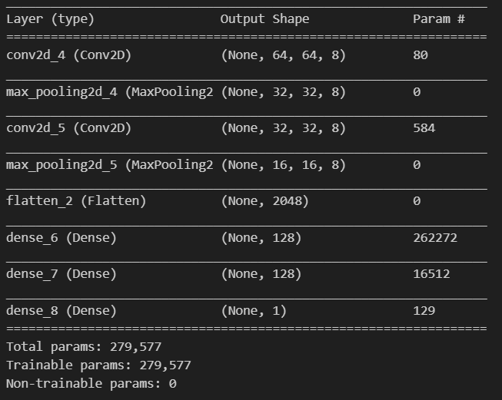
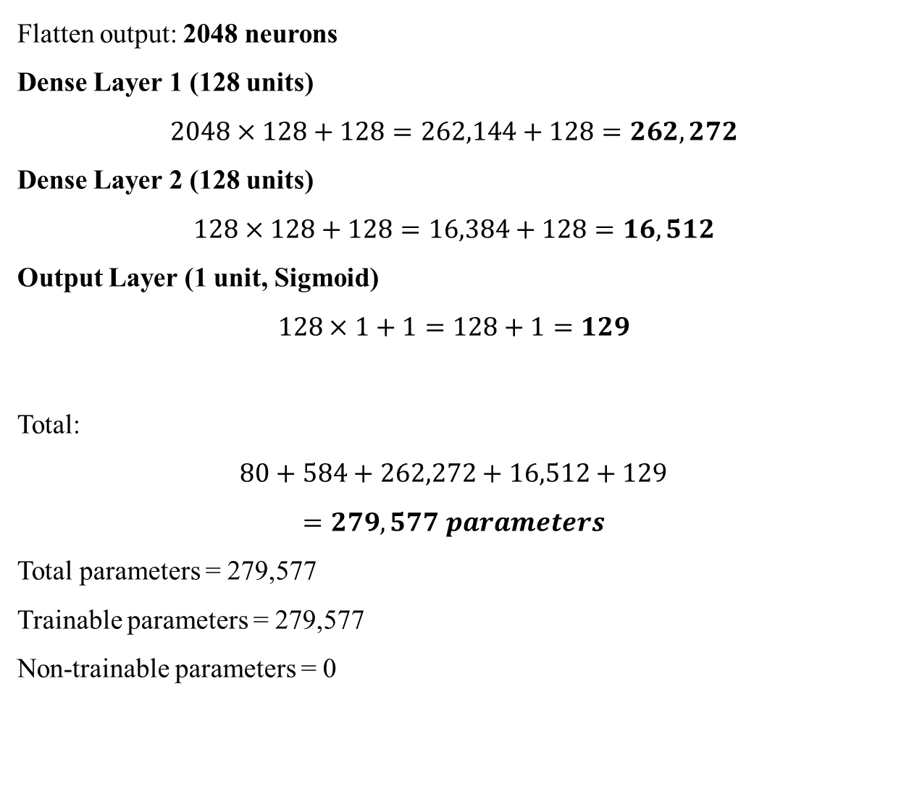
Dense Layer Parameter Calculations :
Flatten output: 2048 neurons
Dense Layer 1 (128 units)
$$2048×128+128=262,144+128=262,272$$
Dense Layer 2 (128 units)
$$128×128+128=16,384+128=16,512$$
Output Layer (1 unit, Sigmoid)
$$128×1+1=128+1=129$$
Total:
$$80+584+262,272+16,512+129$$
$$=279,577 parameters$$
Total parameters = 279,577
Trainable parameters = 279,577
Non-trainable parameters = 0

Slide 12

Model compilation & Training Configuration :
Optimizer: Adam (adaptive learning rate)
Loss: Binary Cross-Entropy
Binary cross-entropy formula:
L=−ylog(p)−(1−y)log(1−p)
Where:
$y∈\left\{0 , 1\right\}($true label)
$p$ is the predicted probability (sigmoid output)
Epochs = 10
Train steps/epoch ≈ 829
Validation steps/epoch ≈ 90
Total training iterations:
$$829 \text{steps}\text{/}\text{epoch}×10 \text{epochs}=8290 iterations$$

Slide 13
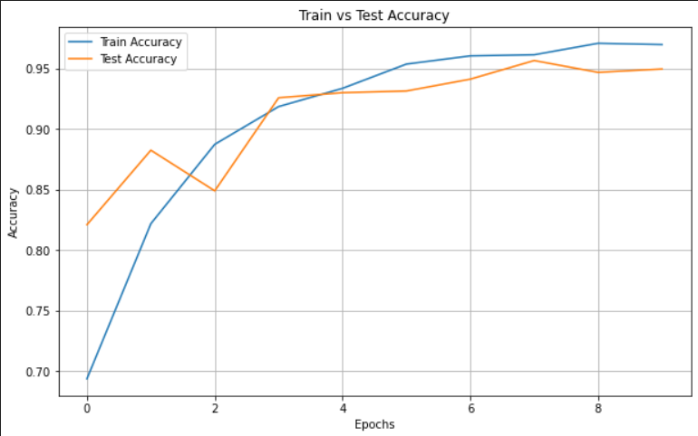
Train VS test Accuracy :
Training accuracy increases steadily from 69% in Epoch 1 to approximately 97% by Epoch 9.
Test accuracy also improves consistently, starting at 82% and reaching around 95–96%.
The two curves follow a similar pattern, indicating that the model is learning meaningful features without significant overfitting.
After Epoch 3, both training and test accuracy stabilize above 90%, showing strong classification ability.
The close proximity of the two curves suggests the model generalizes well to unseen data.
Interpretation:
The convergence of both curves above 95% reflects a highly effective CNN architecture.
Model performance is stable and reliable, with minimal gap between train and test accuracy.

Slide 14
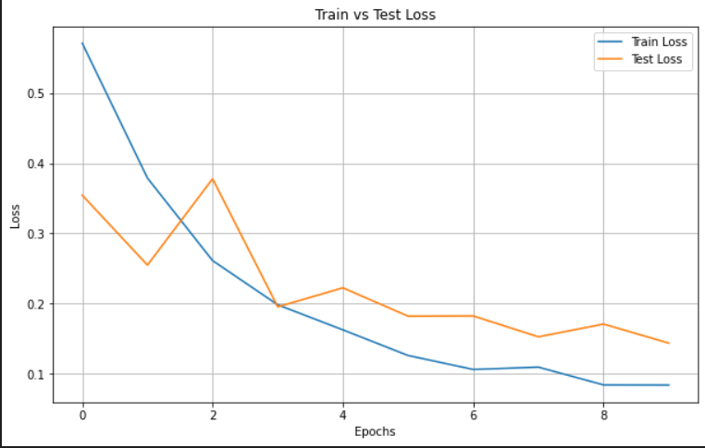
Train VS Test loss :
Training loss shows a sharp decrease from 0.57 to 0.08, indicating efficient learning and parameter tuning.
Test loss begins at 0.35, fluctuates slightly in early epochs, and then consistently decreases to approximately 0.13 by the final epoch.
Despite minor variations in test loss at Epochs 2 and 3, both curves converge toward lower values as training progresses.
The final test loss remains close to training loss, confirming that the model does not overfit.
Interpretation:
Continuous decline in loss demonstrates good optimization and stable learning.
The low final loss values indicate the CNN is confident and accurate in its predictions.
The model maintains a healthy balance between learning and generalization.

Slide 15
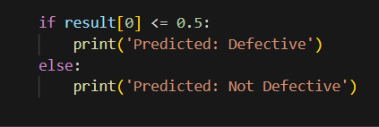
Prediction Workflow:
A test image is selected and preprocessed:
Resized to 64 × 64 pixels
Converted to grayscale
Normalized to the 0–1 range
Reshaped to match model input: (1, 64, 64, 1)
The processed image is passed through the CNN:
Convolution layers extract edges, textures, and defect patterns
Pooling layers reduce noise and highlight dominant features
Flatten layer converts feature maps into a 1D vector
Dense layers learn high-level relationships
Sigmoid output produces a probability score between 0 and 1
Prediction Decision:
p > 0.5 → Non-defective (OK)
p ≤ 0.5 → Defective
The selected test image is displayed along with the predicted label, allowing visual confirmation of classification accuracy.

Slide 16
Applications:
1. Automated Quality Inspection
Real-time detection of casting defects in impellers during manufacturing.
Reduces dependency on manual visual inspection.
2. Production Line Integration
Can be integrated with conveyor systems and cameras for continuous inspection.
Automatically separates defective and non-defective components.
3. Foundry and Casting Industry
Identifies common casting defects such as cracks, blowholes, shrinkage, and surface irregularities.
Improves overall product reliability.
4. Predictive Maintenance
Early detection of defects prevents failures in pumps and rotating machinery.
Reduces unplanned downtime and maintenance costs.
5. Industrial Automation and Industry 4.0
Forms the basis for intelligent manufacturing systems.
Can be deployed on embedded devices (Jetson Nano, Raspberry Pi) for edge AI inspection.
6. Scalable to Other Components
Same CNN technique can be applied to gears, bearings, blades, valves, and other mechanical parts.

Slide 17
Conclusion:
A complete CNN-based system was successfully developed for automatic defect detection in submersible pump impellers.
The model trained on 7,348 real industrial images showed strong performance, with high accuracy and consistent reduction in loss across training.
A lightweight CNN architecture with 279,577 parameters proved sufficient to learn and distinguish defect patterns effectively.
Preprocessing and augmentation enhanced robustness, enabling reliable classification of both defective and non-defective components.
The system demonstrates that deep learning can significantly improve quality control by providing fast, consistent, and automated inspection, reducing reliance on manual visual checks.
The accuracy of the CNN model is approximately 95%

Slide 18
Reference:
Research papers/article | Summary | Source
Recognition and classification of casting defects using the CNN algorithm — Chigateri et al., Materials (2023) | This work also targets casting defects (similar to your impeller dataset), using CNN to categorize cast parts as defective/not defective. | ScienceDirect
Identification of Defects in Casting Products by using a Convolutional Neural Network — International Journal of Precision Engineering & Manufacturing-Green Technology | Presents a CNN-based approach for defect detection in cast products; useful to compare methodology, preprocessing, dataset handling with yours. | ResearchGate
A convolutional neural network‑based method for workpiece surface defect detection — Xing & Jia, Measurement (2021) | Although focused on general surface defects (not impeller-specific), the paper shows how CNNs can effectively detect defects on complex surfaces — good for background/literature-review slides. | ScienceDirect

