Slide 1
Ansible

Slide 2
Ansible is an IT automation, configuration management , Orchastration & provisioning tool.
Provisioning : Supplying all that are needed
(Ansible make sure that all necessary softwares & all other packages downloaded & installed in remote machines to run an application)

Slide 3
Configuration Management :
Managing our software on top of an hardware by using it we can easily configure the versions (either upgrade or rollback)
Ansible will help to configure N no.of systems to upgrade the software or to rollback the software with the help of playbook

Slide 4
Orchestration or IT Automation
Ansible will do the orchestration of a entire system like deploy , manage , build & configure the application.

Slide 5
Installation & configuration
~]$ sudo yum install epel-release
~]$ sudo yum install ansible
~]$ sudo vi /etc/ansible/hosts
[servers]
host1 ansible_ssh_host=192.0.2.1
host2 ansible_ssh_host=192.0.2.2
host3 ansible_ssh_host=192.0.2.3

Slide 6
Before Ansible
Shell scripts to configure
But shell scripts are not idempotent
Not Robust

Slide 7
Ansible features
It works on push based mechanism
It’s having modules to perform different kind of operations like creating users , copying files & etc.
Playbooks
Purely in-order execution

Slide 8
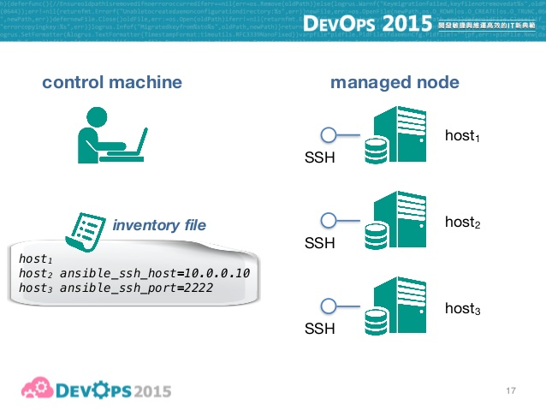

Slide 9
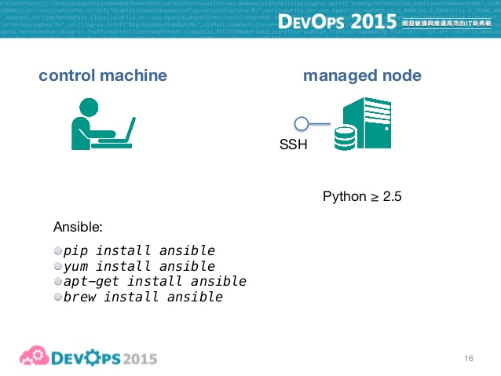

Slide 10
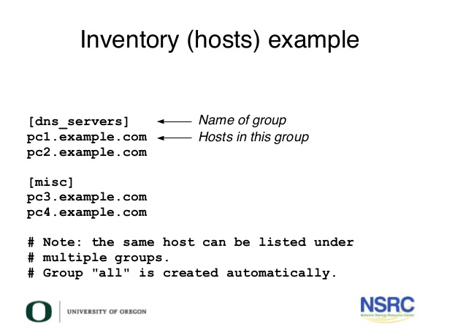

Slide 11
Ansible operations without Playbook
~]$ vi index.html
Hello world : Ansible
:wq
~]$ ansible dns-servers –m copy –k –a “src=index.html dest=/var/www/html”
~]$ ansible dns-servers –m yum –k –a “name=httpd state=installed”
~]$ ansible dns-servers group –m service –k –a “name=httpd state=installed”

Slide 12
Ansible operations with playbook
~]$ vi webserver.yml
--- # playbook webserver
host: webserver
user: tcs
connection: ssh
sudo: yes
tasks:
- name: Installing httpd package
yum: name=httpd state=installed
- name: copying file index.html
copy: src=index.html dest=/var/www/html
- name: start the httpd service
service: name=httpd state=restarted
:wq
~]$ ansible-playbook webserver.yml

Slide 13
Ansible supports variables
~]$ vi webserver.yml
--- # playbook webserver
host: webserver
user: tcs
connection: ssh
sudo: yes
vars:
pkg: httpd
tasks:
yum: name={{pkg}} state=installed

Slide 14
Ansible supports Templates
~]$ vi webserver.yml
--- # playbook webserver
host: webserver
user: tcs
connection: ssh
sudo: yes
task:
- name: copying file with templates
template: src=abc.conf.j2 dest=/tmp/abc.conf
:wq
~]$ vi abc.conf.j2
hello world
{{ansible_distribution}}
{{ansible_cmdline[“LANG”]}}
Goodmorning
:wq

Slide 15
Ansible supports loops
Ansible supports conditional statements
Ansible supports Tags
(Ex: ~]$ ansible-playbook tags.yml –tags “copy/install/restart” )

Slide 16
Ansible playbooks from Ansible-Galaxy
https://galaxy.ansible.com
Browse files
Search the play book which we need (ex : httpd, apache ….etc)
Copy the line & paste the same line in cmd

