Slide 1
CUSTOMER CHURN
Executive Analytics Capstone | Synthetic customer sample
Decision: which customer groups should the team contact first?
15 customers | churn 46.7% | retention 53.3%
Purpose: turn descriptive patterns into a cautious, measurable retention pilot.

Slide 2
1. Executive snapshot
Baseline metrics — descriptive, not predictive
Customers: 15
Churned: 7 (46.7%)
Retention: 53.3%
Average tenure: 18.8 months
Monthly charges associated with churn: ₹409.93 (exposure proxy, not forecast)

Slide 3
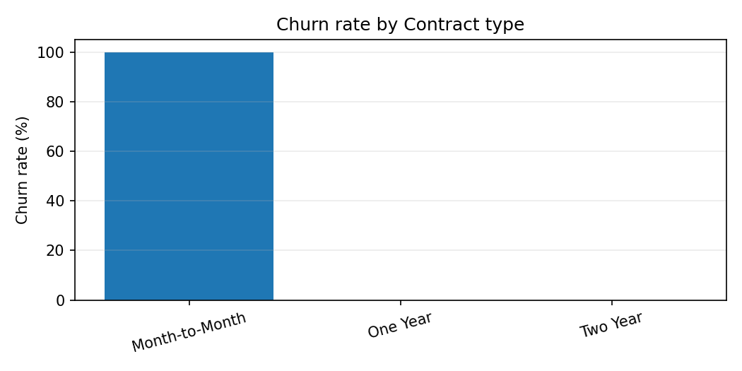
2. Contract patterns
Observed differences do not prove causation
Highest observed contract churn: Month-to-Month (100.0%; n=7).
Verify the number of customers in each group before prioritising outreach.

Slide 4
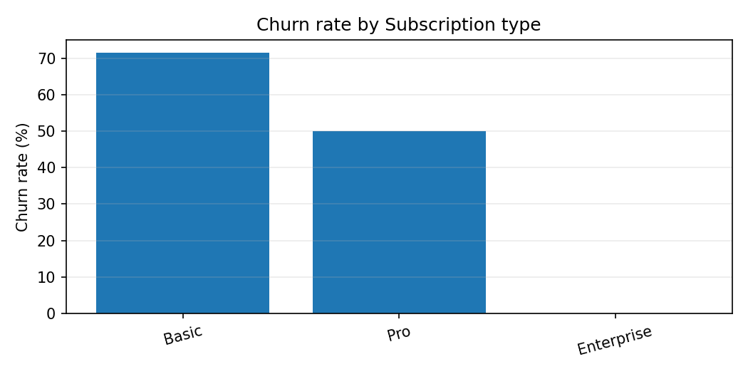
3. Subscription patterns
Observed differences do not prove causation
Compare observed churn rates, but check group sizes before making decisions.
Verify the number of customers in each group before prioritising outreach.

Slide 5
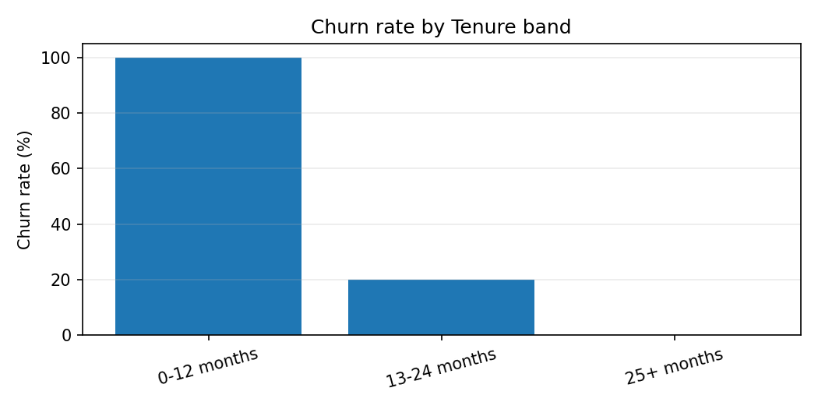
4. Tenure and support signals
Observed differences do not prove causation
Highest observed tenure-band churn: 0-12 months (100.0%; n=6). Highest observed support-ticket-band churn: 4+ tickets (100.0%; n=5).
Verify the number of customers in each group before prioritising outreach.

Slide 6
5. Recommended action
A small pilot is safer than a broad policy change
Audience: month-to-month customers with several recent support tickets; verify counts first.
Action: proactive service check-in, resolve open issues, explain available plan options.
Measure contact and response rates, 30/60-day retention, cost per retained customer, and feedback.
Compare with a holdout or matched group before claiming impact.
Expected impact is a hypothesis, not a promise.

Slide 7
Limitations and next steps
Transparent assumptions protect decision quality
Only 15 synthetic records; one customer can shift rates materially.
No timeline, intervention history, or customer-satisfaction data is available.
Monthly charges of churned customers are not confirmed future revenue loss.
Collect more data and repeat the analysis monthly.
Use this analysis to design a pilot, not to automate customer decisions.

