Slide 1
Digital Portfolio
STUDENT NAME : SANTHOSH . K
REGISTER NO AND NMID: 4204739EF38A90A8D4442BDD41CEA977
DEPARTMENT : B.SC. COMPUTER SCIENCE
COLLEGE : VOORHEES COLLEGE VELLORE,
THIRUVALLUVAR UNIVERSITY

Slide 2
PROJECT TITLE
STUDENT PORTFOLIO USING FRONTEND
DEVELOPMENT.

Slide 3


AGENDA
Problem Statement
Project Overview
End Users
Tools and Technologies
Portfolio design and Layout
Features and Functionality
Results and Screenshots
Conclusion
Github Link
3/21/2024 Annual Review

Slide 4

PROBLEM STATEMENT
Students struggle to present their complete skills, achievements, and growth in a single platform.
Traditional resumes and transcripts provide only limited information about student capabilities.
There is no structured system for students to showcase academic work, projects, and extracurricular activities together.
Lack of a proper portfolio makes it harder for students to apply for internships, higher studies, or career opportunities.
A digital student portfolio can serve as a comprehensive solution to organize and present student accomplishments in a professional way.

Slide 5

PROJECT OVERVIEW
The portfolio website is designed as a personalized digital showcase.
Highlights various details: It highlights academic details, weekly tasks, hobbies, personal information, contact, and hosted projects.
Simple, interactive, and mobile-friendly: The website ensures visitors have a smooth experience.
Central hub: It acts as a central hub where all personal details, tasks, and projects can be viewed in one place.
Serves academic and career goals: Built to serve both academic needs (college submissions) and career goals (professional exposure).

Slide 6

WHO ARE THE END USERS?
Recruiters/Employers: To assess skills, projects, and interests.
Teachers & Mentors: To evaluate weekly tasks, assignments, and progress.
Classmates & Friends: To view and learn from shared projects.
Clients/Collaborators: To explore work before offering opportunities.
General Audience: Anyone curious about the individual's personal and academic journey.

Slide 7

TOOLS AND TECHNIQUES
HTML : Defines the structure of a portfolio (Home, About, Portfolio, Tasks, Projects, Contact).
CSS : Used for styling, background themes, and responsive layouts.
JavaScript : Provides interactivity like switching tabs and navigation.- GitHub Pages: Used for free hosting and deployment of the portfolio.
VS Code : For development and debugging.

Slide 8
POTFOLIO DESIGN AND LAYOUT
Clean and minimalist style – simple colors, typography, and whitespace.
Section-based structure – Home, About, Skills, Projects, Contact.
Fixed navigation bar – easy scrolling between sections.
Hero section – intro text with name, roles, and profile image.
About section – short bio with text and supporting visual.
Skills section – grid/cards showcasing technical skills.
8

Slide 9
Projects section – 3x2 grid of project cards with images, titles, and buttons.
Weekly task section: with direct link to completed assignments.
Contact section – simple form/button for messages.
Footer – minimal, with copyright note
9

Slide 10
FEATURES AND FUNCTIONALITY
Dynamic Navigation: Clicking on menu items switches sections without page reload.
Interactive Design: Includes hover effects and user-friendly buttons.
Weekly Task Integration: Links directly to GitHub-hosted assignments.
Project Showcase: Visitors can open live project demos instantly.

Slide 11
Contact Form: Visitors can send queries directly via the form
Responsive Layout: Works on desktop, tablet, mobile
Attractive Background: Image background with overlay for readability.
Organized Sections: Smooth flow of information.

Slide 12

RESULTS AND SCREENSHOTS
A fully functional portfolio website was created and deployed.
Provides a professional digital identity accessible worldwide.
visitors can Smooth navigation between different sections.
the design enhances Design enhances readability and user
engagement.
3/21/2024 Annual Review
12

Slide 13
Screenshots:
Home Page
About Section
SKILLS
Project Page OR WEEKLY TASK
Contact Page
13

Slide 14
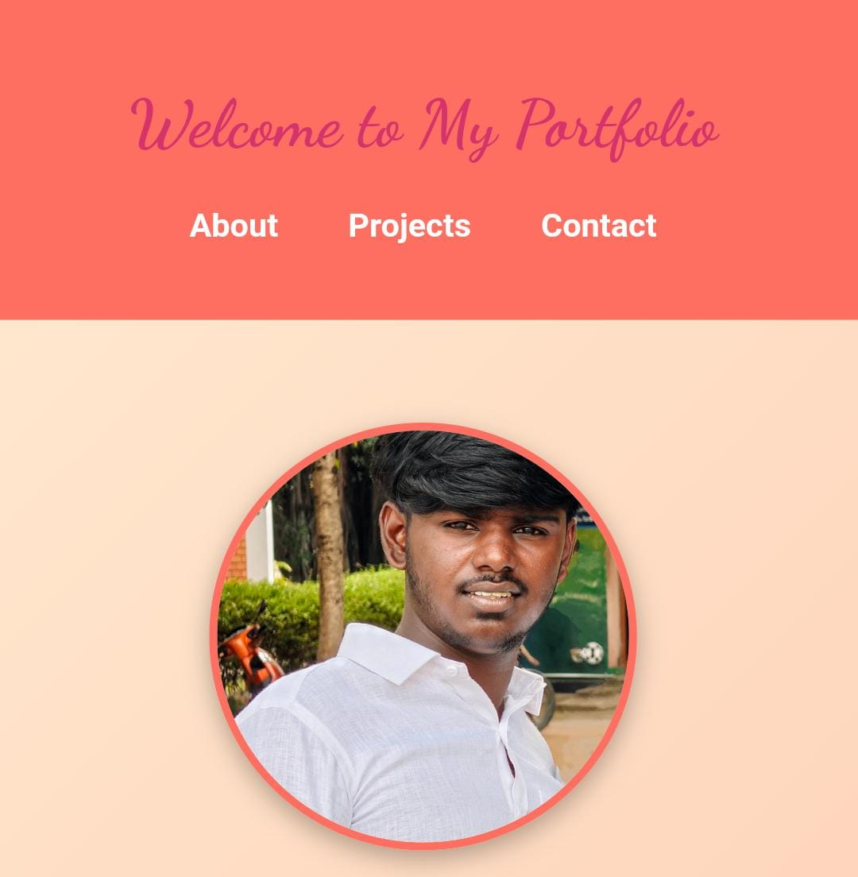
HOME PAGE:

Slide 15
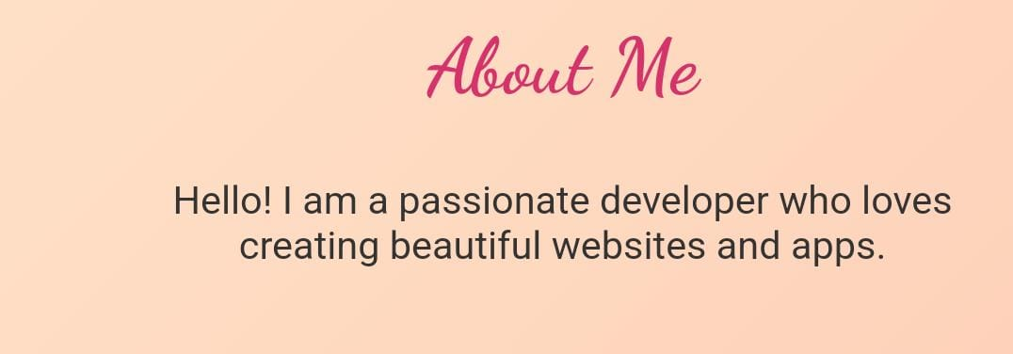

ABOUT SECTION:

Slide 16
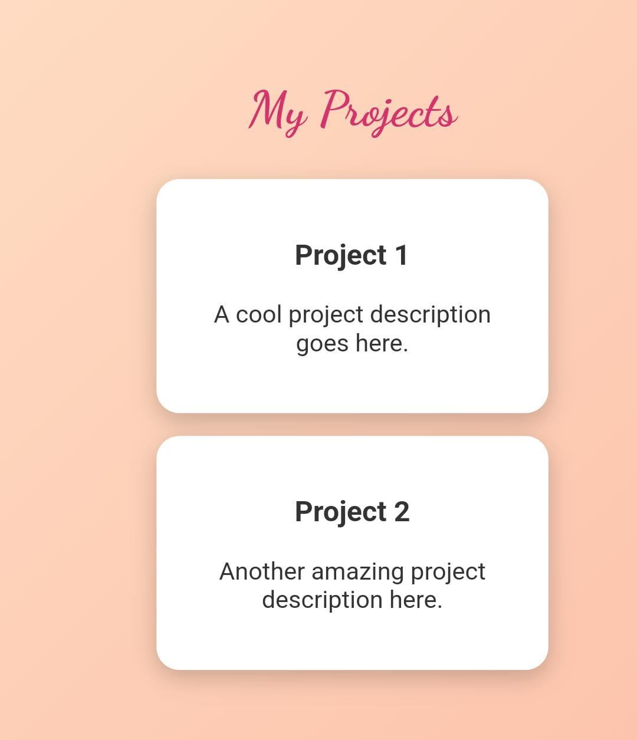
SKILLS:
16

Slide 17
PROJECTS/ WEEKLY TASKS:
17

Slide 18
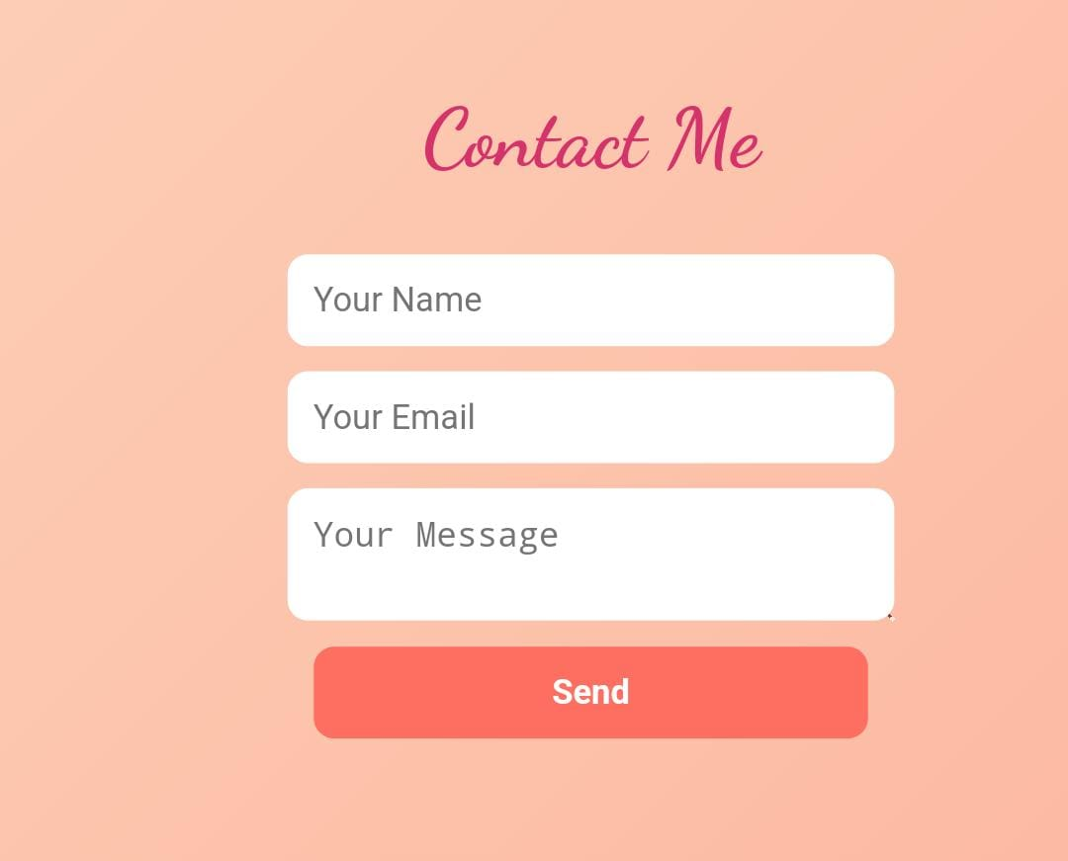
CONTACT PAGE:

Slide 19
CONCULSION:
The portfolio successfully Meets need for a personal digital platform
Helps with academic submissions, professional exposure, personal branding
The ‘’Organized structure’’ makes it easy for recruiters , mentors, and client of view details.
Deployed on GitHub Pages for free global access.
Enhances web development skills (HTML, CSS, JavaScript).
Useful for jobs, internships, collaborations.
Reflects both technical skills and creativity.

Slide 20
GITHUB LINK
Portfolio link:
http://santhoshsandy0351-hub.github.io/TNSDC-FWD-DigitalPortfolio/

